Slide 1
DAY 3 OF 5
Blocks that
answer back
Read
Read
Do
The twelve interactive blocks, when each one earns its place — and a bonus interaction Rise cannot build on its own.
Read
one lean-forward moment per screenful
Rise 360 · Day 3 · Blocks that answer back
1
Notes:
Day 2 was everything a learner reads. Today is everything a learner operates. Open with the honest framing: interactions are not automatically better. A course made entirely of accordions is as tiring as a course made entirely of paragraphs. What changes today is that you get a second gear — and the skill is knowing when to change up. Twelve blocks, grouped into six jobs. Nobody memorises twelve; they remember the six jobs. The bonus at the end is the part people will remember: a Tinder-style swipe deck, which Rise cannot build natively, brought in through the Embed block. Do not skip it — it is also where the honest limits of the tool get taught.

Slide 2
From reading to doing
You can already build a readable lesson. Today it starts asking things of the learner.
YESTERDAY YOU BUILT
BY TONIGHT YOU WILL
A lesson made of static blocks
Consistent padding and backgrounds
No more than half of it text
Name the twelve interactive blocks by the job they do
Turn a text-heavy block into an interaction
Say why an interaction earns its place — or drop it
Know what Rise cannot build, and what to do about it
Open it now. Today you will change part of it.
Assessment blocks — the four question types and question banks — are tomorrow. Today is interaction, not scoring.
Rise 360 · Day 3 · Blocks that answer back
2
Notes:
Get them to open yesterday’s lesson before you go any further — today only works on real content. The line that matters is the third one on the right: saying why an interaction earns its place, or dropping it. That is the difference between a designer and someone who clicks every button in the block library. Head off the assessment question now. Somebody will ask about knowledge checks within ten minutes. Point at the orange strip: interaction today, scoring tomorrow.

Slide 3
SECTION ONE
Twelve blocks,
six jobs
Learn the job, not the block list. The job tells you which two or three to choose between.
Rise 360 · Day 3 · Blocks that answer back
3
Notes:
Six jobs: reveal, explore, sequence, recall, decide, act. Plus the Storyline block, which is a door to another tool rather than a job of its own. Pace: six slides, roughly three minutes each. Demo the block live as you talk about it — these are all faster to show than to describe.

Slide 4
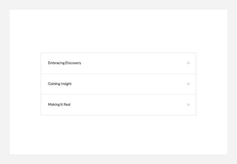
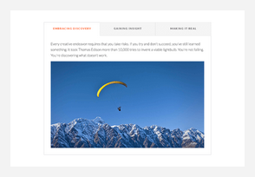
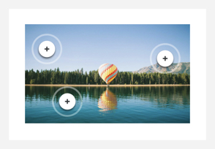
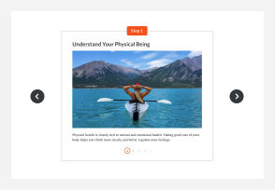
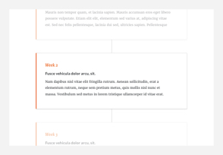
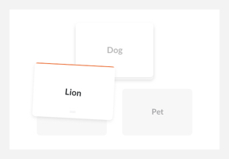
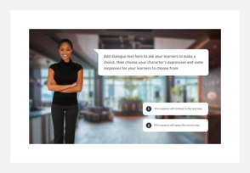
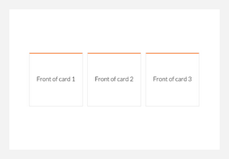
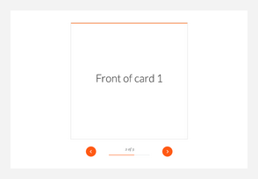
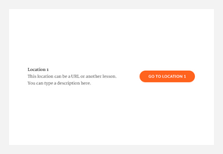
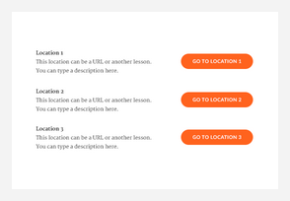
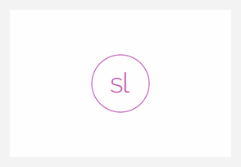
The twelve interactive blocks
Grouped by the job they do. Every one of them costs the learner a click, so every one needs a reason.
Accordion
Tabs
Labeled Graphic
Process
Timeline
Sorting Activity
Scenario
Flashcard grid
Flashcard stack
Button
Button stack
Storyline
12 interactive blocks · question types and question banks are Day 4
Rise 360 · Day 3 · Blocks that answer back
4
Notes:
Thirty seconds. Do not walk the twelve — the next six slides do that. The line to land: every interactive block costs the learner a click. A click is a small tax. You charge it when what is behind the click is worth more than the tax — and not otherwise. If anyone asks why Quote carousel and Gallery carousel are not here: they are filed as static content blocks and we covered them yesterday, even though they do take a click.

Slide 5
Job 1 — Reveal
Hide secondary text so the page stays short, and let the learner pull only what they need.
Accordion
Tabs
Use it when items are independent and a learner will read some but not all of them.
Use it when items are the same shape and the learner is comparing them.
Example Twelve refund-policy FAQs. Nobody reads twelve; everyone reads the two that apply to them.
Example Three pricing plans, each with the same four rows — switch in place, compare like for like.
Never hide anything a learner must not miss. Warnings, safety steps and deadlines belong in a Statement or Note block, in the open.
Rise 360 · Day 3 · Blocks that answer back
5
Notes:
These two look interchangeable and are not. The test is comparison. Accordion is for independent items — FAQs, a reference list, troubleshooting symptoms. You open one, read it, close it. Nobody compares FAQ 3 with FAQ 9. Tabs are for parallel items you want to hold against each other. Three plans, three regions, three customer types — same shape of content each time. The content switches in place, which is what makes comparison possible. Rise converts one to the other, so the cost of getting it wrong is a dropdown click. Show that. The orange rule is the one to labour. Every cohort has someone who puts the safety warning in an accordion because the page looked long. A click is a filter, and a warning must not be filtered.

Slide 6
Job 2 — Explore
One image, several things worth naming. Markers beat a list underneath the picture.
Use it when
the parts only make sense in place — on the hardware, on the screen, on the map.
Example
The card reader with five markers: display, chip slot, contactless zone, power button, USB-C port.
Watch for
markers crowding on a phone. Rise reflows the image, so keep them apart and test on mobile.
Labeled Graphic
Sizing
medium by default (1100px); small (760px) and full width are the alternatives.
A labeled graphic with two markers is a caption wearing a costume. Below about four, just caption the image.
Rise 360 · Day 3 · Blocks that answer back
6
Notes:
The single most persuasive block in Rise for anything physical, and the one that most often gets used for the wrong thing. It earns its place when position carries meaning. Naming the parts of a reader, walking a screen, pointing at a floor plan. If you could rewrite it as a bulleted list with no loss, it should be a list. Demo the mobile crop. Markers that sit comfortably apart on a laptop can collide on a phone, and nobody notices until a learner complains. Preview it on mobile portrait in front of them. The image sizes are a real setting worth knowing: medium at 1100px is the default, with small at 760px and full width available.

Slide 7
Job 3 — Sequence
Order matters and you want the learner to feel the steps, one at a time.
Process
Timeline
Use it when the steps are a procedure someone will carry out.
Use it when the sequence is history or a roadmap, not something to perform.
Example Pairing a card reader: six steps, one screen each, so nobody skims past step four.
Example How the product line changed: first reader in 2012, acquisition, rebrand, current model.
A numbered list is often the better answer. Reach for these when the steps carry enough detail that showing them all at once overwhelms.
Rise 360 · Day 3 · Blocks that answer back
7
Notes:
Both put one thing on screen at a time. The difference is whether the learner will do it or just know it. Process is a procedure. It paces someone through steps they will repeat later — which is exactly why it beats a numbered list for anything with detail per step. Timeline is chronology. Company history, a rollout plan, what changed and when. Nobody performs a timeline. Be honest about the orange note. A six-item numbered list is faster to build, faster to scan and easier to reread than a Process block, and for simple steps it is the better choice. The block earns its place when each step needs a paragraph and a picture — that is when showing all six at once becomes a wall.

Slide 8
Job 4 — Recall
Term on one side, meaning on the other. The learner tries before they are told.
Flashcard grid
Flashcard stack
Use it when the set is small and the learner should see how much there is.
Use it when the set is longer and you want one card at a time, in order.
Example Six product names to learn, laid out at once so the scope is obvious.
Example Ten support FAQs worked through as a run, like revision cards.
The front must be answerable. A card whose front is a statement teaches nothing — the learner flips it without thinking.
Rise 360 · Day 3 · Blocks that answer back
8
Notes:
Flashcards are the cheapest retrieval practice in the tool, and the most commonly wasted. The waste looks like this: the front says "Refund window" and the back says "30 days". The learner flips it, reads it, learns nothing, because they were never asked anything. Make the front a question they could actually attempt: "How long does a customer have to request a refund?" Grid versus stack is about set size and whether scope is useful information. A grid shows six at once and says "this is all of it". A stack gives you one at a time and is better past about eight. Quick exercise if time allows: take any flashcard from a draft and rewrite the front as a question. The difference is immediate.

Slide 9
Job 5 — Decide
The learner commits to an answer and finds out what it costs. This is where interaction earns most.
Sorting Activity
Scenario
Use it when the skill is telling categories apart.
Use it when the skill is choosing a response, and the response has consequences.
Example Twelve emails dragged into Phishing or Safe — the judgement is the learning.
Example An angry refund call: three replies, each leading somewhere different.
Scenario is the most expensive block in the tool to write well. Budget for the branching, not for the styling.
Rise 360 · Day 3 · Blocks that answer back
9
Notes:
If you only add one interaction to a lesson, make it one of these two. Everything else on the list reorganises content; these two make the learner practise the actual skill. Sorting is for discrimination — the moment where someone has to say "this one, not that one". Do and Don’t piles, compliant versus non-compliant, phishing versus legitimate. The dragging is not the point; the judgement is. Scenario is role-play with consequences. It uses Content Library characters, dialogue, responses and feedback. Warn them properly: this is the block that takes real writing time. The branching has to be plausible, every branch needs feedback that teaches rather than scolds, and a badly written scenario is worse than no scenario because it feels like a trick. Note the difference from a quiz: neither of these is scored, and neither reports to an LMS. They are practice. Scoring is tomorrow.

Slide 10
Job 6 — Act
Send the learner somewhere, or give them a choice of routes through the lesson.
Button
Button stack
Use it when there is one clear next action.
Use it when there are two to four routes and the learner picks their own.
Example Download the job aid, or open the policy in the knowledge base.
Example Choose your region, or your role, and jump to the lesson that fits.
Label a button with what happens when it is pressed. “Learn more” tells the learner nothing; “Open the refund policy” tells them everything.
Rise 360 · Day 3 · Blocks that answer back
10
Notes:
The least glamorous pair and the most immediately useful. The whole lesson here is labelling. "Click here", "Learn more" and "Read on" are the three worst button labels in e-learning and they are everywhere. A label should describe the destination or the action, so the learner can decide whether to spend the click. Button stacks are how you branch a course without restricting navigation — offer three routes, let people take theirs. Pair it with the Previous and Next toggles under Theme when you build a branched path, or learners will simply scroll past your carefully designed fork. Mention that a button can open a file or an external link, which makes it the natural partner to the Attachment block from yesterday.

Slide 11
The advanced one — Storyline block
A door out of Rise. It embeds a published Storyline 360 interaction inside a Rise lesson.
Reach for it when Rise genuinely cannot
Free-form drag and drop, a simulated interface, custom logic, anything with its own rules. Build it in Storyline 360, publish it, drop it in here.
The costs, stated plainly
A second tool, a second skill set, and a fixed-size interaction sitting inside a responsive page. It is the one place a Rise lesson stops reflowing.
Storyline
Tracking, for later. When you publish to an LMS you can choose to track “Storyline block viewed” as the completion trigger. Worth knowing today; we set it on Day 5.
Rise 360 · Day 3 · Blocks that answer back
11
Notes:
Keep this short unless your group already uses Storyline. Most beginners will not touch it for months. The reason it is on the slide is boundary-setting: it is the answer to "can Rise do X?" when X is genuinely beyond block-based authoring. Knowing the door exists stops people trying to fake a simulation with fourteen accordions. Be straight about the cost. It is a second product with its own learning curve, and the embedded interaction is fixed-size inside an otherwise responsive lesson — on a phone, that is visible. This slide also sets up the bonus. Storyline is one way out of Rise’s limits. The Embed block is the other, and it is the one you can use this afternoon without buying anything.

Slide 12
SECTION TWO
Choosing well
Which interaction for which job — and the four rules that stop a lesson turning into a fairground.
Rise 360 · Day 3 · Blocks that answer back
12
Notes:
Short section, two slides. This is the judgement half of the day, and it is what separates today from a feature tour.

Slide 13
Which interaction for which job
Start from what the learner has to do. The block falls out of that.
The learner has to…
Reach for
Because
Read some, skip the rest
Accordion
Independent items, read on demand
Compare like with like
Tabs
Same shape of content, switched in place
Find it on the picture
Labeled Graphic
Position carries the meaning
Follow the steps
Process
A procedure they will perform
See what changed when
Timeline
Chronology, not a task
Try to remember it
Flashcards
Retrieval practice — front must ask something
Tell these apart
Sorting Activity
The judgement is the learning
Choose, and live with it
Scenario
Decisions with consequences
Go somewhere next
Button / stack
Label it with what happens
Rise 360 · Day 3 · Blocks that answer back
13
Notes:
Hand this out. It is the artefact people keep from today, exactly as the checklist was yesterday. Do not read it aloud. Instead run it backwards: give the room three of your own lesson topics and ask which row applies. Arguments are good here — "is this comparison or is it reference?" is the exact question you want them asking on their own later. The left column is deliberately written as learner behaviour, not as content type. That is the habit: start from what the learner has to do.

Slide 14
Four rules for interactions
Each one prevents a specific way that interactive lessons go wrong.
1
2
3
4
Lead in
One per screenful
Never hide the critical
Check it on a phone
Every interaction needs a line above it saying what it is and what to do with it.
Space them out. Two interactions back to back read as a quiz nobody agreed to take.
Warnings, deadlines, safety steps stay in the open, in a Statement or Note.
Markers crowd, drag targets shrink, tab labels wrap. Preview mobile portrait before you call it done.
Prevents: a bare accordion nobody opens
Prevents: interaction fatigue
Prevents: the click that gets skipped
Prevents: the defect you ship
The test for any interaction: if you removed it and pasted the content back in as text, would the lesson be worse? If not, remove it.
Rise 360 · Day 3 · Blocks that answer back
14
Notes:
Four rules, four failure modes. Name the failure mode as you go — people remember the symptom, not the rule. Rule 1 is the one from yesterday, restated: an interaction with no lead line gets scrolled past. Rise’s own guidance asks for a line that connects the interaction to the content around it. Rule 4 is the one they will skip. Make them do it during the lab, not after. The bottom line is the whole day compressed into one sentence. If you are short of time and have to cut a slide, cut something else and keep this.

Slide 15
BONUS
Past the block list
What Rise cannot build on its own — and the twenty minutes it takes to get around that.
Rise 360 · Day 3 · Blocks that answer back
15
Notes:
This is the part of the day people talk about afterwards. It is also the part where the tool’s limits get taught honestly, which builds more trust than pretending Rise does everything. Three slides: what Rise can and cannot run, what we built, and how it works. Keep it demo-led.

Slide 16
Code in Rise: what actually runs
The most common misunderstanding on this course, and it is worth ten minutes.
Static block
Static block
Interactive block
Code snippet
Embed
Storyline
Displays code as monospaced text. It is a picture of code. Nothing executes — not one line.
Pulls in a page you host at a public HTTPS address. Your HTML, CSS and JavaScript run inside it.
Runs a published Storyline 360 interaction. Powerful, but a second tool and a fixed size.
So the recipe is three steps
1
Build one self-contained HTML file
2
Host it at a public HTTPS address
3
Paste the address into an Embed block
Rise 360 · Day 3 · Blocks that answer back
16
Notes:
Ask the question first: "If I paste JavaScript into a Code snippet block, does it run?" Let them answer. Most rooms say yes. It does not. The Code snippet block displays code as text — it is a picture of code. The Embed block is the one that runs things, because it loads a page you host and that page executes normally. This is not a hack; it is what the block is for. Two warnings to give with it. The embedded page depends on your hosting staying up, and corporate networks sometimes block third-party frames — so never put anything essential behind an embed alone. And it will not be tracked by your LMS; only quizzes report scores. Hosting does not have to be a project. Any static host works. If your organisation already has an intranet or a documentation site, that is usually the path of least resistance.

Slide 17
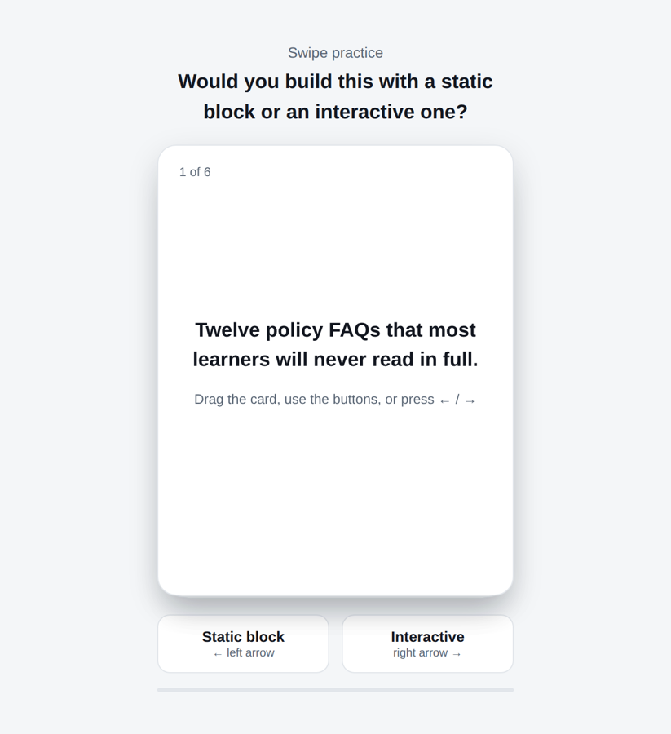
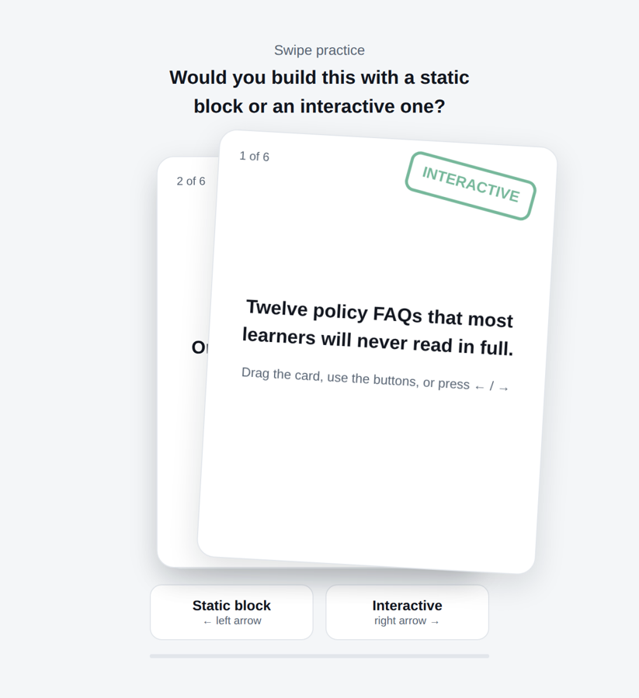
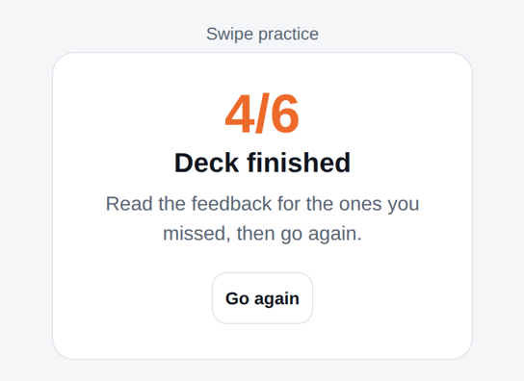
Bonus build: a swipe deck
Card sorting with a phone gesture. Rise has no block for this — so we made one and embedded it.
The stack
Mid-swipe
The result
Three cards deep, so there is visibly more to come.
The card tilts as it travels and the verdict fades in past halfway.
Score, and feedback on the ones they missed.
Why it works as learning, not decoration: every card forces a judgement before the answer appears — the same job as a Sorting Activity, in a gesture people already know.
Rise 360 · Day 3 · Blocks that answer back
17
Notes:
Run it live, on a phone if you can get it on the screen — the gesture is the point and it does not land from a screenshot. The content of the deck is deliberately self-referential: each card is a scenario and the learner swipes right for "an interactive block earns its place here" or left for "a static block does the job". So the bonus doubles as revision of the whole day. Then ask the harder question: is this better than a Sorting Activity? Honest answer — usually not, for a desktop audience. It is better when your learners are on phones, because swiping is native there and dragging into a bucket is fiddly. Say that. It stops the room concluding that custom is always better. The file ships with this deck. They can change the six cards to their own content without touching the JavaScript — the cards are an array at the top.

Slide 18
How the swipe works
One hundred and sixty-five lines, all of it on the next six slides. Four ideas carry the whole thing.
1
2
3
4
Pointer events
Rotation from travel
One threshold
Buttons share the path
One code path covers mouse, touch and pen. You do not write three versions, and setPointerCapture keeps the card following the finger even when it leaves the element.
The card leans by the distance it has moved, divided by eighteen. That single expression is most of what makes it feel like a physical card.
Past 96 pixels it commits and flies off; short of it, the card snaps back. There is no other state to track.
The two buttons and the arrow keys call the same commit function as a drag, so the whole thing works without a pointer at all.
Accessibility is not optional here: a drag-only interaction excludes keyboard and screen-reader users. The buttons and arrow keys are the fix, and they cost four lines.
Rise 360 · Day 3 · Blocks that answer back
18
Notes:
Do not teach JavaScript. Teach the shape of the thing, so a non-coder can brief a developer and a semi-coder can edit the cards. Idea 2 is the one that surprises people. The physicality comes from a single division — the card leans by how far it has been thrown. Take that line out and it becomes a sliding box. Idea 3 is why the code is short. There is no drag state machine, no velocity tracking, no gesture library. One number decides everything. The orange line is the one to insist on. A swipe-only interaction locks out anyone who cannot drag. In this build the buttons run through exactly the same commit path, so there is no second behaviour to maintain and no way for the two to drift apart. The next six slides are the complete file. Tell them not to copy it off the screen — the file ships with the deck.

Slide 19
swipe-deck.html — 1 of 6
Document head and the styling
<!doctype html>
<html lang="en">
<head>
<meta charset="utf-8">
<meta name="viewport" content="width=device-width, initial-scale=1">
<title>Swipe practice — static or interactive?</title>
<style>
:root { --ink:#12161F; --slate:#5A6675; --line:#E2E6EB; --ember:#ED6A2A; --yes:#1F8A5B; --no:#C2410C }
* { box-sizing:border-box }
body { margin:0; min-height:100vh; display:flex; align-items:center; justify-content:center;
background:#F4F6F8; color:var(--ink); padding:24px; font:16px/1.5 "Segoe UI", Roboto, Arial, sans-serif }
.app { width:min(340px,86vw); text-align:center }
.lead { font-size:14px; color:var(--slate); margin:0 0 4px }
.q { font-size:19px; font-weight:700; margin:0 0 16px }
.deck { position:relative; height:min(430px,62vh); margin-bottom:18px }
.card { position:absolute; inset:0; background:#fff; border:1px solid var(--line); border-radius:18px;
box-shadow:0 10px 30px rgba(18,22,31,.13); padding:26px 24px; display:flex; flex-direction:column;
justify-content:center; cursor:grab; touch-action:none; user-select:none; will-change:transform }
.card.animate { transition:transform .32s cubic-bezier(.2,.7,.3,1), opacity .32s }
.card .scenario { font-size:19px; font-weight:600; line-height:1.45; margin:0 }
.card .hint { margin-top:14px; font-size:13px; color:var(--slate) }
.card .n { position:absolute; top:16px; left:20px; font-size:12px; color:var(--slate) }
.stamp { position:absolute; top:22px; padding:6px 12px; border:3px solid currentColor; border-radius:10px;
font-weight:800; font-size:15px; text-transform:uppercase; opacity:0; pointer-events:none }
.stamp.yes { right:20px; color:var(--yes); transform:rotate(12deg) }
.stamp.no { left:20px; color:var(--no); transform:rotate(-12deg) }
.controls { display:flex; gap:12px }
.btn { flex:1; border:1px solid var(--line); background:#fff; color:var(--ink); border-radius:12px;
padding:12px 10px; font-size:14px; font-weight:600; cursor:pointer }
lines 1–29 of 166
Rise 360 · Day 3 · Blocks that answer back
19
Notes:
This is the file as it ships, not a paraphrase — the deck is generated from it, so the two cannot drift apart. Nothing here is unusual. It is one HTML file with a style block and a script block, which is exactly what the Embed block needs: one address that serves one self-contained page. Do not read the code aloud. Put it on screen, point at the two or three lines that matter, and move on.

Slide 20
swipe-deck.html — 2 of 6
The rest of the styling, and the markup
.btn:focus-visible { outline:3px solid var(--ember); outline-offset:2px }
.btn .k { display:block; font-size:11px; font-weight:500; color:var(--slate); margin-top:2px }
.meter { margin-top:14px; height:4px; background:var(--line); border-radius:2px }
.meter i { display:block; height:100%; width:0; background:var(--ember); transition:width .3s }
.done { display:none; background:#fff; border:1px solid var(--line); border-radius:18px; padding:28px }
.done h2 { margin:0 0 6px; font-size:22px } .done p { margin:0 0 18px; color:var(--slate) }
.score { font-size:44px; font-weight:800; color:var(--ember); line-height:1 }
.sr { position:absolute; width:1px; height:1px; overflow:hidden; clip:rect(0 0 0 0) }
@media (prefers-reduced-motion:reduce) { .card.animate, .meter i { transition:none } }
</style>
</head>
<body>
<div class="app">
<p class="lead">Swipe practice</p>
<p class="q" id="prompt">Would you build this with a static block or an interactive one?</p>
<div class="deck" id="deck"></div>
<div class="controls">
<button class="btn" id="btnNo" type="button">Static block<span class="k">&larr; left arrow</span></button>
<button class="btn" id="btnYes" type="button">Interactive<span class="k">right arrow &rarr;</span></button>
</div>
<div class="meter"><i id="meter"></i></div>
<div class="done" id="done">
<div class="score" id="score">0/6</div>
<h2>Deck finished</h2>
<p id="verdict"></p>
<button class="btn" id="again" type="button">Go again</button>
</div>
<p class="sr" role="status" aria-live="polite" id="live"></p>
lines 30–57 of 166
Rise 360 · Day 3 · Blocks that answer back
20
Notes:
This is the file as it ships, not a paraphrase — the deck is generated from it, so the two cannot drift apart. The styling is ordinary CSS. The two rules worth pointing at are touch-action:none, which stops the browser scrolling the page while you drag a card, and the prefers-reduced-motion query at the end. Do not read the code aloud. Put it on screen, point at the two or three lines that matter, and move on.

Slide 21
swipe-deck.html — 3 of 6
The six cards, and the state
</div> <script> // answer: true = an interactive block earns its place here; false = a static block does the job. var CARDS = [ { text:'Twelve policy FAQs that most learners will never read in full.', answer:true, why:'Accordion — hide the secondary text, let people open only what they need.' }, { text:'One sentence you want every learner to remember.', answer:false, why:'Statement block. An interaction would bury the thing you are emphasising.' }, { text:'Three pricing plans the learner needs to compare.', answer:true, why:'Tabs — same shape of content, switched in place, easy to compare.' }, { text:'A photo of the reader with five parts to name.', answer:true, why:'Labeled Graphic — markers on the image beat a list underneath it.' }, { text:'A two-line safety warning that must not be missed.', answer:false, why:'Note block. Never hide a warning behind a click.' }, { text:'A refund call where the answer depends on what the customer says.', answer:true, why:'Scenario — a decision needs consequences, not an explanation.' } ]; var THRESHOLD = 96; // px of travel that commits a swipe var deckEl = document.getElementById('deck'), doneEl = document.getElementById('done'); var meterEl = document.getElementById('meter'), liveEl = document.getElementById('live'); var idx, right; function show(on) { // flip between the deck and the result ['deck','prompt'].forEach(function (id) { document.getElementById(id).style.display = on ? '' : 'none' }); document.querySelector('.controls').style.display = on ? '' : 'none'; document.querySelector('.meter').style.display = on ? '' : 'none'; doneEl.style.display = on ? 'none' : 'block'; } function start() { idx = 0; right = 0; show(true); render() }
lines 58–87 of 166
Rise 360 · Day 3 · Blocks that answer back
21
Notes:
This is the file as it ships, not a paraphrase — the deck is generated from it, so the two cannot drift apart. This is the only part most people will ever edit. Six objects, each with the scenario text, the answer, and the feedback line. Swap those for your own subject and you have a new activity. Do not read the code aloud. Put it on screen, point at the two or three lines that matter, and move on.

Slide 22
swipe-deck.html — 4 of 6
Drawing the stack, and picking up a card
function render() { // draw at most three cards, back to front
deckEl.innerHTML = '';
for (var i = Math.min(idx + 2, CARDS.length - 1); i >= idx; i--) {
var d = i - idx, el = document.createElement('article');
el.className = 'card';
el.style.zIndex = 100 - d;
el.style.transform = 'translateY(' + d * 10 + 'px) scale(' + (1 - d * 0.04) + ')';
el.innerHTML = '<span class="n">' + (i + 1) + ' of ' + CARDS.length + '</span>' +
'<span class="stamp yes">Interactive</span><span class="stamp no">Static</span>' +
'<p class="scenario">' + CARDS[i].text + '</p>' +
(d ? '' : '<p class="hint">Drag the card, use the buttons, or press &larr; / &rarr;</p>');
deckEl.appendChild(el);
if (!d) attach(el);
}
meterEl.style.width = (idx / CARDS.length * 100) + '%';
}
function attach(el) {
var startX = 0, dx = 0, dy = 0, dragging = false;
var yes = el.querySelector('.stamp.yes'), no = el.querySelector('.stamp.no');
el.addEventListener('pointerdown', function (e) { // one path for mouse, touch and pen
dragging = true; startX = e.clientX;
el.setPointerCapture(e.pointerId); el.classList.remove('animate');
});
el.addEventListener('pointermove', function (e) {
if (!dragging) return;
dx = e.clientX - startX;
el.style.transform = 'translate(' + dx + 'px,' + dy + 'px) rotate(' + dx / 18 + 'deg)';
var t = Math.min(Math.abs(dx) / THRESHOLD, 1); // stamps fade in as the card travels
yes.style.opacity = dx > 0 ? t : 0;
lines 88–117 of 166
Rise 360 · Day 3 · Blocks that answer back
22
Notes:
This is the file as it ships, not a paraphrase — the deck is generated from it, so the two cannot drift apart. render() draws at most three cards so the stack has visible depth, and attaches the drag handlers only to the top one. Everything below it is decoration until its turn comes. Do not read the code aloud. Put it on screen, point at the two or three lines that matter, and move on.

Slide 23
swipe-deck.html — 5 of 6
Committing the swipe
no.style.opacity = dx < 0 ? t : 0;
});
function release() {
if (!dragging) return;
dragging = false;
el.classList.add('animate');
if (Math.abs(dx) >= THRESHOLD) commit(el, dx > 0); // past the line: fly off
else { el.style.transform = ''; yes.style.opacity = no.style.opacity = 0 } // short: snap back
dx = 0;
}
el.addEventListener('pointerup', release);
el.addEventListener('pointercancel', release);
}
function commit(el, saidInteractive) {
var card = CARDS[idx], correct = (card.answer === saidInteractive);
if (correct) right++;
el.classList.add('animate');
el.style.transform = 'translate(' + (saidInteractive ? 1 : -1) * (window.innerWidth || 800) +
'px, 40px) rotate(' + (saidInteractive ? 24 : -24) + 'deg)';
el.style.opacity = '0';
liveEl.textContent = (correct ? 'Correct. ' : 'Not quite. ') + card.why;
setTimeout(function () { idx++; idx >= CARDS.length ? finish() : render() }, 300);
}
function choose(saidInteractive) { // buttons and keys use the same path,
var top = deckEl.querySelector('.card'); // so it works without a pointer
lines 118–144 of 166
Rise 360 · Day 3 · Blocks that answer back
23
Notes:
This is the file as it ships, not a paraphrase — the deck is generated from it, so the two cannot drift apart. commit() is where the answer is scored, the card is thrown off screen, and the feedback is announced to screen readers through the live region. Note that it does not care whether the swipe came from a finger or the keyboard. Do not read the code aloud. Put it on screen, point at the two or three lines that matter, and move on.

Slide 24
swipe-deck.html — 6 of 6
Buttons, keys and the result screen
if (top) commit(top, saidInteractive); } document.getElementById('btnYes').addEventListener('click', function () { choose(true) }); document.getElementById('btnNo').addEventListener('click', function () { choose(false) }); document.addEventListener('keydown', function (e) { if (e.key === 'ArrowRight') choose(true); if (e.key === 'ArrowLeft') choose(false); }); function finish() { show(false); document.getElementById('score').textContent = right + '/' + CARDS.length; document.getElementById('verdict').textContent = right === CARDS.length ? 'Every one right. You are picking interactions on purpose.' : 'Read the feedback for the ones you missed, then go again.'; } document.getElementById('again').addEventListener('click', start); start(); </script> </body> </html>
lines 145–166 of 166
Rise 360 · Day 3 · Blocks that answer back
24
Notes:
This is the file as it ships, not a paraphrase — the deck is generated from it, so the two cannot drift apart. The last piece: the buttons and the arrow keys, then the result screen. show() flips between the deck and the result rather than rebuilding either. Do not read the code aloud. Put it on screen, point at the two or three lines that matter, and move on.

Slide 25
Your build: earn one interaction
Back into yesterday’s lesson. One change, made for a reason you can say out loud.
THE BRIEF
Say it out loud
Find your most text-heavy block
Turn it into the interaction its job calls for
Write the lead line above it
Add one decide block — Sorting or Scenario
Preview on mobile portrait before you stop
For each interaction you added, finish this sentence for your neighbour: “This is a ___ because the learner has to ___.” If you cannot, take it out.
If you finish early
Open the swipe deck file, replace the six cards with scenarios from your own subject, and open it in a browser. No build step, no account.
One interaction added well beats four added quickly. If a block does not survive the sentence test, that is a result, not a failure.
Rise 360 · Day 3 · Blocks that answer back
25
Notes:
Forty-five minutes is enough. Walk the room. The sentence test in the top-right is the assessment for the whole day, and it is verbal on purpose. "This is an accordion because the learner has to read some and skip the rest." Anyone who cannot finish the sentence has added decoration, and taking it out is the right answer — say so, warmly, before they start, so removing something does not feel like failing. Insist on the mobile preview. It is the rule they skip and the one that catches real defects. The early-finisher task is genuinely doable by a non-coder: the cards are a plain array of text at the top of the file, and it opens straight from disk in any browser.

Slide 26
DAY 3 COMPLETE
Twelve blocks.
One good reason each.
Interaction is not the goal. Getting the learner to do the thinking is — and now you have twelve ways to ask.
Day 4 › Assess, theme, navigate
Rise 360 · Day 3 · Blocks that answer back
26
Notes:
Close on the contract from slide 2, then two housekeeping items. One: tomorrow is assessment, theming and navigation — the four question types, knowledge checks versus scored quizzes, brand colours and fonts, and free versus restricted navigation. Their lesson now has something worth assessing, which is why it is in this order. Two: send them the swipe deck file. The people who will actually use it are the ones who open it that evening, and they will not if they have to ask. If the room struggled today, it was almost certainly with Scenario. That is normal — it is a writing problem, not a Rise problem. Offer to look at branching drafts tomorrow morning.

