Slide 1
DAY 2 OF 5
Blocks that carry
your content
The nine static block families in Articulate Rise 360 — and the layout rules that keep a lesson readable.
one lesson = a stack of blocks
Rise 360 · Day 2 · Blocks that carry your content
1
Notes:
Welcome to Day 2. Yesterday was the mental model — Course > Sections > Lessons > Blocks — and finding your way around. Nobody has built a lesson yet, so today starts by creating one, and then we live inside it. Framing to say out loud: Rise gives you roughly 42 static blocks. Nobody memorises 42 things. What you memorise is nine families and what each family is FOR. Once you know the family, you pick the member by eye from the block library. Today is deliberately not about interactivity — accordions, tabs, labeled graphics, scenarios and the rest are Day 3. If someone asks about them, park it on the whiteboard and point at tomorrow. Deliverable by the end of the day: one visually varied lesson that obeys the anti-clutter rules.

Slide 2
Where today sits
Five days, one build workflow. Today is the second step: filling a lesson.
1
2
3
4
5
Orientation
Static blocks & layout
Interactive blocks
Assessment & theme
Preview & publish
The web-page model, the hierarchy, the dashboard, Course vs Microlearning
Create a lesson, the nine content families, padding, backgrounds, anti-clutter
Accordion, tabs, labeled graphic, process, sorting, scenario
Knowledge checks, quizzes, colours, fonts, free vs restricted navigation
Multi-device preview, Quick Share, Reach 360, LMS export
You are here
Rise 360 · Day 2 · Blocks that carry your content
2
Notes:
Thirty seconds on this slide, no more. The point is orientation, not detail. Say: the five days follow the order you actually build in. You outlined yesterday. Today you fill a lesson with content blocks. Tomorrow you add the interactions. Day 4 you assess and brand it. Day 5 you ship it. If your group is publishing to a corporate LMS, flag now that Day 5 will spend extra time on SCORM version and tracking choices.

Slide 3
From yesterday to today
Yesterday was the map. Today you build on it — starting from nothing.
WHAT YOU ALREADY KNOW
BY TONIGHT YOU WILL
Why Rise is responsive, not slide-based
The hierarchy: Course › Sections › Lessons › Blocks
Your way around the dashboard
The difference between a Course and Microlearning
Create a lesson and open the block editor
Name the nine static families and what each is for
Add, reorder, swap and delete blocks fluently
Set padding and backgrounds on purpose, not by accident
Build one lesson that passes the anti-clutter rules
Nobody has a lesson yet — that is the first thing we do today, before a single block goes in.
Rise 360 · Day 2 · Blocks that carry your content
3
Notes:
Say the orange line out loud. Day 1 ended with the concepts and the tour, not with anything built, so start from the assumption that everyone is looking at an empty account. That is fine — creating the lesson takes about five minutes and it is the next thing we do. Quick verbal check before you move on — ask two people to answer, do not lecture: 1. Why does Rise not have slide dimensions? 2. What is the difference between a Section and a Lesson? If more than a couple of people are shaky on the hierarchy, spend five minutes re-drawing Course > Sections > Lessons > Blocks on the whiteboard before starting. Everything today assumes it. The right-hand column is the contract for the day. Come back to it at the close.

Slide 4
SECTION ONE
The stack
What a lesson is, how to create one from scratch, and the three ways to put a block into it.
Rise 360 · Day 2 · Blocks that carry your content
4
Notes:
Three ideas in this section: a lesson is a vertical stack, here is how you create one, and here are the three routes for adding to it. This is the section that changed because Day 1 did not end with a built lesson. Everyone leaves this section with an empty lesson open in the block editor — do not move on to the families until they do, or the rest of the day is a spectator sport.

Slide 5
A lesson is a vertical stack
No slides, no canvas, no fixed size. Blocks sit one on top of the next and the learner scrolls.
1
One column, top to bottom
Heading
Blocks never sit side by side. Two-column looks come from inside a block — Two column text, Image & text, a grid gallery — never from placing two blocks next to each other.
Paragraph
Image
2
Order is the only layout you control
Move a block with the up and down arrows; duplicate and delete appear on hover. There is no free positioning — to move something, you move its block.
Statement
3
Every block reflows on its own
List
You do not design a phone version. Rise re-stacks the same blocks narrower. Preview it — do not assume it.
scroll ↓
Rise 360 · Day 2 · Blocks that carry your content
5
Notes:
This is the slide that unteaches PowerPoint. Say it plainly: there is no canvas and there are no slide dimensions. You are writing a web page. The trap to name early is the two-column one. Somebody always tries to place two blocks side by side to get columns. You cannot. Side-by-side comes from a block that is itself two-column: Two column text, Image & text, or a grid gallery. Naming it now saves you a support question every single cohort. Second trap: people assume a desktop layout is the layout. It is one of five previews. We check all five on Day 5, but get them previewing on mobile today, while their lessons are still small.

Slide 6
First: create the lesson you will fill today
Five minutes, once. Everything after this happens inside the block editor.
1
2
3
4
5
Open your course
Name the lesson
Choose Lesson
Add Content
You are in the editor
From the dashboard, open the course you want this lesson in. No course yet? Create › Course › Blank.
Type the lesson title straight into the outline. Titles run to 100 characters and save themselves.
Press Enter and Rise offers Lesson or Quiz. Take Lesson. Shift + Enter would give you a Section instead.
Click Add Content on the new lesson, then Blank Lesson. Templates are there; start blank today.
The block editor opens on an empty stack. This is where the rest of the day happens.
Enter vs Shift + Enter
Course, not Microlearning
Enter makes a Lesson — a place blocks live. Shift + Enter makes a Section — a text-only label that groups lessons and holds nothing. Everyone does this by accident once.
Microlearning is a single lesson and does not support quizzes. For a course you will grow — and assess on Day 4 — start from Course.
Rise 360 · Day 2 · Blocks that carry your content
6
Notes:
Do this together, screens up, everybody following. It is the one moment today where you want the whole room in lockstep, because everything else depends on having an empty lesson open. Walk the five steps on your own screen first, then give them five minutes and walk the room. Do not move on until every person has the block editor open. Ask them to say "in" when they are there. The two boxes at the bottom are the two traps. Shift + Enter is the classic one: someone presses it, gets a Section, and cannot work out why there is no Add Content button. A Section is a label, not a container — it holds no content at all. Show the difference on screen rather than describing it. The Course versus Microlearning point matters because Microlearning cannot hold a quiz, and we add a quiz on Day 4. Anyone who starts a Microlearning today will have to rebuild. Tell them to pick a real topic from their own work now, not later — the lesson they create here is the one they will build in this afternoon’s lab and carry into Day 3.

Slide 7
Three ways to add a block
All three insert the same thing. Which one you reach for is a habit worth choosing deliberately.
A
B
C
The blocks shortcut bar
All Blocks
The insert icon ( + )
The row of common block types under the block you are on. Fastest for the block you already know you want.
Opens the full block library sidebar, grouped by family. Browse when you are not sure what exists or what it looks like.
Appears between two existing blocks. The only route that puts a block in the middle of a finished stack.
Use when: drafting fast
Use when: choosing
Use when: revising
Swap without retyping. Every block has a dropdown in its upper-left corner. It swaps the block for another member of the same family and keeps your content. Try Quote A, then Quote C, then Quote on image — same words, three looks.
Rise 360 · Day 2 · Blocks that carry your content
7
Notes:
Demo all three live, in this order, on a throwaway lesson. Ninety seconds. The swap dropdown at the bottom is the single most useful thing on this slide and the most missed. Show it deliberately: type a quote once, then cycle it through Quote A, C and On image. People relax visibly when they see that choosing the wrong variant costs nothing. Also show, quickly: up/down arrows to reorder, and the duplicate and delete icons that appear on hover. Then stop — resist demonstrating any interactive block today.

Slide 8
The nine static families
Learn the families, not the 42 members. The family tells you where to look; the library shows you the rest.
Text
Statement
Quote
List
Image
Carry the argument
Make one line land
Give a voice a face
Sequence or itemise
Show, don’t tell
7 blocks
5 blocks
6 blocks
3 blocks
5 blocks
Gallery
Multimedia
Chart
Divider
Several images at once
Audio, video, files, embeds
Make a number visual
Pace and separate
4 blocks
5 blocks
3 blocks
4 blocks
42 static blocks in total · interactive and assessment blocks come on Days 3 and 4
Rise 360 · Day 2 · Blocks that carry your content
8
Notes:
Have the group read the nine names aloud once. It sounds silly; it works. The families are the vocabulary for the rest of the day and for every conversation you will have about a lesson afterwards. The right-hand number is how many members each family has. Nobody needs to memorise members. The skill is: "I need this line to land" -> Statement family -> open the library -> pick by eye. Note the curriculum outline lists Chart separately from the static families; we teach it here because it behaves exactly like the other content blocks — you fill it in, it is not interactive. Next nine slides are one per family, same shape each time: what it is for, what the members look like, and one thing to watch.

Slide 9
SECTION TWO
The nine families
One slide each: the official purpose, every member, and the mistake to avoid.
Rise 360 · Day 2 · Blocks that carry your content
9
Notes:
Pace warning. Nine slides at roughly four minutes each is about 35 minutes. Do not let Text blocks eat fifteen of them — it is the family everyone is most comfortable with and least needs. Spend your time on the families they will under-use: Statement, Divider, Chart.

Slide 10
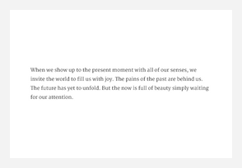
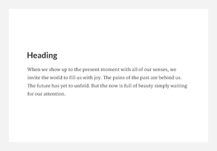
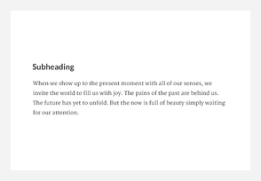
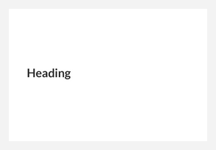
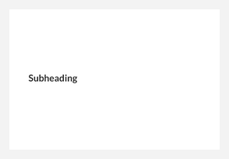
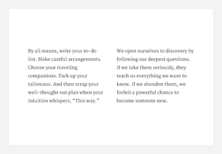
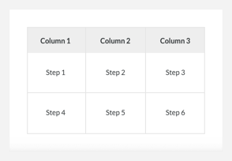
Text blocks
“Tell your story with these text block layouts.” Seven layouts — the workhorses of any lesson, and the ones to ration.
7 BLOCKS
Paragraph
Paragraph with heading
Paragraph with subheading
Heading
Subheading
Two column
Table
Keep paragraphs to two to four sentences. If a paragraph needs more, it usually wants to be a list, a table, or a second block.
Rise 360 · Day 2 · Blocks that carry your content
10
Notes:
Four things worth saying here. 1. Paragraph vs Paragraph with heading vs with subheading — the difference is only the heading level above the text. Use heading blocks to create scannable structure; people skim before they read. 2. Two column is where two-column layout actually comes from. Point back to the stack slide. 3. Table is plain and unstyled by design. It is for genuine tabular data. It is not a layout tool, and it does not scroll gracefully on a phone — if a table has more than about four columns, rethink it. 4. This is the family the anti-clutter rule is aimed at. Everyone over-reaches for Paragraph. The discipline is: write the paragraph, then ask what it would look like as a list, a statement, or an image with a caption.

Slide 11
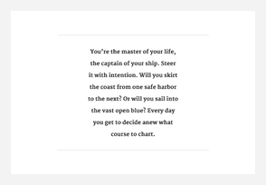
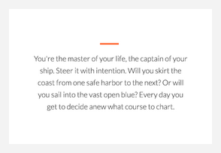
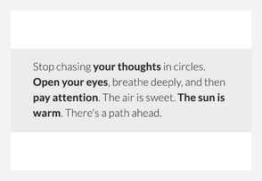
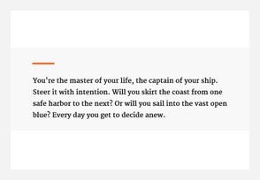
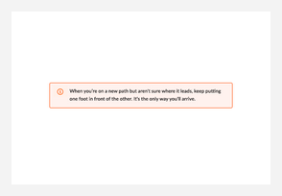
Statement blocks
“Make important information stand out… four uniquely-styled statement blocks and a useful note block.”
5 BLOCKS
Statement A
Statement B
Statement C
Statement D
Note
Narrow, centred, hairline rules — quiet and formal
Centred under a short accent rule — a wider measure
Full-width tinted panel — the loudest of the four
Left-aligned and compact — emphasis mid-flow
A boxed aside for a caveat or a heads-up
A statement earns its weight by being rare. Two or three per lesson read as emphasis; one every screen reads as shouting.
Rise 360 · Day 2 · Blocks that carry your content
11
Notes:
The most under-used family in a beginner’s first course, and the fastest way to make a text-heavy lesson breathe. Statement A through D are four visual treatments of the same thing: one short, important line. Pick by look — there is no functional difference, so do not let people agonise. Note is the odd one out and worth calling out explicitly: it is styled as an aside — a caveat, a heads-up, a "check with your manager first". Teach it as the block for the sentence that would otherwise sit in brackets. Exercise if you have a minute: take a dense paragraph from someone’s draft and pull one sentence out of it into a Statement. The paragraph gets shorter and the point gets louder. That is the whole lesson of this family.

Slide 12
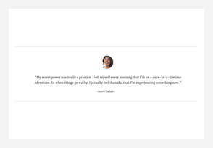
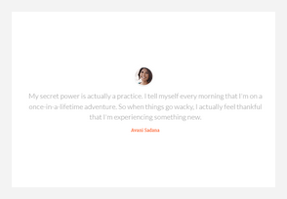
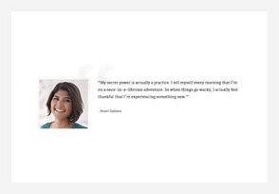
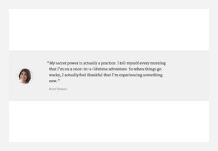
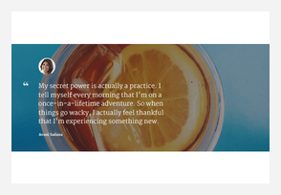
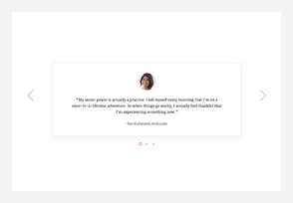
Quote blocks
“Highlight quotes in your story using these eye-catching quote blocks.” Four styles, plus quote on image and a carousel.
6 BLOCKS
Quote A
Quote B
Quote C
Quote D
Quote on image
Quote carousel
Attribute every quote. An unattributed quote in a training module reads as decoration and learners discount it.
Rise 360 · Day 2 · Blocks that carry your content
12
Notes:
Quotes do a specific job: they bring a human voice into the lesson. A line from a real customer, a real technician, a real manager carries weight that the same sentence in a paragraph does not. Quote on image is the one to demo — it is the highest-impact block in this family and it is where cover-image cropping bites. Remind them: the image crops differently on every device, so the subject needs to survive edge cropping. Quote carousel holds several quotes in one block. Useful for a "what our learners said" moment. Note that it does require a click to advance, so it sits at the border of static and interactive — but it is filed as a quote block, and we teach it here. Warn against invented quotes. If the quote is fabricated for illustration, label it as an example.

Slide 13
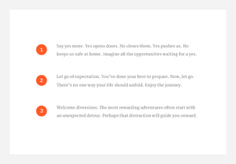
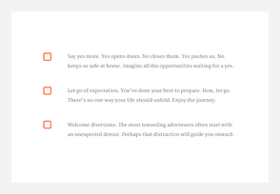
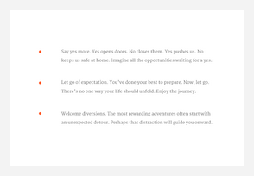
List blocks
“Make your point with lists. Choose from three styles.” The choice of marker is a meaning, not a decoration.
3 BLOCKS
Numbered list
Checkbox list
Bulleted list
Numbered markers — use when order matters
Square markers — things the learner will tick off
Plain dots — an unordered set
Numbered means order matters. Checkbox means the learner will do these. Bulleted means neither. Pick on meaning, not on looks.
Rise 360 · Day 2 · Blocks that carry your content
13
Notes:
Small family, easy to teach, and the one where you can plant a genuinely useful habit. The marker carries meaning. Numbered list = a sequence; doing step three before step two breaks something. Checkbox list = things the learner will actually tick off or verify. Bulleted = an unordered set. Beginners pick these by appearance and end up numbering things that have no order, which quietly tells the learner a lie about the task. Second habit worth planting: parallel phrasing. Every item in a list should start the same way — all verbs, or all noun phrases. A list that mixes "Check the reader" with "Battery life" is harder to scan than it looks. This comes up again in the editorial review on Day 5.

Slide 14
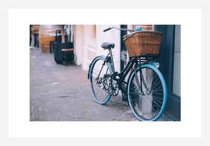
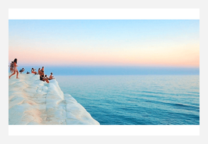
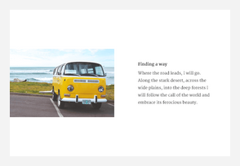
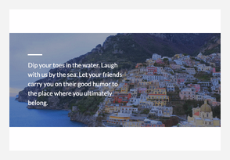

Image blocks
“Make pictures pop with these stunning image blocks.” Five ways to place a single image.
5 BLOCKS
Image centered
Image full width
Image & text
Text on image
Banner
Sits inside the content column — the safe default
Breaks the margins edge to edge — use sparingly
Picture on one side, words on the other
Words laid over the picture — watch contrast
Wide and short — good as a section opener
Images crop differently on every device. Keep the subject central and preview on mobile before you commit.
Rise 360 · Day 2 · Blocks that carry your content
14
Notes:
The five members differ in how much room the image gets and whether text sits with it. Image centered — sits in the content column with margins either side. The safe default. Image full width — breaks the margins, edge to edge. Use it for a moment, not for every picture. Image & text — the honest two-column layout: picture one side, words the other. Text on image — words laid over the picture. Contrast is on you; a busy photo makes the text unreadable. Rise gives you an overlay for exactly this reason. Banner — a wide, short strip. Good as a section opener inside a long lesson. The cropping point matters more than any of the above. Rise reflows, so the same image is cropped differently on desktop, tablet and phone. Anything critical near an edge will be lost. Say it once here and prove it in preview.

Slide 15
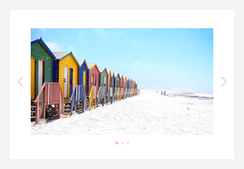
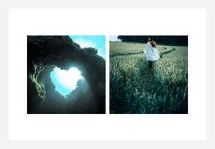
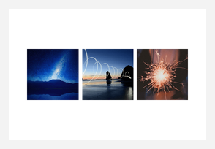
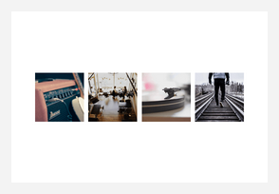
Gallery blocks
“Showcase multiple images in gallery blocks, including carousels and grids.”
4 BLOCKS
Carousel
Two column grid
Three column grid
Four column grid
One at a time, learner advances — good for sequence
Two images side by side
Three peers — comparison at a glance
Four peers — keep each one visually simple
Every gallery image needs a caption that says something. “Image 1” is not a caption.
Rise 360 · Day 2 · Blocks that carry your content
15
Notes:
Use a gallery when several images are peers — four product shots, four workspace setups, four before-and-afters. If one image matters more than the others, it wants an Image block, not a slot in a grid. Carousel shows one at a time and needs a click; the grids show everything at once. Grids are better when you want comparison, the carousel is better when you want sequence. Choose the column count for the number of images, not the other way round. A three-column grid with four images leaves an orphan on the second row and it looks like a mistake. Captions: this is where galleries fall down. A grid of four uncaptioned photos teaches nothing. Every caption should tell the learner what to notice.

Slide 16
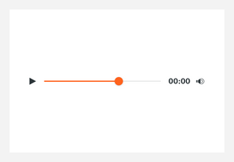
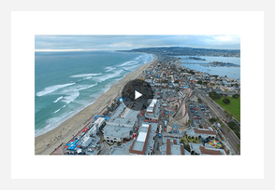
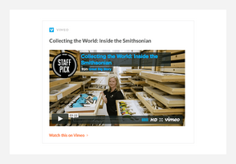
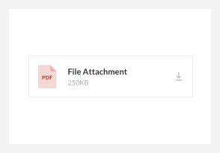
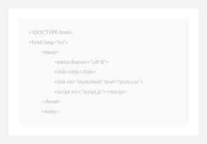
Multimedia blocks
“Create media-rich content… audio clips, videos, website embeds, file attachments, and code snippets (text only).”
5 BLOCKS
Audio
Video
Embed
Attachment
Code snippet
Upload or link a clip — introduce it first
Upload or link — say what to watch for
Pulls in an external page or player
A downloadable job aid, checklist or form
Monospaced — displays code, never runs it
Always write a lead line above a video or audio block that says what the learner should watch or listen for.
Rise 360 · Day 2 · Blocks that carry your content
16
Notes:
Five very different things filed under one family. Audio and Video — upload or link. Always introduce them. A bare video with no lead-in gets skipped; "Watch the two minutes below and note where the technician confirms the code" gets watched. Embed — pulls in an external page or player. Two warnings: it depends on that external service staying up, and it may be blocked on a corporate network. Never put anything essential behind an embed alone. Attachment — a downloadable file: a job aid, a checklist, a form. This is the block people forget exists and then email the PDF separately. Code snippet — text only, monospaced. It displays code; it does not run it. Accessibility, briefly: captions and transcripts are your responsibility, not the block’s.

Slide 17
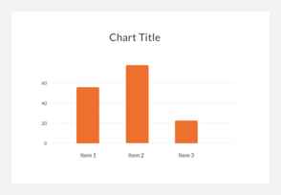
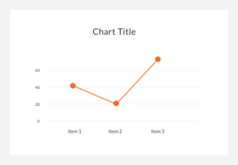
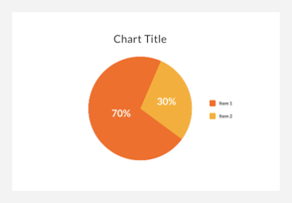
Chart blocks
“Create gorgeous data visualizations… simple to build bar, line, and pie charts your learners will love.”
3 BLOCKS
Bar
Line
Pie
Compares things
Shows change over time
Parts of one whole — only a few slices
Say the finding in a heading above the chart. A chart on its own makes the learner guess what you wanted them to see.
Rise 360 · Day 2 · Blocks that carry your content
17
Notes:
Three chart types, built by typing values into the block — no spreadsheet, no image editor. Match the type to the question. Bar compares things. Line shows change over time. Pie shows parts of one whole — and only works with a handful of slices; past five or six it becomes unreadable. The habit to teach is the headline. Do not write "Q3 results" above a chart. Write the finding: "Escalations fell by a third after the new script." Then the chart is evidence for a claim rather than a puzzle. Keep the data small. These blocks are for making one point visual, not for reporting. A note on the curriculum: charts are sometimes listed apart from the other static families. They belong here — you fill one in exactly like any other content block.

Slide 18
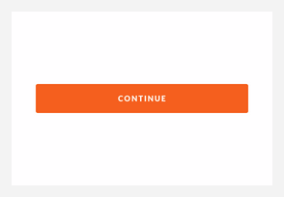
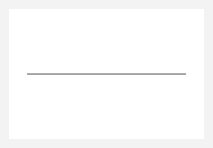
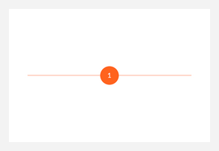
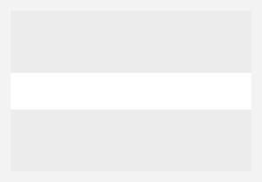
Divider blocks
“Organize block lessons into logical sections… and use continue blocks to encourage learners to master content before moving on.”
4 BLOCKS
Continue
Divider
Numbered Divider
Spacer
Hides what follows until the learner clicks
A plain rule between sections
A rule with a step number — good for procedures
Pure white space when padding is not enough
Continue is the one block here that changes behaviour: it stops the lesson until the learner clicks. Use it to gate, not to decorate.
Rise 360 · Day 2 · Blocks that carry your content
18
Notes:
The family that looks like nothing and does the most for readability. Divider — a rule between sections. Numbered divider — the same, with a step number, which is excellent for procedures. Spacer — pure white space, for when two blocks are crowding each other and padding is not enough. Continue is different in kind, so separate it clearly. It hides everything below it until the learner clicks. That is a real behaviour change: it forces a pause. Use it at a genuine decision or comprehension point — before an assessment, or before "now that you have read the policy". Sprinkling Continue blocks through a lesson just makes people click. Tie back to pacing: a long lesson with no dividers reads as an undifferentiated wall. Dividers are how you show structure without adding words.

Slide 19
SECTION THREE
Layout & polish
Padding, backgrounds, animation — the three settings that decide whether a good lesson looks good.
Rise 360 · Day 2 · Blocks that carry your content
19
Notes:
The families were about choosing. This section is about finishing. These three settings are where beginner lessons visibly differ from experienced ones — not in the content, in the consistency.

Slide 20
Padding: the space above and below a block
Open the design icon in the block’s upper-right corner. Padding is the first thing in the panel and the first thing people get wrong.
THE NUMBERS
THE RULE THAT MATTERS
30px
the default — Articulate calls this “plenty of breathing room”
Consistency beats any particular value.
200px
the current maximum in the Format menu
A course where every block sits at 30px looks deliberate. A course where padding wanders between 20, 45 and 60 looks broken, even though no single block is wrong.
Pick a value. Use it everywhere. Change it only when you mean something by it.
0px
no padding at all, for blocks meant to touch
S / M / L
presets; exact pixel values still live under “more”
Documentation lag, worth knowing. Older Articulate help pages describe a 0–100px range from the legacy sidebar Settings tab. The current Format menu goes to 200px. When a help article and the interface disagree, the interface is right — Rise ships faster than its documentation. Teach people to check the live UI rather than trust a screenshot in an article.
Rise 360 · Day 2 · Blocks that carry your content
20
Notes:
Demo, do not describe. Put three blocks on a lesson, set the middle one to 100px, and let them see the lesson go lopsided. Then set all three to 30 and watch it settle. The consistency point is the one to labour. Beginners tune padding block by block, chasing a look on one screen, and end up with a course that has no rhythm. Get them to decide their value now and write it on a sticky note. The documentation-lag box is a genuine teaching moment beyond padding: two Articulate documentation sets exist, the older help.rise.com and the newer support site, and the newer one reflects current settings. Trust the live interface over any article.

Slide 21
Backgrounds and contrast
The same panel fills a block’s white space — with a colour, a theme tint, or an image.
Colour
Image
Contrast
Type a hex code, pick manually, or take a theme colour or a tint of one.
A photo behind the block’s content. Handy behind a statement; risky behind a paragraph.
Auto, Light or Dark, set per block. Auto guesses from the background; override it when the guess is wrong.
Banding — what to avoid
Grouping — what to do instead
Alternating fills stripe the page and flatten the hierarchy.
One fill across blocks that belong together reads as a section.
Rise 360 · Day 2 · Blocks that carry your content
21
Notes:
Backgrounds are where enthusiastic beginners do the most damage, so lead with the failure mode. The banded look on the left happens when someone colours every other block to "add interest". The result is a stripey page where nothing stands out because everything does. Show the two stacks and let them see it. The fix on the right: use a background to group blocks that belong together, so the fill means "this is one section". The other fix, if you want visual transitions without stripes, is full-width imagery between sections. Contrast: Auto is right most of the time and wrong on busy images. If text becomes hard to read over a background image, that is what Light and Dark are for. Check it on mobile, where the crop changes what is behind the text.

Slide 22
Block entrance animations
On by default for non-text blocks. One toggle, course-wide, and worth a deliberate decision.
Where it lives
Turn it off when…
Theme › Blocks › Block Entrance Animations
the course is reference material people scan rather than read
your audience includes people sensitive to motion
the lesson is long and the repeated fade becomes a drag
Not in a block’s own settings — this is a Theme-level switch that applies to the whole course. Non-text blocks fade in as the learner scrolls to them; text blocks do not animate.
Why a facilitator should mention it at all
Because it is the most common "why does my course feel slow?" question, and because nobody finds it — people look in the block settings, where it is not. Show them the Theme menu once and it stops being a mystery. It also previews the Day 4 point that all global styling lives under Theme.
Rise 360 · Day 2 · Blocks that carry your content
22
Notes:
Two minutes. This is a small setting with an outsized number of support questions attached to it. Show the toggle live. The reason it matters is location, not function: it is under Theme, not under the block, and that is exactly the confusion that comes back on Day 4 with navigation — course navigation lives under Theme too, while each quiz has its own Settings panel. Plant the pattern now: block-level settings are on the block, course-level settings are under Theme. Do not turn this into an accessibility lecture, but do name motion sensitivity as a real reason to switch it off.

Slide 23
SECTION FOUR
Keeping it readable
Four rules of thumb, and the five mistakes every first Rise course makes.
Rise 360 · Day 2 · Blocks that carry your content
23
Notes:
Change of register here. Everything so far has been "what the tool does". This section is judgement. Be explicit that these are practitioner conventions, not settings the software enforces. That honesty buys you credibility for the rest of the day.

Slide 24
Four rules of thumb
None of these is enforced by Rise. All four are what separates a first course from a fifth.
≤ 50%
1–2+
≤ 20
0
text blocks
images per lesson
blocks per lesson
stripes
No more than about half a lesson should be text blocks. The rest earns its place as images, media, dividers and — from tomorrow — interactions.
At minimum. A lesson with no picture in it is a document, and people read documents somewhere other than an LMS.
Past roughly twenty blocks, ask whether this is really two or three shorter lessons. Rise scrolls forever; attention does not.
Never alternate background colours block by block. Group with one fill, or transition with full-width imagery.
Say this out loud to your group: these figures come from practitioner guidance in the Articulate community, not from Articulate’s own documentation. They are good defaults to design against, not standards to audit against.
Rise 360 · Day 2 · Blocks that carry your content
24
Notes:
The credibility move on this slide is the orange box. Do not present community heuristics as vendor rules — somebody in the room will go looking for them in the Articulate documentation, not find them, and then discount everything else you said today. The 50% rule is the useful one and the one to enforce in the lab. It is easy to check: count the blocks, count the text blocks. The 20-block threshold usually lands with people who have already written a monster lesson. Ask who has one. Then ask where it would naturally split. The stripe rule connects straight back to the banding demo two slides ago.

Slide 25
The five mistakes every first course makes
Recognise them in your own draft before someone else does.
Too much text
Paragraphs that run past four sentences, and every idea delivered as prose.
Cut to need-to-know. Pull one line into a Statement.
1
Not enough visuals
A lesson with no image in it at all.
One or two image blocks, minimum. Caption them.
2
No block variety
Paragraph, paragraph, paragraph, list, paragraph.
Vary the family. Aim for no more than half text.
3
No pacing
One unbroken run of blocks with no visual structure.
Dividers between sections; Continue at real checkpoints.
4
Endless lessons
One lesson carrying an entire topic.
Split it. Two or three short lessons beat one long one.
5
Rise 360 · Day 2 · Blocks that carry your content
25
Notes:
Read the middle column, not the left — the symptom is what people recognise in their own work; the label is not. Best way to run this slide: have someone volunteer a lesson they have already drafted, put it on the screen, and let the group name which of the five it has. It is much more effective than agreeing with the slide in the abstract. Be kind about it. Everyone’s first Rise course has at least three of these, including yours. The point is that they are all cheap to fix once you can see them — which is why we spent the morning learning what else is available.

Slide 26
SECTION FIVE
Build it
The rest of today is hands on. One lesson, built to a brief.
Rise 360 · Day 2 · Blocks that carry your content
26
Notes:
Stop talking. The remaining time is theirs. Have the brief slide up on the screen for the whole lab so nobody has to ask what the requirements were.

Slide 27
Your build: one varied lesson
Fill out the lesson you created this morning. A real topic from your own work — you will want to keep this.
THE BRIEF
How you will know it works
Eight to fourteen blocks
No more than half of them text
Two or more image or gallery blocks, captioned
One statement or quote carrying the key point
A divider, and a Continue where a pause helps
One padding value throughout
No two adjacent blocks with different fills
Swap laptops with the person next to you. They read your lesson on a phone preview and tell you, without scrolling back, what the main point was. If they cannot, the layout is doing the wrong job.
If you finish early
Rebuild your busiest text block three ways using the swap dropdown, and keep the version that reads fastest. Then try one chart block — most people never open that family unprompted.
Do not add accordions, tabs, flashcards or knowledge checks today — they are tomorrow, and the brief is deliberately about what static blocks alone can do.
Rise 360 · Day 2 · Blocks that carry your content
27
Notes:
Give them a real block of time — an hour is not too much. Walk the room; do not narrate from the front. They already have the empty lesson from this morning, so nobody should be starting from the dashboard. If anyone is, sort it out before the lab proper begins. Insist on a real topic. People build a throwaway lesson about coffee, learn nothing they can reuse, and delete it. A lesson from their actual work becomes the seed of a real course and they will care whether the layout is any good. The peer test in the top-right corner is the part to protect. It is the only feedback in the day that comes from someone who does not already know what the lesson is supposed to say — and reading it on a phone surfaces cropping and padding problems immediately. Enforce the no-interactions rule gently but firmly. Someone always sneaks in an accordion. The constraint is the lesson: static blocks alone can carry a good lesson, and if you skip straight to interactions you never learn that.

Slide 28
Before you call it done
Run this against your lesson. It is also the checklist you will use on every course after today.
Content
Layout
Check
Every paragraph is four sentences or fewer
One padding value, used throughout
Previewed on mobile portrait, not just desktop
Every image and gallery slot has a real caption
No two adjacent blocks with different fills
Nothing important sits near an image edge
Lists use the marker that matches their meaning
Dividers mark the sections a reader would expect
Under twenty blocks, or split into two lessons
Any chart has the finding stated above it
Continue blocks sit at real checkpoints only
No more than half the blocks are text
Rise 360 · Day 2 · Blocks that carry your content
28
Notes:
Hand this out on paper if you can. It is the artefact people keep from today. Walk it once, quickly — do not read all twelve lines aloud. Point out that the Check column is the one people skip: previewing on mobile takes ten seconds and catches the majority of layout problems while they are still cheap to fix. Tell them this checklist grows. Day 3 adds interaction questions, Day 4 adds assessment and branding, Day 5 adds the publishing checks.

Slide 29
Tomorrow: the blocks that answer back
Everything today was content the learner reads. Day 3 is content the learner operates.
WHAT YOU CAN DO NOW
WHAT DAY 3 ADDS
Nine families, forty-two static blocks
Add, reorder, swap, duplicate, delete
Padding and backgrounds set on purpose
A lesson that passes the anti-clutter rules
Accordion and Tabs — hide secondary text
Labeled Graphic — an image to explore
Process and Timeline — sequence with pacing
Sorting and Scenario — decisions, not reading
Flashcards, Buttons and Button stacks
Bring your lesson with you. Tomorrow starts by taking the most text-heavy block in the lesson you just built and turning it into an interaction. That works much better on real content than on a blank page.
Rise 360 · Day 2 · Blocks that carry your content
29
Notes:
Close the loop back to the contract you set on slide 3. Ask the room to say what they can now do — do not read the left column to them. The reason to preview Day 3 is motivational, not informational: the accordion is the block that solves the problem they have all just felt, which is having more to say than a lesson can comfortably hold. The homework line matters. If they arrive tomorrow with a real lesson, Day 3 has real content to transform and the exercises are far better. If they arrive empty-handed we spend the first half hour inventing filler.

Slide 30
DAY 2 COMPLETE
Nine families.
One readable lesson.
The tool was never the hard part. Choosing which block carries which idea — that is the craft, and you have started it.
Day 3 › Interactive blocks
Rise 360 · Day 2 · Blocks that carry your content
30
Notes:
Two things before people leave. One: remind them the deliverable is the lesson, and to bring it tomorrow. Two: collect one sentence each on what they found hardest today. That tells you whether Day 3 needs to open with a recap of block mechanics or can go straight into interactions. If the room struggled with the tool rather than the choices — hunting for settings, losing blocks — slow Day 3 down and re-demo the block toolbar first. If they struggled with the choices, that is exactly right, and Day 3 will help.

