Slide 1
Presidential Race:
Candidate Correlations

Slide 2
Question
Do the Democratic & Republican candidates correlate with each other?
For example, does the amount of support for Mr. Dem correlate with the support Mrs. Repub by counties?

Slide 3
Method:
Gather vote results by county
Normalize voting data to percentages
Join the vote results to demographic stats
Calculate Pearson's correlation

Slide 4
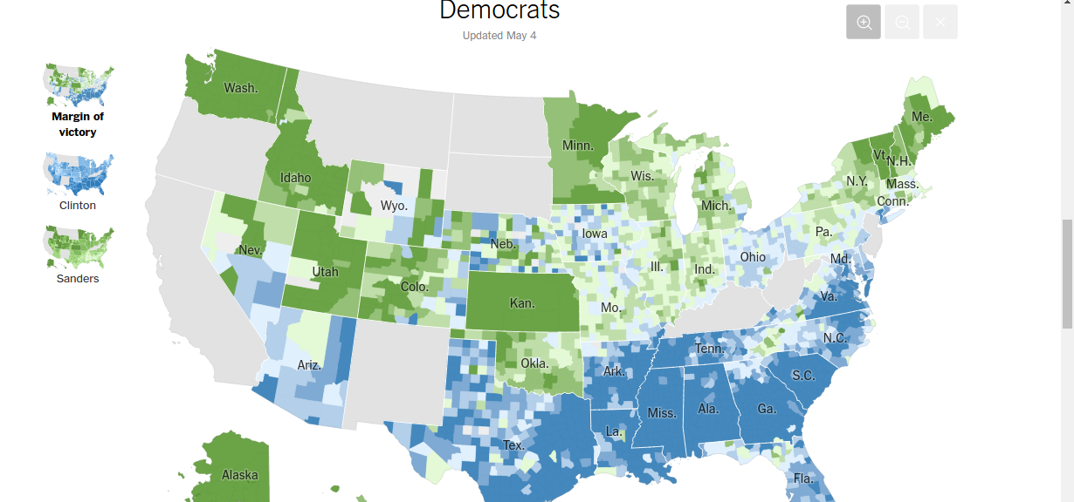
Data Source
NY Times Election Results – Extract a large JSON file from the network traffic in the browser.

Slide 5
Data Wrangling
Use Python to munge the data into a table format.
Join all Republican results with Democratic results by county (this leaves out some races in either party)
Normalize vote count to percentage by party.

Slide 6
Pythonic Wrangling
import json
import csv
with open('primaries.json', 'r') as data:
data = json.load(data).get('races')
with open('tmp_results.csv', 'w') as out:
writer = csv.writer(out)
row = ['FIPS', 'NAME', 'CLINTON', 'SANDERS',
'OMALLEY', 'DEM_OTHER', 'TRUMP',
'CRUZ', 'RUBIO', 'KASICH', 'CARSON',
'BUSH', 'CHRISTIE', 'PAUL', 'REP_OTHER']
cd = dict(zip(row[2:], range(2, len(row))))
writer.writerow(row)
for race in data:
if race.get('race_type') == 'president' and\
race.get("result") == "winner":
counties = race.get('counties')
if not counties:
….... et cetera . . . . .

Slide 7
Sample (subset) of a Row
FIPS | Sanders | Clinton | Trump | Cruz
10029 | 0.67 | 0.31 | 0.28 | 0.19

Slide 8
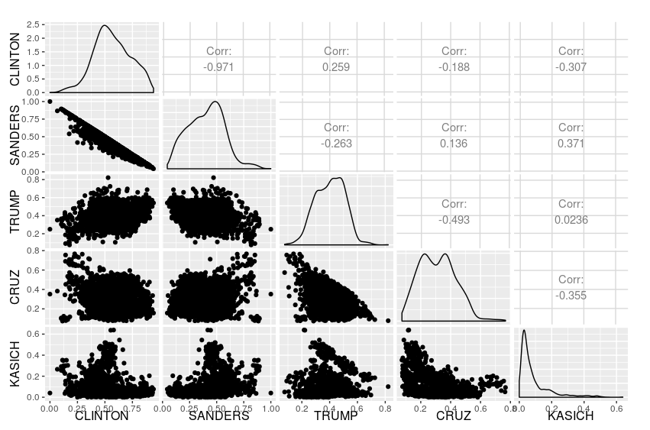
Initial pairwise plot

Slide 9
That was a lot of data.
Let's look closer at specifics.

Slide 10
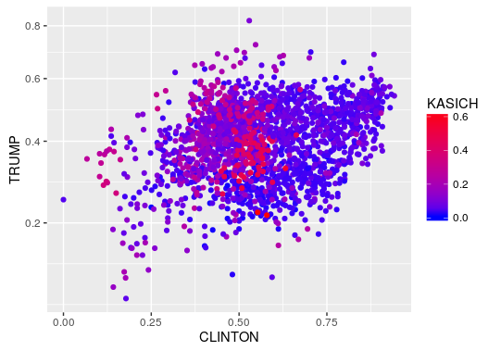
Clinton and Trump (w/ Kasich)
ggplot(data = results.all, aes(CLINTON, TRUMP)) +
scale_y_sqrt() +
geom_point(aes(colour=KASICH)) +
scale_colour_gradient(low="blue", high="red")

Slide 11
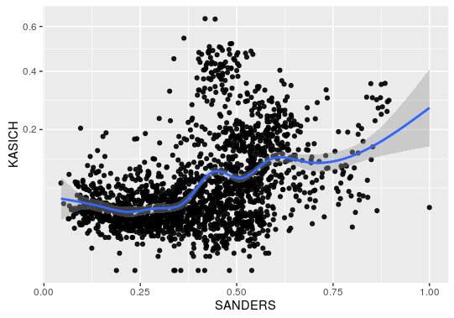
Sanders and Kasich
ggplot(data = results.all, aes(SANDERS, KASICH)) +
scale_y_sqrt() +
geom_point(alpha=0.9) +
geom_smooth()

Slide 12
We're interested in correlation.
Let's compare the candidates

Slide 13
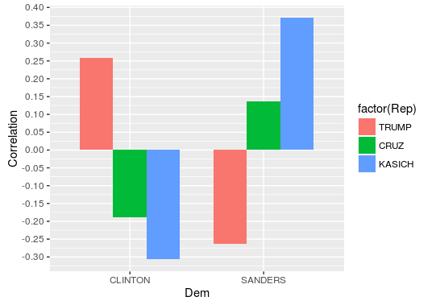
Correlation by Repub
ggplot(data = correlations.long, aes(x=Dem, y=Correlation, fill=factor(Rep))) +
geom_bar(width=.75, stat="identity", position="dodge") +
scale_y_continuous(breaks=pretty_breaks(n=20))

Slide 14
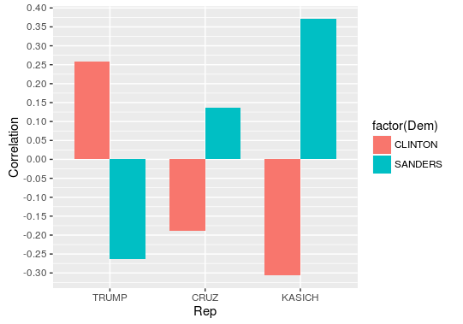
Correlation by Dem
ggplot(data = correlations.long, aes(x=Rep, y=Correlation, fill=factor(Dem))) +
geom_bar(width=0.75, stat="identity", position="dodge") +
scale_y_continuous(breaks=pretty_breaks(n=20))

Slide 15
These are all significant
(p < 0.01)
Why are Clinton & Trump correlated?
Let's look at demographics by county.

Slide 16
We will inspect:
% BA Degrees,
Population Density,
% Black,
Average Income,
% Unemployed

Slide 17
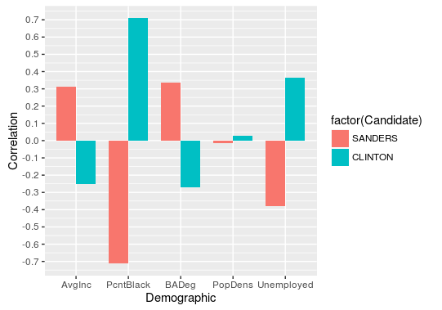
Correlation with Dems

Slide 18
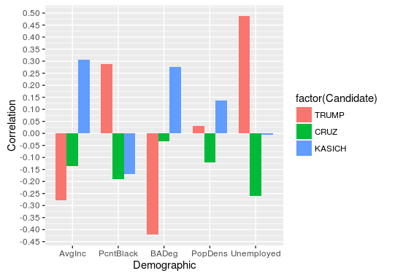
Correlation with Repubs

Slide 19
OK. How do these correlations compare, pairwise with candidates?
That is, how do candidates from each party differ with their correlations with each demographic?

Slide 20
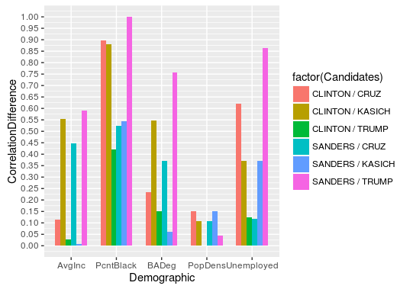
Absolute Difference of Correlation (range: 0-2)

Slide 21
Clinton and Trump have nearly the same correlations with population density (~0.03) and average income (~ -0.25)
Population density is not significant, so I suggest we should pay attention to average income.

Slide 22
Thank you.
Questions?

