Slide 1
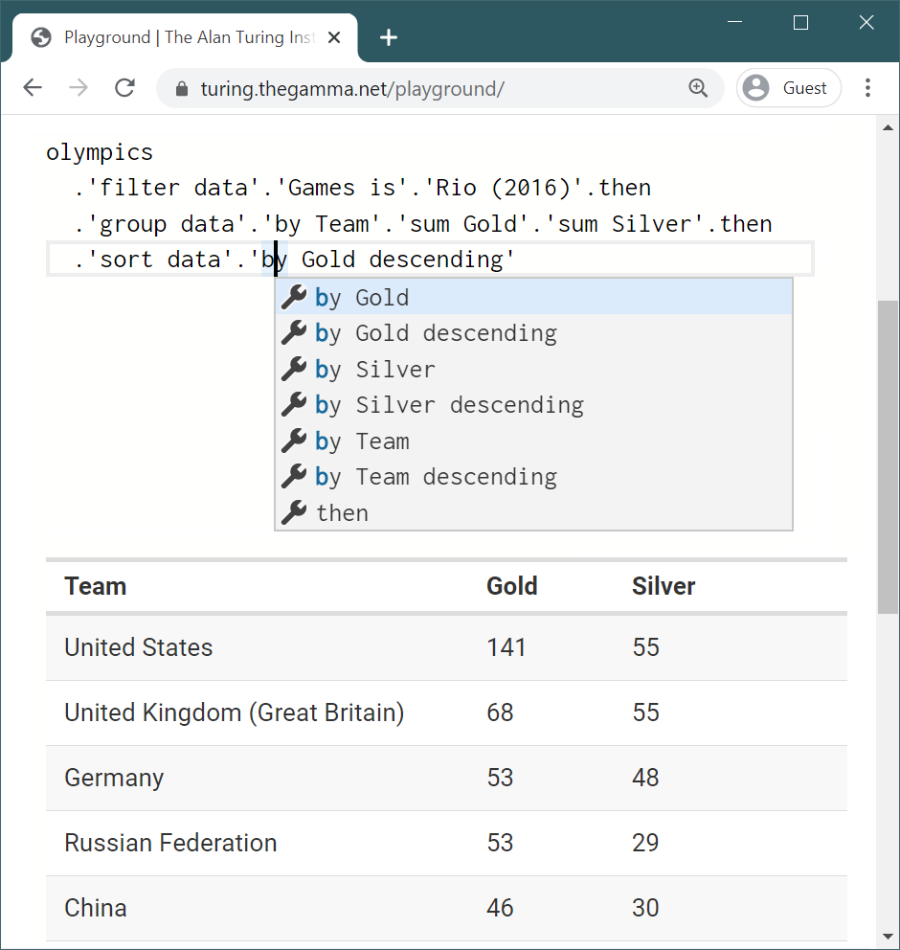
1
2
Source code in a text editor
Context-sensitive auto-complete
3
Instantaneous result preview

