Slide 1
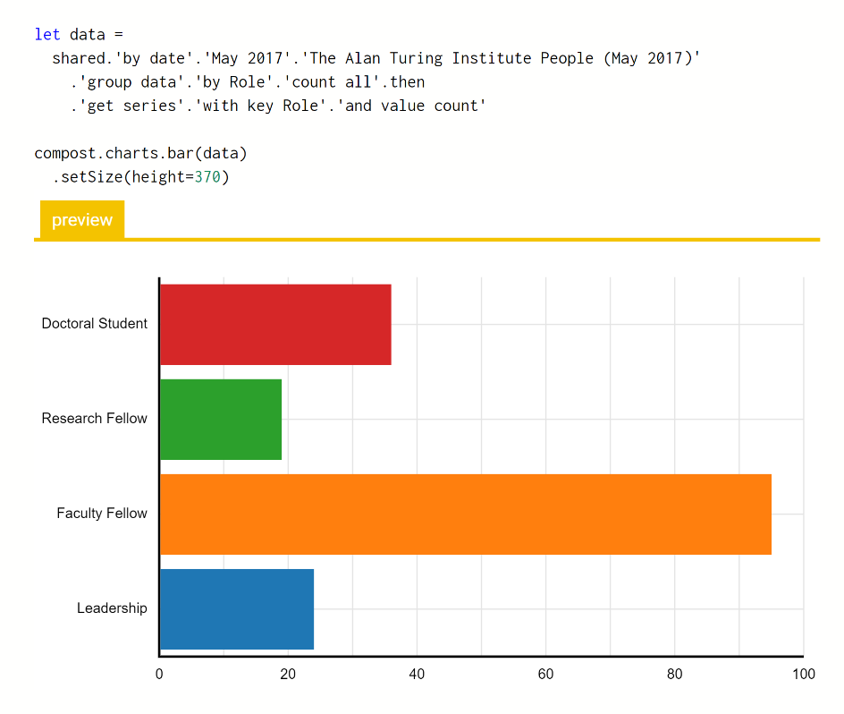
The Gamma Democratizing Data Science
“In recent years, divergent levels of trust in statistics has become one of the key schisms that have opened up in western liberal democracies.”
William Davies
The Guardian, January 2017
Tools for open data-driven visualizations
Accountable Readers can analyse data sources & methods
Reproducible Can be recreated using primary data sources
Engaging Encourage the reader to explore data further

