Slide 1
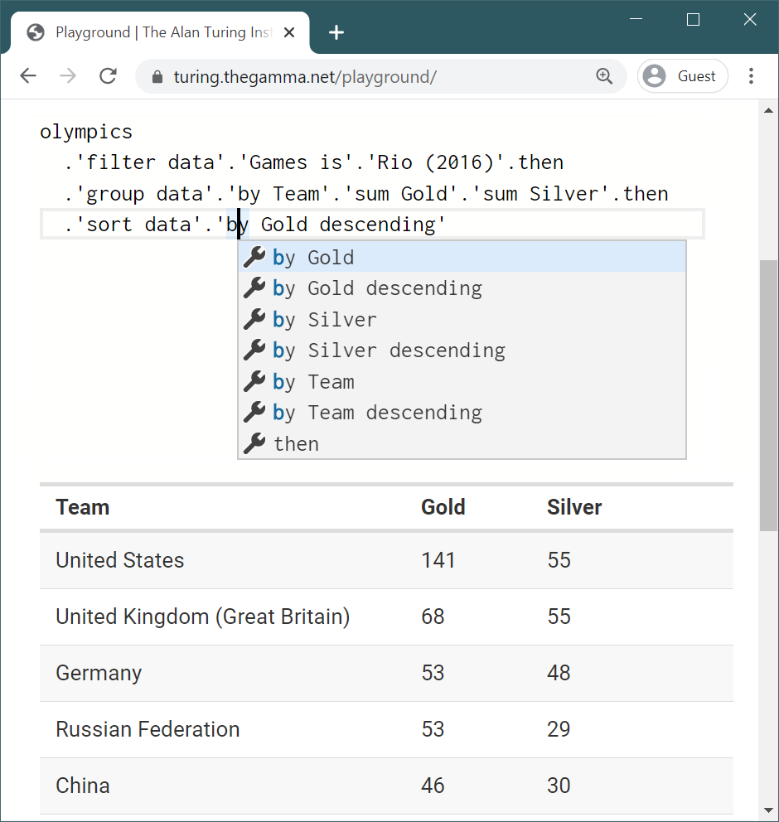
1
2
Source code in a text editor
Context-sensitive auto-complete
3
Instantaneous result preview

Slide 2
Indicator
Indicator
Year
CO₂
CO₂
Year
2010
US
Country
Country

Slide 3
Dalek
Bad Wolf
Doctor
River Song
Day of The Moon
ENEMY
APPEARS
The Silence

