Slide 1
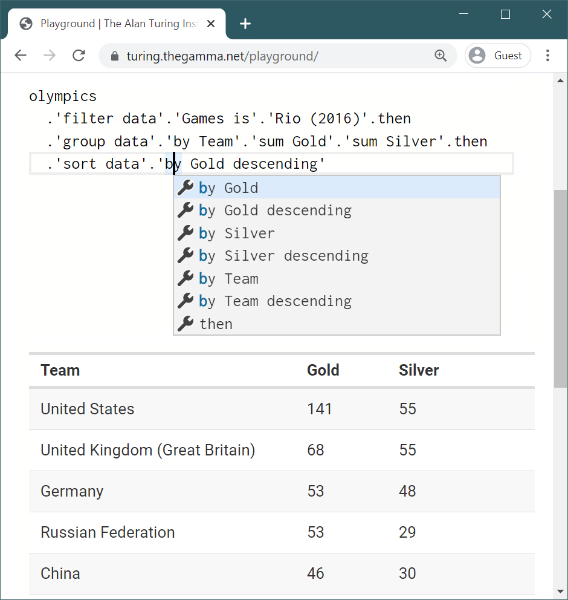
1
2
Full source code in a text editor
Programming via iterative prompting
3
Instantaneous preview of results

Slide 2
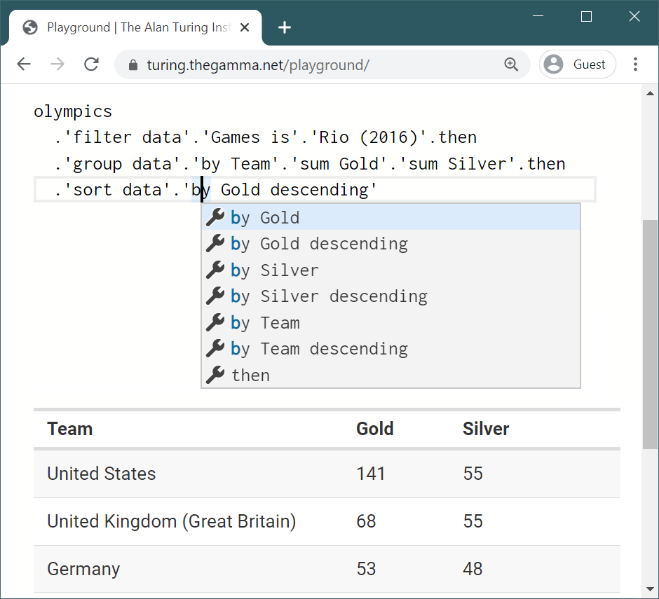
1
2
Full source code in a text editor
Programming via iterative prompting
3
Instantaneous preview of results

Slide 3
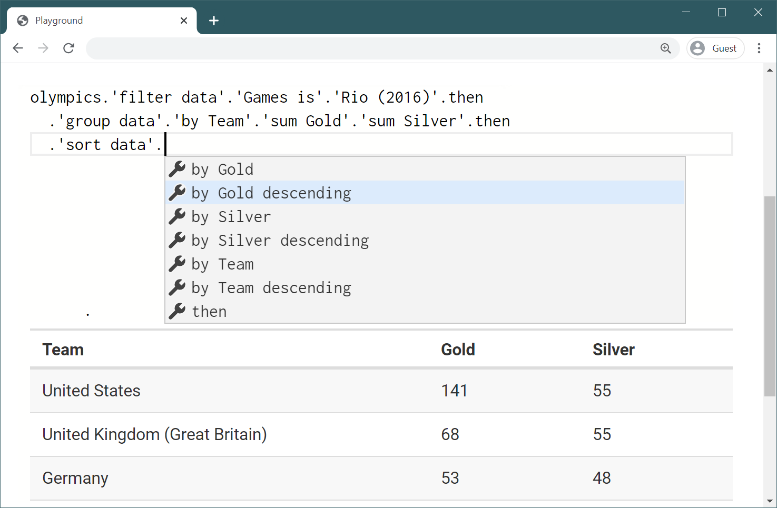
Programming via iterative prompting
1
2
Full source code in a text editor
3
Instantaneous preview of results

Slide 4
Indicator
Indicator
Year
CO₂
CO₂
Year
2010
US
Country
Country

Slide 5
Dalek
Bad Wolf
Doctor
River Song
Day of The Moon
ENEMY
APPEARS
The Silence

