Slide 1
Help Session Note
Welcome to the Help Session
The session runs for one hour before each workshop.
If you have any questions, please do raise your hand or speak up and I will be with you shortly.
Notes:
Camille

Slide 2

Generative AI for Work & Research
We’ll get started in a few minutes
Notes:
Camille

Slide 3
Workshop Schedule
👋🏽 Welcome, Announcements (5 mins)
📝 Pre-work Recap, Workshop Intro and Demo (15 mins)
👩🏽‍💻 Workshop 3 Exercise (1 hour 10 minutes)
📣 Presentations (10 mins)
👨🏻‍🏫 Additional Tool Demonstrations (20 mins)
(No Kahoot game today, as the workshop task is quite long)
Notes:
Camille
Welcome and intro: Say hello, we’re excited to have everyone. Introduce TGC people (Kene, Joy, Zachary, Sara, Olivia, etc.), words from Olivia, mission/goals – Joy/Kene/Olivia
Cosmos practice: Update last year’s slides - Joy
Icebreakers: Games/activities: TBD – Joy
Course overview: syllabus (basically walk thru learning journey figure from brochure) – Kene
Course navigation: screen share TGC website, walk through navigating to the course pages, explain new content will be uploaded each week – Joy
Expectations and policies: assessments/grading, attendance policy, code of conduct – Kene
Intro to Discord – Kene
Final announcements: next workshop material, calendar invites, general reminders, etc.

Slide 4

Welcome, Announcements
Notes:
Sabina

Slide 5
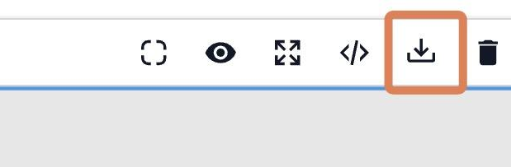
Three Ways to Edit Your Website
1. GitHub Direct Edit
Best for very simple text replacements.
Go to your GitHub repo index.html.
Click the pencil icon to edit.
Press Ctrl+F to find text.
Search, replace, and then commit changes.
2. GUI Editor (GrapesJS)
For slightly more complex tasks (e.g., adding links).
Use app.grapesjs.com/playground as a visual builder.
Click the “Import code” icon to import your code. Paste in your website code.
Then edit in the GUI. When done, again click the import code button, then copy your code back out into GitHub
Note: Can sometimes break complex UIs.
3. AI Model Assistance
For complex structural changes or new features.
Simply ask the LLM to write or modify the code for you based on your specific requirements.
Notes:
Sabina

Slide 6
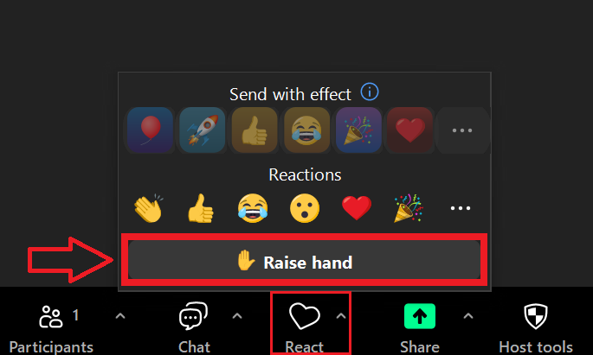
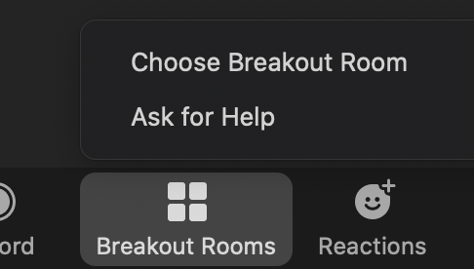
Reminder: We can’t see group chat in breakout rooms. Raise hand or Ask for Help

Slide 7
Workshop Intro
Notes:
Sabina

Slide 8
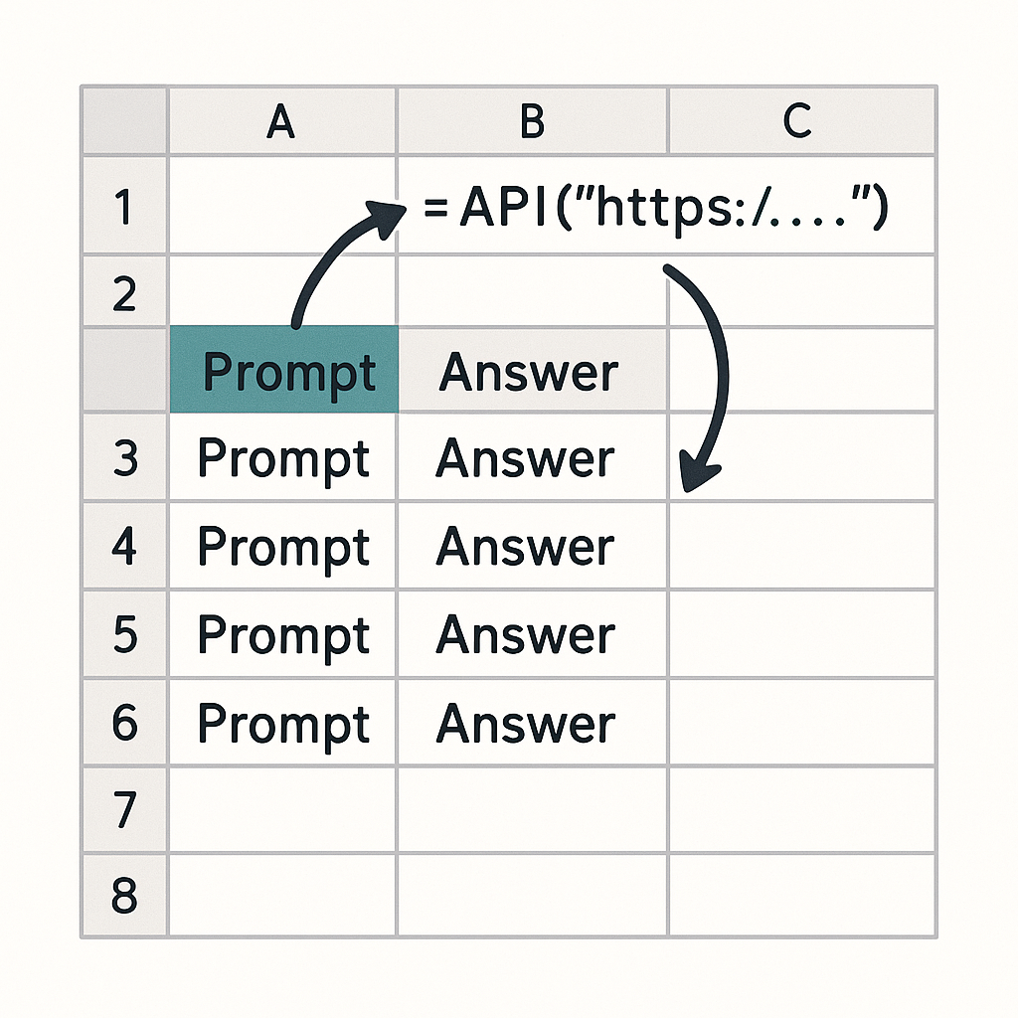

Pre-work recap: using LLMs in spreadsheets
vs
Graphical User Interface (GUI)
Application Programming Interface (API)
Visual interface designed for human interaction.
Code-based interface for program interactions.
Notes:
Kene

Slide 9
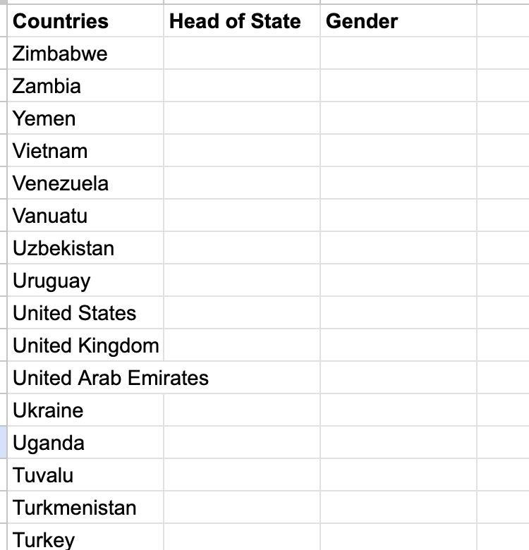
Reminder of pre-work
https://docs.google.com/spreadsheets/d/1qGOgr8jCPi74QWvCKRewR7o-kfcxeXmYiidTCmusOmU/
https://thegraphcourses.org/courses/aiw-2026-t2/topics/using-llm-apis-with-openrouter-and-google-sheets-2/
Notes:
Kene

Slide 10
Two more applications of LLMs in a loop
•Literature Review
•Qualitative Data Analysis
Notes:
Sabina

Slide 11
From spreadsheets → Academic Literature Review?
IDEA: Could we use the API in Google Sheets setup for academic paper review?
Answer: Possible. But best to use a dedicated tool. e.g. Gemini Notebook (today), Elicit
Notes:
Kene

Slide 12
Today: summarise a body of literature
OUR PAPERS
OR BRING YOUR OWN
Social media breaks
Your own PDFs
14
experiments
Does quitting or cutting down on social media improve mood?
10+
papers or reports
Any collection you are allowed to upload to an AI tool.
Facebook deactivation, week-long breaks, daily time limits
6 are in a 2025 systematic review; 8 are not
You write the paragraph(s) yourself, from a template
Design your own columns
One extraction table and one figure
Pulled into a Google Doc to submit

Slide 13
The workflow: one question, every document
1
2
3
4
5
Upload
Extract
Chart
Check
Write
Add the 14 PDFs to one Gemini Notebook.
One prompt: a table with one row per comparison, every cell cited.
Ask for a bar chart of the results; download it from Studio.
Click the citations for 3 rows. Is the AI right?
Your own paragraph(s) and an AI-use statement, in a Google Doc.
Why Gemini Notebook rather than a general chatbot?
It answers only from the sources you upload, and every cell comes with a citation you can click to see the passage. With many long PDFs at once, a general chatbot tends to skim, skip papers and blur details together. It's the pre-work idea again: the same questions, asked of every document.

Slide 14
The extraction table: 6 columns
Your 6 columns (one row per comparison)
Then
Design RCT / non-randomised / within-person
Sample number, who and where
Intervention Quit or Limit; platforms; length in days
Outcomes measured with the scales used
Positive affect result Improved / No clear effect / Worse / Not measured
Key finding one sentence, with effect size if reported
Bar chart: sample size per row, split by positive affect result, coloured quit vs limit
Check sample and result for 3 rows by clicking the citations
Read the meta-analysis: what does it show that your table doesn't?
Write 1-2 paragraphs yourself, from a template
Add an AI-use statement: tool, task, what you checked
One row per comparison with a control group: Przybylski 2021 has three, Hartanto 2025 two. 17 rows in all.
Every column constrains the answer and gives the AI a way to say “Not stated”. Full prompts are in the instructions.

Slide 15
What a meta-analysis shows that our table doesn't
Your table
The meta-analysis
A quick narrative summary
Lemahieu et al. 2025, Scientific Reports
Counts verdicts: how many rows say “Improved”?
Every study counts once, whether it had 35 people or 3,000
Only the papers we picked, free to read
Mixes quit and cut-down studies, and different outcomes
Pools effect sizes: positive affect g = 0.03, not significant
Weights by precision: big studies count more
Systematic search: includes studies behind paywalls
Checks heterogeneity, bias and whether break length matters
You will write 2-3 sentences on this in your own words (Part 5 of the instructions).

Slide 16
Check the AI's work, then write it up
Check 3 rows against the PDFs: click the citation, read around it
Row | Column | AI answer | Correct? | Note
Vally & D'Souza (2019) | Sample | 68 | No | Abstract says 68; methods and Table 1 report 78 (39 per group)
Przybylski et al. (2021) | Rows | 1 row | No | Three separate experiments, so three rows
Illustrative examples of what to look for; your own notebook's answers may differ.
Hand in one Google Doc
1
Paragraph(s)
written by you, from a template
2
Meta-analysis note
2-3 sentences
3
AI-use statement
tool, task, what you checked
4
Figure
from Gemini Notebook
5
Appendix
the extraction table
Own PDFs? Table and figure are enough.

Slide 17
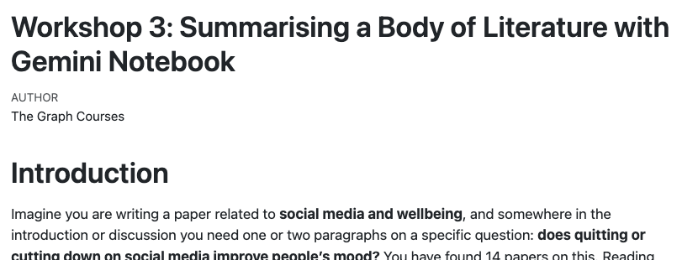
Live demo: Gemini Notebook
Notes:
Kene

Slide 18


EXERCISE TIME
✨ Breakout Rooms!✨
Notes:
Camille

Slide 19

Presentations✨
Notes:
Camille

Slide 20




Limitations of LLM-Powered Text Analysis
Model inaccuracy and hallucinations
Reproducibility limitation. Non-determinism
MITIGATION: Click the citations and check a sample by hand. Test multiple models
MITIGATION: Rerun multiple times to ensure stability
API Costs
Privacy Issues. Sensitive Data
MITIGATIONS: Try free tiers first. Today: Gemini Notebook's free plan handles 14 PDFs; the figure needs Google AI Pro
MITIGATION: Only upload public or permitted documents. Local models. Privacy agreements.
Notes:
Sabina

Slide 21

Demo of Elicit: LLM-Powered Literature Review
Are other papers reporting similarly large seroprev? What methods did they use?
Before: Read through papers manually
Now: search “SARS-CoV-2 seroprevalence in Cameroon” on Elicit (Find Papers) and let the AI read through each.
Notes:
Sabina

Slide 22
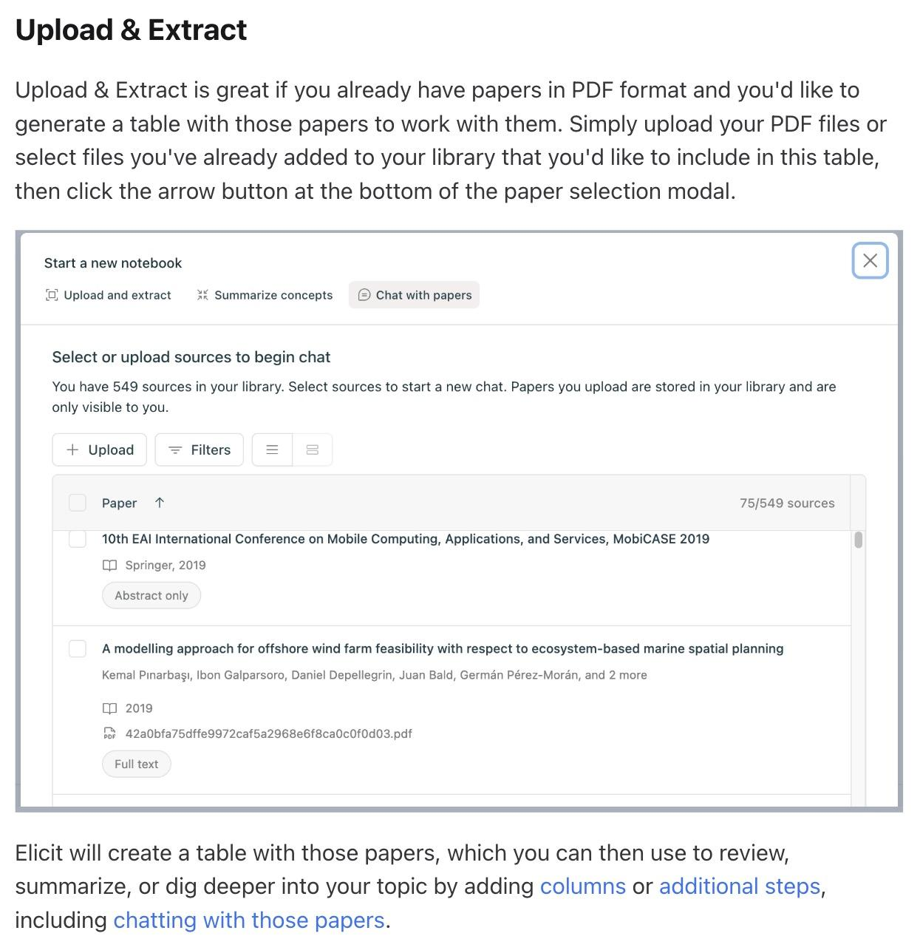
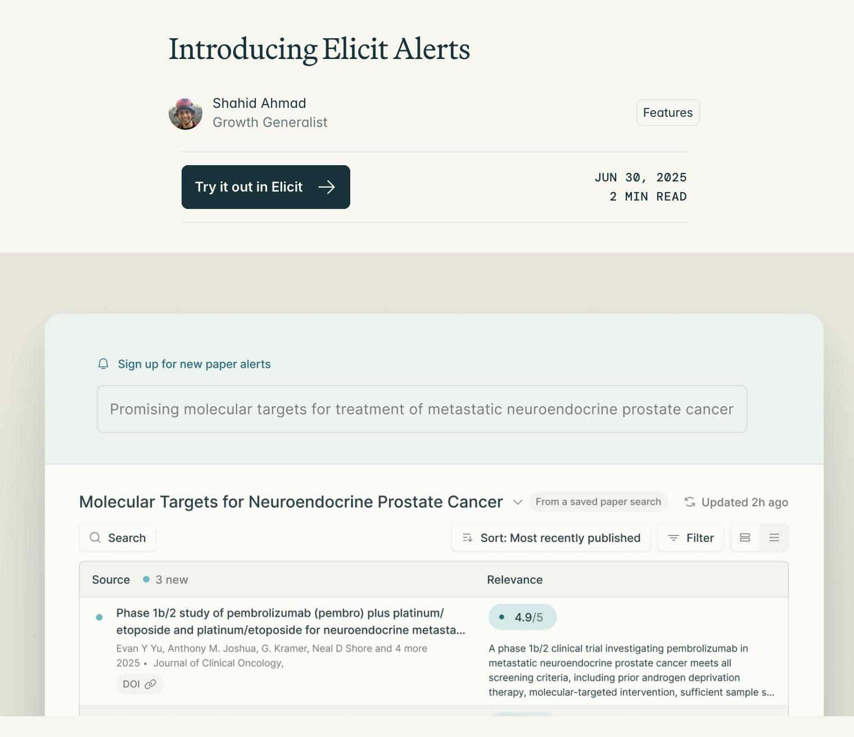
Other features of Elicit
Notes:
Sabina

Slide 23


Full Walkthroughs
https://www.youtube.com/watch?v=bXN9B8_Pfl8
https://www.youtube.com/watch?v=Ki2OBrW1HFU
Notes:
Sabina

Slide 24
From spreadsheets → Qualitative Data Analysis?
IDEA: Could we use the API in Google Sheets setup for qualitative data analysis?
Answer: Possible. But best to use a dedicated tool. e.g. Atlas TI, NVIVO
Notes:
Kene

Slide 25
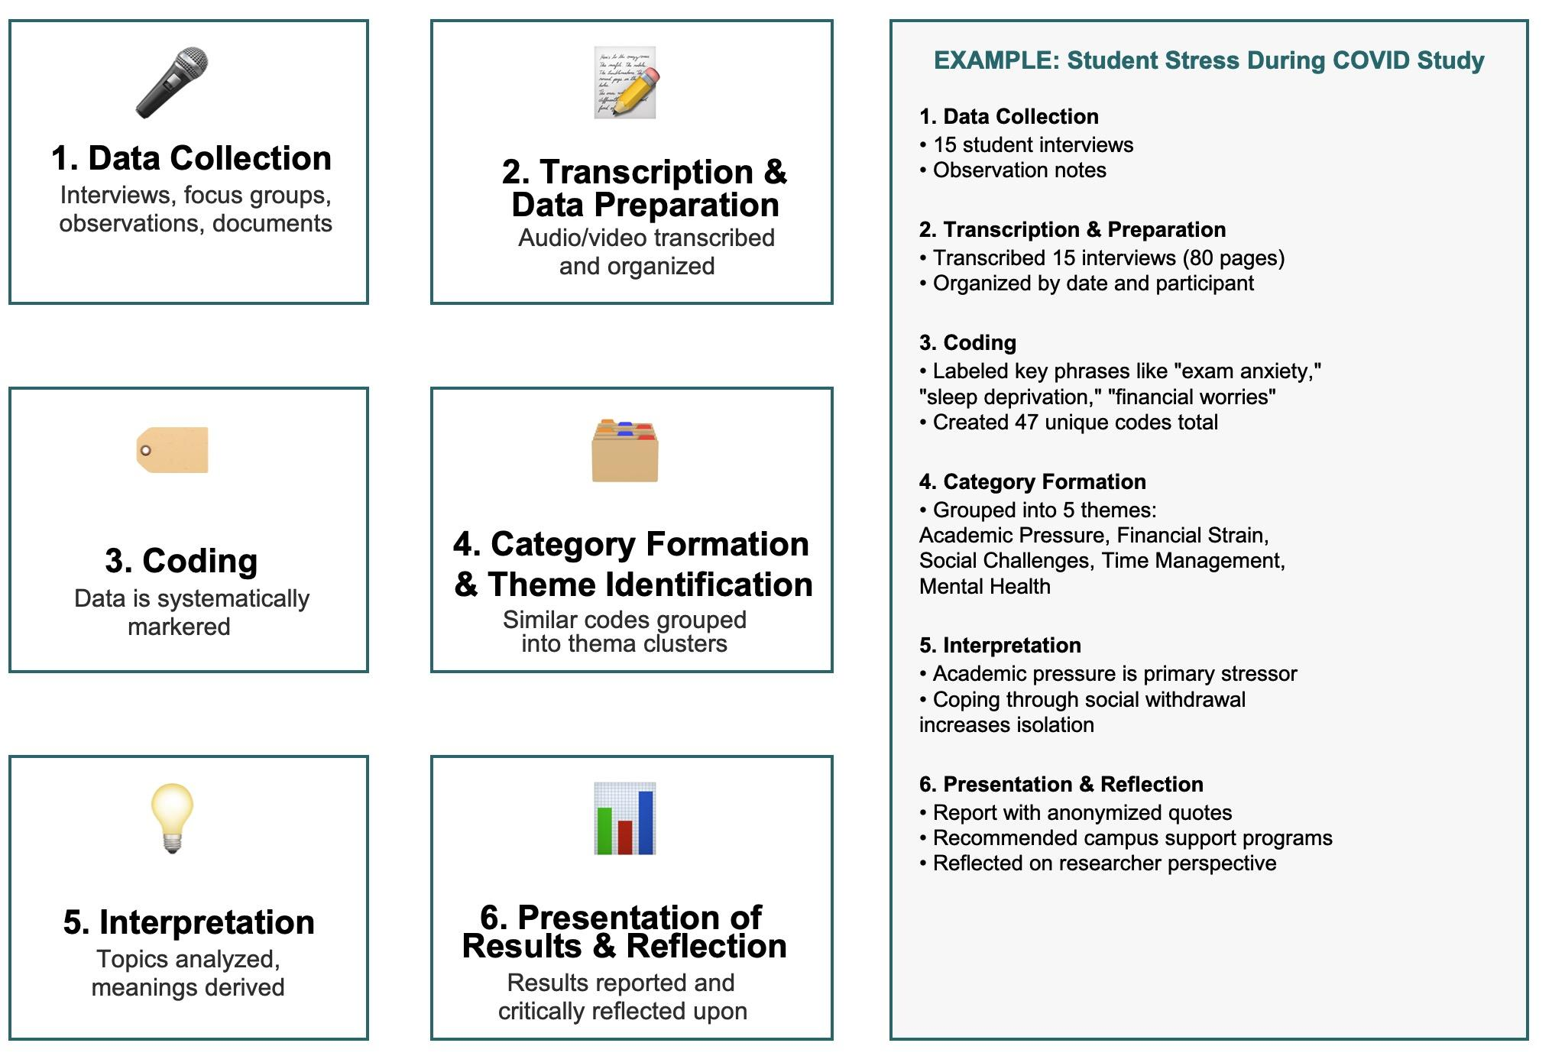
Which parts of qualitative analysis are most amenable to AI help?
Notes:
Kene

Slide 26
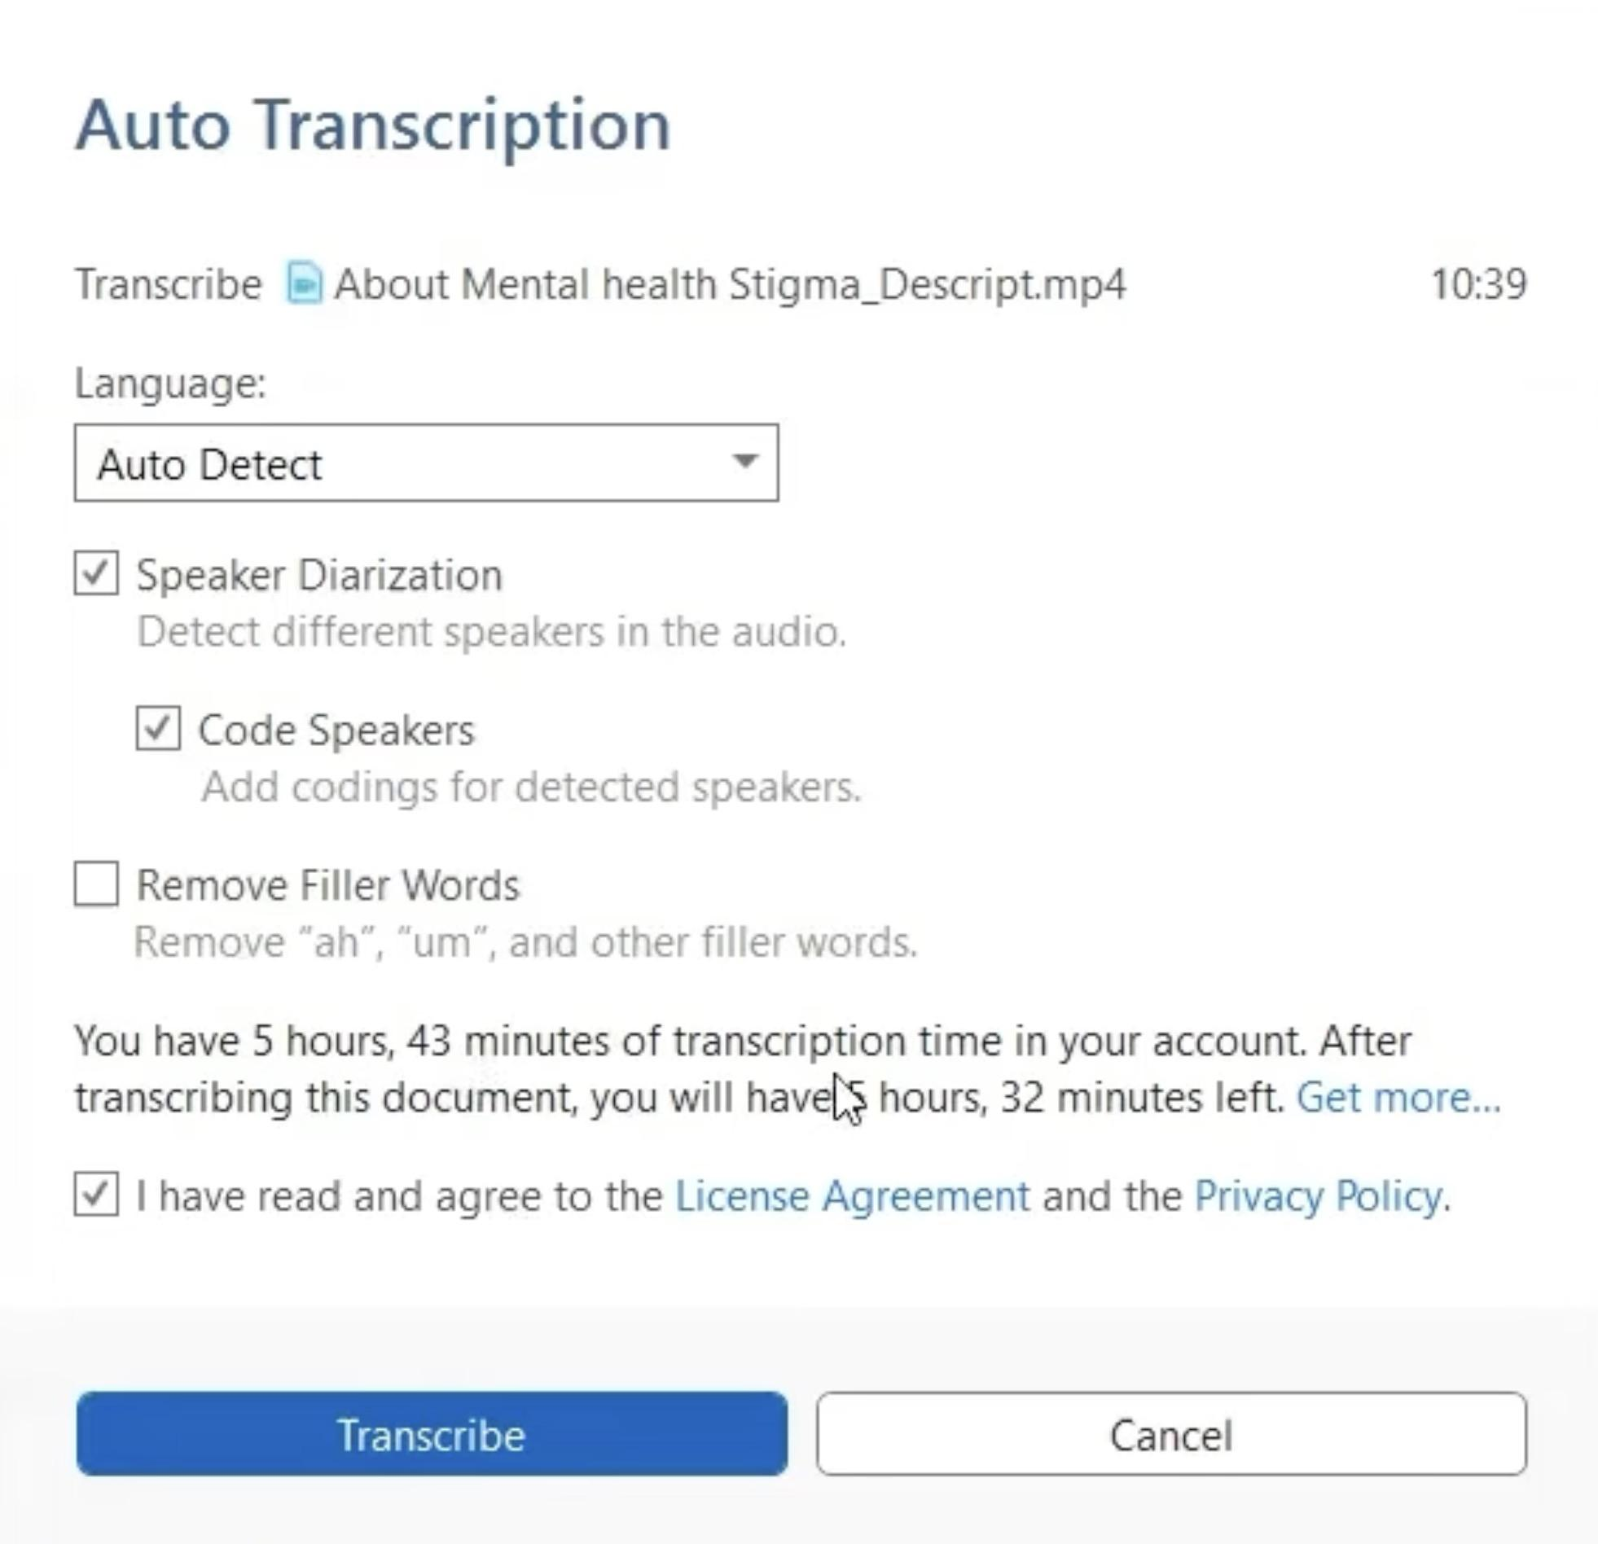
AI Transcription & Translation
Notes:
Kene

Slide 27
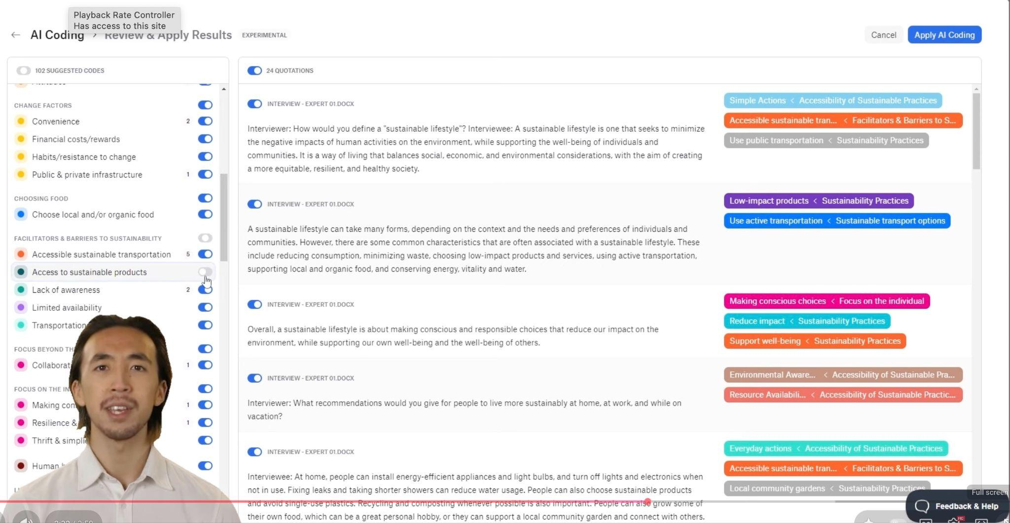
Demo of thematic Coding in Atlas TI
Start at 1:50: https://www.youtube.com/watch?v=QJVC1h2qzv4
Notes:
Kene

Slide 28
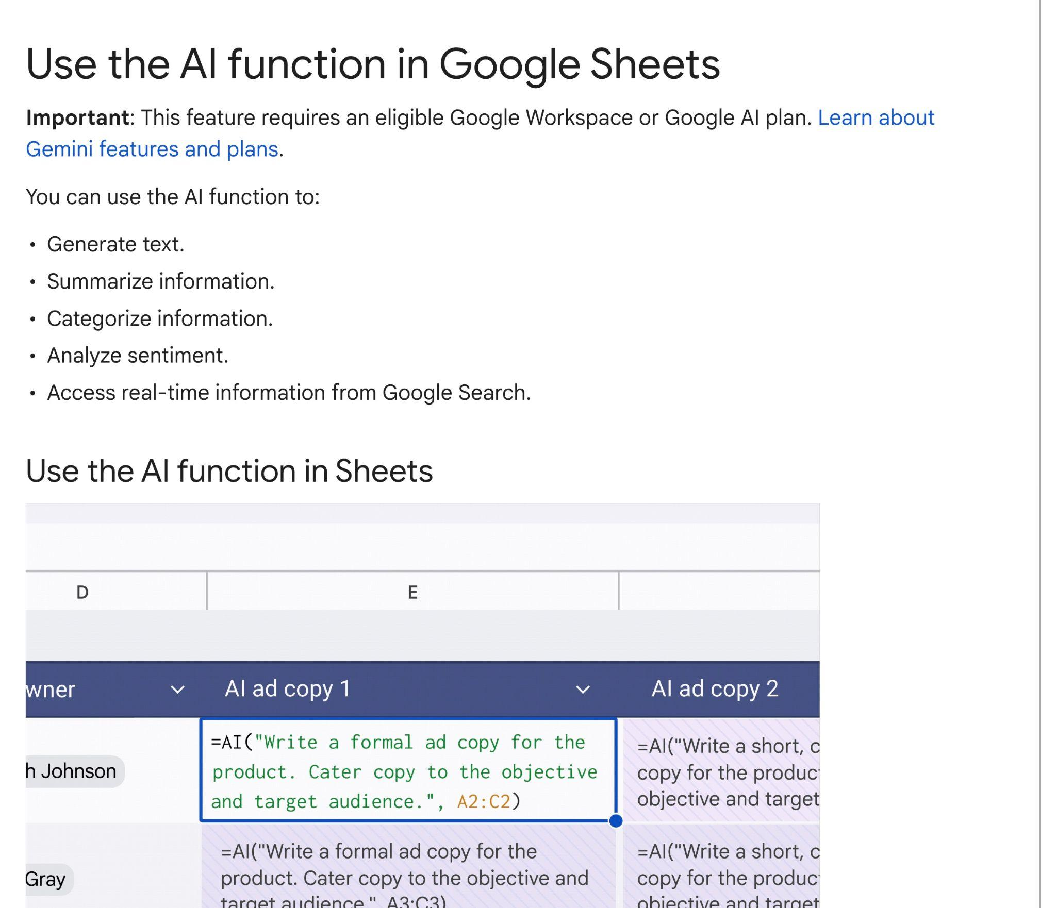
Built in AI function with Google Sheets
Limitations
• Limited control over models
• Opaque pricing and rate limits
Notes:
Sabina

Slide 29
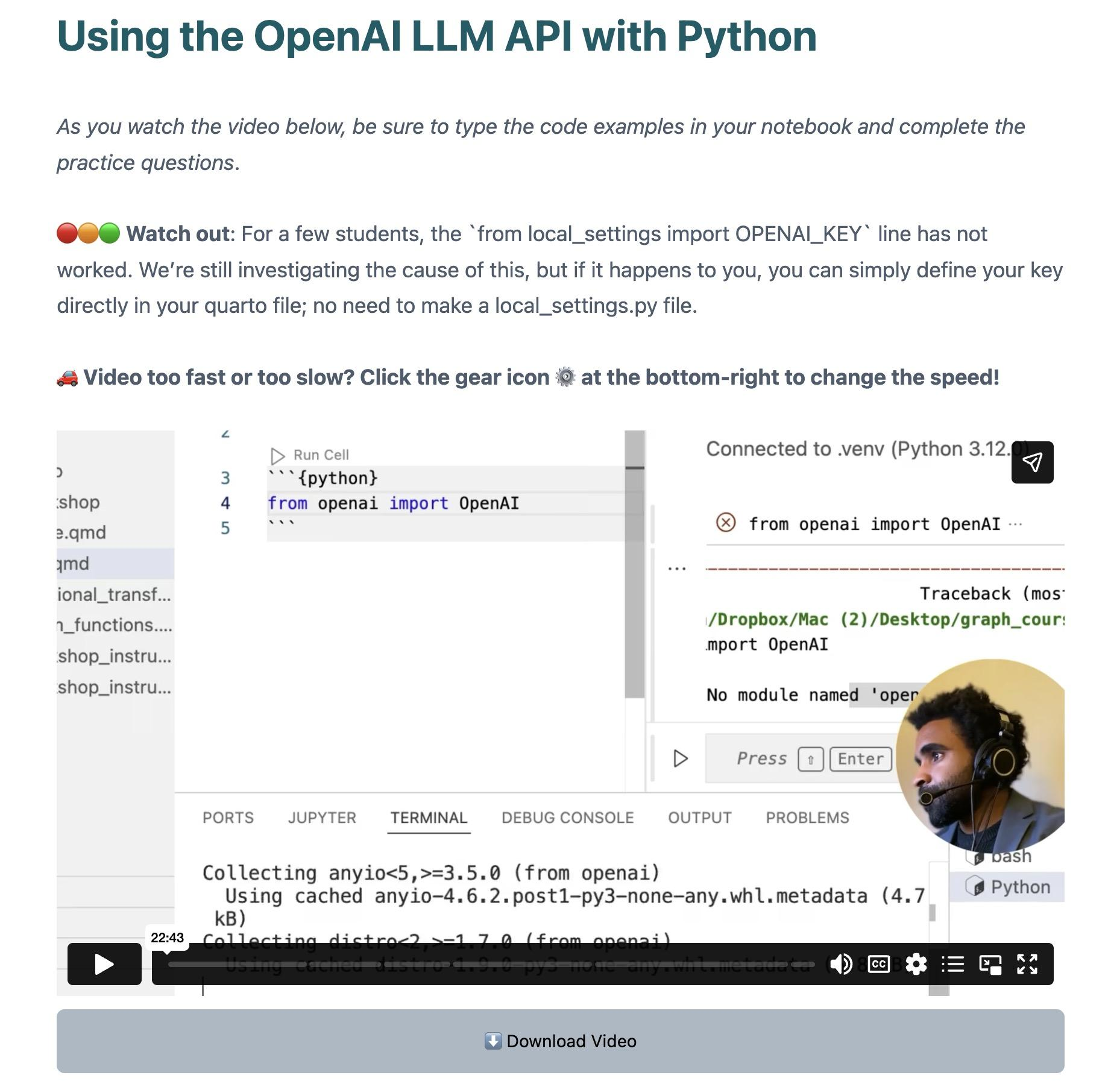
LLM API calls directly with code
• NOTE: Requires you to get your own OpenAI API key
• In R, equivalent workflow can be built with the ellmer library
thegraphcourses.org/courses/ai-llm-automations-with-python/topics/using-the-openai-llm-api-with-python/
Notes:
Sabina

Slide 30
Discussion:
Do you have any ideas from your work, research or personal life for applying LLMs in a loop? (massively parallel LLM calls)
How might you build it?
Notes:
Camille

Slide 31
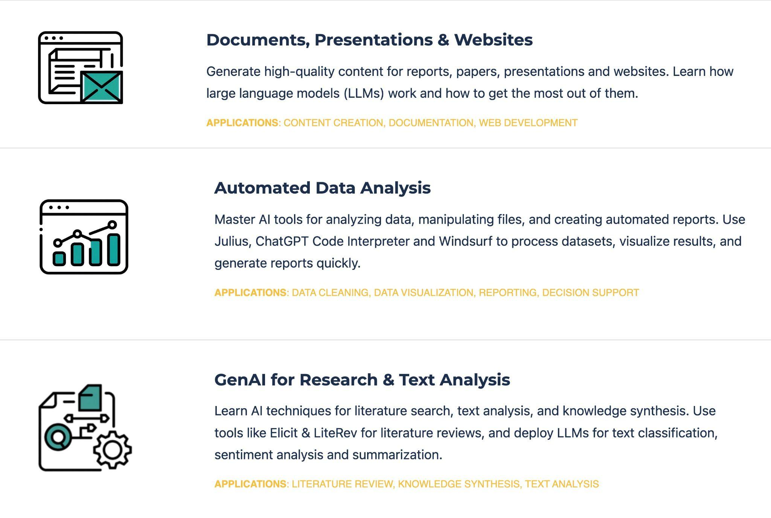
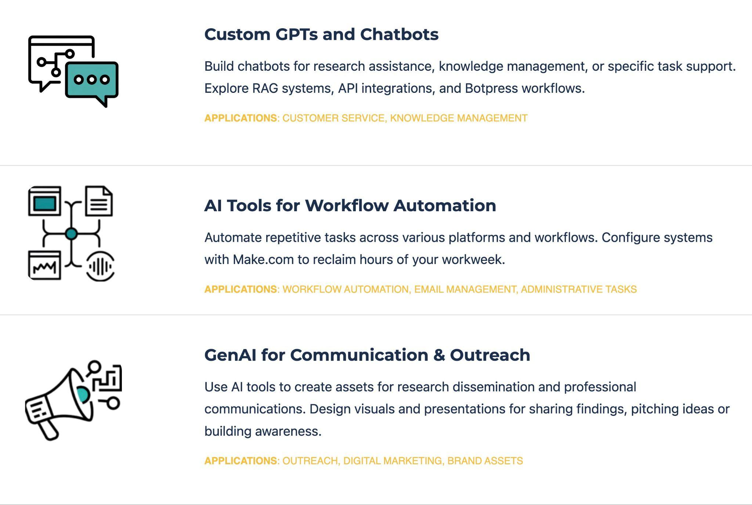
Halfway through core content
Focused on researchers and data analysts
More broadly-directed
Notes:
Sabina

Slide 32
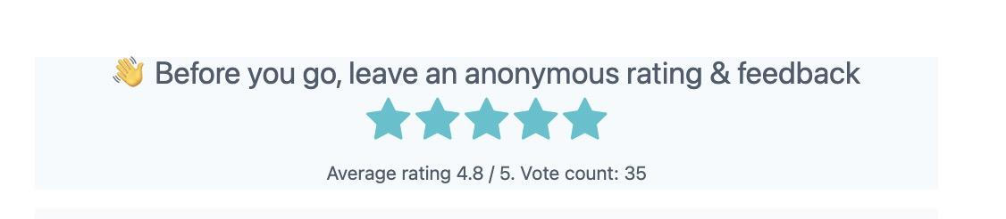
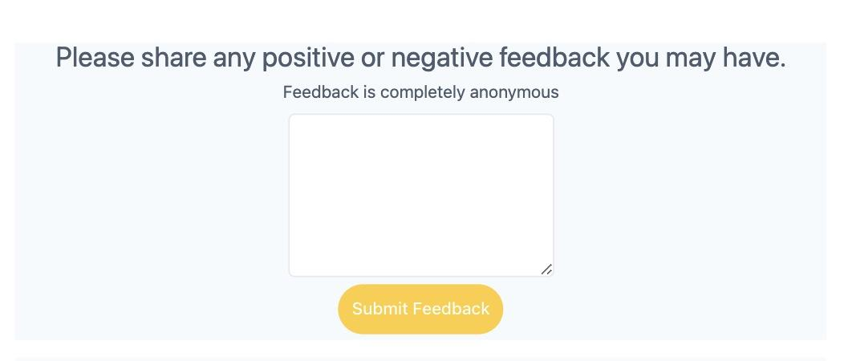
Remember to leave anonymous feedback
Notes:
Camille

Slide 33
THANK YOU SO MUCH!
See you next week :)
Notes:
Camille

