Slide 1
Help Session Note
Welcome to the Help Session
The session runs for one hour before each workshop.
If you have any questions, please do raise your hand or speak up and I will be with you shortly.
Notes:
Camille

Slide 2

Generative AI for Work & Research
We’ll get started in a few minutes
Notes:
Camille

Slide 3
Workshop Schedule
👋🏽 Welcome & Introductions (20 mins)
🗣️ Icebreakers & Class Photo (10 mins)
📝 Course Details (10 mins)
✅ Pop quiz (10 mins)
👩🏽‍💻 Workshop Exercise (45 minutes)
📣 Presentations & Announcements (15 mins)
Notes:
Camille
Welcome and intro: Say hello, we’re excited to have everyone. Introduce TGC people (Kene, Joy, Zachary, Sara, Olivia, etc.), words from Olivia, mission/goals – Joy/Kene/Olivia
Cosmos practice: Update last year’s slides - Joy
Icebreakers: Games/activities: TBD – Joy
Course overview: syllabus (basically walk thru learning journey figure from brochure) – Kene
Course navigation: screen share TGC website, walk through navigating to the course pages, explain new content will be uploaded each week – Joy
Expectations and policies: assessments/grading, attendance policy, code of conduct – Kene
Intro to Discord – Kene
Final announcements: next workshop material, calendar invites, general reminders, etc.

Slide 4
👋🏽 Welcome & Introductions
About The GRAPH Courses

Slide 5
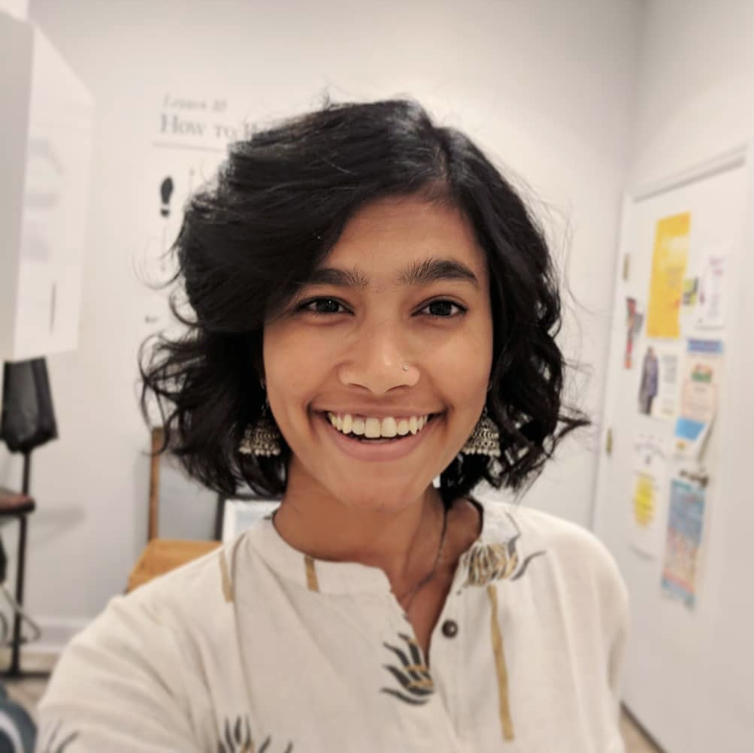

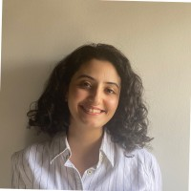
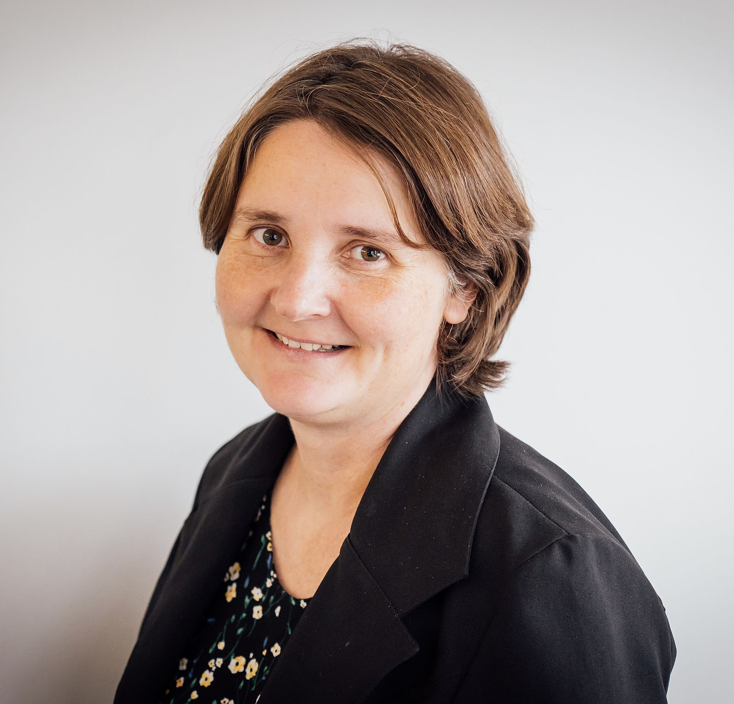


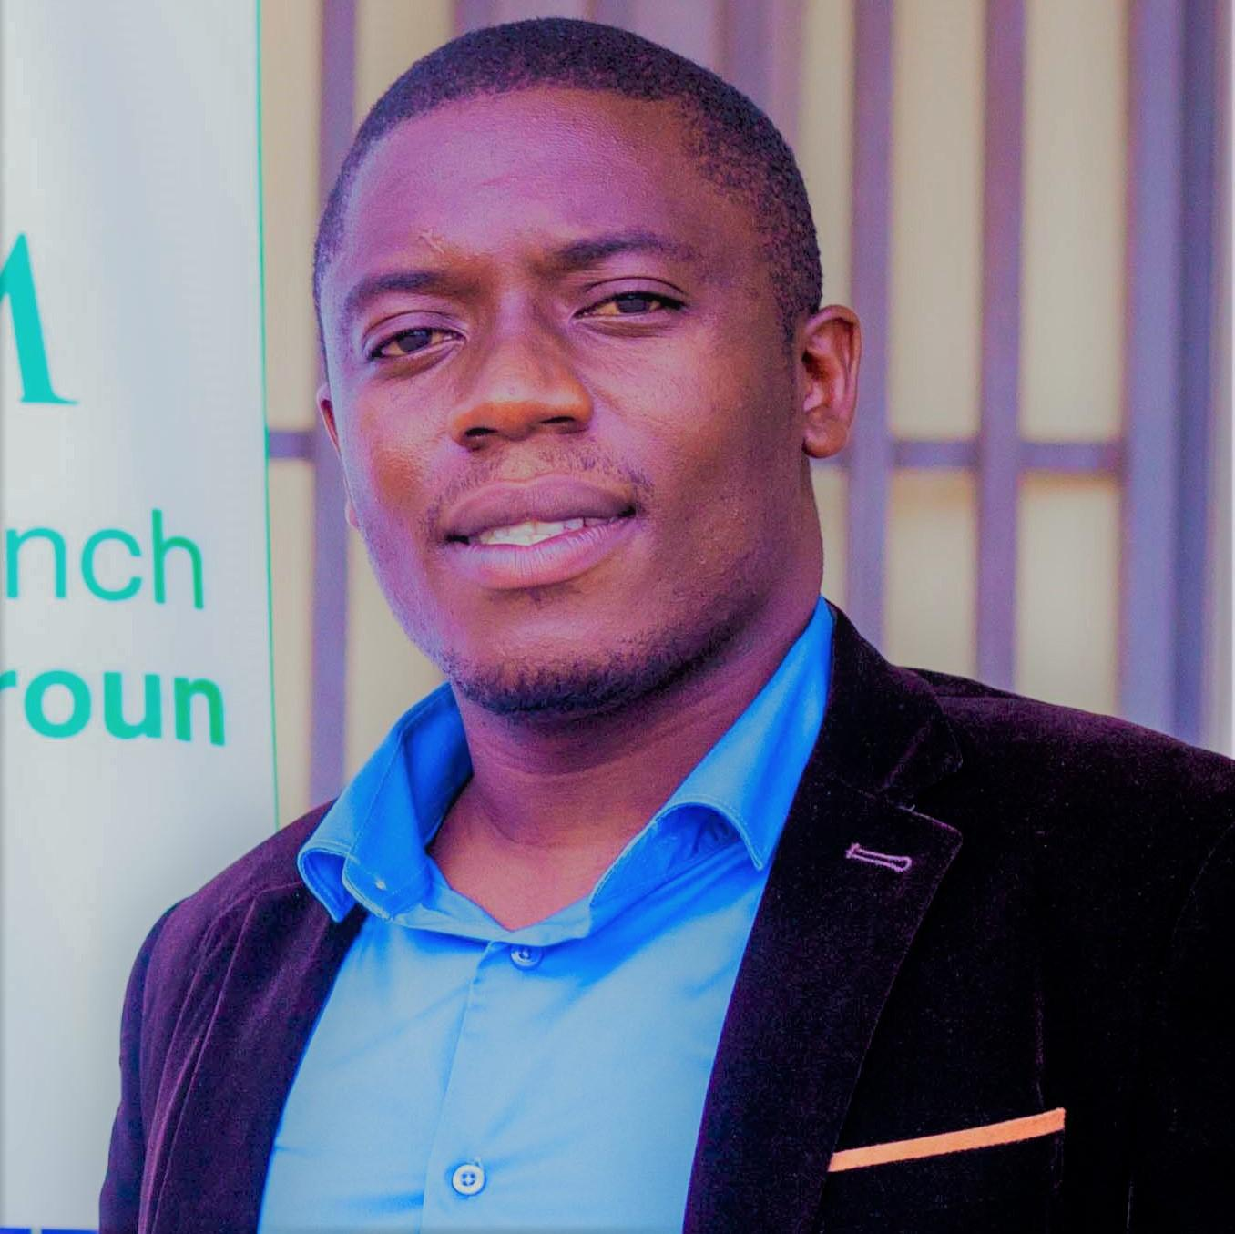

Instructors and Coaches
Joy Vaz
Kene David Nwosu
Imane Bensouda Korachi
Prof. Olivia Keiser
Dr. Amanda Mabhula
Ivan Ogasawara
Dr. Guy Sadeu Wafeu
Santiago Sotelo
Notes:
Camille

Slide 6
The mission of the GRAPH Courses

Slide 7

The mission of the GRAPH Courses

Slide 8
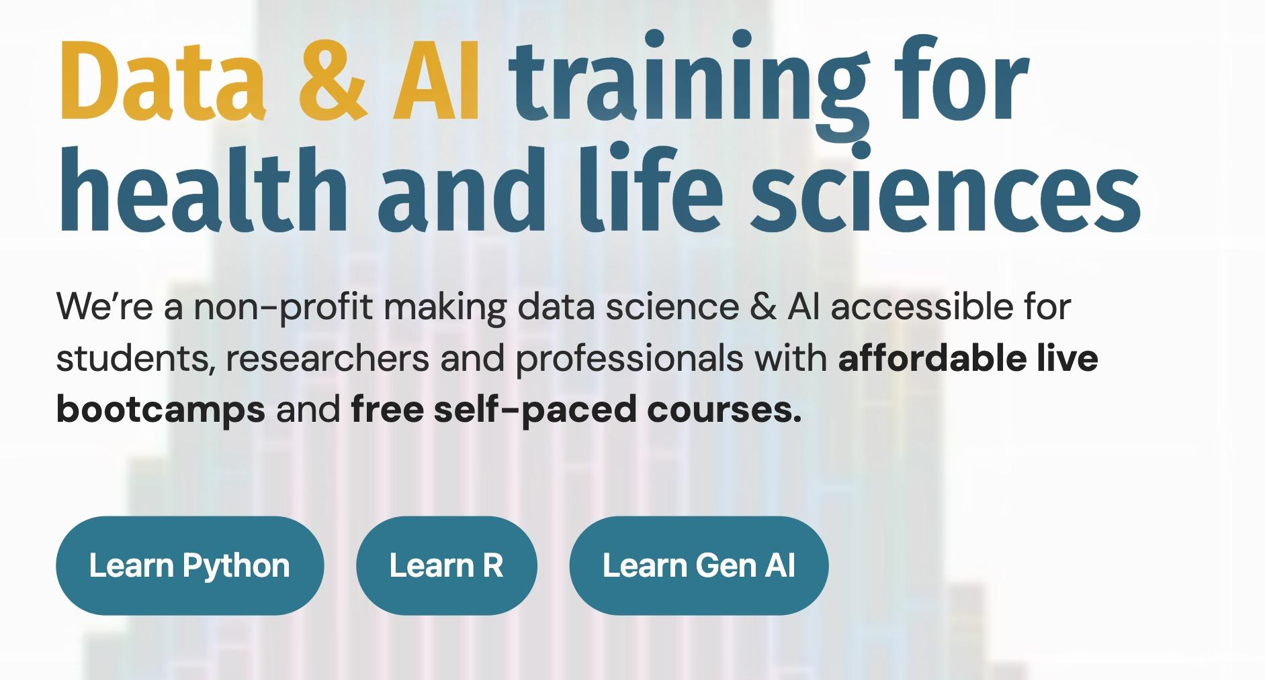
The mission of the GRAPH Courses

Slide 9
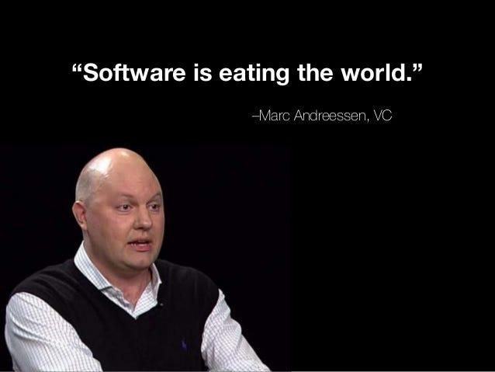
On the horizon: a platform shift as important as the digital computing revolution
Notes:
Kene

Slide 10


What was the digital computing revolution?
News/reporting
Filing
Calculator
Files
Spreadsheet
Clock
Music
13
Banking
Clock
Radio
Docs
Email
Calendar
+ more
Typewriter
Notes:
Kene

Slide 11
Now: AI is eating software
🧑
YOU
🤖
AI AGENTS
🤖
</>
FILES
Files
Data
Docs
Design
Comms
Code
Notes:
Kene

Slide 12

The implication
For many tasks that can be done through a computer
(a large fraction of knowledge work)
Research
Data analysis
Coding
Design
Workflows
Presentations
your effectiveness will be largely determined by how well you understand and can safely manage these AI agents
Notes:
Kene

Slide 13
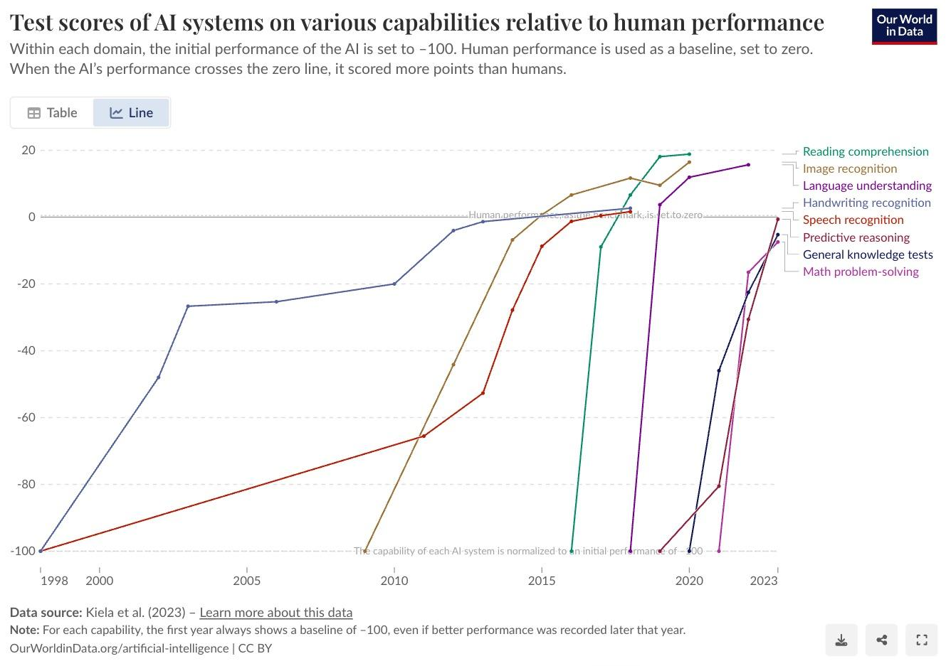
AI is reaching human-level performance across many tasks
Why?
They are trained on the
entire internet of data.
Any task that can be represented
in text or data is being learned.
And they have advantages:
Tireless and persistent
Hyper-optimizable
Orders of magnitude faster on many tasks
Very scalable
Notes:
Kene

Slide 14
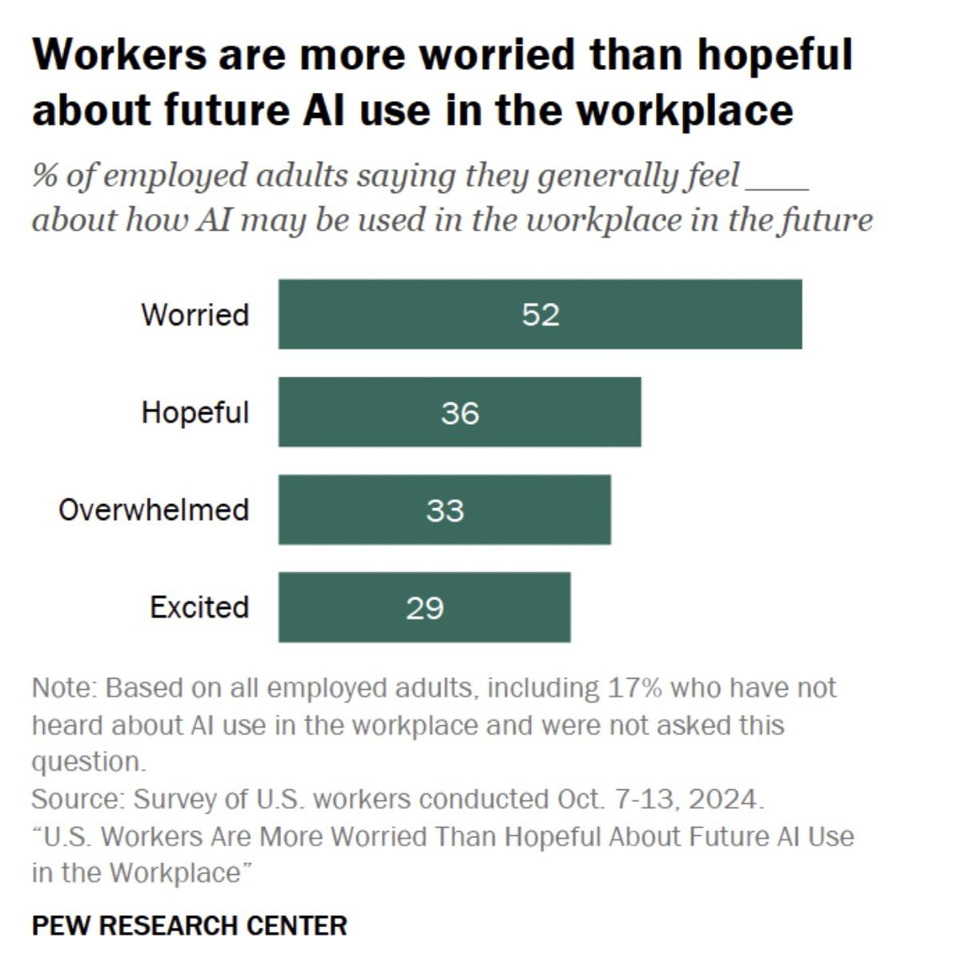
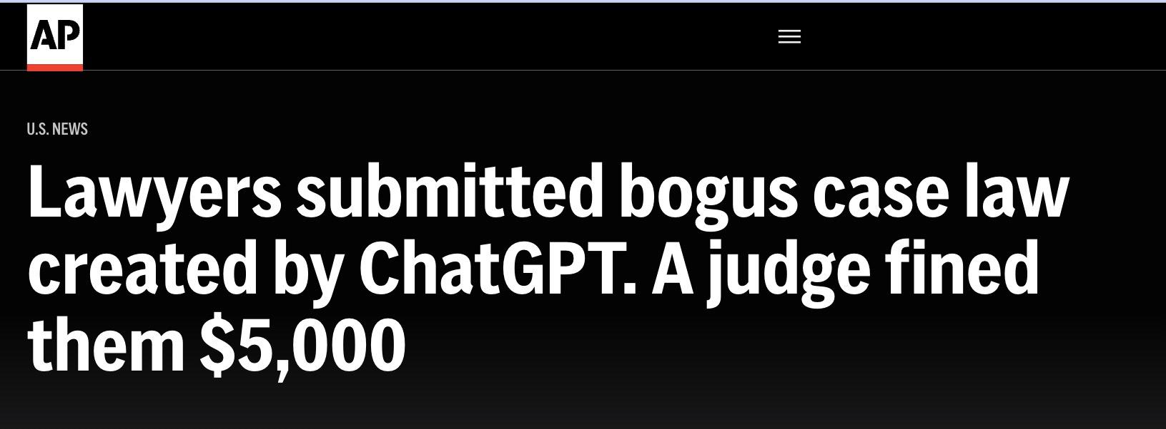
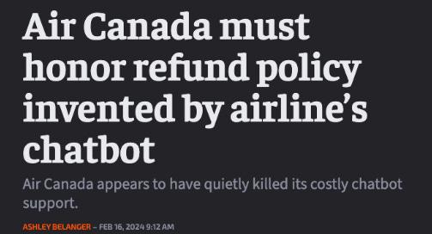
Fear and lack of literacy about these tools
Notes:
Kene

Slide 15
Course Goals
🧠 AI Literacy: Base understanding of the underlying technology–avoid gaffes
🛠️ Essential Toolbox: Show you a range of useful tools and practices:
Websites, documents & presentations
Automated data analytics
Deep research and text analysis
Custom GPTs and chatbots
Workflow automations
GenAI for graphics, designs & images
🤝 Collaborative Brainstorming: Explore, test, and refine use-cases together; we’re all still learning.
Notes:
Kene

Slide 16
Now you know about us, time to get to know your colleagues!
Notes:
Camille

Slide 17
🗣️ Icebreakers (10 mins)
Join a breakout room (~3 per room)
Introduce yourselves
  Name
  Background
  Why you are here
We will reset the rooms in 2-3 mins
Notes:
Camille

Slide 18
✨ Cohort Class Photo✨
📸
Please turn on your video!
(This will be shared on LinkedIn. To opt out, send us a quick message or email)
Notes:
Camille

Slide 19
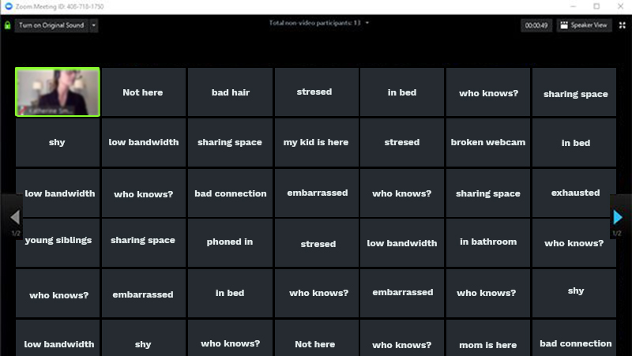
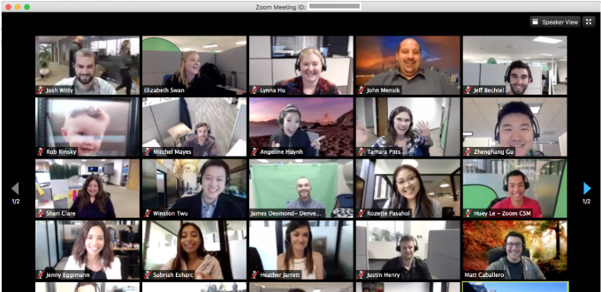
We recommend keeping your video on in the future, if possible
😢
😊
No need to be worried about a bad hair day:
- Recordings are only for students of the course, not public
- In the breakout rooms, nothing is recorded
Notes:
Camille

Slide 20
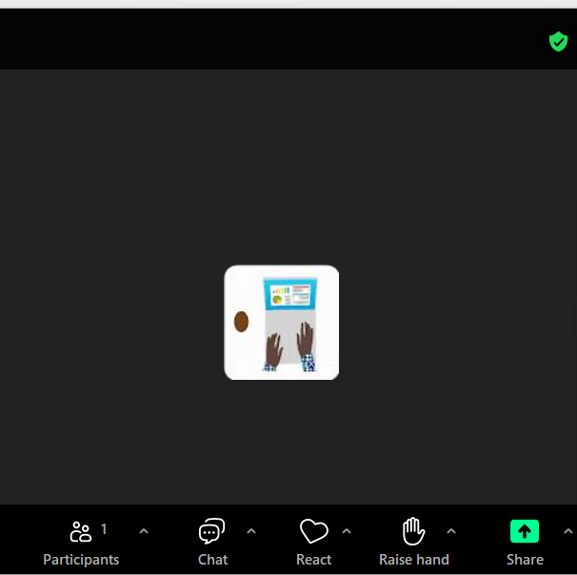
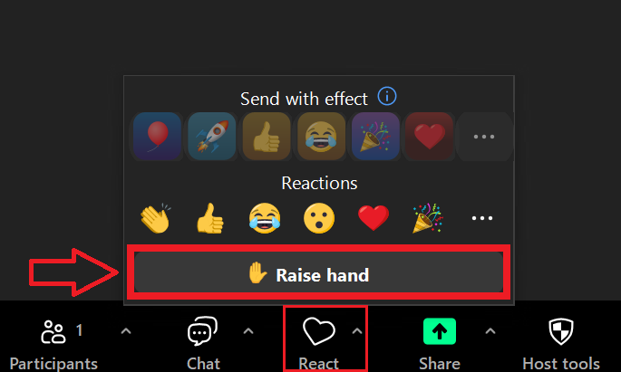
Use the raise hand button to get instructor attention
Two ways it might show up for you:

Slide 21
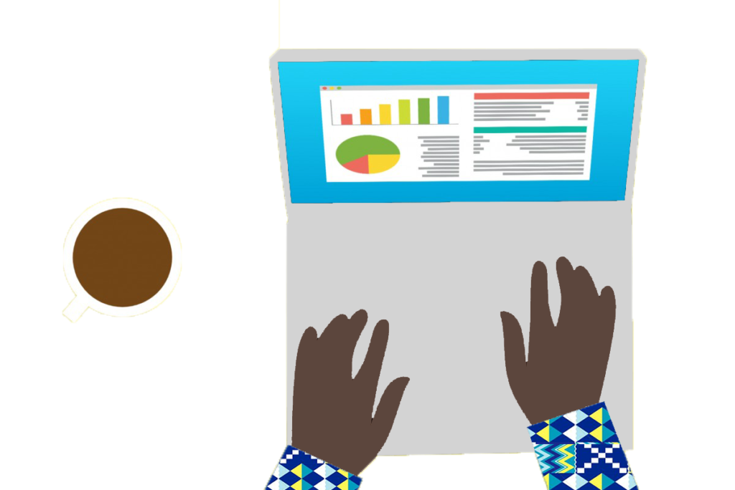
Course Details
Notes:
Sabina

Slide 22
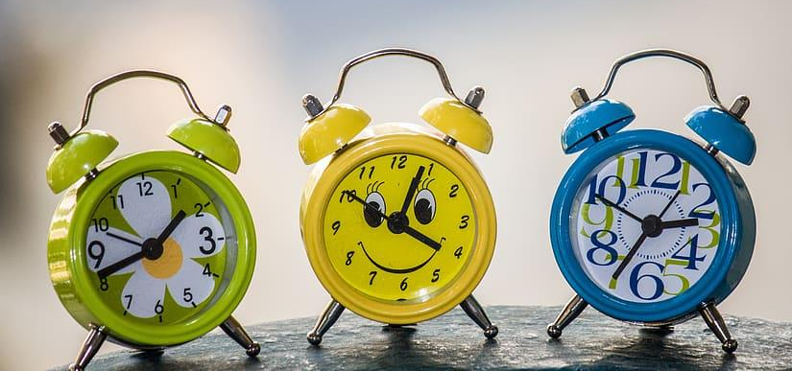

Class Time and Help Sessions
Workshops Sundays 17h00 GMT or Wednesday 15h00 GMT
Help Sessions: One hour before each workshop
Notes:
Sabina

Slide 23



Bootcamp Teaching: “Flipped classroom"
~2 hours of self-paced learning
Video tutorials
~2 hours of classroom time + ~2 hours of wrap-up time
+ Weekly whole-class workshop & group projects
+ Weekly office hours/help sessions

Slide 24
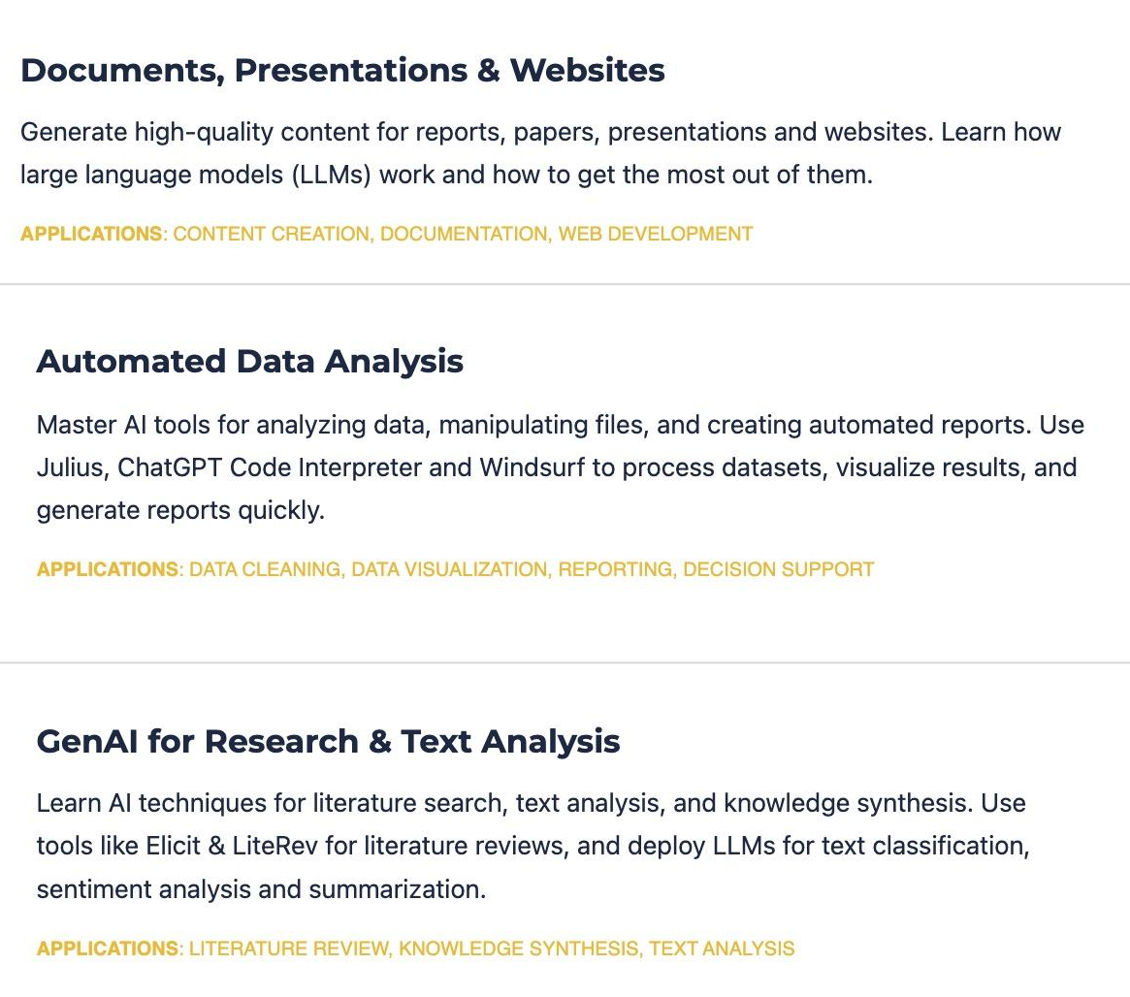
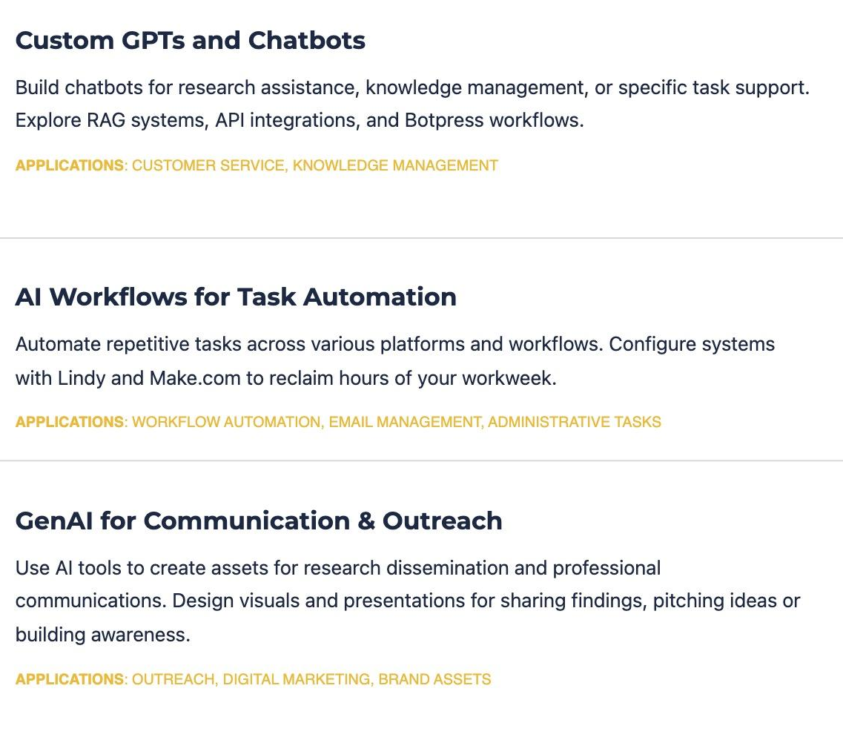
Course Content
Notes:
Sabina

Slide 25
Grading
The final grade will be a combination of:
Graded assignments from the workshop (50%)
Workshop attendance and participation (10%)
Final project (40%)
Attendance policy:
Attend at least 5 workshops to receive full attendance credit
  Passing grade: 80%
Notes:
Sabina

Slide 26
Any questions?

Slide 27
Pop Quiz
Notes:
https://dashboard.blooket.com/set/6a00ad769083ef3e368534bc

Slide 28
Workshop Intro
Notes:
Sabina

Slide 29
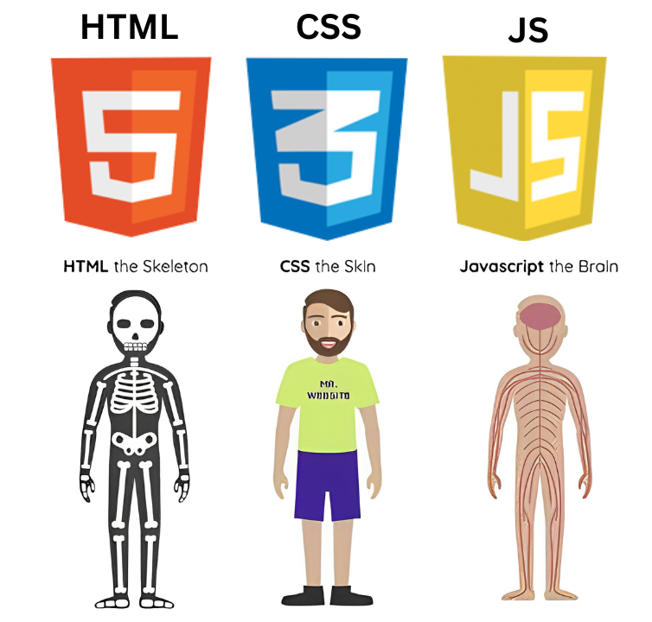
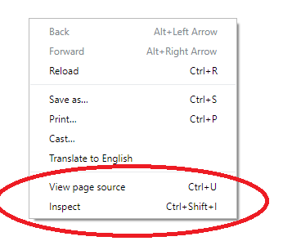
The languages of the web: Why LLMs are extremely good at web design
Notes:
Sabina

Slide 30
Live Demo of Workshop Tasks
Note that I will move fairly quickly in my demo
The goal is to get quick visual sense of the tasks (and a recording you can refer back to)
For detailed steps, see instructions on course page

Slide 31
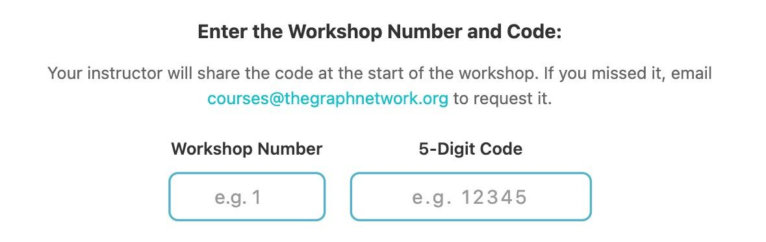
Workshop Unlock Code
During each workshop, the instructor will give you a numerical code needed to unlock that week’s workshop. If you miss workshop, please email courses@thegraphnetwork.org
Today’s code is….
Notes:
Sabina

Slide 32


EXERCISE TIME
✨ Breakout Rooms!✨
Introduce yourselves before you start
Notes:
Camille

Slide 33

✨Questions & Presentations✨
Notes:
Camille

Slide 34

Custom domains for GitHub
gbengasaolu.github.io/graph_courses_aiw/
genaiforhealth.co.uk
https://www.youtube.com/watch?v=e5AwNU3Y2es
Notes:
Camille

Slide 35
Websites vs web apps
Quiz: Website or App?
Portfolio showcasing some of your work (what we just built)
Lab's publications and team bios page
Online hub to connect researchers
Online report on malaria trends in a country
Survey data collection tool for a clinical study
Simple Website | Web App
Mostly static content (everyone sees the same thing) | User-specificity and personalization
No login or user interaction. | Login and accounts
Front-end site only | Requires “back-end” database
Minimal security concerns | Security a major concern
AI tools today can auto-build easily | Still need some development experience
Notes:
Sabina

Slide 36
Websites vs web apps
Quiz: Website or App?
Portfolio showcasing some of your work (what we just built) SITE
Lab's publications and team bios page SITE
Online hub to connect researchers APP
Online report on malaria trends in a country SITE
Survey data collection tool for a clinical study APP
Simple Website | Web App
Mostly static content (everyone sees the same thing) | User-specificity and personalization
No login or user interaction. | Login and accounts
Front-end site only | Requires “back-end” database
Minimal security concerns | Security a major concern
AI tools today can auto-build easily | Still need some development experience
Notes:
Sabina

Slide 37
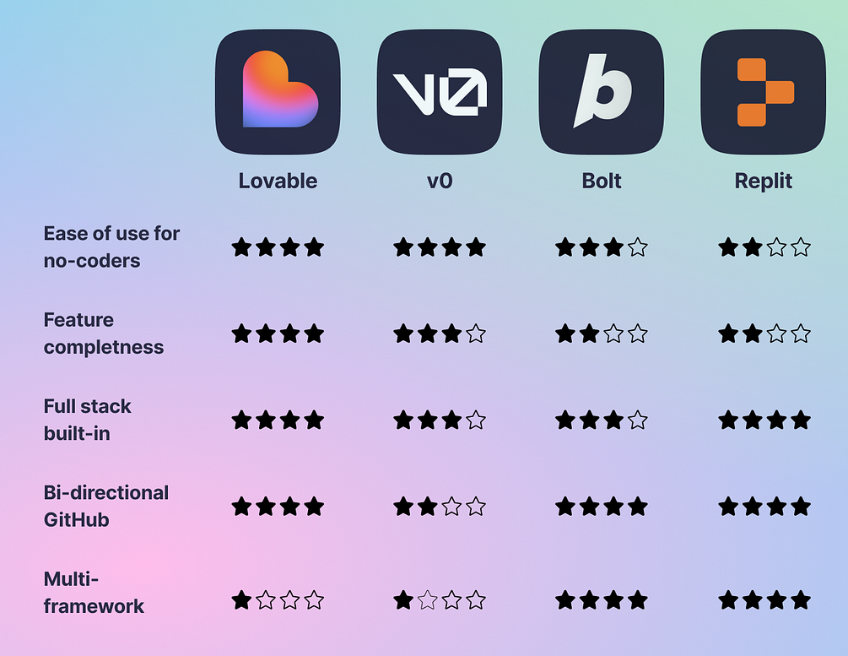
However…improvement is rapid
Below are some AI tools that can already build you a decent MVP web app
Very limited free plans though
If sufficient time, suggestion from the class on a web app idea to try to build
Notes:
Sabina

Slide 38
Moving on to another document format:
Presentations
Notes:
https://create.kahoot.it/share/mastering-large-language-models-myths-risks-and-best-practices/ab24f873-62fe-4a30-87be-dd75c28dbd0d

Slide 39
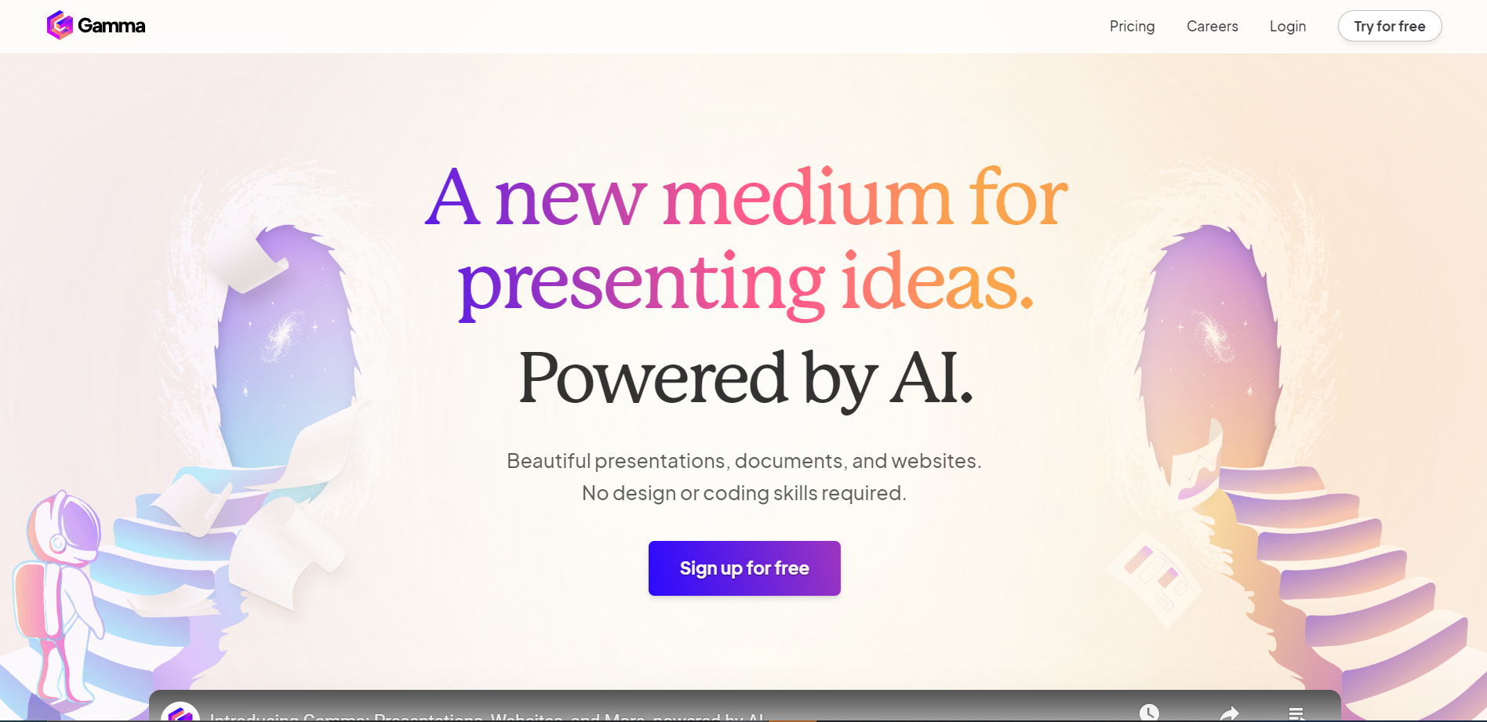
The best AI tool for presentations
Full tutorial (external resource): https://www.youtube.com/watch?v=VgH5wWVy_64
Notes:
Sabina

Slide 40
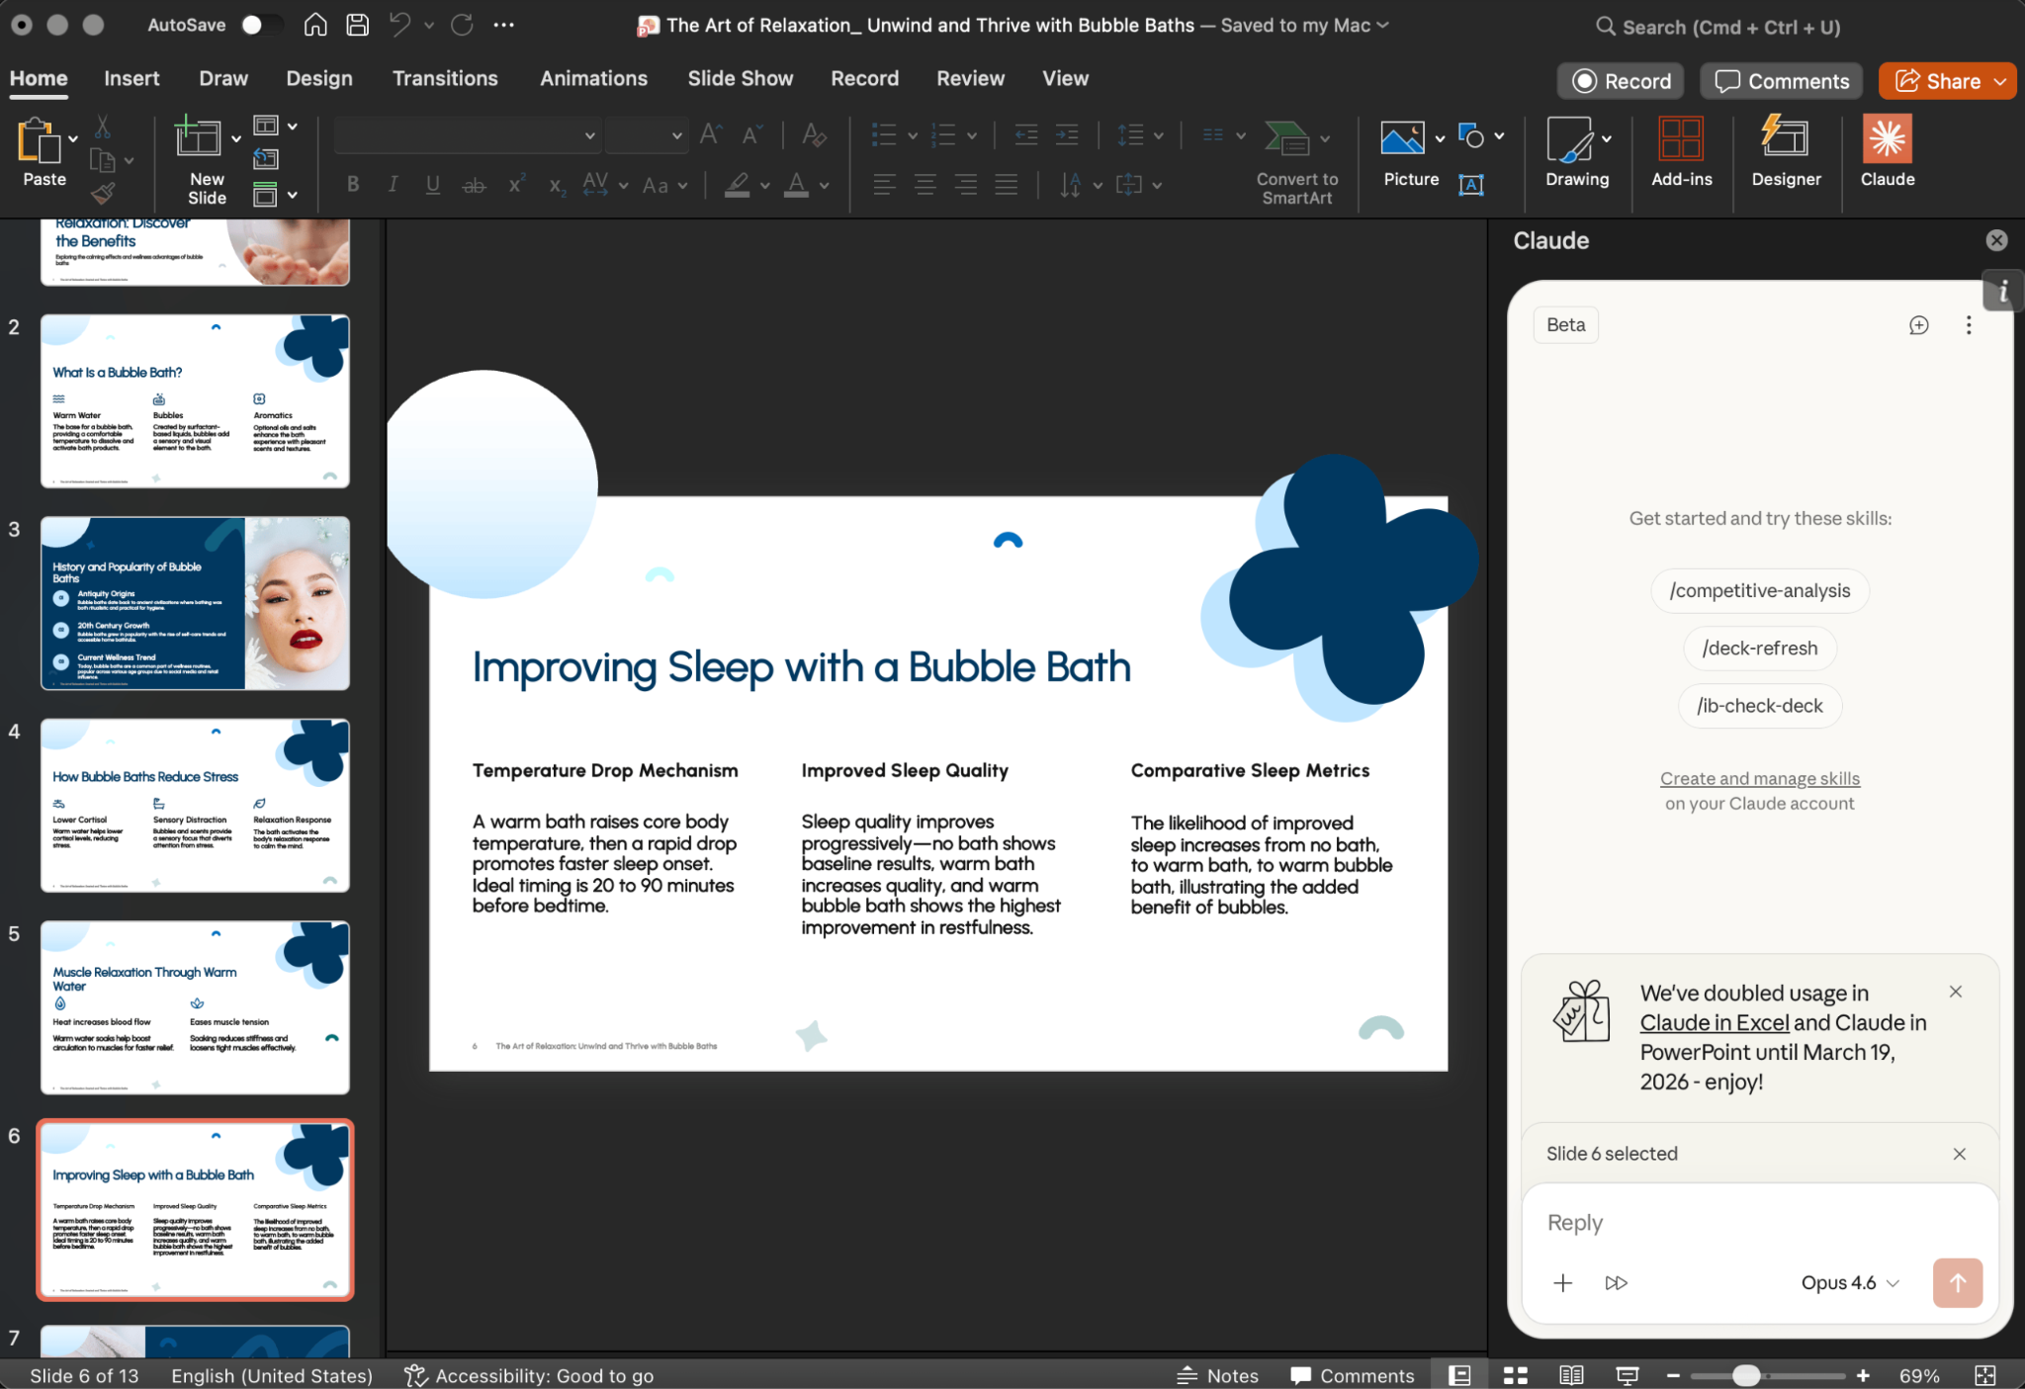
Young but with potential: Claude for powerpoint
Native powerpoint, but slower and expensive.
Full tutorial (external resource): https://www.youtube.com/watch?v=uLJp_4XCNIg
Notes:
Sabina

Slide 41
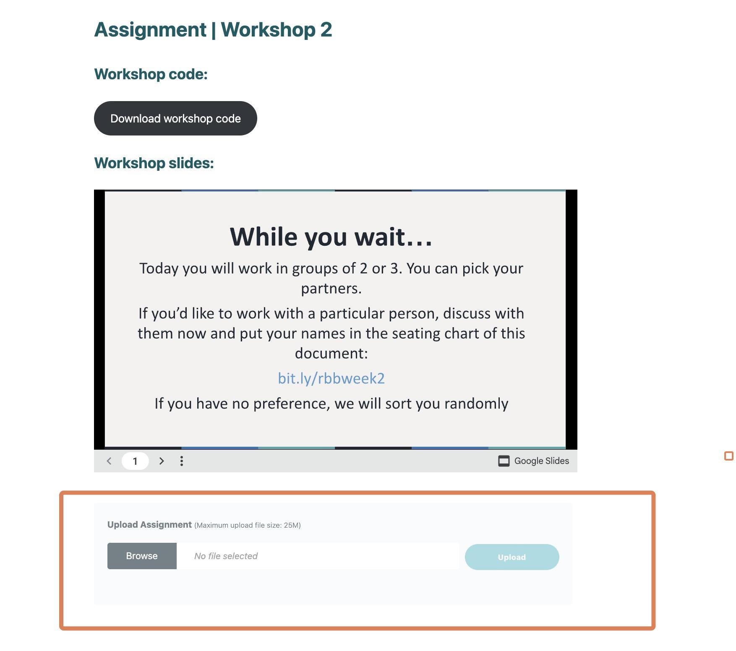
Submitting
Instructor will demo the submission protocol on the website
Notes:
Camille

Slide 42
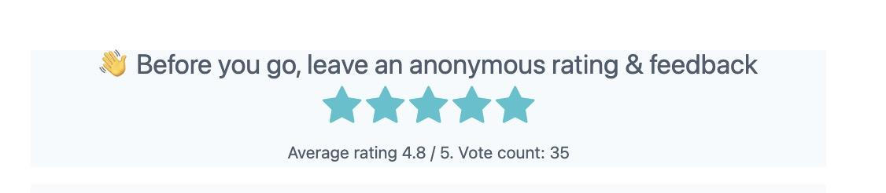

Remember to leave anonymous feedback
Notes:
Camille

Slide 43
Return to check on websites
Notes:
Camille

Slide 44
THANK YOU SO MUCH!
See you next week :)
Notes:
Camille

