Slide 1

Generative AI for Work & Research
We’ll get started in a few minutes
Notes:
Camille

Slide 2
Workshop Schedule
👋🏽 Welcome (10 mins)
🙋‍♂️ Pop Quiz (Not graded) (10 mins)
📝 Workshop Demo (20 mins)
👩🏽‍💻 Workshop 1 Exercise (50 minutes)
📣 Presentations (10 mins)
👨🏻‍🏫 Reflection & Additional Tool Demonstrations (20 mins)
Notes:
Camille
Welcome and intro: Say hello, we’re excited to have everyone. Introduce TGC people (Kene, Joy, Zachary, Sara, Olivia, etc.), words from Olivia, mission/goals – Joy/Kene/Olivia
Cosmos practice: Update last year’s slides - Joy
Icebreakers: Games/activities: TBD – Joy
Course overview: syllabus (basically walk thru learning journey figure from brochure) – Kene
Course navigation: screen share TGC website, walk through navigating to the course pages, explain new content will be uploaded each week – Joy
Expectations and policies: assessments/grading, attendance policy, code of conduct – Kene
Intro to Discord – Kene
Final announcements: next workshop material, calendar invites, general reminders, etc.

Slide 3

Welcome, Announcements
Notes:
Sabina

Slide 4
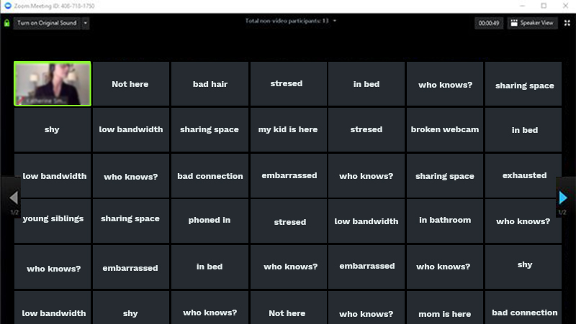
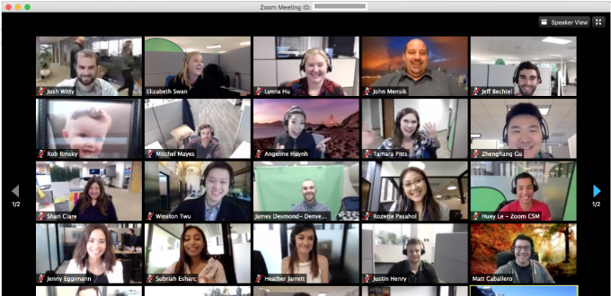
We recommend keeping your video on in the future, if possible
😢
😊
Notes:
Camille

Slide 5
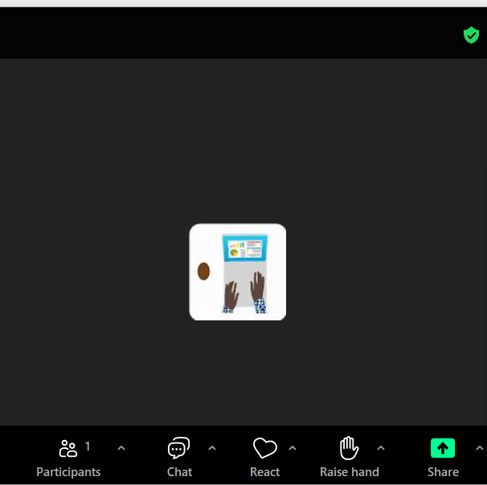
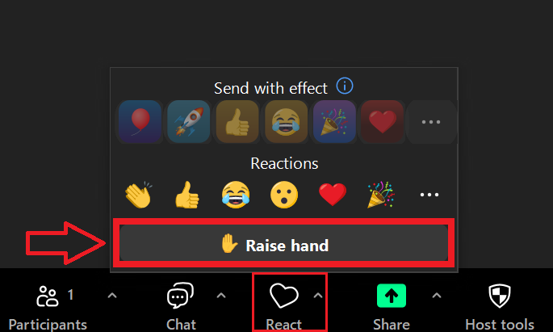
Use the raise hand button to get instructor attention
Two ways it might show up for you:

Slide 6
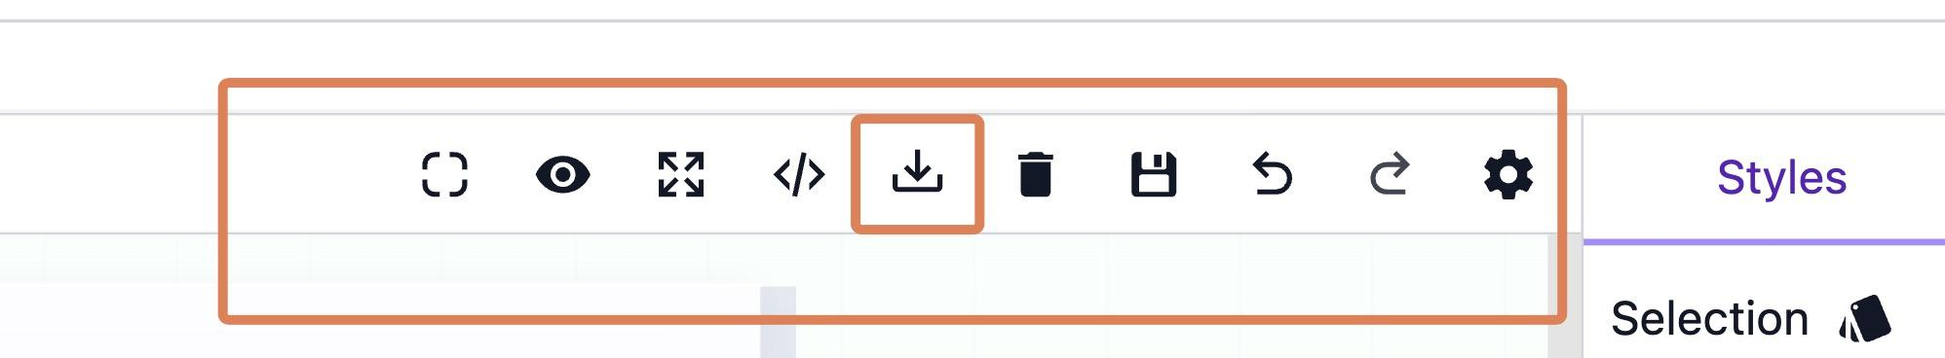
GrapesJS. A free GUI for editing your HTML code 🎉
app.grapesjs.com/playground
• To import, click import icon and paste in the code from your index.html file
• Then make your changes using the GUI
• To export, click the import icon again and copy out your code
NOTE:
• Only works for static websites. Highly interactive websites or apps will break if edited in this way. Still need to learn code!
• May also break complex UIs or interfaces. YMMV!
Notes:
Sabina

Slide 7
Pop Quiz
Notes:
https://dashboard.blooket.com/set/6a09f3cd753b45cd2933e6ce

Slide 8
Workshop Intro
Notes:
Sabina

Slide 9
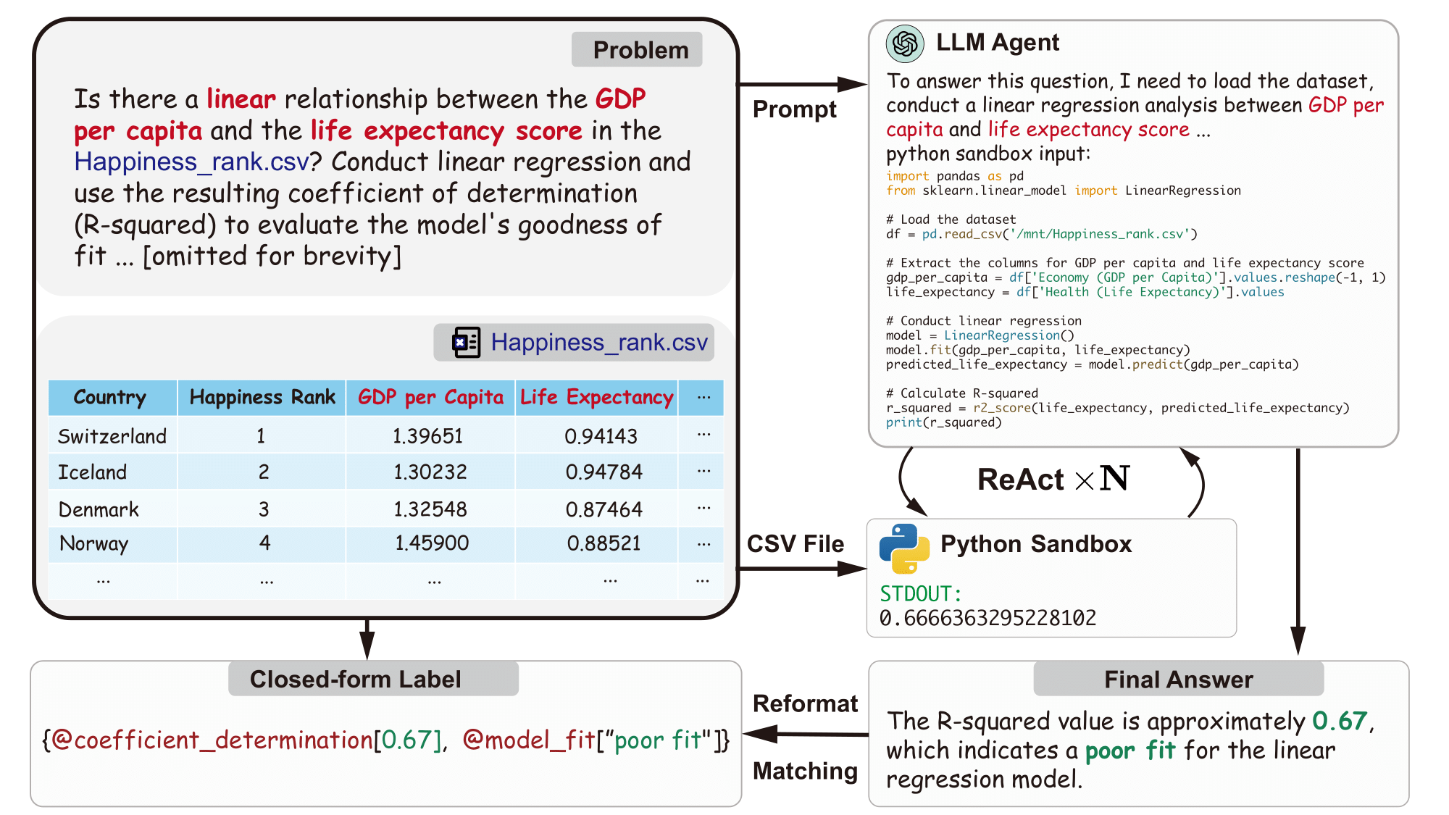
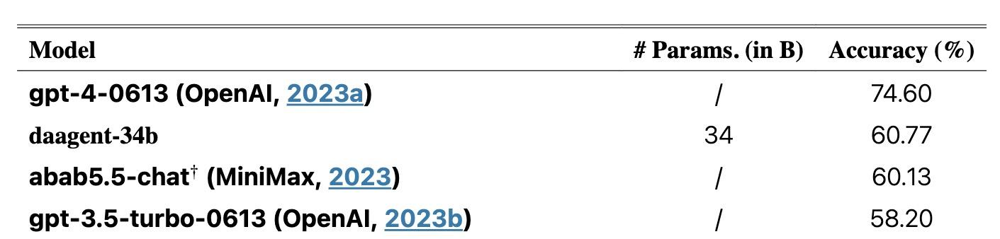
LLMs are getting very good at coding and data analysis
Notes:
Kene

Slide 10
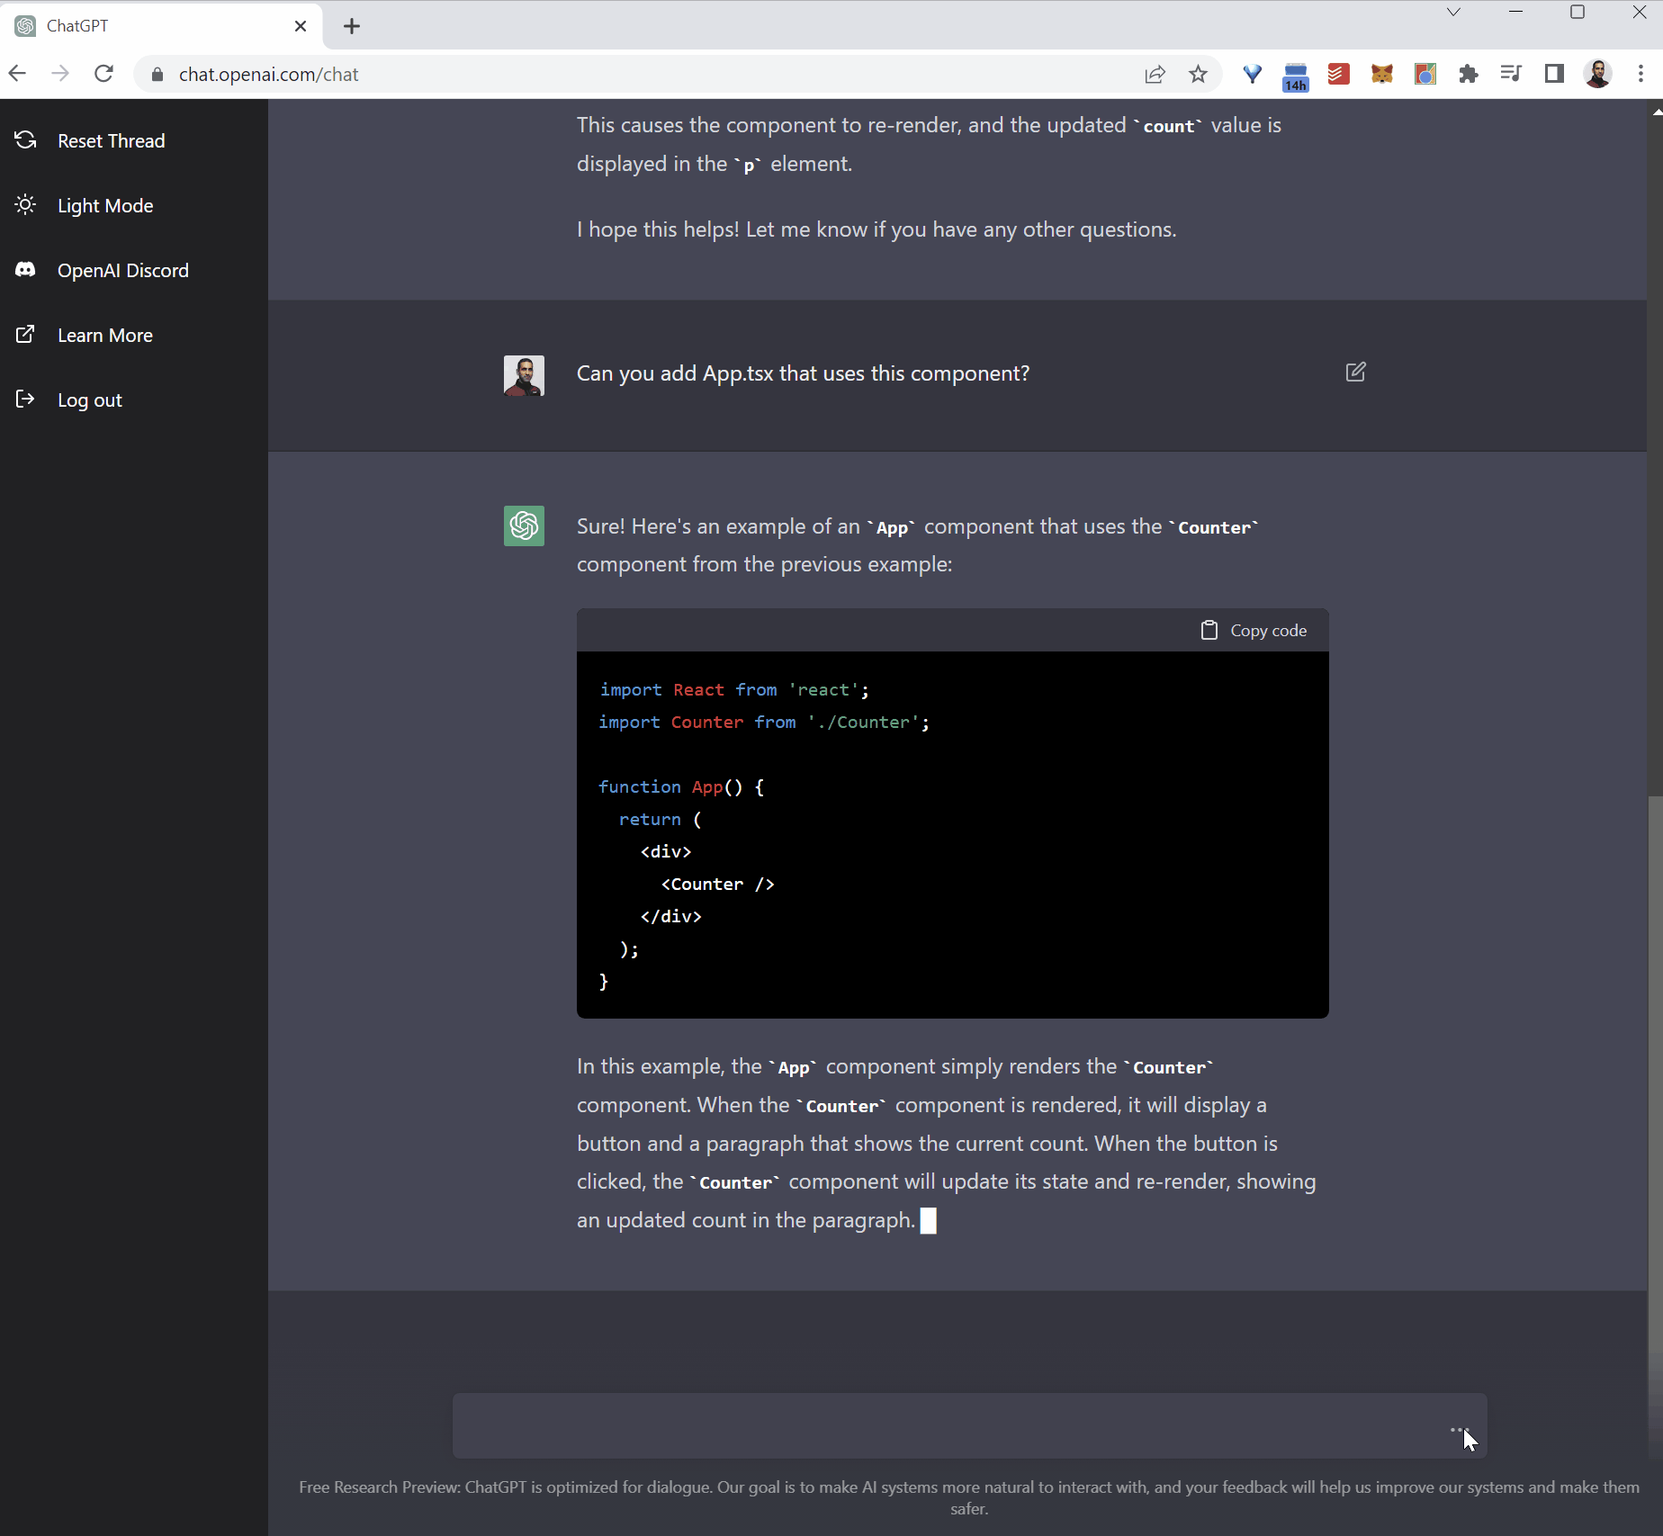
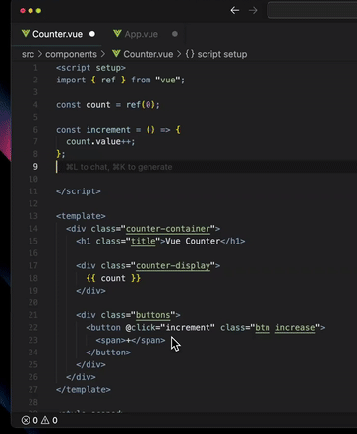
Some ways LLMs help with data analysis
Problems with pure chat for LLM help
Model can’t see your data or run code
No feedback loop → no learning from mistakes
Suggestions often don’t work or are off-base
Autocomplete
Copy-paste chat

Slide 11
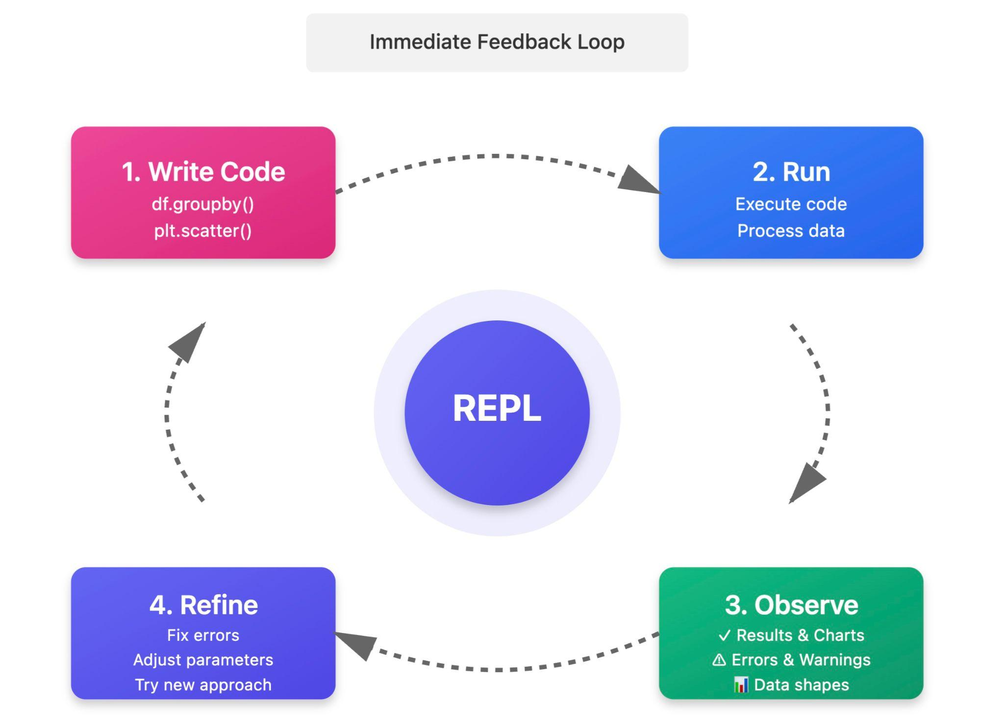
Stronger use case: data agents with a REPL loop

Slide 12
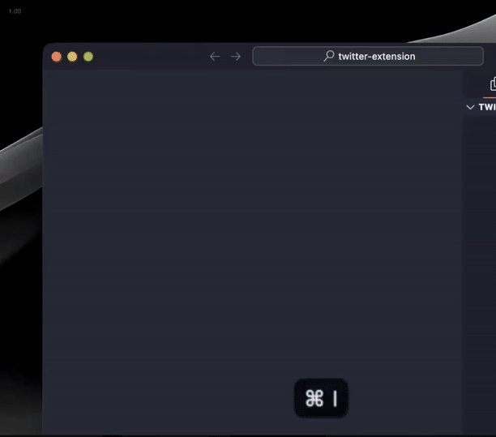
A range of modalities
Autocomplete
Chat
Coding agent

Slide 13
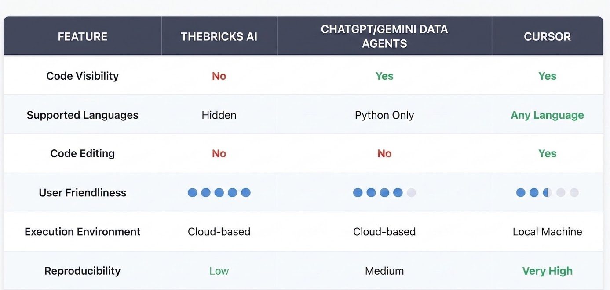
Data agents we’ll review today
Notes:
Kene

Slide 14
Live demo of workshop
Note that I will move fairly quickly in my demo
The goal is to get quick visual sense of the tasks (and a recording you can refer back to)
For detailed steps, see instructions on course page
(If you desire, you might choose to ignore the live demo, and get started immediately!)
Notes:
Sabina

Slide 15


EXERCISE TIME
✨ Breakout Rooms!✨
Notes:
Camille

Slide 16

✨Questions & Presentations✨
Notes:
Camille

Slide 17
Additional Tool Demonstration & Reflection
Notes:
Sabina

Slide 18
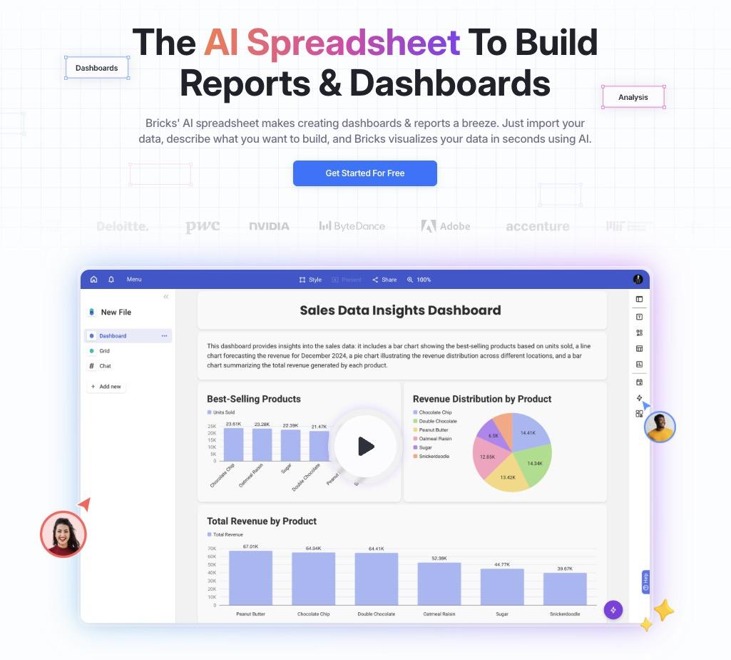
More tool demonstrations
Thebricks.com for spreadsheet manipulation and quick dashboarding
Dataset: https://github.com/the-graph-courses/misc_public/blob/main/personal_expenses_demo_aiw.csv
Tasks: 1) Summarize spending per week. 2) Compare spending on education vs travel with a pie chart.
Notes:
Sabina

Slide 19
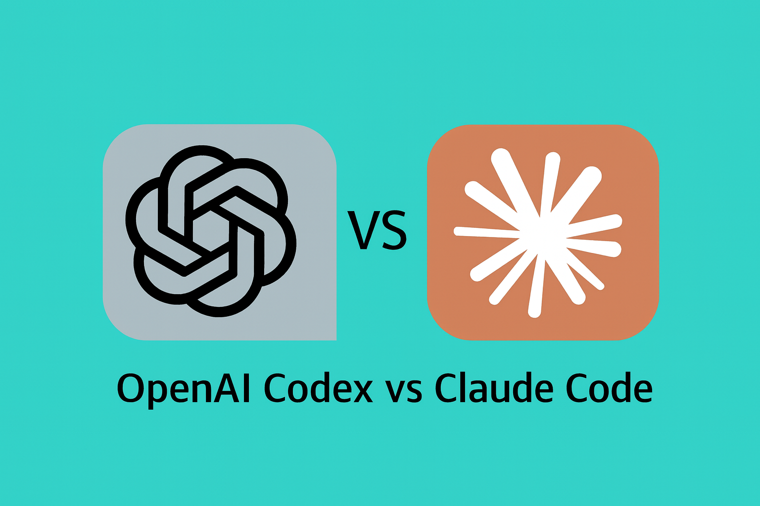
Claude Code/Cowork and Codex? What’s the fuss about?
For non-programming work, a slight convenience over the webapp (no need to upload your files)
For coding:
  OpenAI and Anthropic have the best coding models at the moment.
  And Claude Code/Cowork and Codex give you subsidized access to these mo.
  But you can get the same access with extensions within Cursor/VSCode
Notes:
Sabina

Slide 20
Overview of tools covered
Notes:
Kene

Slide 21
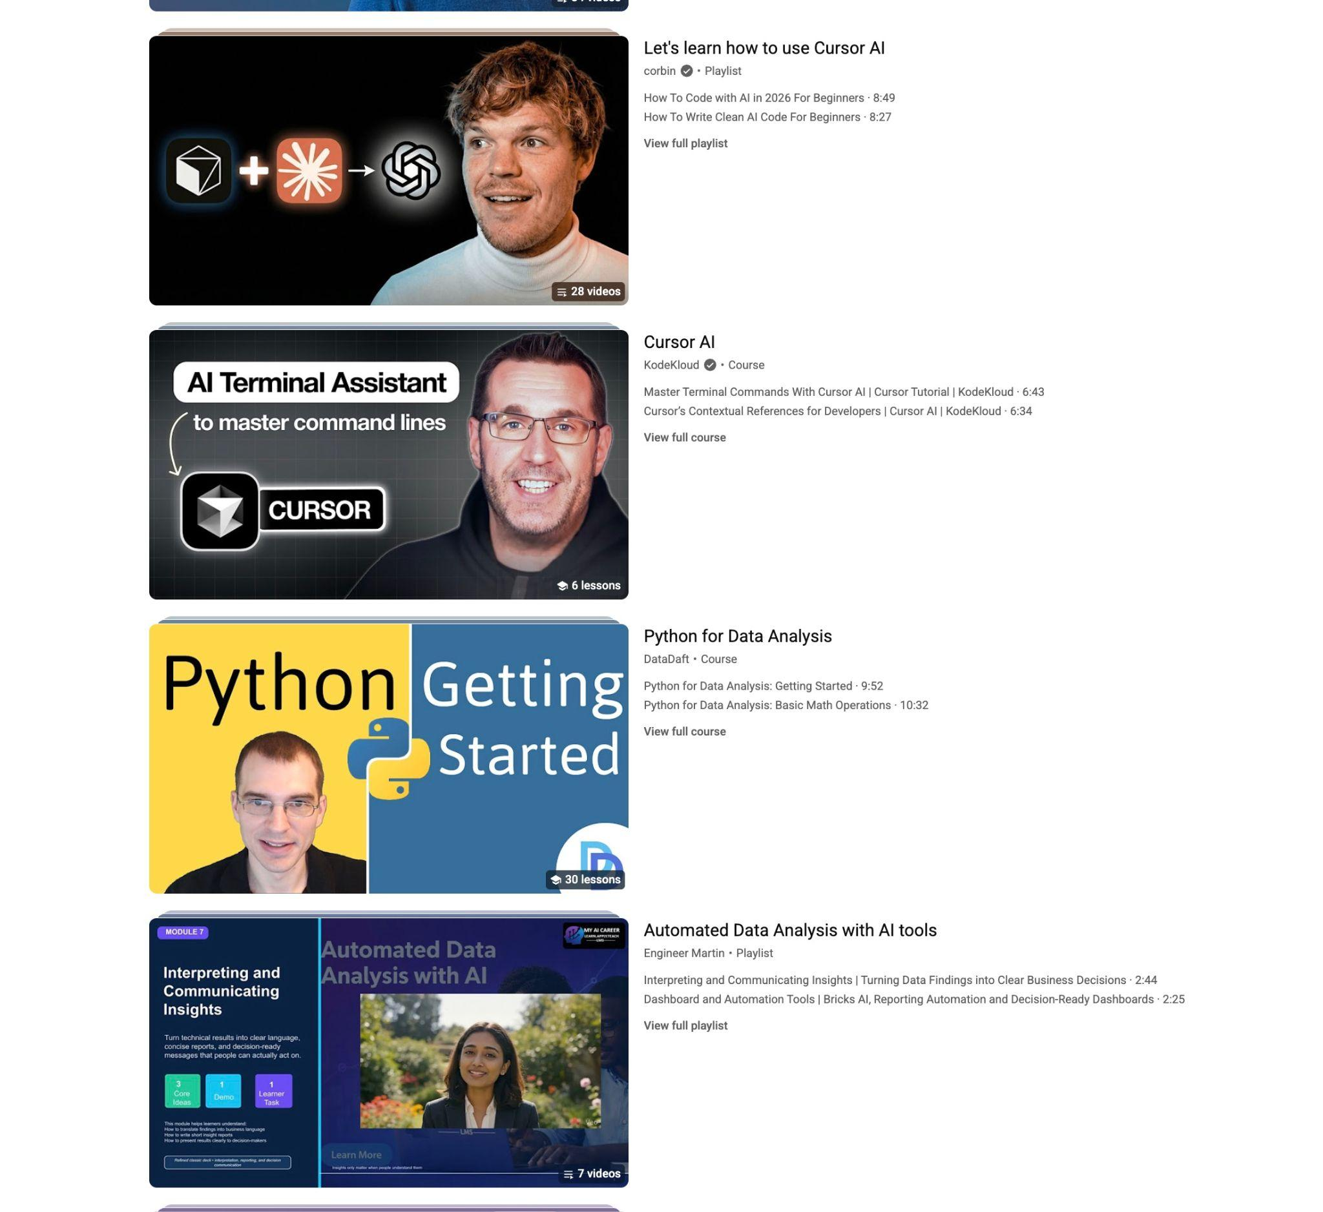
Reminder: our goal is brief overview of the landscape of tools
For deeper dives, youtube is your friend.
Notes:
Kene

Slide 22
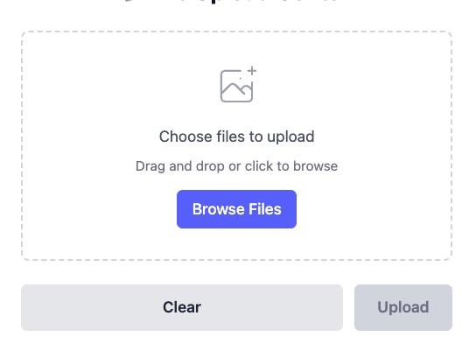
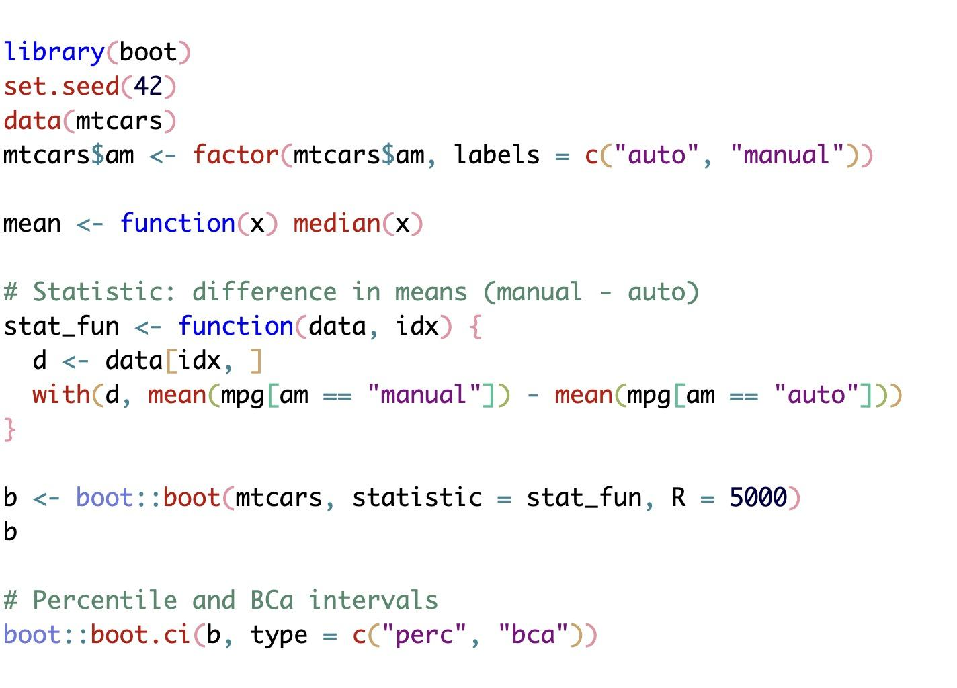
The verification problem with AI data agents
🤖:“I have now made the button red!”
🤖:“I have now done the bootstrap analysis”
Both of these contain silly mistakes/hallucinations.
Much harder to spot hallucinations in statistical code or outputs!
How do you know when the AI has made a mistake?
A few mitigations:
Compare across multiple tools
Manual spot checks of outputs (calculate by hand)
Code review
Notes:
Kene

Slide 23

ZOOMING OUT:
What does the rise of coding AIs mean for programmers & data scientists?

Slide 24
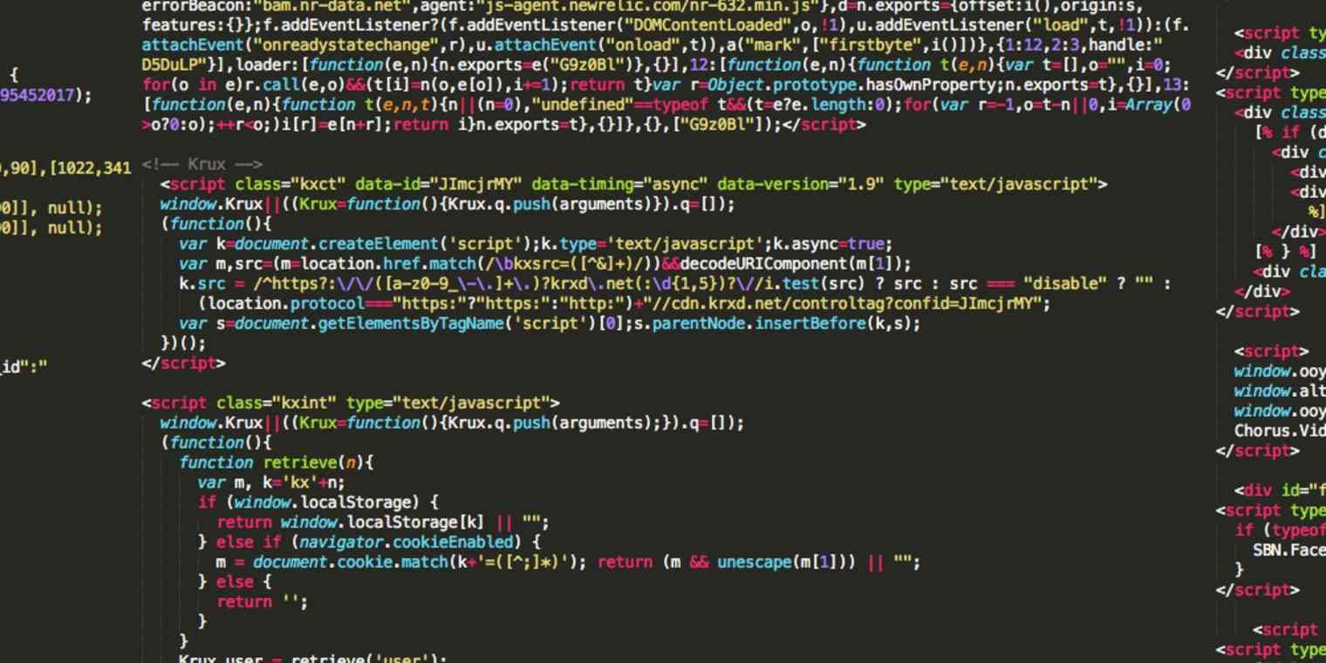
Short term (next ~1-2 years):
Not yet good enough to act autonomously as programmers/data scientists
(with messy real-world datasets)
Still need a lot of handholding
But can greatly increase coding output

Slide 25
Medium/long-term (in 3-4 years):
Data scientists will be more like today’s PMs and PIs (product managers/principal investigators)
Focus on:
  Data finding/selection
  Research direction
  Methodological oversight
Code knowledge no longer useful?

Slide 26


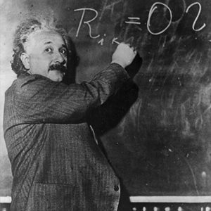
Should children still learn basic arithmetic? (Yes!)
Even in a world with calculators…
🗣️ Need to speak the "language" of arithmetic to specify, and understand
🔧 Hard problems still need human judgment. Humans need strong foundations.

Slide 27

Should data scientists and researchers still learn basic code? (Yes!)
Even in a world where most code is AI-generated...
🗣️ Still need to speak the "language" of code to specify and understand
🔧 Hard problems still need human judgment. Humans need strong foundations

Slide 28
Wrap up
Notes:
Sabina

Slide 29
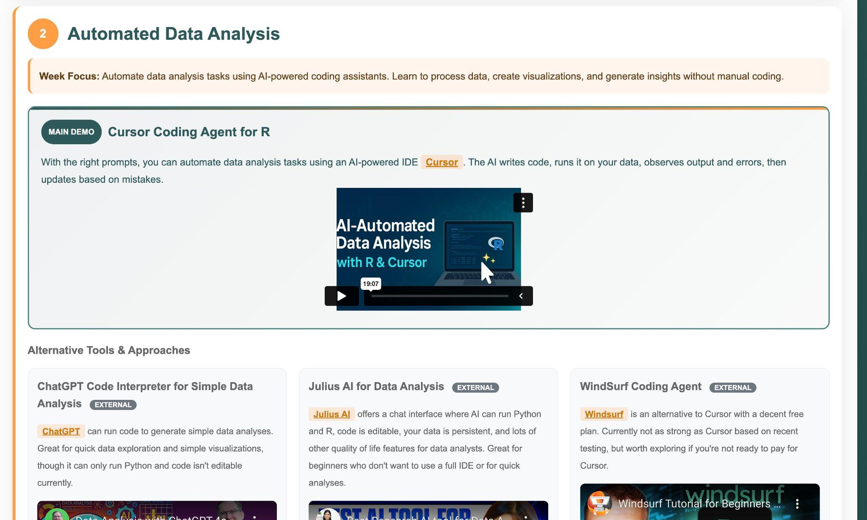
Tool compilation coming!

Slide 30
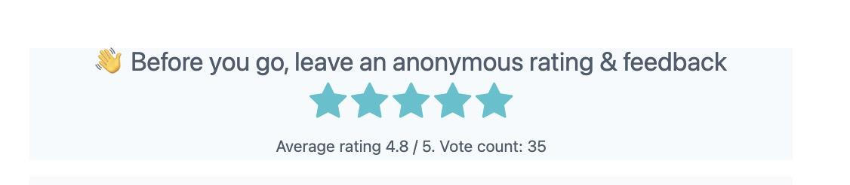

Remember to leave anonymous feedback
Notes:
Camille

Slide 31
THANK YOU SO MUCH!
See you next week :)
Notes:
Camille

