Slide 1
Help Session Note
Welcome to the Help Session
The session runs for one hour before each workshop.
If you have any questions, please do raise your hand or speak up and I will be with you shortly.
Notes:
Camille

Slide 2

Generative AI for Work & Research
We’ll get started in a few minutes
Notes:
Camille

Slide 3
Workshop Schedule
👋🏽 Welcome, Announcements (5 mins)
📝 Workshop Demo (15 mins)
👩🏽‍💻 Workshop 1 Exercise (1 hour 10 minutes)
📣 Presentations (10 mins)
👨🏻‍🏫 Additional Tool Demonstrations (20 mins)
(No Kahoot game today, as the workshop task is quite long)
Notes:
Camille
Welcome and intro: Say hello, we’re excited to have everyone. Introduce TGC people (Kene, Joy, Zachary, Sara, Olivia, etc.), words from Olivia, mission/goals – Joy/Kene/Olivia
Cosmos practice: Update last year’s slides - Joy
Icebreakers: Games/activities: TBD – Joy
Course overview: syllabus (basically walk thru learning journey figure from brochure) – Kene
Course navigation: screen share TGC website, walk through navigating to the course pages, explain new content will be uploaded each week – Joy
Expectations and policies: assessments/grading, attendance policy, code of conduct – Kene
Intro to Discord – Kene
Final announcements: next workshop material, calendar invites, general reminders, etc.

Slide 4

Welcome, Announcements
Notes:
Sabina

Slide 5
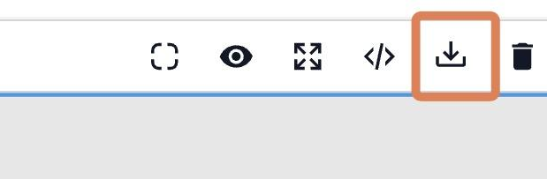
Three Ways to Edit Your Website
1. GitHub Direct Edit
Best for very simple text replacements.
Go to your GitHub repo index.html.
Click the pencil icon to edit.
Press Ctrl+F to find text.
Search, replace, and then commit changes.
2. GUI Editor (GrapesJS)
For slightly more complex tasks (e.g., adding links).
Use app.grapesjs.com/playground as a visual builder.
Click the “Import code” icon to import your code. Paste in your website code.
Then edit in the GUI. When done, again click the import code button, then copy your code back out into GitHub
Note: Can sometimes break complex UIs.
3. AI Model Assistance
For complex structural changes or new features.
Simply ask the LLM to write or modify the code for you based on your specific requirements.
Notes:
Sabina

Slide 6
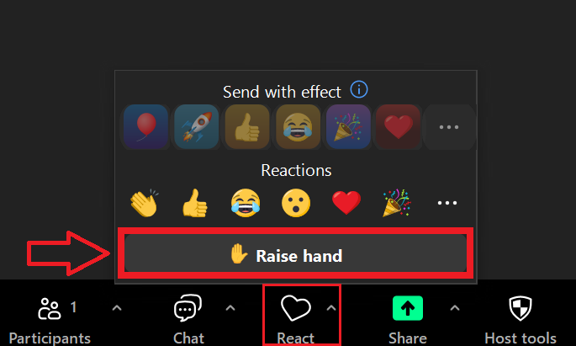
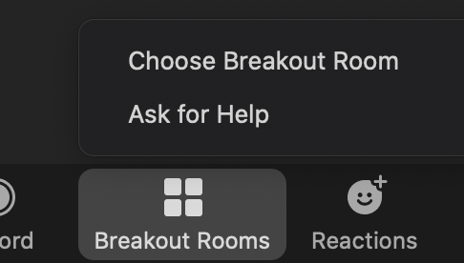
Reminder: We can’t see group chat in breakout rooms. Raise hand or Ask for Help

Slide 7
Workshop Intro
Notes:
Sabina

Slide 8
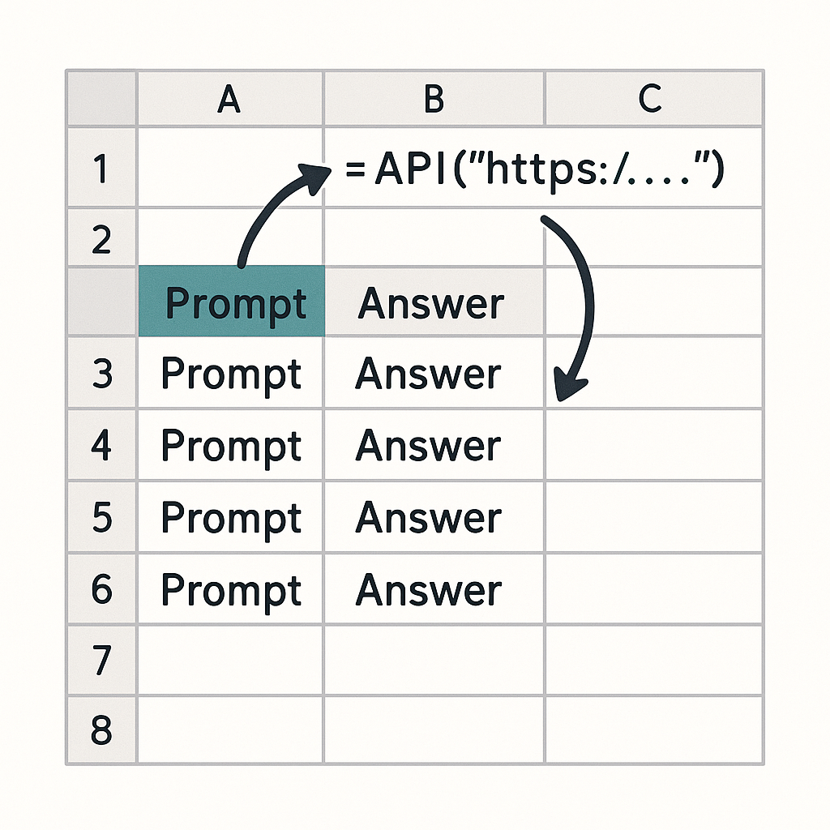

Using LLMs in spreadsheets
vs
Graphical User Interface (GUI)
Application Programming Interface (API)
Visual interface designed for human interaction.
Code-based interface for program interactions.
Notes:
Kene

Slide 9
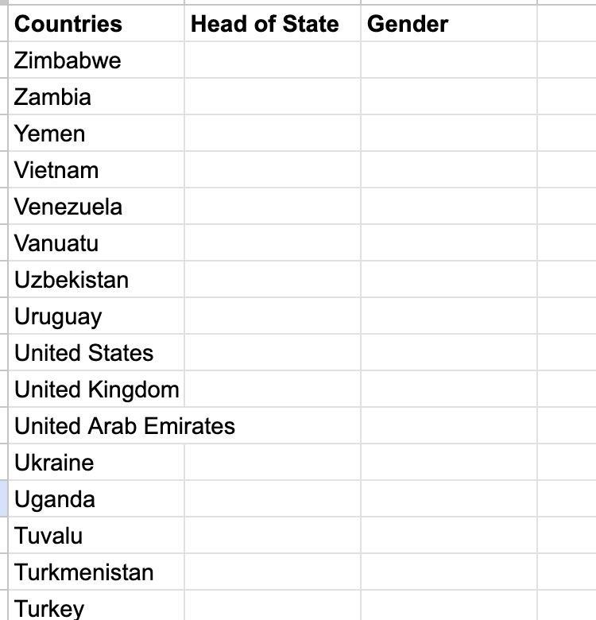
Reminder of pre-work
https://docs.google.com/spreadsheets/d/1qGOgr8jCPi74QWvCKRewR7o-kfcxeXmYiidTCmusOmU/
https://thegraphcourses.org/courses/aiw-2026-t2/topics/using-llm-apis-with-openrouter-and-google-sheets-2/
Notes:
Kene

Slide 10
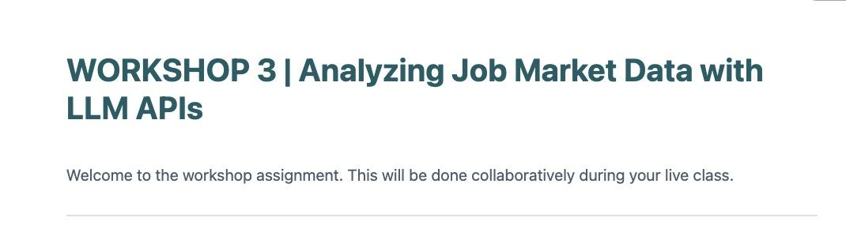
Live demo
Notes:
Kene

Slide 11


EXERCISE TIME
✨ Breakout Rooms!✨
Notes:
Camille

Slide 12

Presentations✨
Notes:
Camille

Slide 13
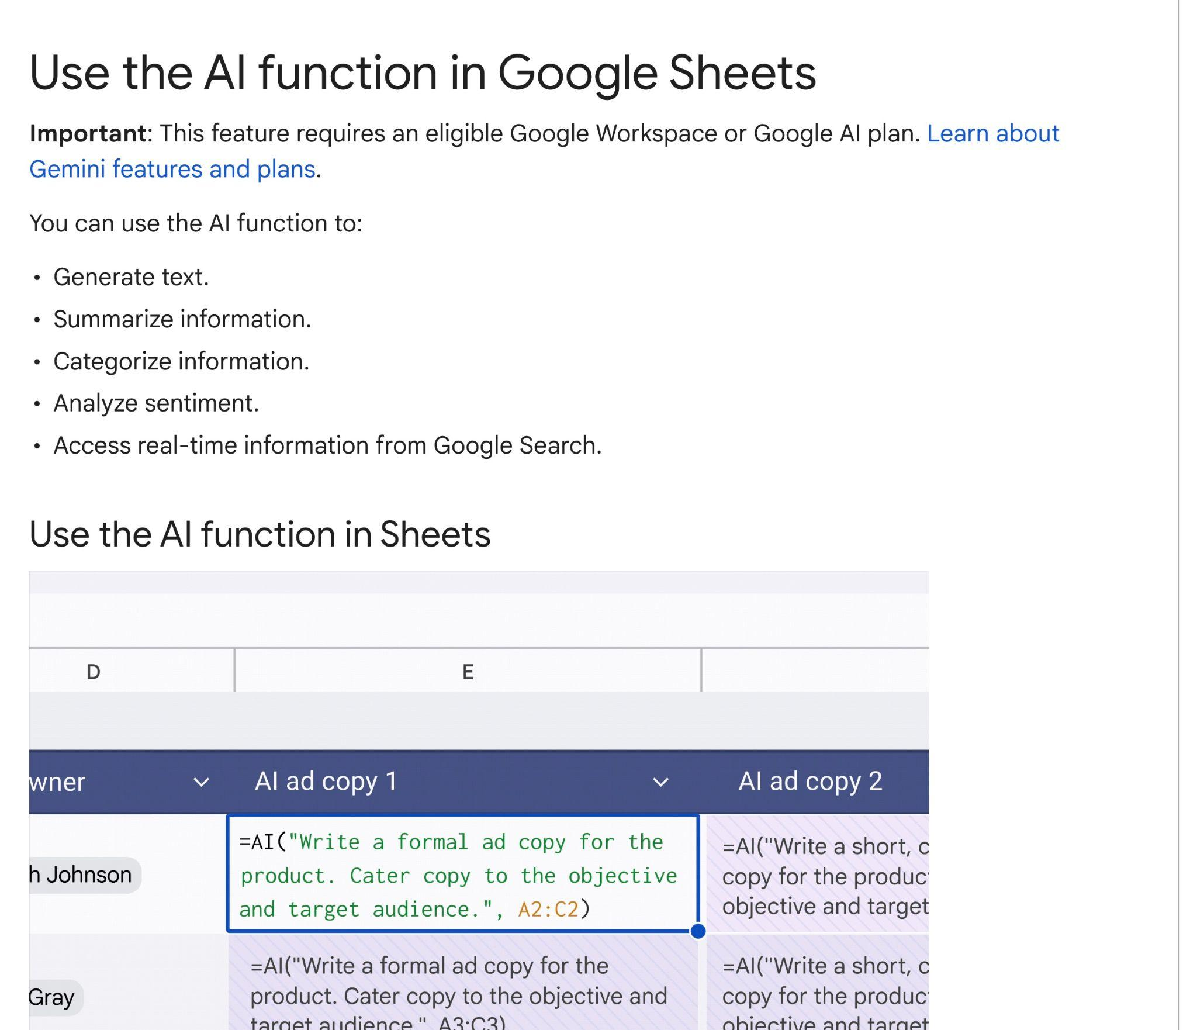
Built in AI function with Google Sheets
Limitations
• Limited control over models
• Opaque pricing and rate limits
Notes:
Sabina

Slide 14
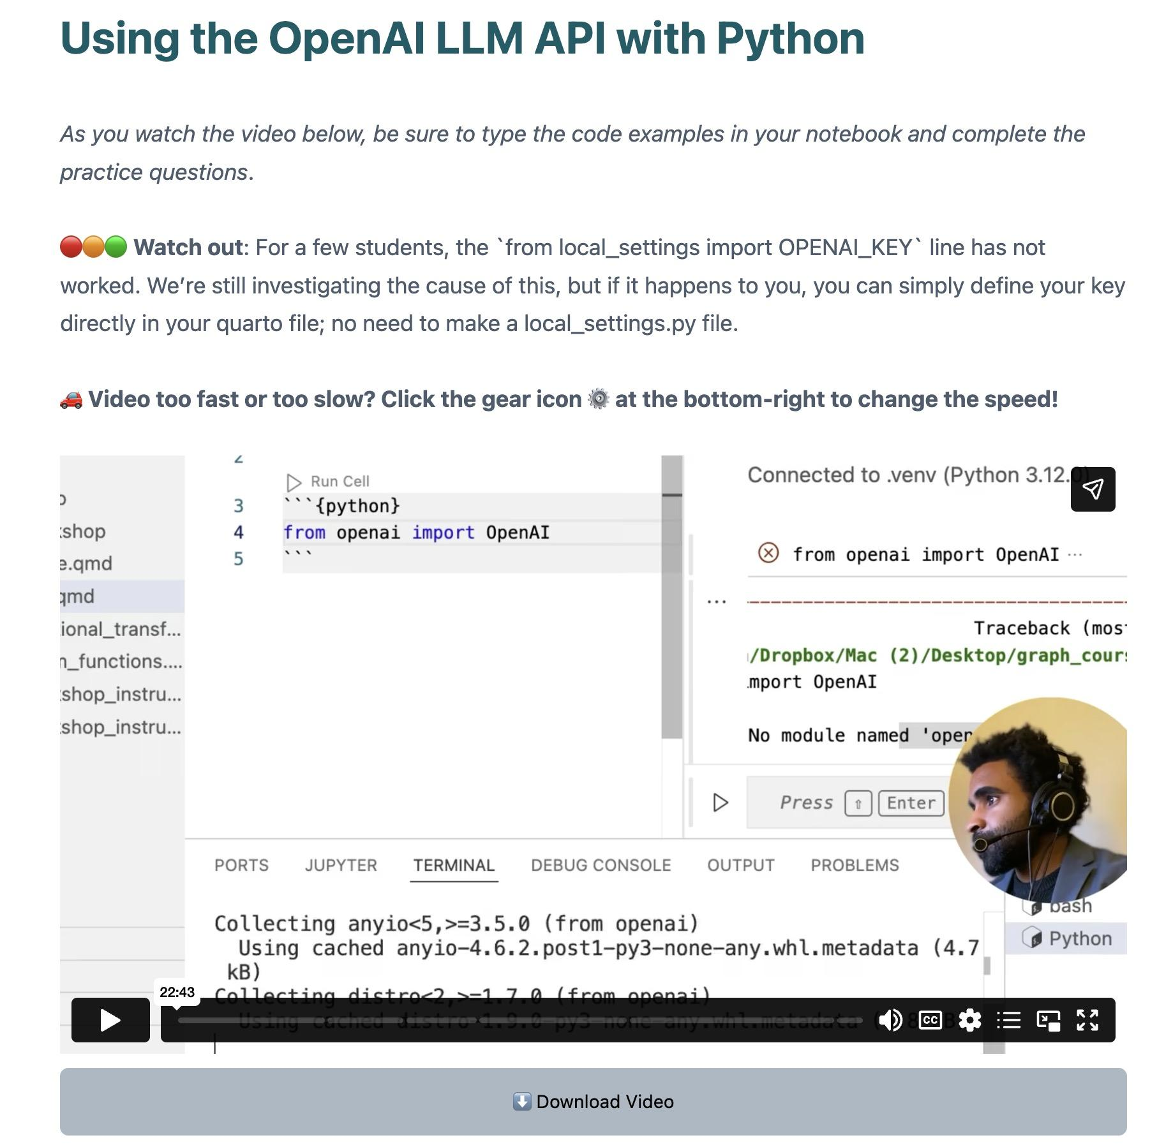
LLM API calls directly with code
• NOTE: Requires you to get your own OpenAI API key
• In R, equivalent workflow can be built with the ellmer library
thegraphcourses.org/courses/ai-llm-automations-with-python/topics/using-the-openai-llm-api-with-python/
Notes:
Sabina

Slide 15




Limitations of LLM-Powered Text Analysis
Model inaccuracy and hallucinations
Reproducibility limitation. Non-determinism
MITIGATION: Validate on sample first. Test multiple models
MITIGATION: Rerun multiple times to ensure stability
API Costs
Privacy Issues. Sensitive Data
MITIGATIONS: Try out cheaper models first. For our workshop ~30 cents per student (400 queries)
MITIGATION: Local models. Privacy agreements. Check it, Clean it, Clear it.
Notes:
Sabina

Slide 16
Two more applications of LLMs in a loop
•Literature Review
•Qualitative Data Analysis
Notes:
Sabina

Slide 17
Using LLMs in spreadsheets → Academic Literature Review?
IDEA: Could we use the API in Google Sheets setup for academic paper review?
Answer: Possible. But best to use a dedicated tool. e.g. Elicit
Notes:
Kene

Slide 18

Demo of Elicit: LLM-Powered Literature Review
Are other papers reporting similarly large seroprev? What methods did they use?
Before: Read through papers manually
Now: search “SARS-CoV-2 seroprevalence in Cameroon” on Elicit (Find Papers) and let the AI read through each.
Notes:
Sabina

Slide 19
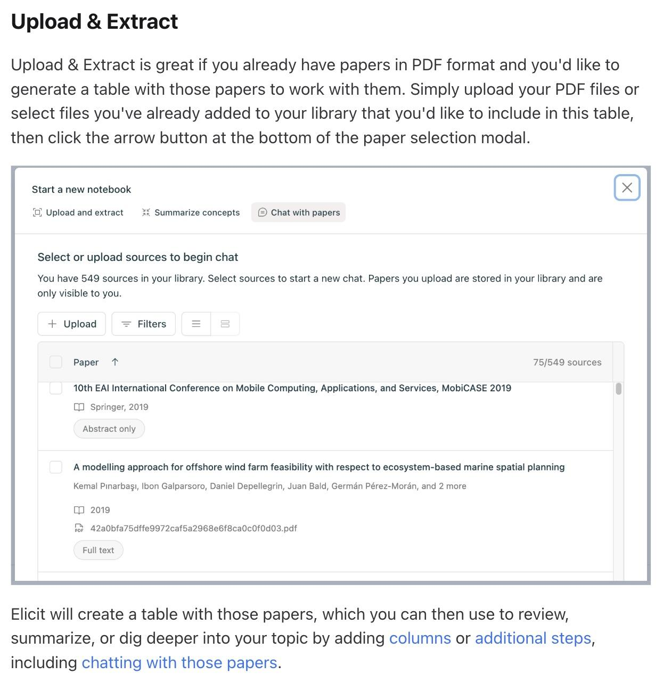
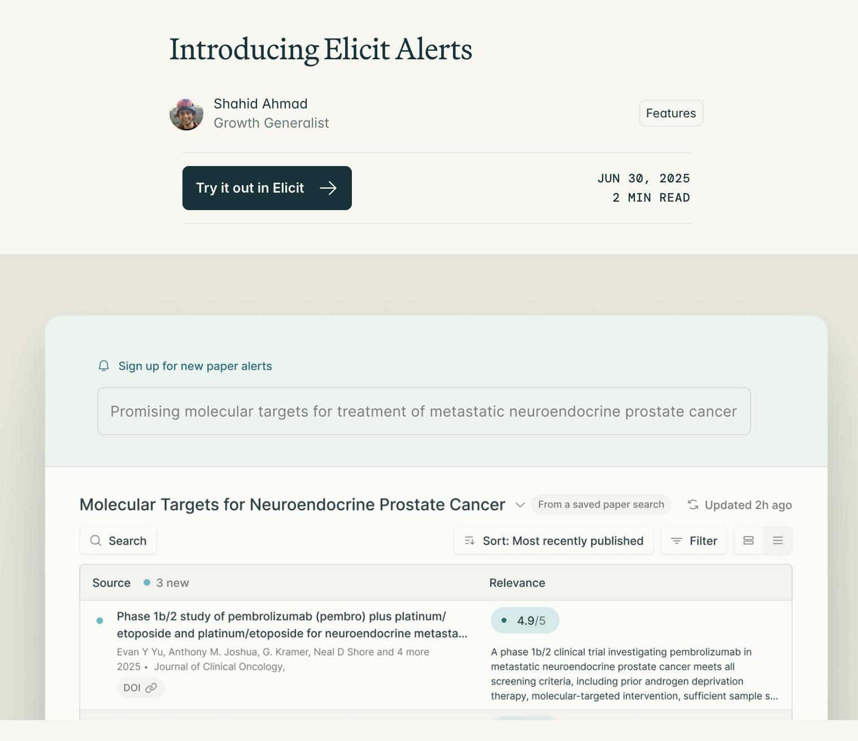
Other features of Elicit
Notes:
Sabina

Slide 20


Full Walkthroughs
https://www.youtube.com/watch?v=bXN9B8_Pfl8
https://www.youtube.com/watch?v=Ki2OBrW1HFU
Notes:
Sabina

Slide 21
Using LLMs in spreadsheets → Qualitative Data Analysis?
IDEA: Could we use the API in Google Sheets setup for qualitative data analysis?
Answer: Possible. But best to use a dedicated tool. e.g. Atlas TI, NVIVO
Notes:
Kene

Slide 22
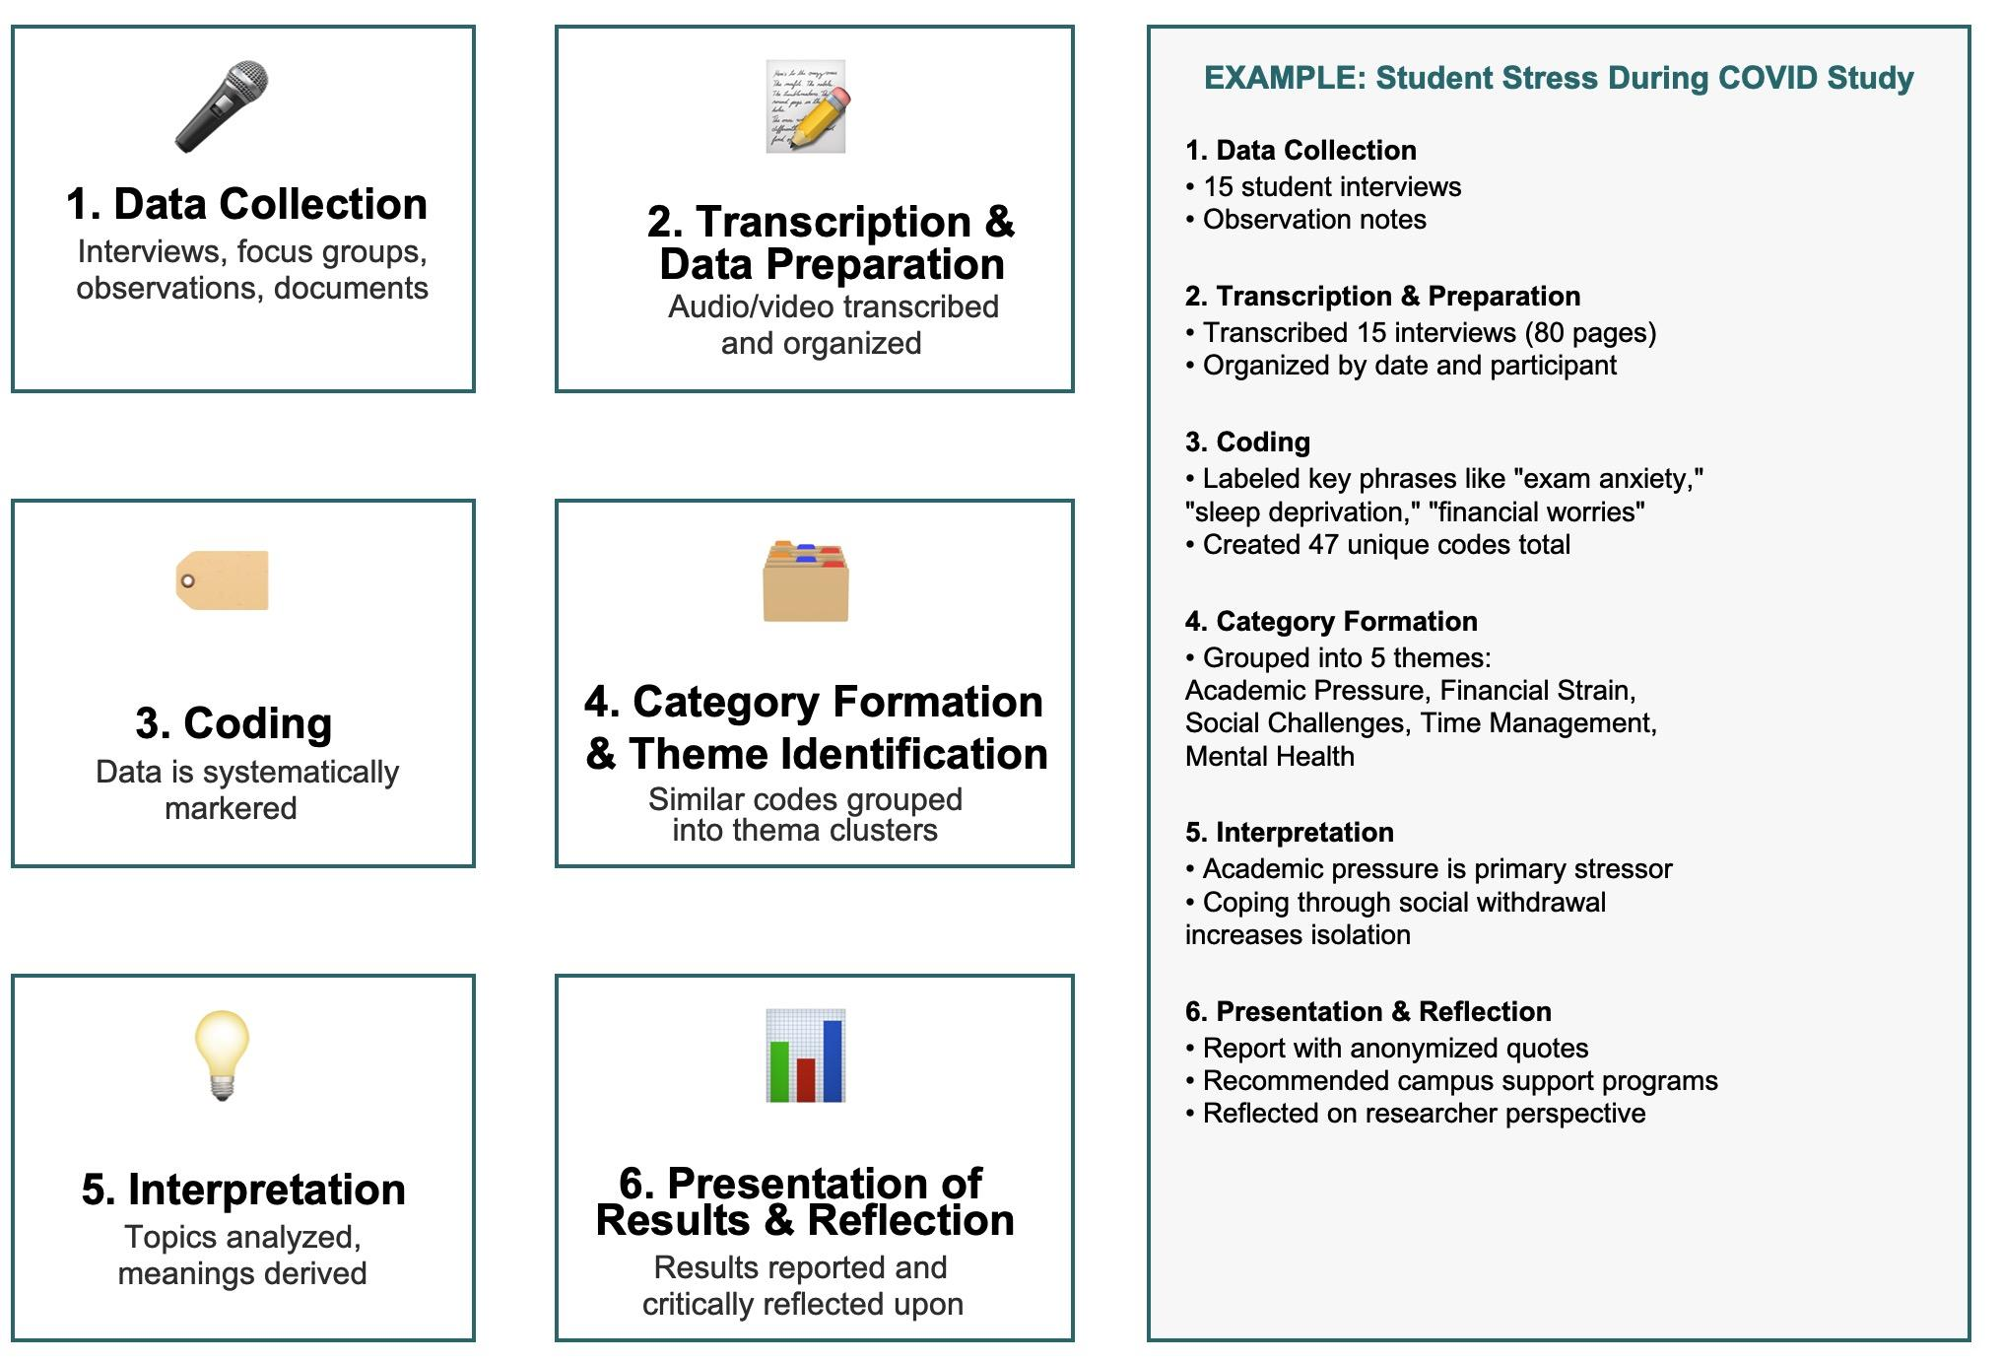
Which parts of qualitative analysis are most amenable to AI help?
Notes:
Kene

Slide 23
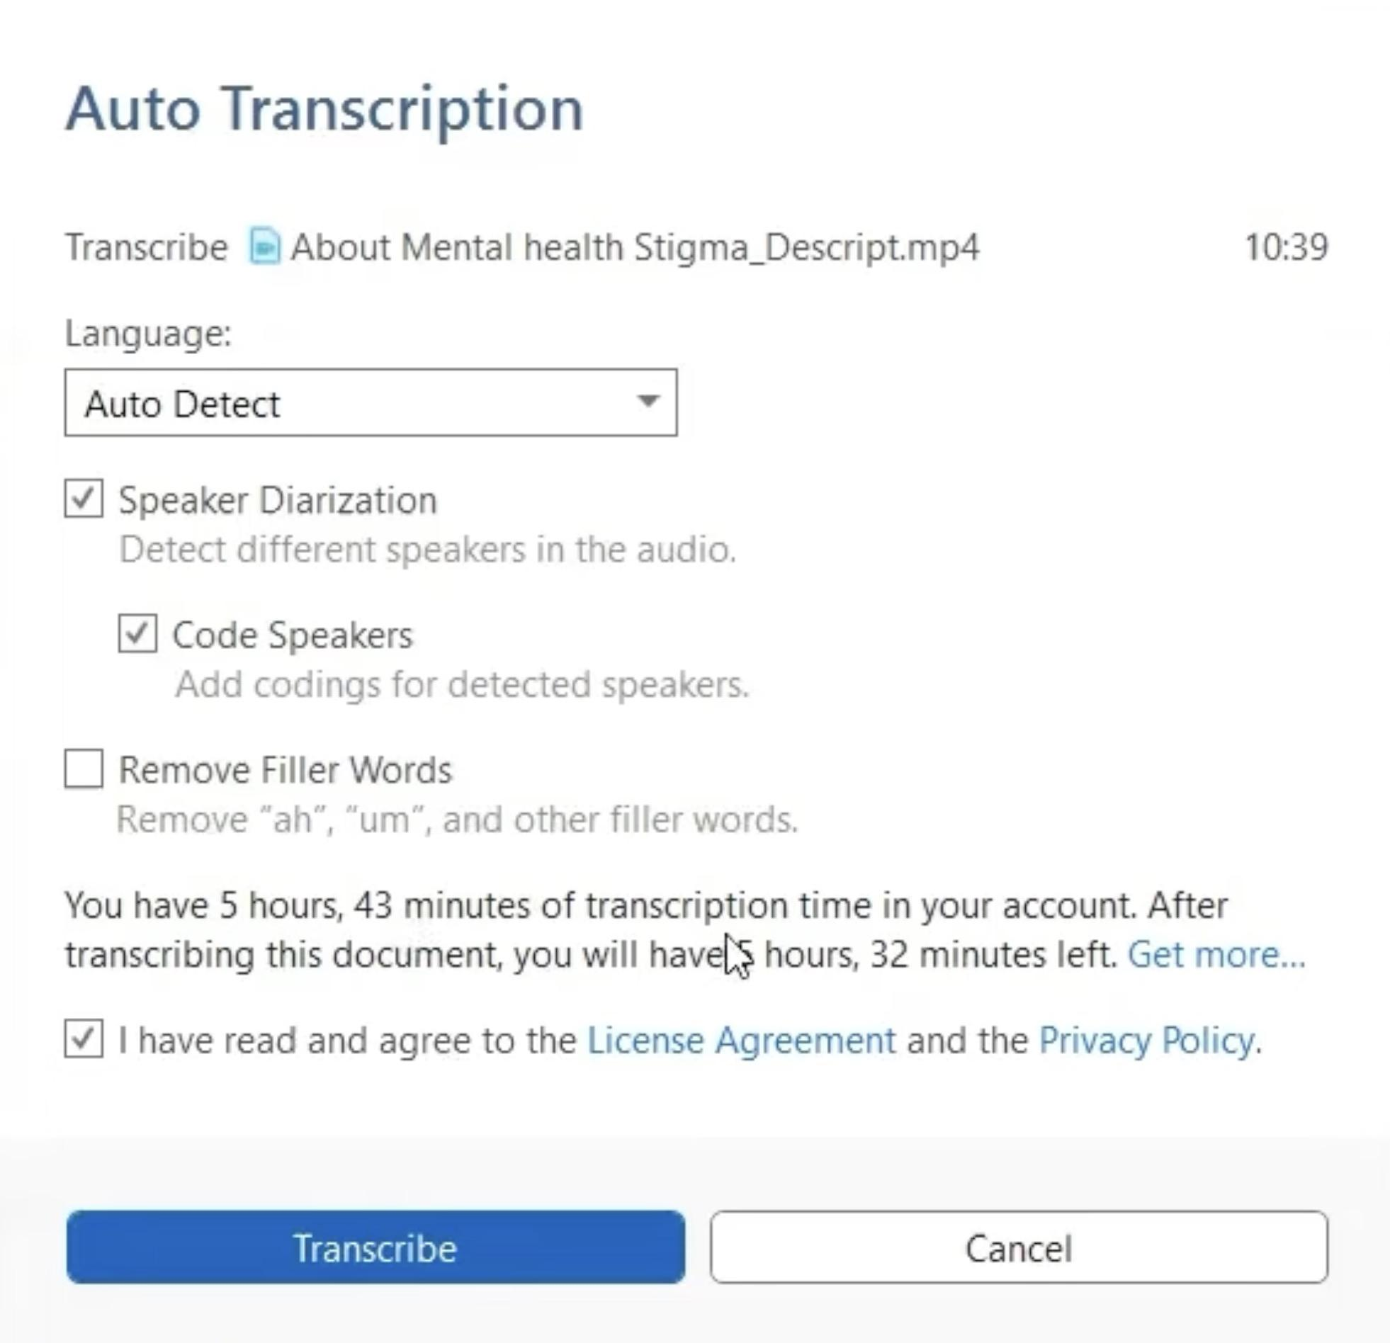
AI Transcription & Translation
Notes:
Kene

Slide 24
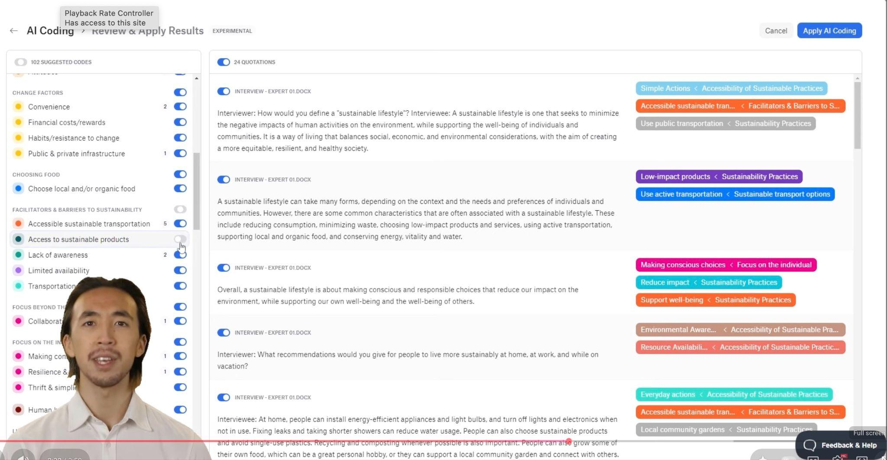
Demo of thematic Coding in Atlas TI
Start at 1:50: https://www.youtube.com/watch?v=QJVC1h2qzv4
Notes:
Kene

Slide 25
Discussion:
Do you have any ideas from your work, research or personal life for applying LLMs in a loop? (massively parallel LLM calls)
How might you build it?
Notes:
Camille

Slide 26
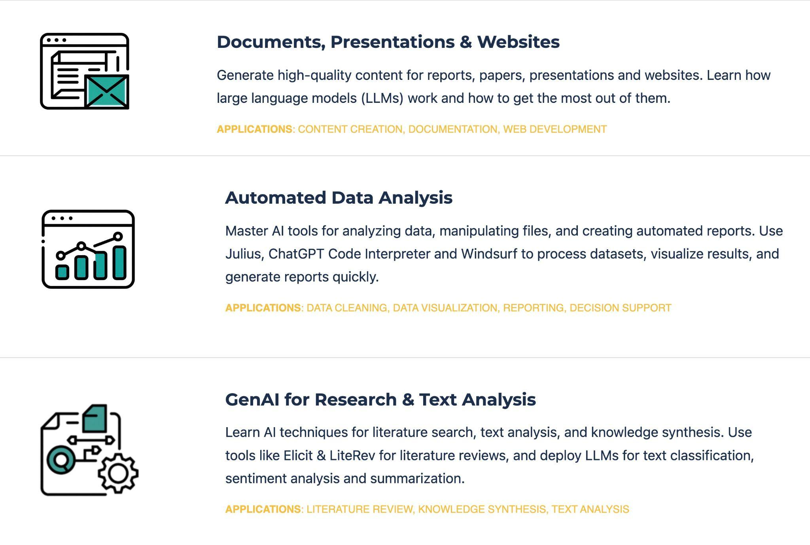
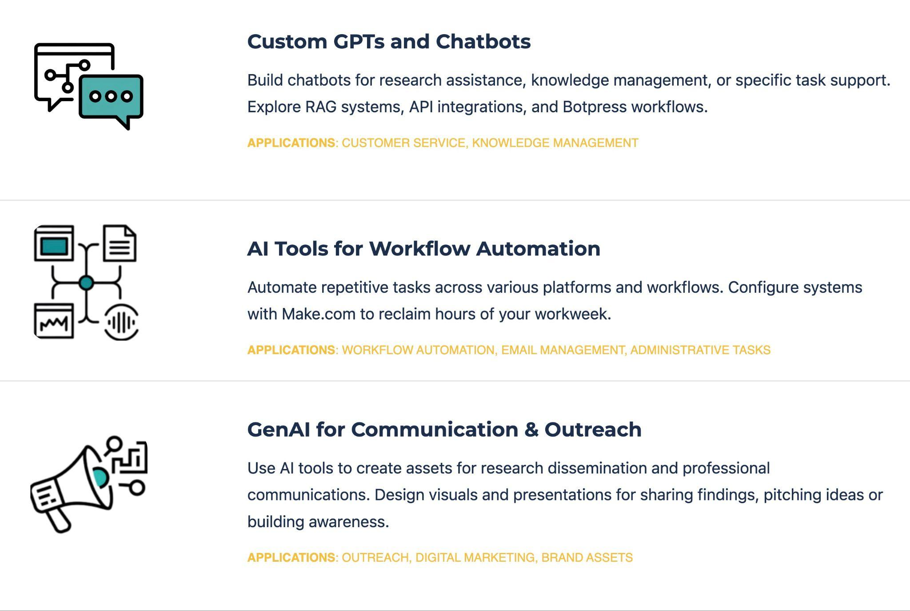
Halfway through core content
Focused on researchers and data analysts
More broadly-directed
Notes:
Sabina

Slide 27


Remember to leave anonymous feedback
Notes:
Camille

Slide 28
THANK YOU SO MUCH!
See you next week :)
Notes:
Camille

