Slide 1
Help Session Note
Welcome to the Help Session
The session runs for one hour before each workshop.
If you have any questions, please do raise your hand or speak up and I will be with you shortly.
Notes:
Camille

Slide 2

Generative AI for Work & Research
We’ll get started in a few minutes
Notes:
Camille

Slide 3
Workshop Schedule
👋🏽 Welcome, Intro (10 mins)
🚀 Workshop Demo (20 mins)
🧑‍💻 Workshop hands-on time (60 mins)
🔄 Further notes on automations & agents (20 mins)
💡 Discussion: Possible Use Cases & Applications (10 mins)
Notes:
Camille
Welcome and intro: Say hello, we’re excited to have everyone. Introduce TGC people (Kene, Joy, Zachary, Sara, Olivia, etc.), words from Olivia, mission/goals – Joy/Kene/Olivia
Cosmos practice: Update last year’s slides - Joy
Icebreakers: Games/activities: TBD – Joy
Course overview: syllabus (basically walk thru learning journey figure from brochure) – Kene
Course navigation: screen share TGC website, walk through navigating to the course pages, explain new content will be uploaded each week – Joy
Expectations and policies: assessments/grading, attendance policy, code of conduct – Kene
Intro to Discord – Kene
Final announcements: next workshop material, calendar invites, general reminders, etc.

Slide 4
Traditional vs LLM-Powered Automations
An automation runs a series of (software) steps automatically when triggered by an event.
Traditional (Rule-Based)
LLM-Powered
Examples:
Patient form submitted → add to database → notify a nurse
Every Monday → pull sales data from database → update dashboard
Add an LLM to handle nuance and unstructured data.
Examples:
When an email arrives → classify by intent → route to team
Every Monday → Summarise papers → send a daily digest
Quick Quiz: Traditional or LLM-Powered?
1
Patient online form submitted → create a ticket with the form data
Traditional
2
Incoming patient referral email → extract diagnosis, and flag for triage
LLM
3
New student signs up for course → send welcome email and add to calendar
Traditional

Slide 5
When to use an automation platform vs. back and forth chat
Use an automation platform when:
You want it to run frequently, automatically, and similarly each time
e.g. every time an email asking for an automated report arrives, respond with a
Just chat with the AI when:
It's a one-off or occasional task
You want to interact and iterate on results
The output doesn't need to go to another app
You need human judgment at each step
vs
Quick Quiz: Automate It or Back & Forth Chat?
Should you build an automation, or just open ChatGPT / Gemini?
1
Every time a journalist mentions your NGO on social media, log in a spreadsheet and alert comms lead
Automate
2
Analyze data from the final output of a user survey
Back & forth chat
3
Every time a patient flags emotional distress in an intake form, email the patient a response
Only automate with human in loop!
4
Every week, perform an online search of possible new relevant grants and post a summary in a team messaging channel
Automate

Slide 6
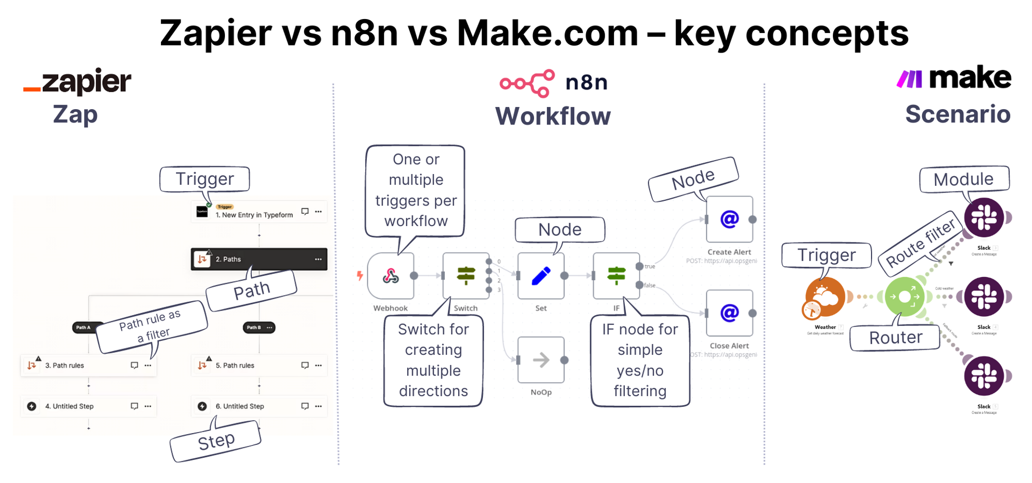
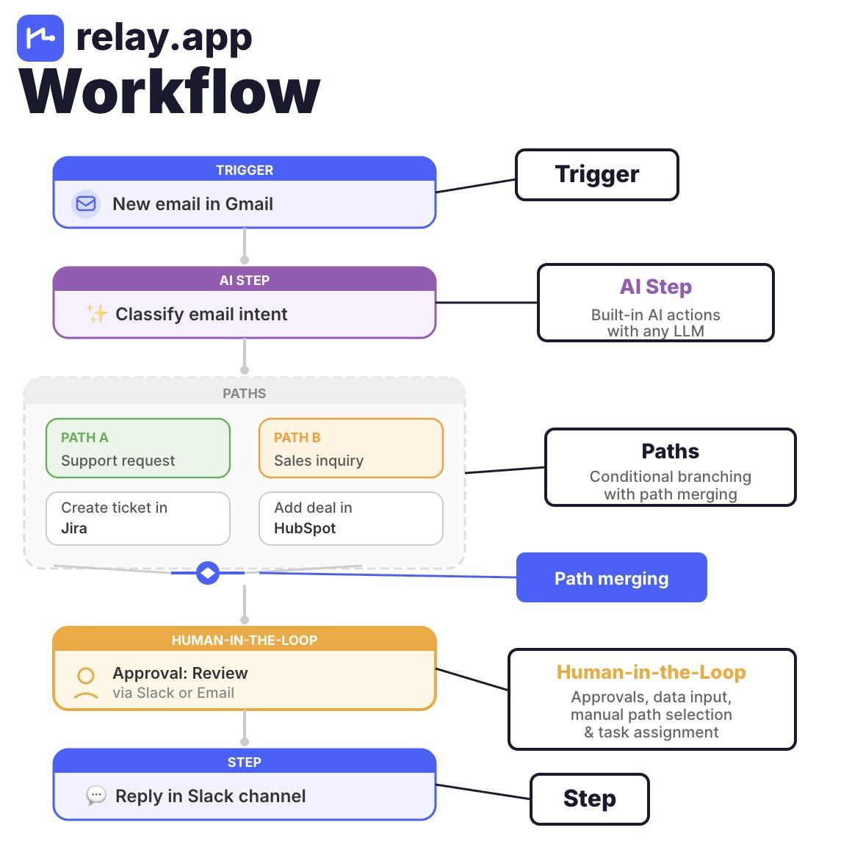
Some no-code automation platforms
Has anyone used any of these?
Before: Make.com. Affordable (good free plan), mature product.
Now: Relay. Younger product. But similarly affordable. Strong AI assistant. Clean UI.

Slide 7
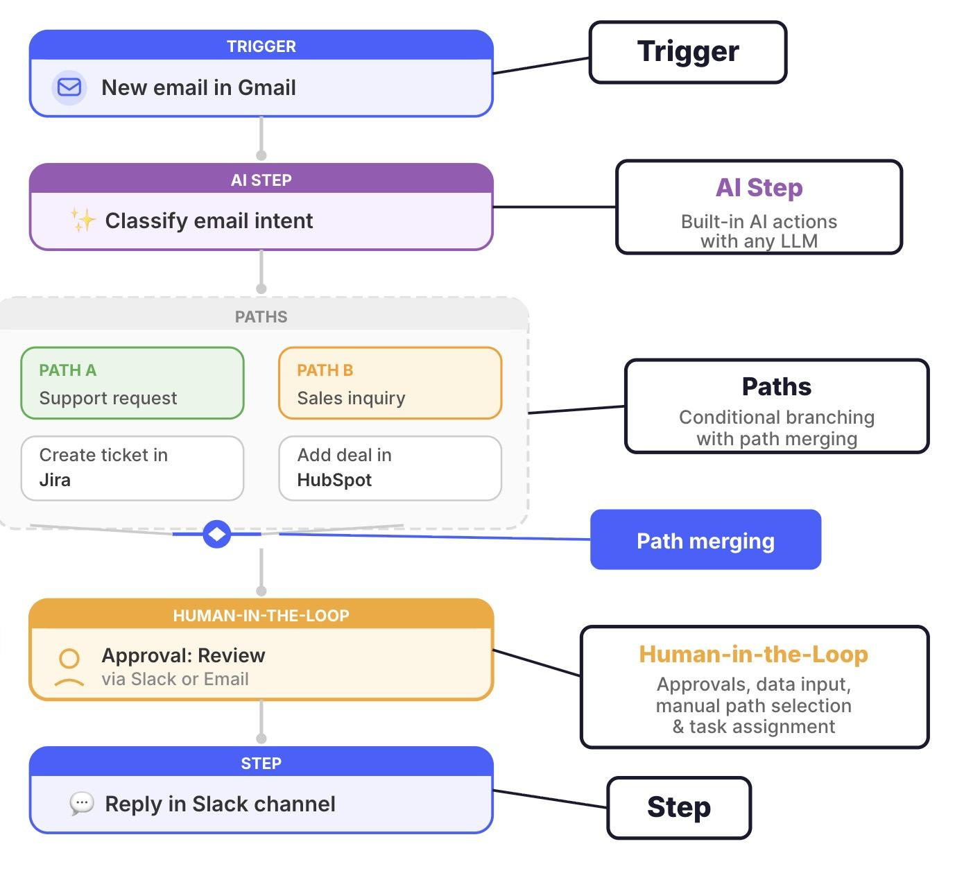
Zooming in on Relay

Slide 8
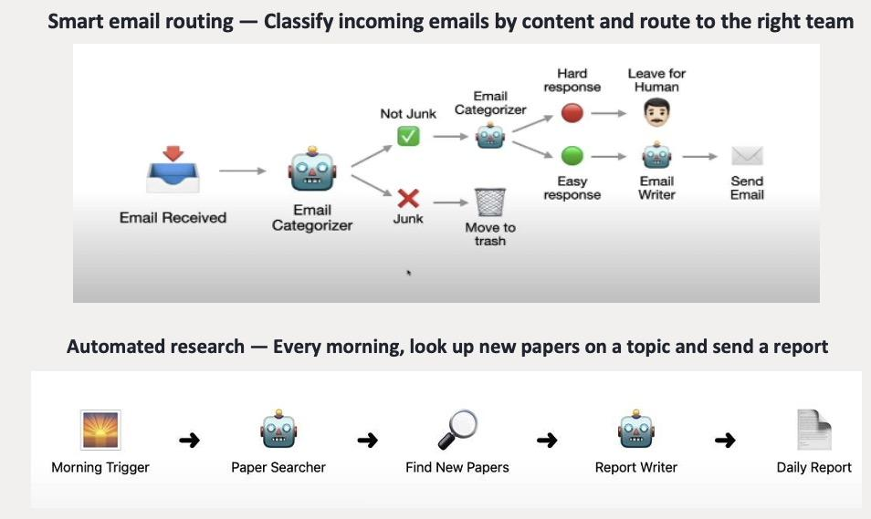
Two types of triggers: Action-Based Trigger & Frequency Triggers
Can you classify which is which?
Today we’ll build both types

Slide 9

Workshop Intro
Automation with Relay.app
Notes:
Sabina

Slide 10
Workshop Breakout Rooms
Notes:
Sabina

Slide 11
Further notes on Automations & Agents
Notes:
Sabina

Slide 12
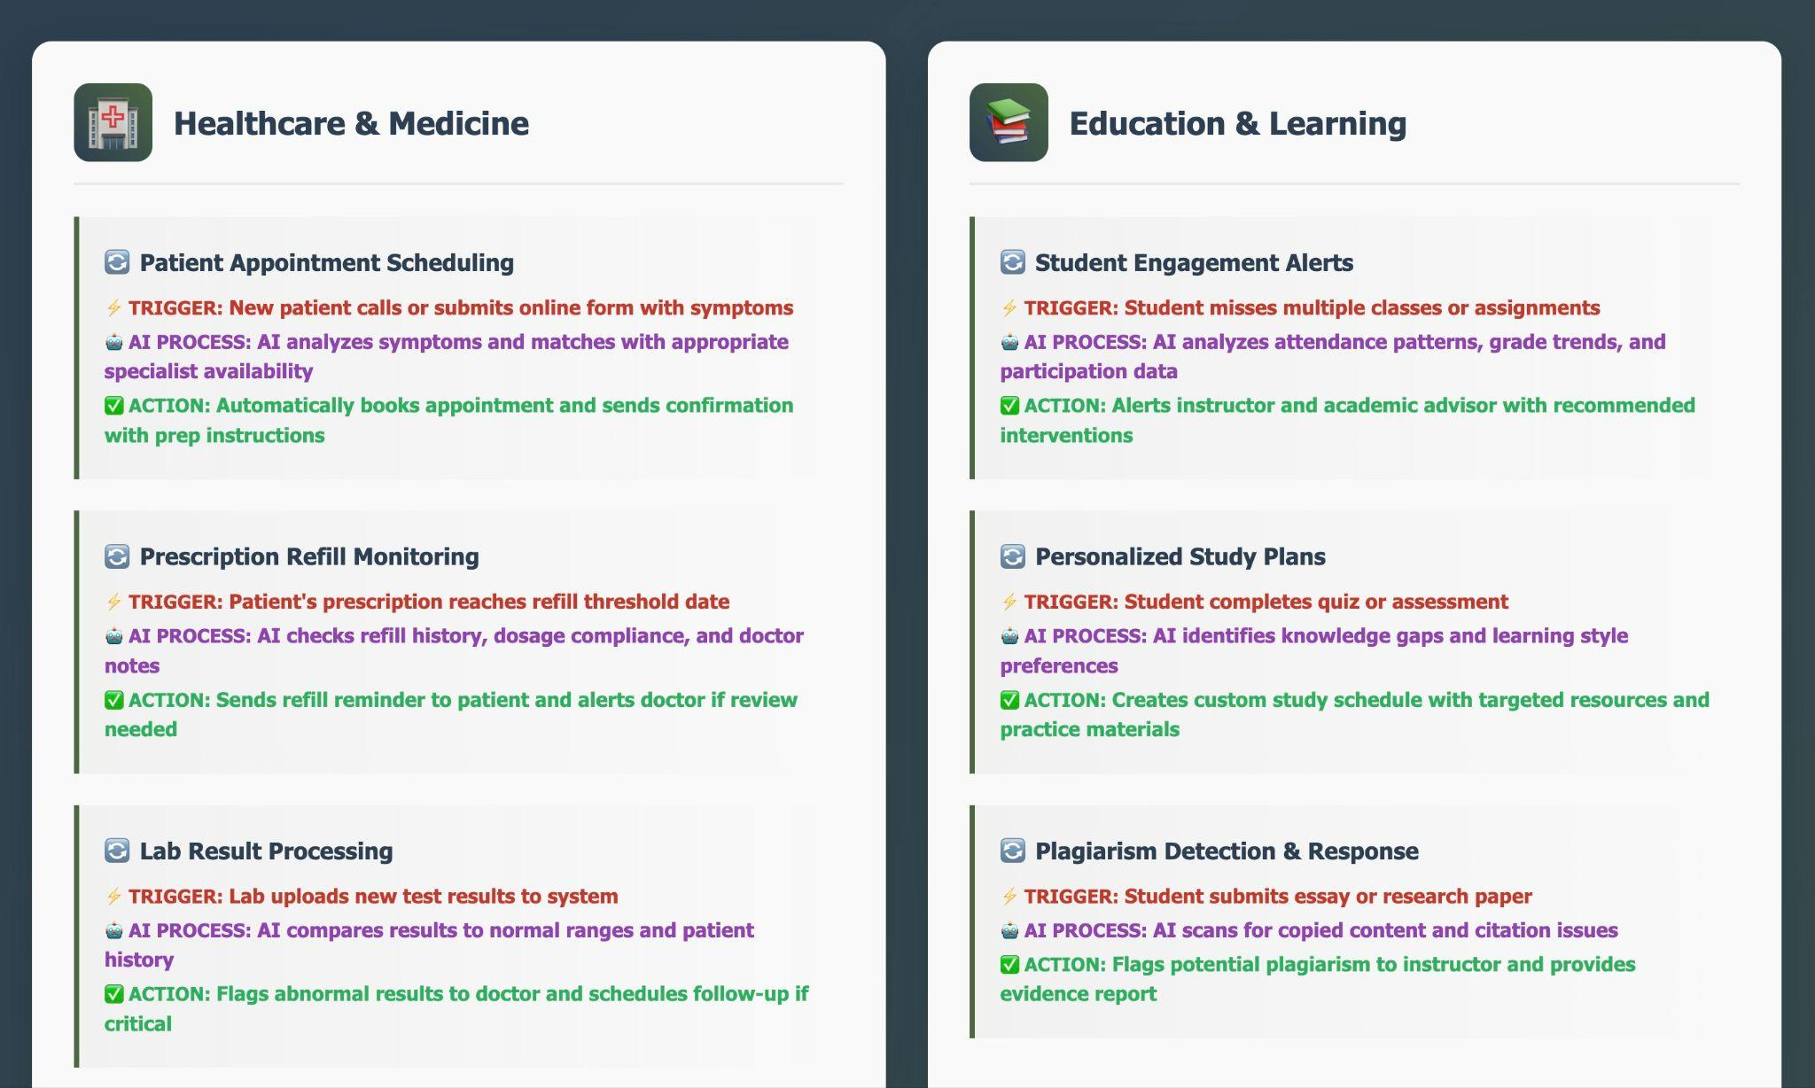
Other example automations
Courtesy of Claude: https://claude.ai/public/artifacts/81464596-7e3b-4742-bd9d-3ebd6b65ec10

Slide 13
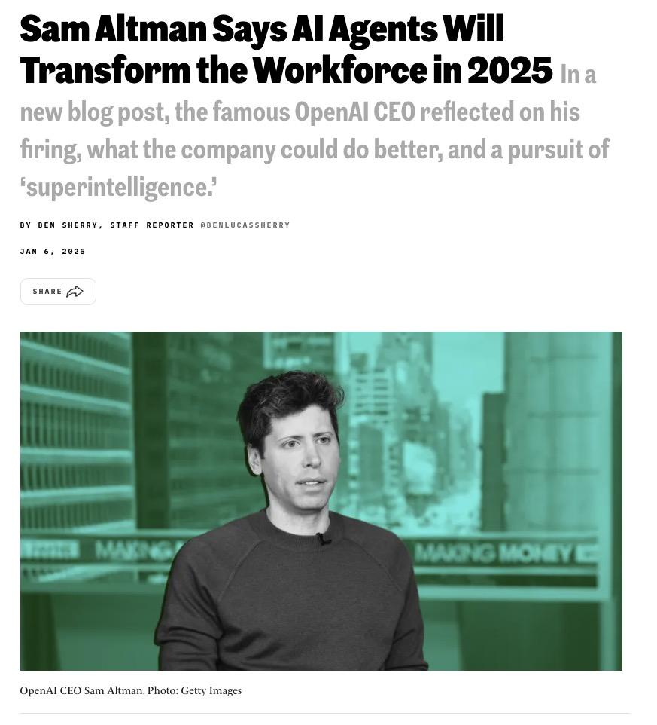
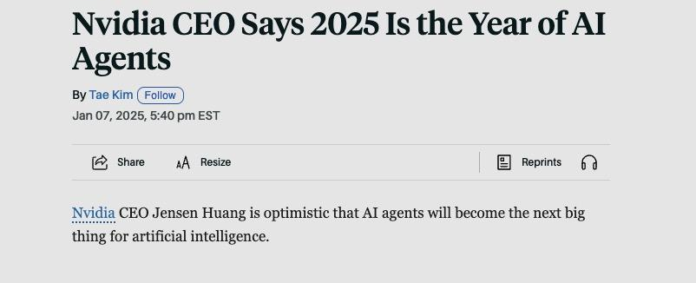

From Automations -> Agents

Slide 14
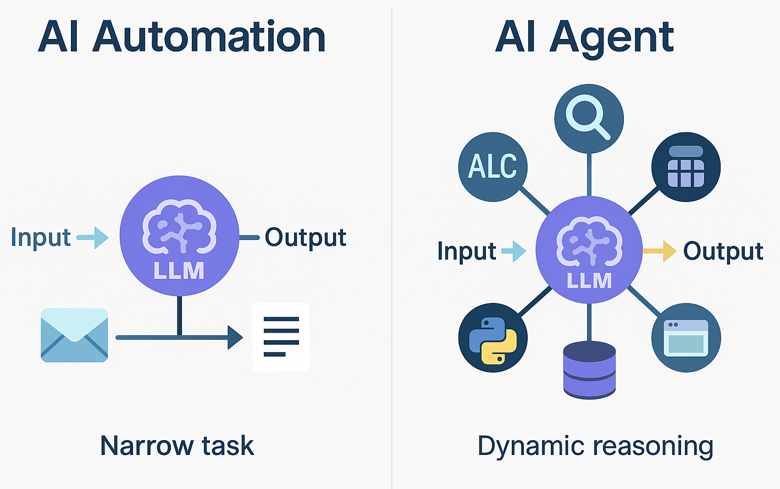
Automations vs Agents
 | AI Automation | AI Agent
 | • At one or multiple places in your pipeline, you give an LLM a prompt, it produces answer • Easy to set up and control | • The LLM has tools, and decides when and whether to use tools until the goal is met. • Harder to set up and control
Note that this is different from how relay.app uses the term agent
QUIZ:
1. Resume Reformatter: Upload your resume and a job description. LLM refocuses your resume to the target job.
2. Shopping research assistant: Enter an item and budget. LLM researches deals until it finds a good bet.
3. Customer support bot: Handles customer inquiries by checking order status, searching knowledge bases, and escalating to humans when needed.

Slide 15
Examples of agents
The ChatGPT/Claude/Gemini interfaces: generic agents
Cursor: Data/code agents
Shortwave: Email agents
✨Live Demo: Shortwave email agent

Slide 16
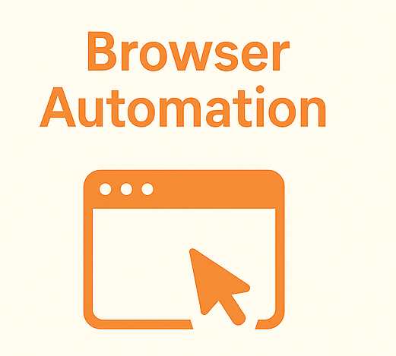
Computer use agents (clicks instead of code)
Do tasks like a human would, clicking in a browser
Example use cases
Scraping dynamic online websites
Filling out or working with online forms
Good providers:
Anthropic’s Claude Chrome Extension
Perplexity’s Comet Browser
Still nascent, immature, slow, mistake-prone. But watch this space.
Also potentially dangerous
✨ Live demo: Anthropic Claude Chrome
Prompt: “Make copies of this Google form in French and Spanish. (Translate all text) To make a copy, click the ‘More’ icon at the top of the course page, then click the ‘make a copy’ button.”

Slide 17
Discussion: Possible use cases for automations & agents in your domains?
💡
1 minute to think
4 minutes to discuss in groups (breakout room)
5 minutes to share out to the whole class
Notes:
Sabina

Slide 18


Remember to leave anonymous feedback
Notes:
Camille

Slide 19
THANK YOU SO MUCH!
See you next week :)
Notes:
Camille

