Slide 1

Generative AI for Work & Research
We’ll get started in a few minutes
Notes:
Camille

Slide 2
Workshop Schedule
👋🏽 Welcome & Introductions (15 mins)
🗣️ Student Presentations (1 hour 30 mins)
📣 Wrap up (10 mins)
Notes:
Camille
Welcome and intro: Say hello, we’re excited to have everyone. Introduce TGC people (Kene, Joy, Zachary, Sara, Olivia, etc.), words from Olivia, mission/goals – Joy/Kene/Olivia
Cosmos practice: Update last year’s slides - Joy
Icebreakers: Games/activities: TBD – Joy
Course overview: syllabus (basically walk thru learning journey figure from brochure) – Kene
Course navigation: screen share TGC website, walk through navigating to the course pages, explain new content will be uploaded each week – Joy
Expectations and policies: assessments/grading, attendance policy, code of conduct – Kene
Intro to Discord – Kene
Final announcements: next workshop material, calendar invites, general reminders, etc.

Slide 3
The mission of the GRAPH Courses

Slide 4
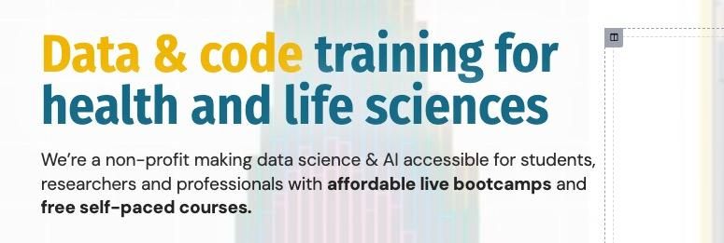
The mission of the GRAPH Courses

Slide 5
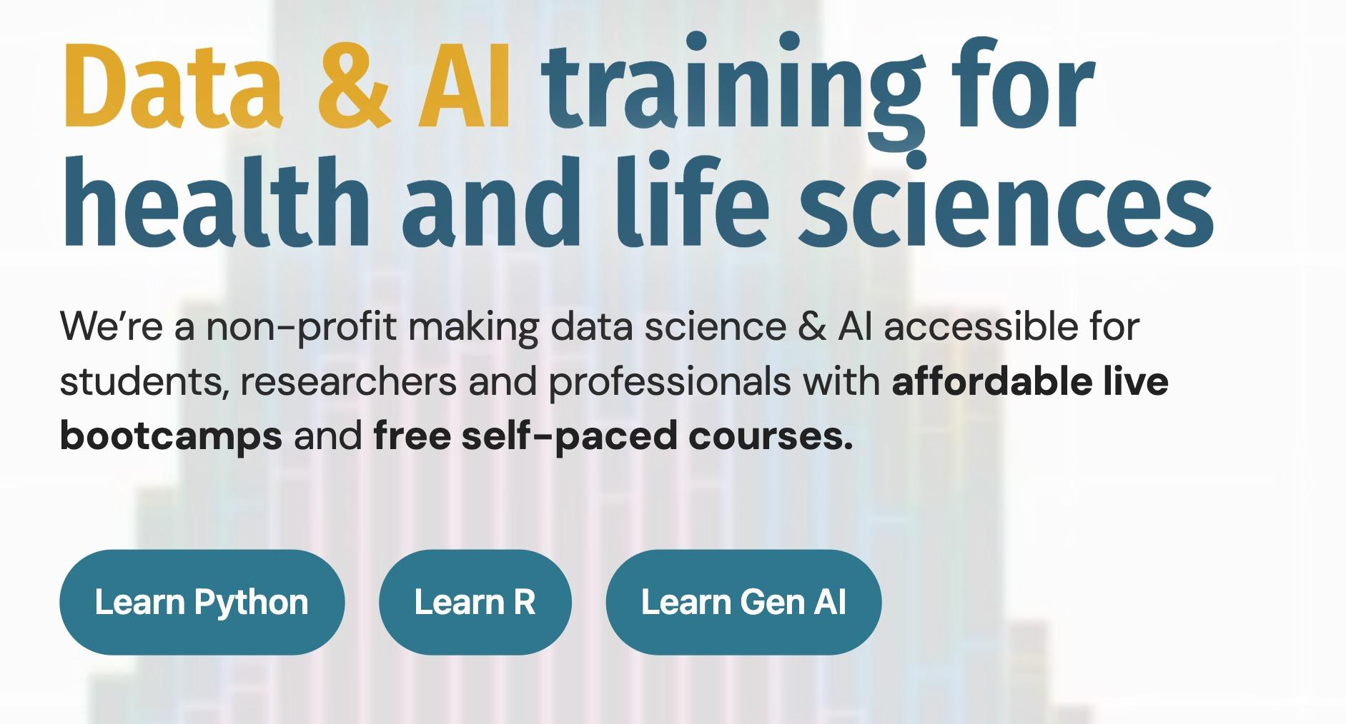
The mission of the GRAPH Courses

Slide 6
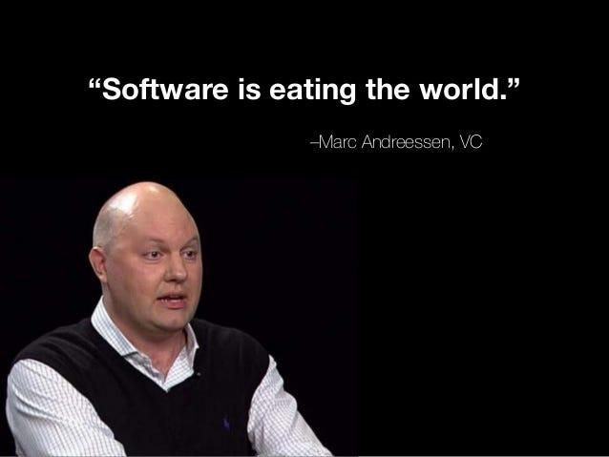
On the horizon: a platform shift as important as the digital computing revolution
Notes:
Kene

Slide 7


What was the digital computing revolution?
News/reporting
Filing
Calculator
Files
Spreadsheet
Clock
Music
13
Banking
Clock
Radio
Docs
Email
Calendar
+ more
Typewriter
Notes:
Kene

Slide 8
Now: AI is eating software
🧑
YOU
🤖
AI AGENTS
🤖
</>
FILES
Files
Data
Docs
Design
Comms
Code
Notes:
Kene

Slide 9

The implication
For many tasks that can be done through a computer
(a large fraction of knowledge work)
Research
Data analysis
Coding
Design
Workflows
Presentations
your effectiveness will be largely determined by how well you understand and can safely manage these AI agents
Notes:
Kene

Slide 10
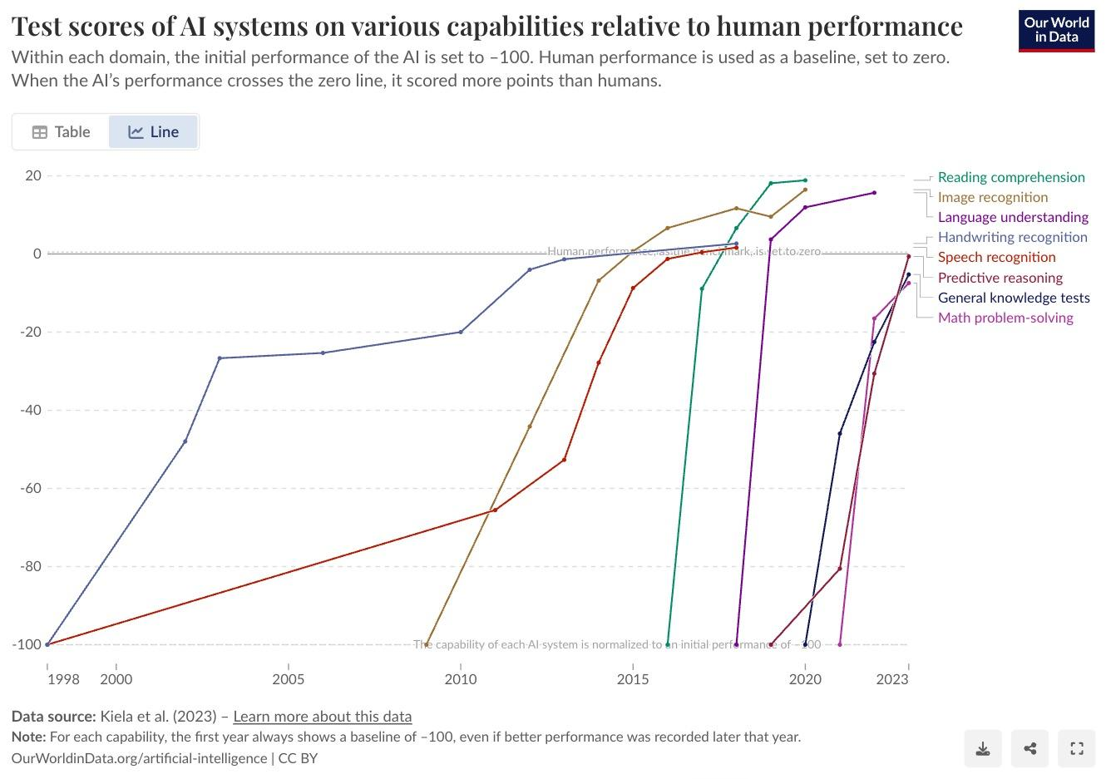
AI is reaching human-level performance across many tasks
Why?
They are trained on the
entire internet of data.
Any task that can be represented
in text or data is being learned.
And they have advantages:
Tireless and persistent
Hyper-optimizable
Orders of magnitude faster on many tasks
Very scalable
Notes:
Kene

Slide 11
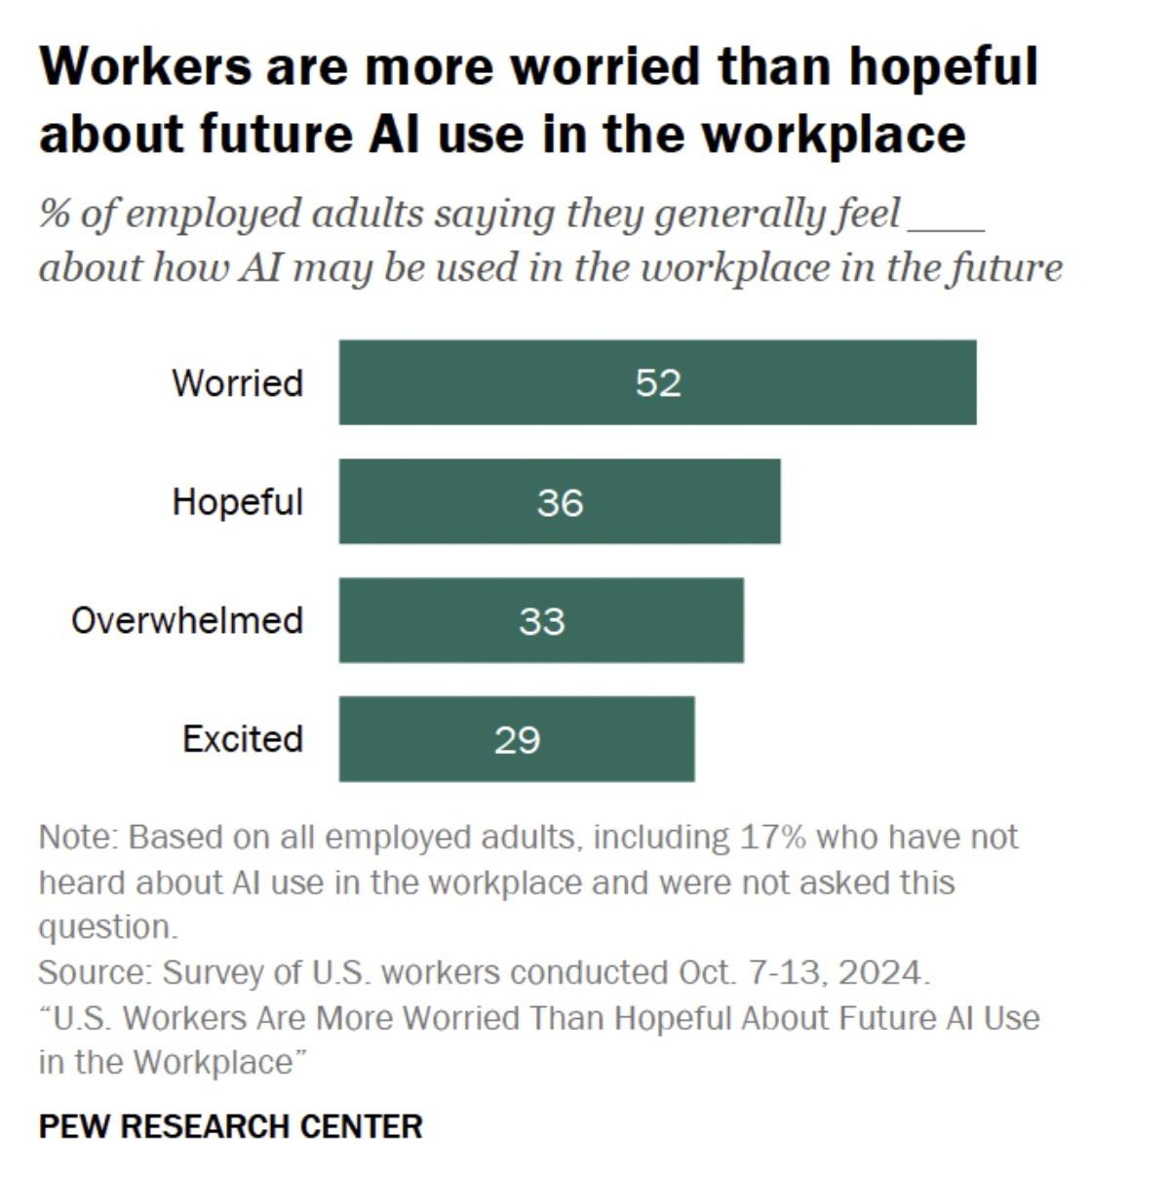
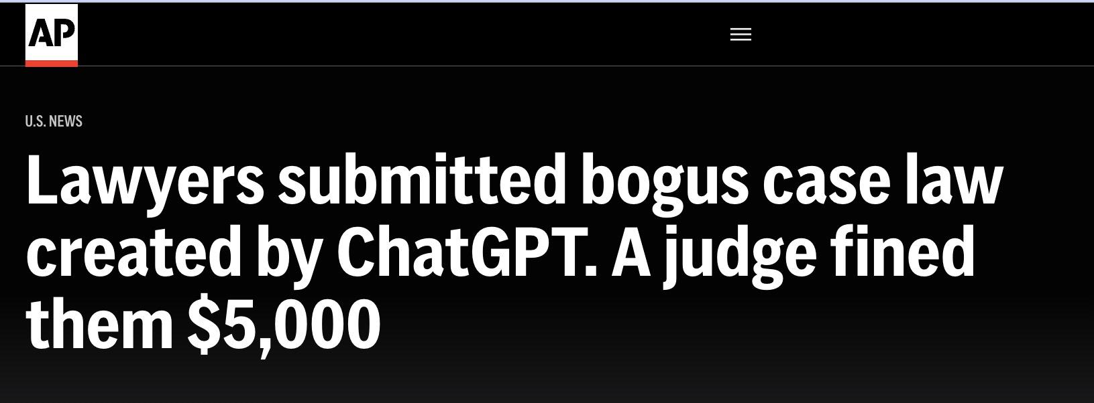
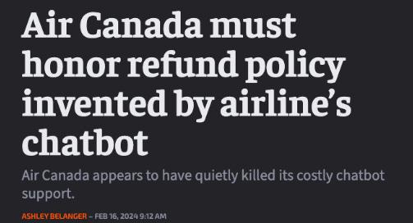
Fear and lack of literacy about these tools
Notes:
Kene

Slide 12
Course Goals
🧠 AI Literacy: Base understanding of the underlying technology–avoid gaffes
🛠️ Essential Toolbox: Show you a range of useful tools and practices:
Websites, documents & presentations
Automated data analytics
Deep research and text analysis
Custom GPTs and chatbots
Workflow automations
GenAI for graphics, designs & images
🤝 Collaborative Brainstorming: Explore, test, and refine use-cases together; we’re all still learning.
Notes:
Kene

Slide 13
Now on to the final projects
Notes:
Camille

Slide 14
Instructions
You will deliver a 4- minute live presentation and submit your slide deck.
Your project should use at least two different modules of the course:
Websites, documents and presentations (Week 1)
Data analytics (Week 2)
Deep research and text analysis using LLMs (Week 3)
Chatbots/agents (Week 4)
Automation workflows (Week 5)
Designs, images and videos (Week 6)
Notes:
Sabina

Slide 15
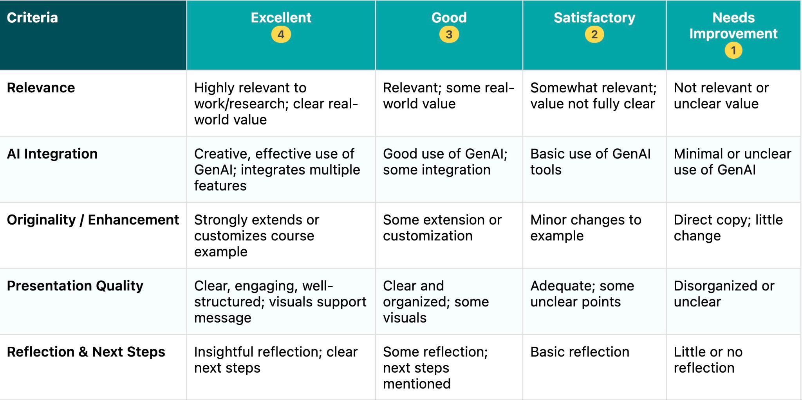
Grading
Notes:
Sabina

Slide 16
Order
Thibaut
Etienne
Callie
Laurent
Sabrine
Richmond
Nyi
Laura
Rocio
Garance
Bertha
Notes:
Sabina

Slide 17
Quick notes
Notes:
Camille

Slide 18
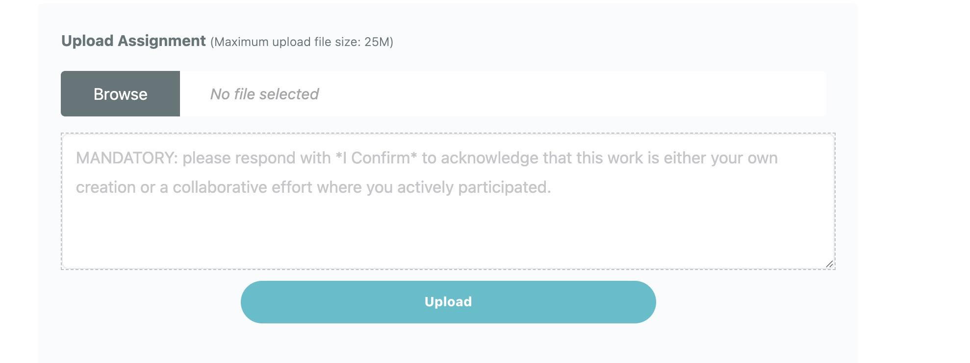
Reminder
You can upload up to three files for your final project.
Good idea to upload other relevant files (e.g. screenshots of relay scenarios, website HTML)
You can also comment on the page
Notes:
Sabina

Slide 19
Late assignments
If you miss the live presentation during workshop:
record a maximum 5 minute video of your presentation using a service like loom.com
Share the link to your video as a comment.
Grading & certificates by the end of the month
Notes:
Sabina

Slide 20
Wrap up
Notes:
Camille

Slide 21




Next steps? Further learning
Build out projects with tools we learned
genai_software_compilation
Keep up to date on further tools
Youtube.com , x.com and podcasts are your friends
Learn to code
thegraphcourses.org
Bring your team along
team-training

Slide 22
“Learning”?!
But I thought human skills were going obsolete
Notes:
Camille

Slide 23
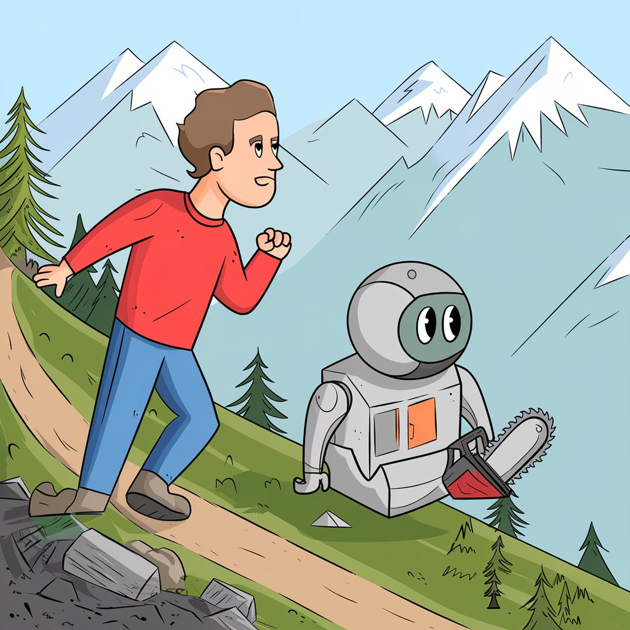
Golden age for learners
AI as a skill multiplier
Still need to know the domain to get the most from AI
Notes:
Camille

Slide 24
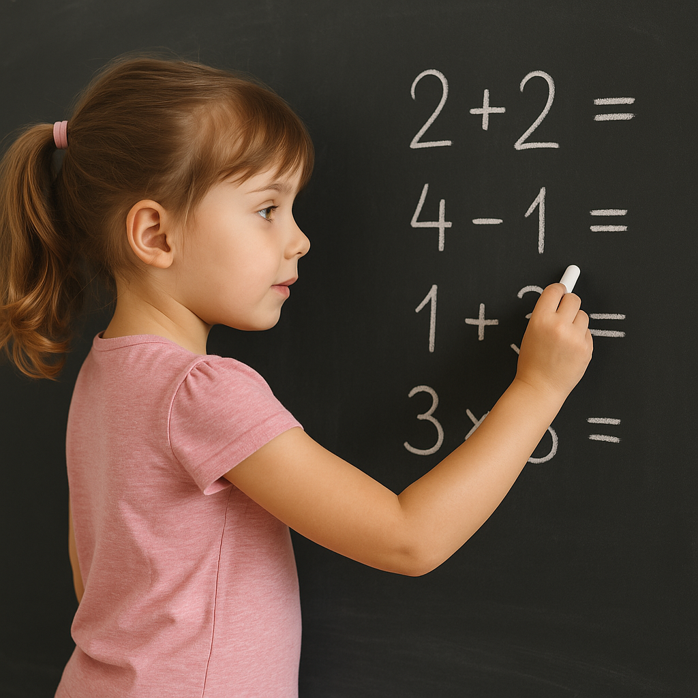

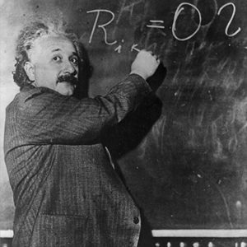
Consider an analogy: should children still learn arithmetic?
Even in a world with calculators (which can do arithmetic billions of times faster than humans)
🗣️ You still need to speak the "language" of arithmetic to specify what you want to the calculators, and understand what you get out.
🔧 Certain types of problems still need human judgment. These humans need strong foundations.

Slide 25
Even in a world where a majority of knowledge work is mediated through AI models
🗣️ Need to speak the "language"of each knowledge domain to specify, and understand
🔧 Certain types of problems will still need human judgment. Those humans need strong foundations.

Slide 26
Final Task assignment_turned_in
Post Course Survey
https://thegraphcourses.org/courses/aiw-2026-t2/topics/aiw-post-course-survey/
Notes:
Camille

Slide 27
mic
Open Mic!
Reflections on the journey?
+ Chance to say thanks to the group 🤝
Notes:
Camille

Slide 28
Thank you very much!
Notes:
Camille

