Slide 1
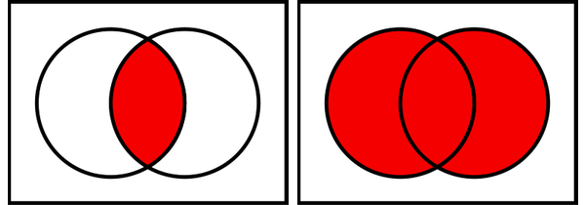
! A (Not A)
A | B (A or B)
A
A
B
A & B (A and B)
! (A & B) (Not A and Not B)
A
B
A
B

