Slide 1
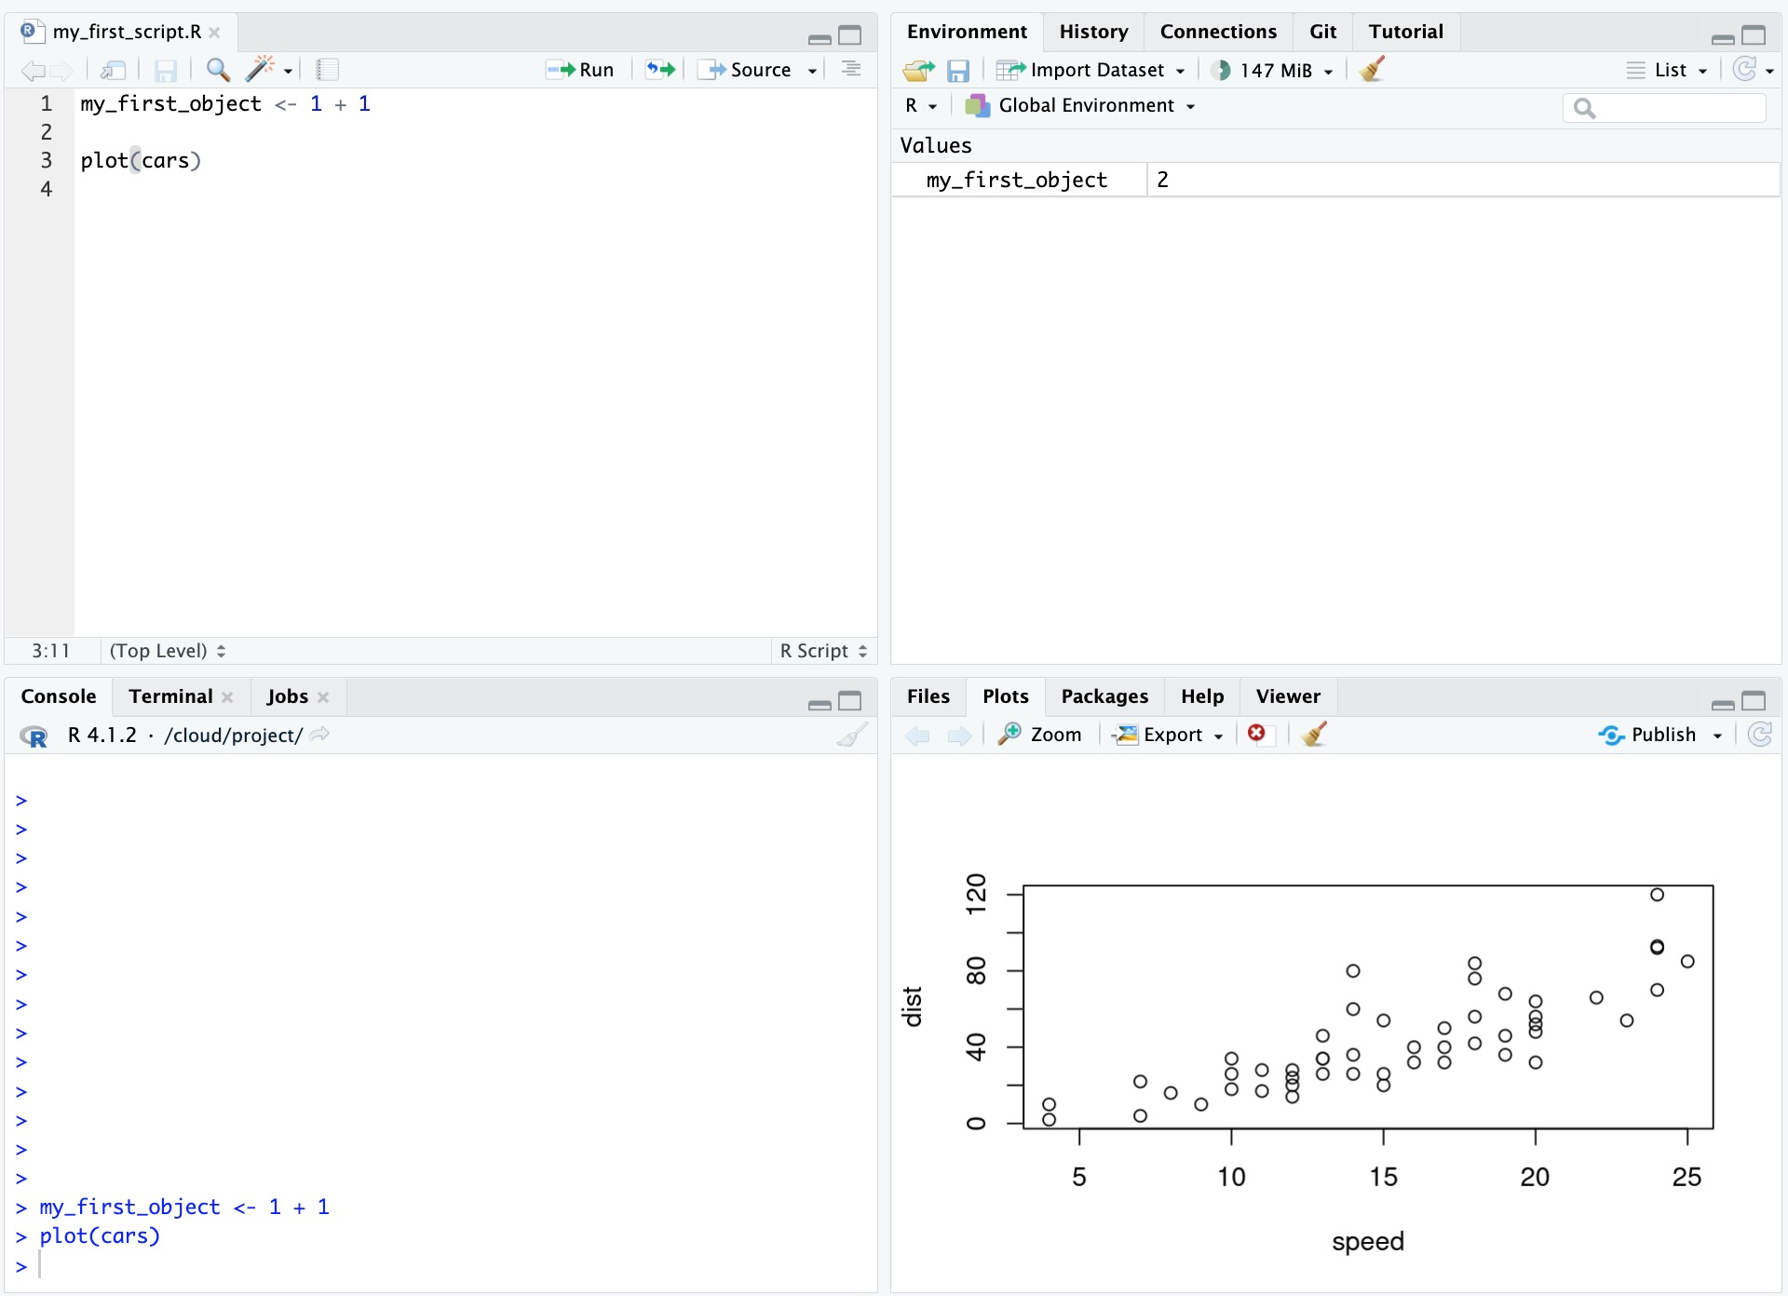
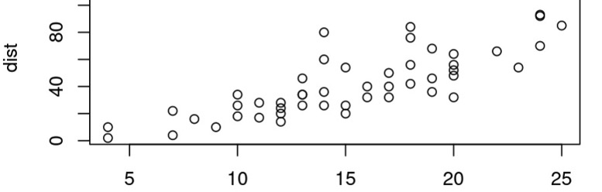
Environment: View objects in workspace
History: View previously run code
Connections: Connect to online services Git: Version control
Tutorial: Some R tutorials
Source: Write R scripts
Console: Run R code
Terminal: Text-based interface to computer
Jobs: Monitor background processes
Files: Browse project folder
Plots: View output figures
Packages: Install and load libraries Help: View documentation for functions
Viewer: Preview HTML outputs

Slide 2
Environment: View objects in workspace
Source: Write R scripts
History: View previously run code
Connections: Connect to online services
Git: Version control
Tutorial: Tutorials!
Viewer: Preview HTML outputs
Jobs: Monitor background jobs
Help: View documentation
Terminal: Text interface to computer
Packages: Install and load libraries
Console: Run R code
Plots: View output figures
Files: Browse folders

Slide 3




Highlight R function calls
Rainbow parentheses

Slide 4



Your Project Name
.Rproj (R Project File)
data
scripts
outputs

Slide 5
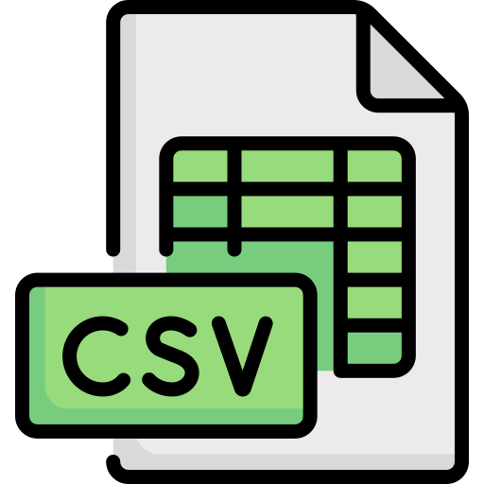
data
ebola_sierra_leone.csv
scripts
ebola_analysis.R
outputs
scripts import data from the data folder

Slide 6

data
ebola_sierra_leone.csv
scripts import data from the data folder
scripts
ebola_analysis.R
and write outputs to the outputs folder
outputs
histogram_plot.png
bar_plot.png
scripts import data from the data folder

