Slide 1

Prezi title
Subtitle

Slide 2
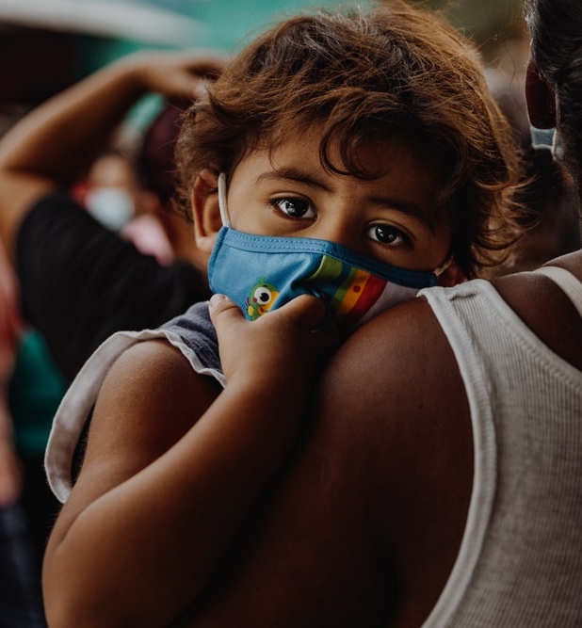
Section title

Slide 3
Slide title
Level 1
Level 2
Level 3
Default text box

Slide 4
Talking head dimensions
You don’t need to pay attention to the dimension numbers. Just paste this slide into your Camtasia canvas and adjust your talking head to fit in the circumscribed area.
13.36cm
33.87cm
19.05cm
4.5cm
28.8cm
4.5cm

