Slide 1
Lesson plan
Introduction
Setting up: Github.com & GitHub Desktop
Action Sequence 1: create new repo → commit → publish
Action Sequence 2: edit existing repo → commit → push
Git vocabulary & theory
Action Sequence 3: pull from remote
Action Sequence 4: add a new collaborator
Action Sequence 5: access old versions of file(s)
Action Sequence 6: fork and clone a repo
NOTES:
- Git can be painful
Several ways to use Git: command line, VSCode interface, GitHub Desktop
GitHub Desktop is the least painful

Slide 2
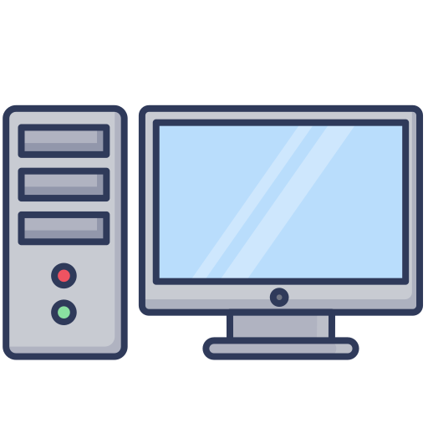

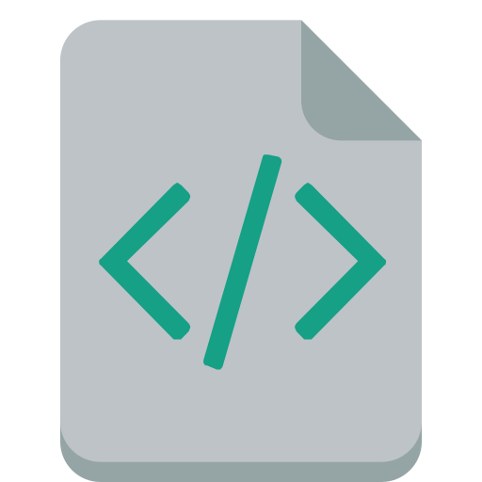
Action Sequence 1: Create a new repo & publish it to Github
With GitHub Desktop, create a new repository
Commit your changes
Publish your repository to GitHub
.com
Local Repo
Remote Repo
Repo (repository): Your project folder. This can be either local or remote.
Working
Copy
.git Directory
commit
Local Repo: Version of the folder on your local computer
Remote Repo: Version of the folder on online service like GitHub. Sometimes called origin.
publish

Slide 3
Action Sequence 1.1: Add an existing folder to github
With GitHub Desktop, create a new repository
Move your files into this repo
Commit your changes
Publish your repository to GitHub
.com
Local Repo
Remote Repo
Repo (repository): Your project folder. This can be either local or remote.
Working
Copy
.git Directory
commit
Local Repo: Version of the folder on your local computer
Remote Repo: Version of the folder on online service like GitHub. Sometimes called origin.
publish

Slide 4
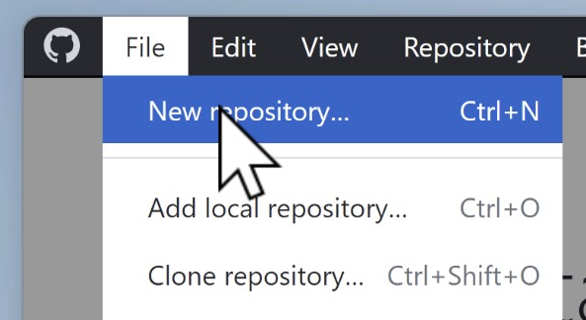
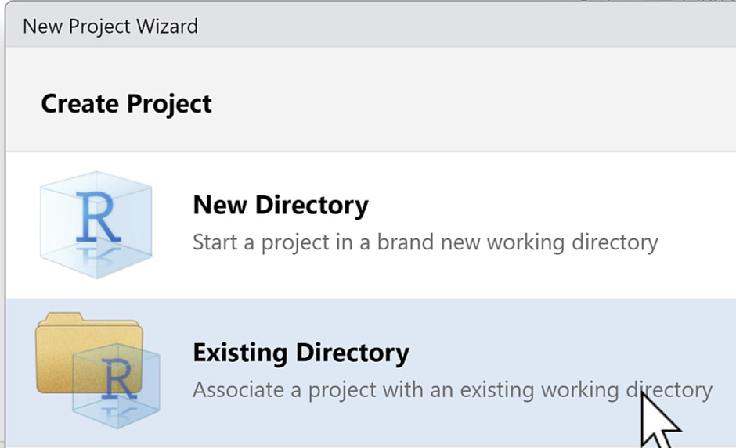
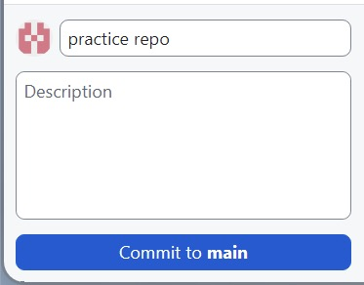
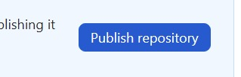
Practice Q: Create a new repo & publish it to Github
Create a new repository called hello_world
Add a new script called “main.py” to the repository with the following code
print("Hello, World!")
Share this repository publicly to your online GitHub account.

Slide 5
Action Sequence 2: Make changes, commit & push
With VScode, update some code in your existing repo
Commit the new changes
Push your changes to GitHub
.com
Local Repo
Remote Repo
Working
Copy
.git Directory
commit
push

Slide 6
Practice Q : Update your repository, commit & push
Open the “hello_world” repository and change the code in in the main.py file to
print("Hello, Universe!")
Commit this change and push the change to your online GitHub account.

Slide 7
Learning git vocabulary
Repo (repository): Your project folder. This can be either local or remote.
Local Repo: Version of the folder on your local computer
Remote Repo: Version of the folder on online service like GitHub. Sometimes called origin.
.com
Local Repo
Remote Repo
Working
Copy
.git Directory
Your local repo contains:
Working Copy: The current version of files you’re working on. .git Directory: folder (sometimes hidden) that keeps track of file versions, “commits”.
commit
push
GIT VERBS:
pull
commit: Save the current version of files to the .git directory
push: Upload your latest commits to the remote repo. First time: publish
pull: Get the latest commits from the remote repo. First time: clone
*verbs are in lowercase because these are git command line terms
* commit is also a noun. E.g. “My latest commits”

Slide 8
Practice Vocab: Match the word to its definition
A. A snapshot of the current state of a working directory
B. Upload your latest commits to the remote repo
C. Get the latest commits from the remote repo
D. Your project folder
E. Version of your project hosted on a shared network
1. push
2. pull
3. commit
4. remote
5. repo
Answers: 1B, 2C, 3A, 4E, 5D

Slide 9
How collaboration fits into the picture
.com
Local Repo
Remote Repo
Bob’s local repo
Working
Copy
.git Directory
.git directory
Working
copy
commit
commit
push
push
pull
pull

Slide 10

Practice Vocab: Office chat quiz | Fill in the blanks
Adam: Hey Bob! Did you start the analysis yet? If you did, can you _______ your _______ to ________ so that I can _______ it to my computer?
GitHub, repo, publish, clone
Bob: Yes, it’s already on _________. But give me until noon to ________ my latest _________.
commits, push, GitHub
Adam: Great! I’ll _________ the repo now to look. At noon, I’ll ________ your more recent _______!
commits, pull, clone
Answers:
- …If you did, can you publish your repo to GitHub so that I can clone it to my computer?
Yes, it’s already on GitHub. But give me until noon to push my latest commits.
Great! I’ll clone the repo now to look. At noon, I’ll pull your more recent commits!

Slide 11
Let’s talk briefly about branches
.com
Local Repo
Remote Repo
Bob’s local repo
Working
Copy
.git Directory
.git directory
Working
copy
commit
commit
push
push
pull
pull

Slide 12
Let’s talk briefly about branches
.git Directory
Not necessarily linear!

Slide 13
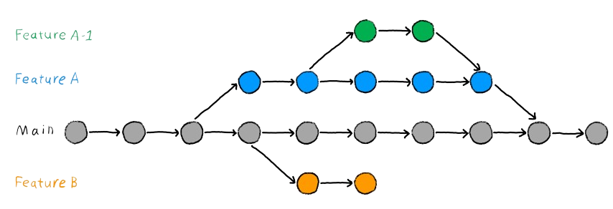
Let’s talk briefly about branches
Central branch called “main or “master”
Source: https://the-turing-way.netlify.app/reproducible-research/vcs/vcs-git-branches.html

Slide 14
Lesson plan
Introduction
Setting up: Github.com & GitHub Desktop
Action Sequence 1: create new repo → commit → publish
Action Sequence 2: edit existing repo → commit → push
Git vocabulary & theory
Action Sequence 3: pull from remote
Action Sequence 4: add a new collaborator
Action Sequence 5: access old versions of file(s)
Action Sequence 6: fork and clone a repo
NOTES:
- Git can be painful
Several ways to use Git: command line, VSCode interface, GitHub Desktop
GitHub Desktop is the least painful

Slide 15
Action Sequence: Pulling changes from remote
pull from remote
.com
Local Repo
Remote Repo
Working
Copy
.git Directory
commit
push
pull

Slide 16
Action Sequence: Pulling changes from remote
We’ll simulate being a coworker by making an edit on the online version of our repo.
Pulling that change to your local repository

Slide 17
Practice Q: Pulling changes from remote
Reproduce a similar process on your “hello_world” project.
On GitHub, change the code from
print(“Hello, Universe”)
to
print(“Goodnight moon”)
Then pull the changes to your local repo

Slide 18
Lesson plan
Introduction
Setting up: Github.com & GitHub Desktop
Action Sequence 1: create new repo → commit → publish
Action Sequence 2: edit existing repo → commit → push
Git vocabulary & theory
Action Sequence 3: pull from remote
Action Sequence 4: add a new collaborator
Action Sequence 5: access old versions of file(s)
Action Sequence 6: fork and clone a repo
NOTES:
- Git can be painful
Several ways to use Git: command line, VSCode interface, GitHub Desktop
GitHub Desktop is the least painful

Slide 19

Action Sequence: Add a new collaborator
.com
Local Repo
Remote Repo
Bob’s local repo
.git Directory
Add a new collaborator
Working
Copy
.git directory
Working
copy
commit
commit
push
push
pull
pull

Slide 20
Lesson plan
Introduction
Setting up: Github.com & GitHub Desktop
Action Sequence 1: create new repo → commit → publish
Action Sequence 2: edit existing repo → commit → push
Git vocabulary & theory
Action Sequence 3: pull from remote
Action Sequence 4: add a new collaborator
Action Sequence 5: access old versions of file(s)
Action Sequence 6: fork and clone a repo
NOTES:
- Git can be painful
Several ways to use Git: command line, VSCode interface, GitHub Desktop
GitHub Desktop is the least painful

Slide 21
Action Sequence: Access old versions of your file

Slide 22
Action Sequence: Access old versions of your file
.com
Local Repo
Remote Repo
Bob’s local repo
Working
Copy
.git Directory
Access old file versions
.git directory
Working
copy
commit
commit
push
push
pull
pull

Slide 23
Action Sequence: Access old versions of your file
Go to github.com and view old commits, then copy or download
There are ways to do this locally, but involve more steps.

Slide 24
Practice Q: Access old versions of your files
Navigate to your “hello_world” project on Github.com
Browse the old commits of your files

Slide 25
Lesson plan
Introduction
Setting up: Github.com & GitHub Desktop
Action Sequence 1: create new repo → commit → publish
Action Sequence 2: edit existing repo → commit → push
Git vocabulary & theory
Action Sequence 3: pull from remote
Action Sequence 4: add a new collaborator
Action Sequence 5: access old versions of file(s)
Action Sequence 6: fork and clone a repo
NOTES:
- Git can be painful
Several ways to use Git: command line, VSCode interface, GitHub Desktop
GitHub Desktop is the least painful

Slide 26
Action Sequence: fork and clone a repository

Slide 27
Action Sequence: fork and clone a repository
github.com/the-graph-courses/fork-practice
fork
.com
.com
Local Repo
Remote Repo
Someone else’s repo
Working
Copy
.git Directory
clone

Slide 28
SUMMARY

Slide 29
Action Sequence 1: create new repo → commit → publish
.com
Local Repo
Remote Repo
Working
Copy
.git Directory
commit
publish

Slide 30
Action Sequence 2: edit existing repo → commit → push
.com
Local Repo
Remote Repo
Working
Copy
.git Directory
commit
push

Slide 31
Action Sequence 3: pull from remote
.com
Local Repo
Remote Repo
Working
Copy
.git Directory
pull

Slide 32
Action Sequence 4: add a new collaborator
.com
Local Repo
Remote Repo
Bob’s local repo
.git Directory
Add a new collaborator
Working
Copy
.git directory
Working
copy
commit
commit
push
push
pull
pull

Slide 33
Action Sequence 5: access old versions of your file
.com
Local Repo
Remote Repo
Bob’s local repo
Working
Copy
.git Directory
Access old file versions
.git directory
Working
copy
commit
commit
push
push
pull
pull

Slide 34
Action Sequence 6: fork and clone a repo
fork
github.com/the-graph-courses/fork-practice
.com
.com
Local Repo
Remote Repo
Someone else’s repo
Working
Copy
.git Directory
clone

Slide 35
Lesson plan
Introduction
Setting up: Github.com & GitHub Desktop
Action Sequence 1: create new repo → commit → publish
Action Sequence 2: edit existing repo → commit → push
Git vocabulary & theory
Action Sequence 3: pull from remote
Action Sequence 4: add a new collaborator
Action Sequence 5: access old versions of file(s)
Action Sequence 6: fork and clone a repo

