Slide 1
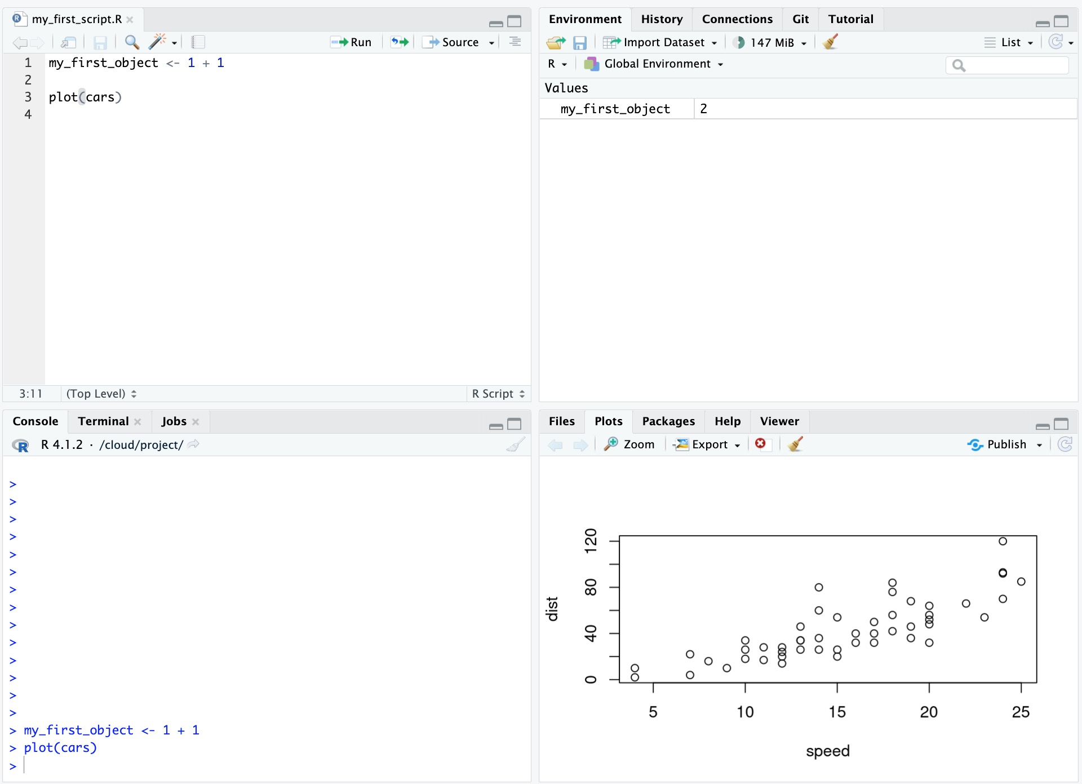
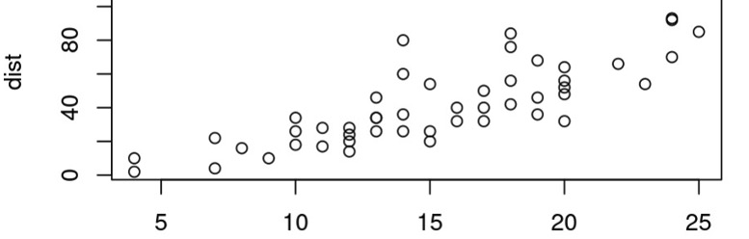
Environment: View objects in workspace
History: View previously run code
Connections: Connect to online services
Git: Version control
Tutorial: Some R tutorials
Source: Write R scripts
Console: Run R code
Terminal: Text-based interface to computer
Jobs: Monitor background processes
Files: Browse project folder
Plots: View output figures
Packages: Install and load libraries
Help: View documentation for functions
Viewer: Preview HTML outputs

Slide 2
Environment: View objects in workspace
Source: Write R scripts
History: View previously run code
Connections: Connect to online services
Git: Version control
Tutorial: Tutorials!
Viewer: Preview HTML outputs
Jobs: Monitor background jobs
Help: View documentation
Terminal: Text interface to computer
Packages: Install and load libraries
Console: Run R code
Plots: View output figures
Files: Browse folders

Slide 3
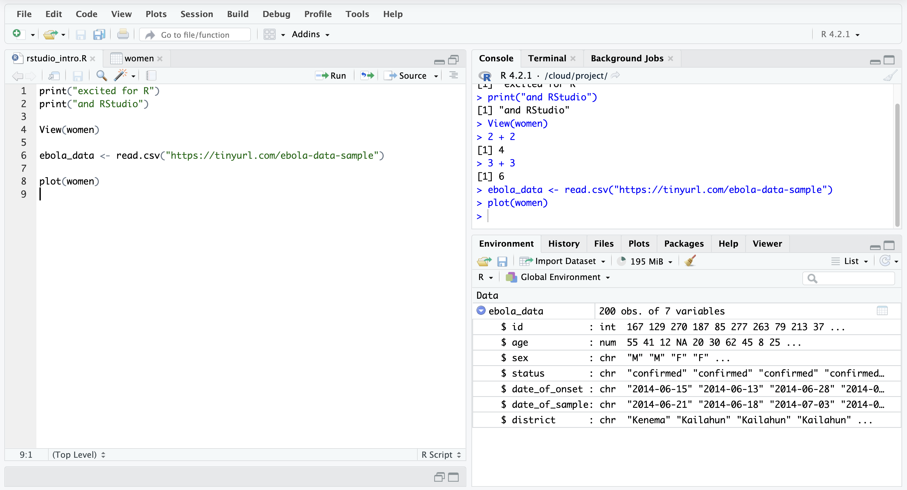

Slide 4
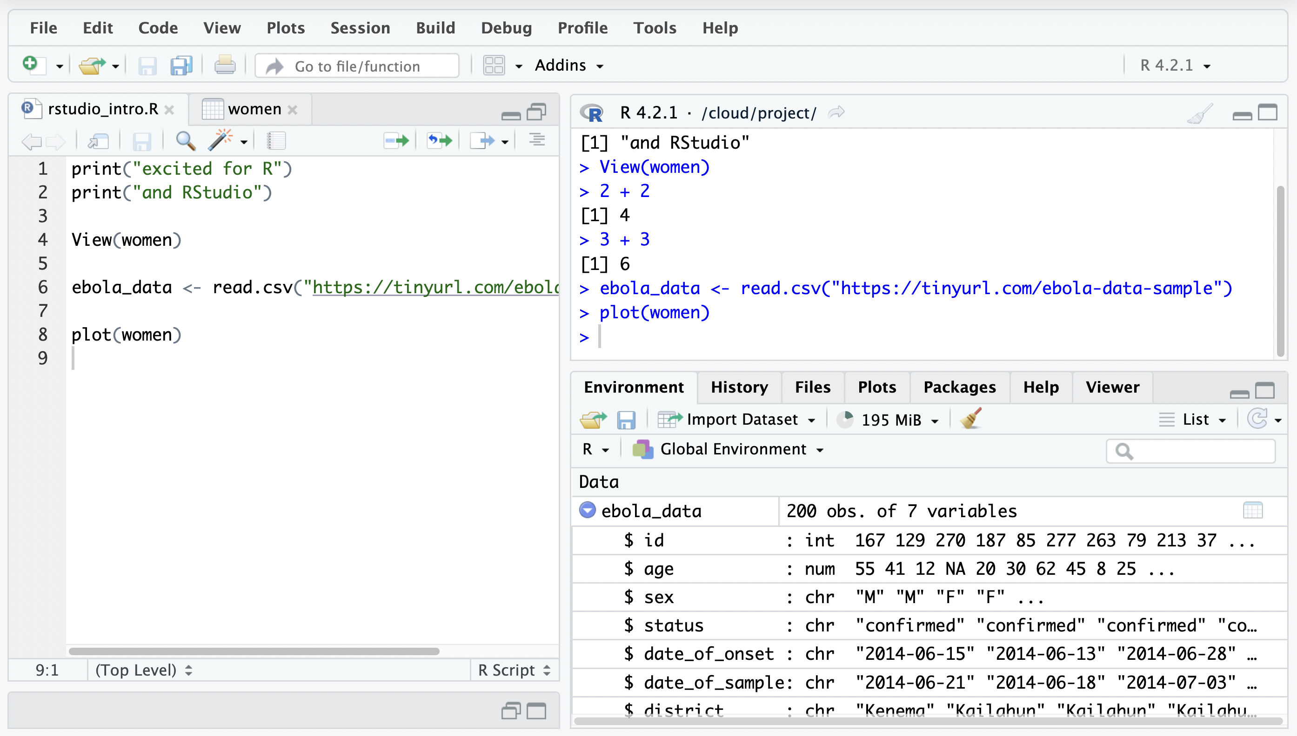
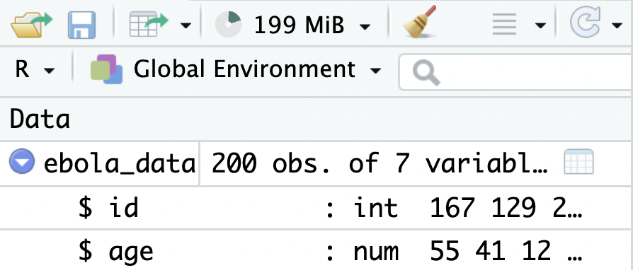
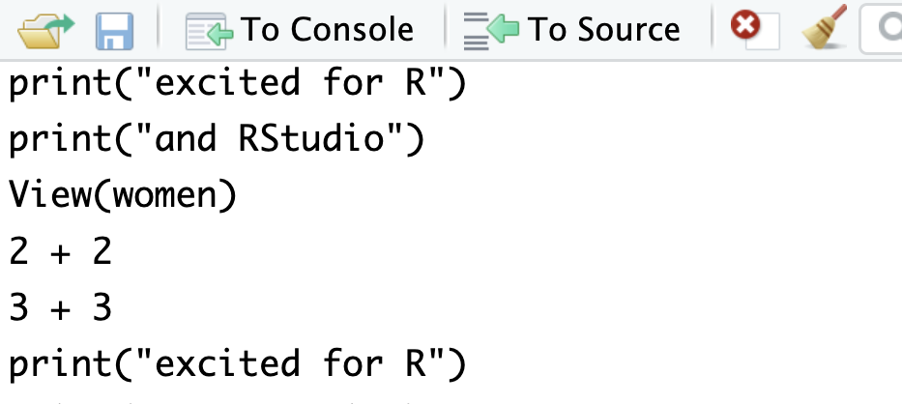
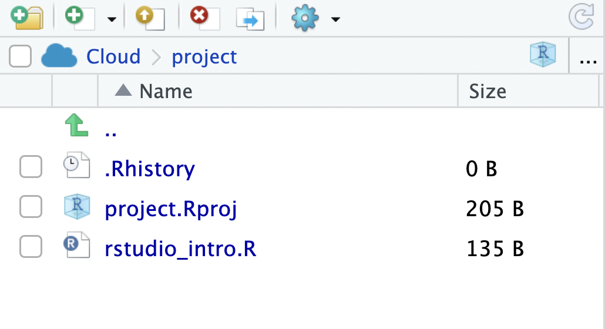
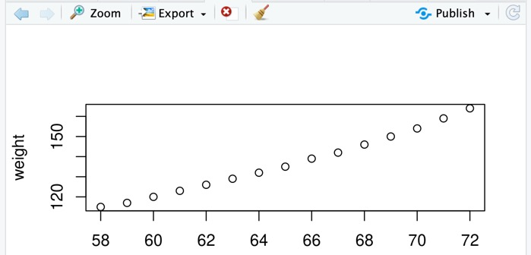
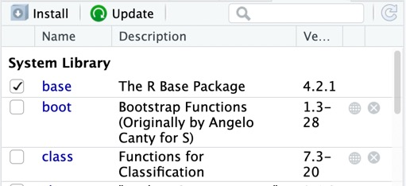
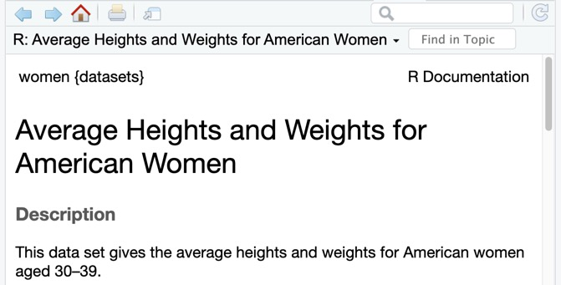
Editor
Type and save code as scripts
Console
Run code
Environment
View datasets & other objects in workspace
History
View and search through previous commands
Files
Interact with the computer’s fie system
Plots
View and export plots created with R
Packages
Install and load packages
Help
Consult R documentation

Slide 5

my_obj <- 20
Put the number 20 inside an object called `my_obj`
20
my_obj

Slide 6
first_name <- “Joanna”
Put the value “Joanna” inside an object called `first_name`
“Joanna”
first_name

Slide 7
my_obj <- 2 + 2
Evaluate `2 + 2` then store the result inside an object called `my_obj`
4
2 + 2
my_obj

Slide 8
my_obj <- 20
Put the number 4 inside an object called 'my_obj'
20
“Joanna”
20
my_obj
first_name
my_obj

Slide 9




Highlight R function calls
Rainbow parentheses

Slide 10



Your Project Name
.Rproj (R Project File)
data
scripts
outputs

Slide 11

data
ebola_sierra_leone.csv
scripts
ebola_analysis.R
outputs
scripts import data from the data folder

Slide 12

data
ebola_sierra_leone.csv
scripts import data from the data folder
scripts
ebola_analysis.R
and write outputs to the outputs folder
outputs
histogram_plot.png
bar_plot.png
scripts import data from the data folder

