Slide 1
Learning Objective
You can access R and Rstudio, either through RStudio.cloud or on your local computer.
Notes:
To start you off on your R journey, we'll need to set you up with the required software, R and RStudio. R is the programming language that you'll use write code, while RStudio is an integrated development environment (IDE) that makes working with R easier. To follow this course, you’ll need to get access to both these tools. So let’s get started.

Slide 2

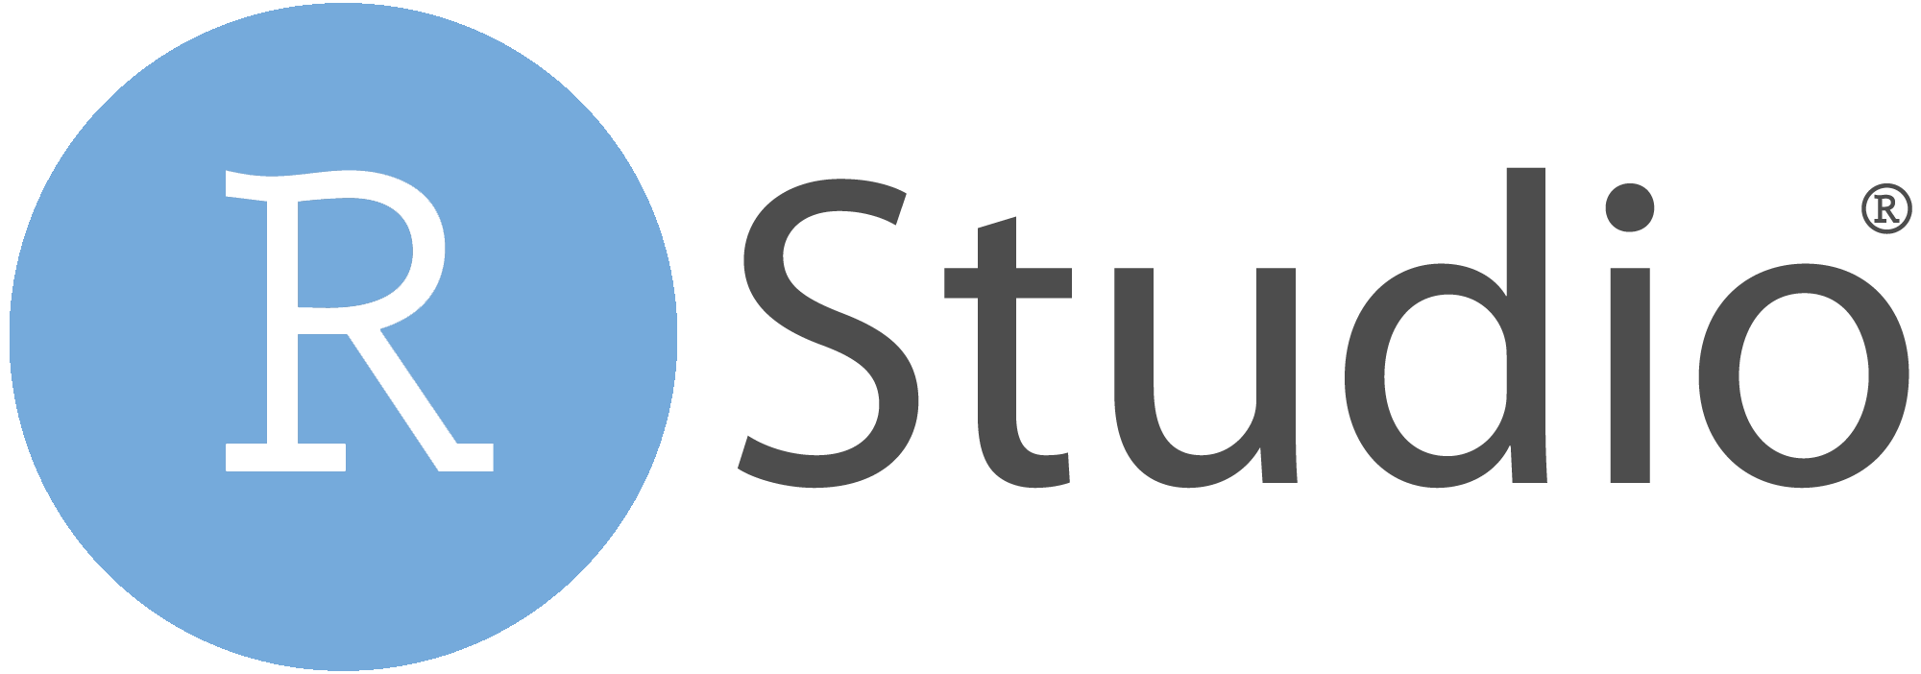
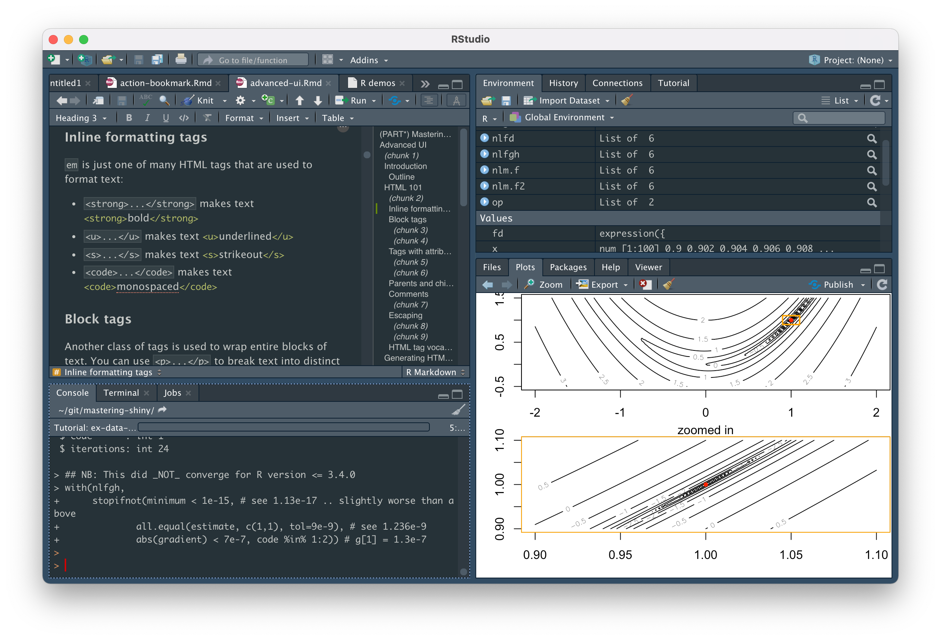
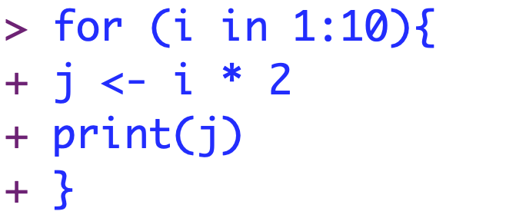
R vs RStudio
Programming language
Integrated development environment (IDE)
Notes:
Two quick distinctions before we start.
What is R and what is Rstudio
R is programming language.
To work with R on your computer, you need to download this language.
Specifically what you’ll be downloading is an interpreter that will allow your computer to understand the R code that you write
Rstudio is an IDE
Many other IDEs. But Rstudio is by far the best at the moment.

Slide 3



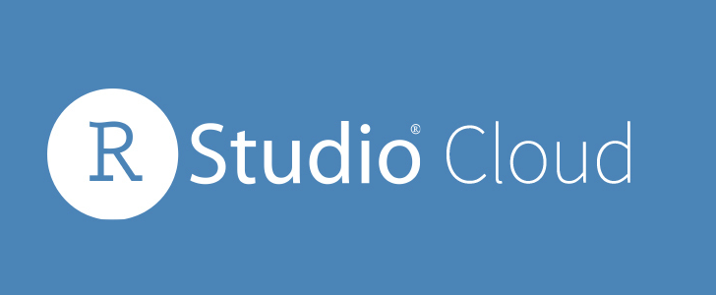
Cloud vs local
Quick test-drive
Your computer is old or slow
Run into trouble with installation
25 hours per month free

Slide 4

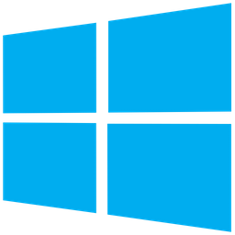
Local
(Windows)
Local
(macOS)
Cloud

