Slide 1
Learning Objective
You can identify and use the following tabs in RStudio: Source, Console, Environment, History, Files, Plots, Packages, Help and Viewer.
Notes:
To start you off on your R journey, we'll need to set you up with the required software, R and RStudio. R is the programming language that you'll use write code, while RStudio is an integrated development environment (IDE) that makes working with R easier. To follow this course, you’ll need to get access to both these tools. So let’s get started.

Slide 2
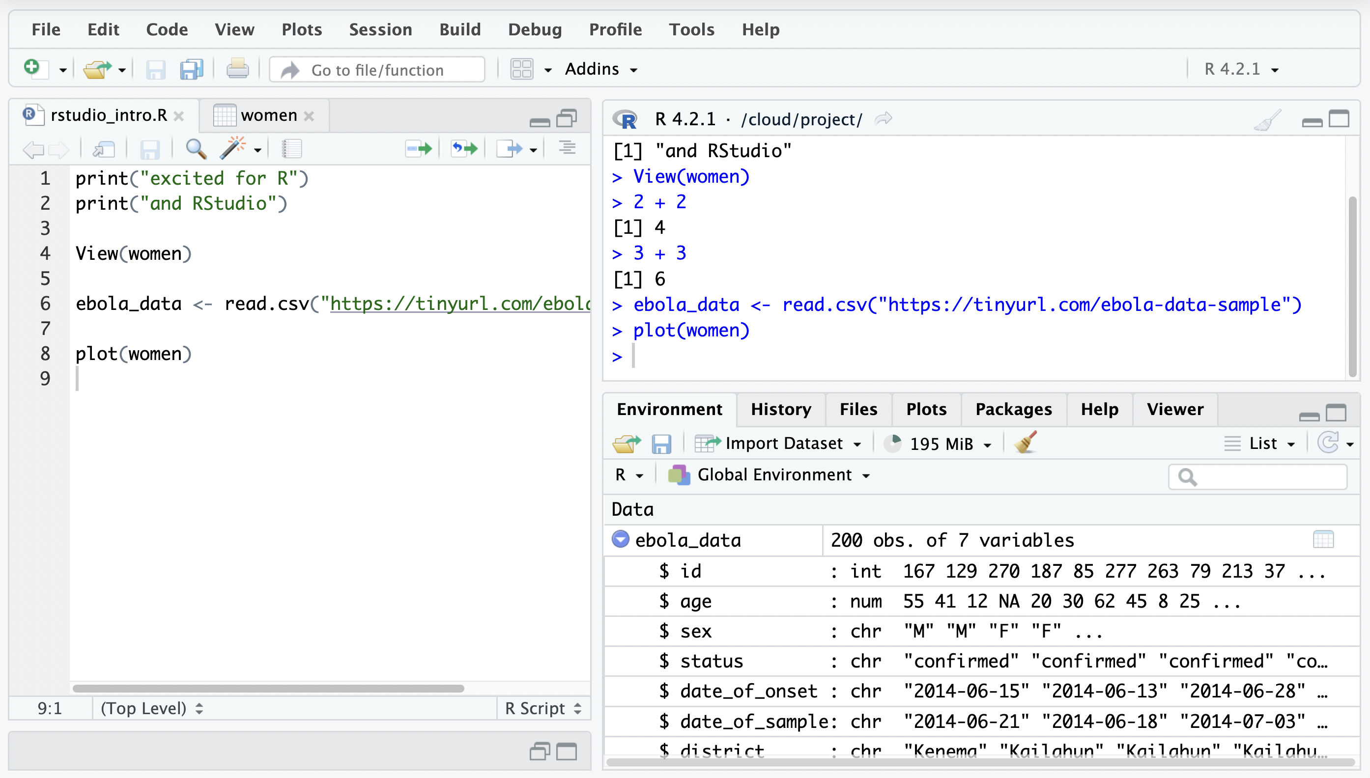
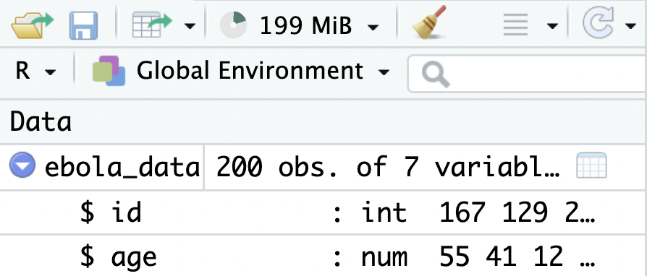
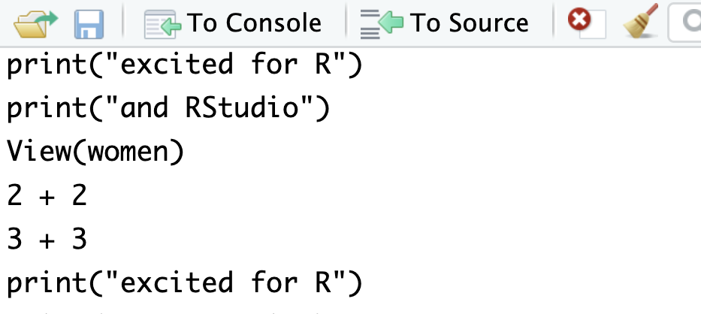
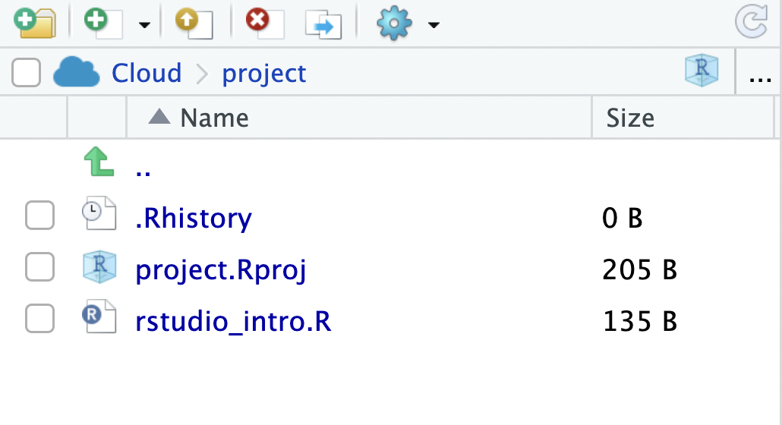
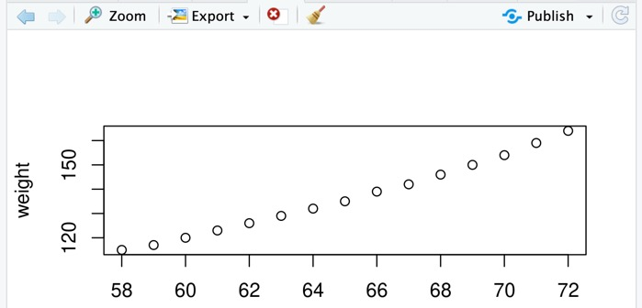
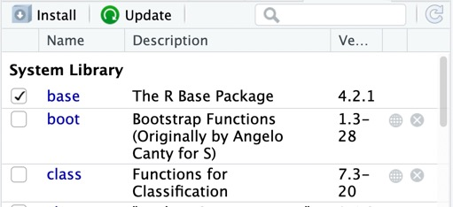
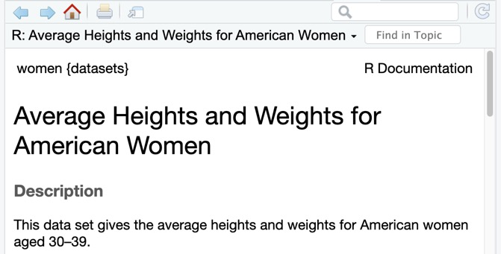
Learning Objective
Editor
Type and save code as scripts
Console
Run code
Environment
View objects in workspace
History
View previously-run commands
Files
Interact with the computer’s files
Plots
View and export plots
Packages
Install and load packages
Help
Consult R documentation
Notes:
To start you off on your R journey, we'll need to set you up with the required software, R and RStudio. R is the programming language that you'll use write code, while RStudio is an integrated development environment (IDE) that makes working with R easier. To follow this course, you’ll need to get access to both these tools. So let’s get started.

Slide 3
Don’t panic
A lot of territory quickly
Won’t remember it all
Will be assimilated over the whole course
Notes:
To start you off on your R journey, we'll need to set you up with the required software, R and RStudio. R is the programming language that you'll use write code, while RStudio is an integrated development environment (IDE) that makes working with R easier. To follow this course, you’ll need to get access to both these tools. So let’s get started.

