Slide 1
Learning Objectives
You can write comments in R.
You can create section headers in RStudio.
You know how to use R as a calculator.
You can create, overwrite and manipulate R objects.
You understand the basic rules for naming R objects.
You understand the syntax for calling R functions.
You know how to nest multiple functions.
You can use install and load add-on R packages and call functions from these packages.
Notes:
To start you off on your R journey, we'll need to set you up with the required software, R and RStudio. R is the programming language that you'll use write code, while RStudio is an integrated development environment (IDE) that makes working with R easier. To follow this course, you’ll need to get access to both these tools. So let’s get started.

Slide 2
Quick notes
Quite long. Feel free to watch in sections.
Type with me!
Pause often to think
Watch several times (at 1x, then 1.5x, then 2x)
Notes:
To start you off on your R journey, we'll need to set you up with the required software, R and RStudio. R is the programming language that you'll use write code, while RStudio is an integrated development environment (IDE) that makes working with R easier. To follow this course, you’ll need to get access to both these tools. So let’s get started.

Slide 3

my_obj <- 20
Put the number 20 inside an object called `my_obj`
20
my_obj

Slide 4
first_name <- “Joanna”
Put the value “Joanna” inside an object called `first_name`
“Joanna”
first_name

Slide 5
my_obj <- 2 + 2
Evaluate `2 + 2` then store the result inside an object called `my_obj`
4
2 + 2
my_obj

Slide 6
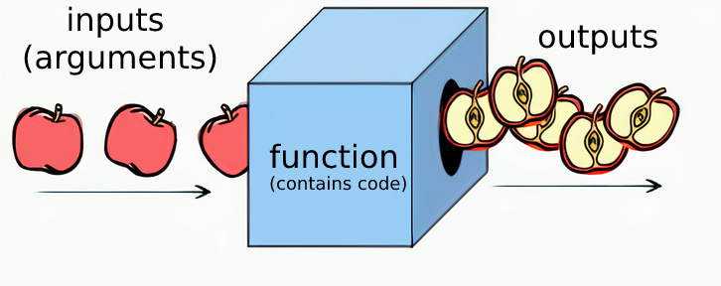

Slide 7
Learning Objectives
You can write comments in R.
You can create section headers in RStudio.
You know how to use R as a calculator.
You can create, overwrite and manipulate R objects.
You understand the basic rules for naming R objects.
You understand the syntax for calling R functions.
You know how to nest multiple functions.
You can use install and load add-on R packages and call functions from these packages.
Notes:
To start you off on your R journey, we'll need to set you up with the required software, R and RStudio. R is the programming language that you'll use write code, while RStudio is an integrated development environment (IDE) that makes working with R easier. To follow this course, you’ll need to get access to both these tools. So let’s get started.

