Slide 1


R for Busy People
Workshop 01

Slide 2
Workshop outline
- 👋🏽 Welcome and announcements (10 minutes)
- 👩🏽‍💻 Workshop exercise (1 hour)
👨‍👨‍👦‍👦 Presentations on google slides (40 minutes)
Prepare presentations (15 minutes)
Give presentations (25 minutes)

Slide 3

Reminders: do the homework!
Pre-work tasks should be done before the workshop (~ 4 hours per week)
Else you will get lost eventually!

Slide 4
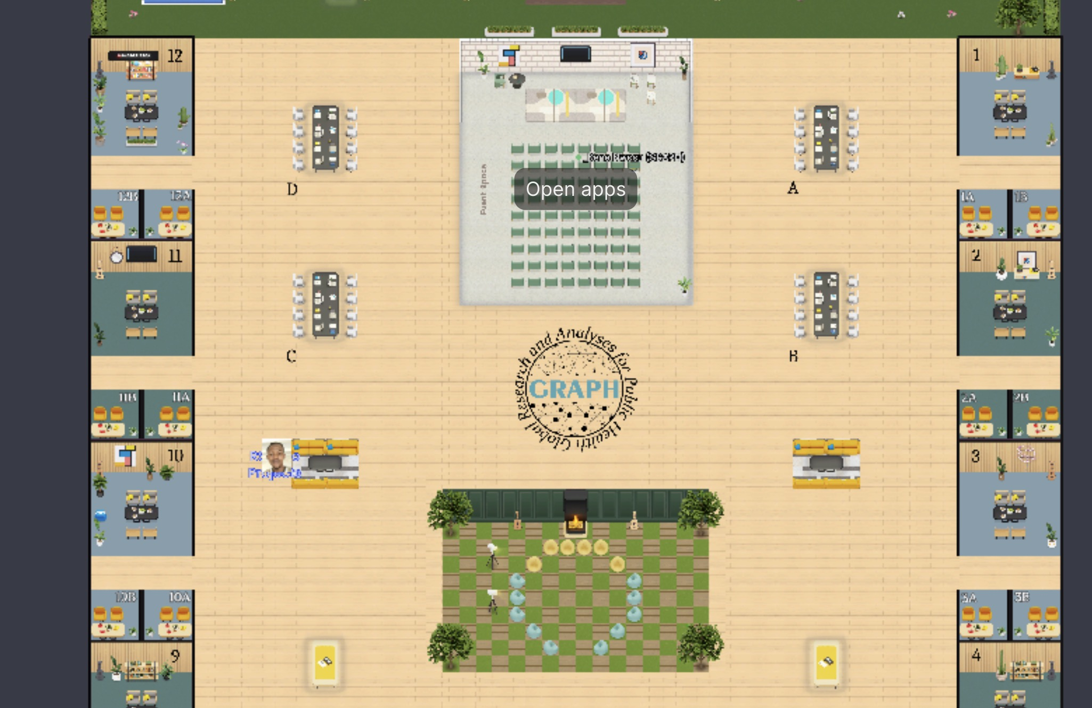
Reminder: help sessions on Tuesdays
Optional study hall sessions on Tuesdays 18:30 Lagos/London/GMT+1 time (19:30 Geneva/Lilongwe/GMT+2 time)

Slide 5

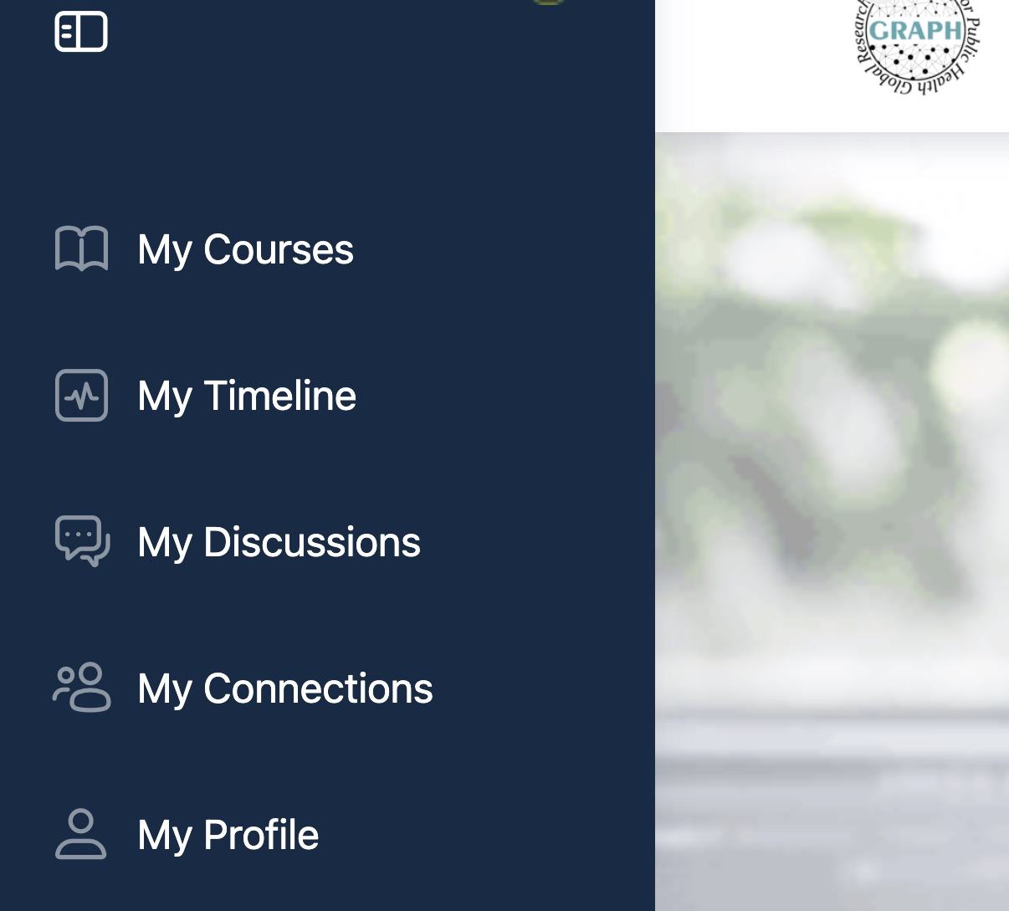
Reminder: enroll in the correct course
Make sure you are doing the correct course: R Basics and Beyond | Private Cohort. Not “Foundations of data analysis with R”
https://tinyurl.com/rbb000
Then accessible from your “My Courses” menu item.

Slide 6
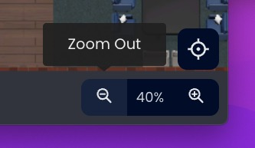
Reminder: zoom out!
Pinch your trackpad or scroll your scroll-wheel to zoom in or out
Or use the icons at the bottom right of the screen

Slide 7
Plan for today
Step 1: Split up into groups of 2 or 3 and pick a room
If you know someone you would like to work with, you can join them in a room
If not, you can
Go to Workshop 2 on the course page tinyurl.com/rbb000
Download the R script from there.
(Or with this link: )

Slide 8
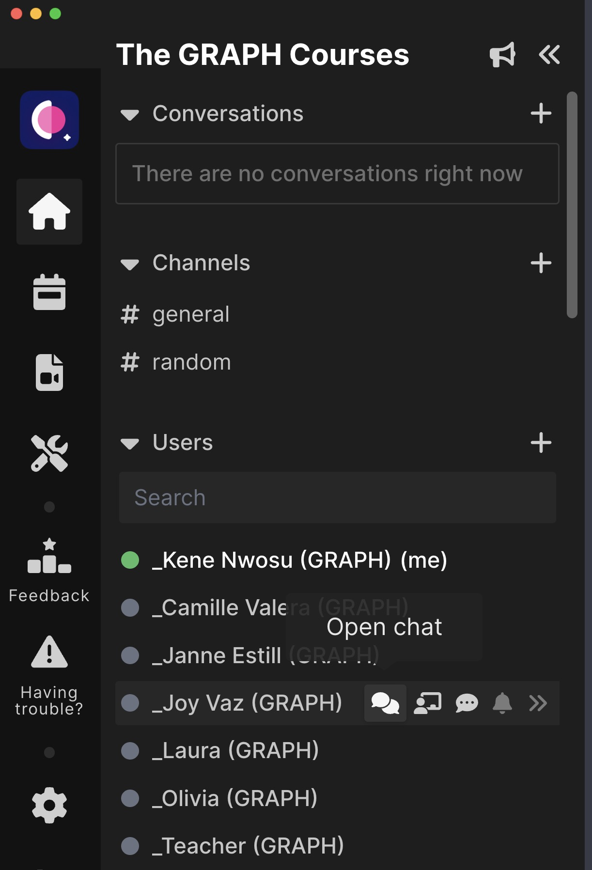
How to ask for help
Send a chat to any

Slide 11
Grading
At the end of the course, you will receive a certificate if you have passed the course
The final grade will be a combination of
Completion of self-learning material on the website (25%)
Attendance (10%). We will be lenient
Graded materials from the workshop (25%)
Final project (40%)
To pass the course, your overall grade will need to be above 70% across all of these

Slide 12
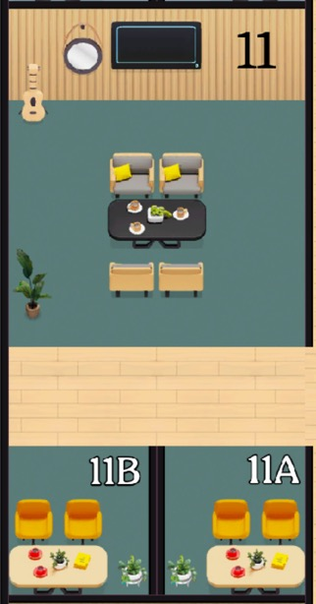

Classroom arrangement: pair rooms
Pair work: work with one other person in a pair room.
Can’t find a partner? Zoom out and look again.
If no success, join an existing pair to make a trio.
Sometimes pairs will be pre-assigned; sometimes you get to choose. Today you can pair yourselves.
Pair rooms

Slide 13
Classroom arrangement: pod rooms
Pod work: Join another pair in the pod room. 4 in a room.
Can’t find another pair to join? You can join an existing pod. Maximum of 6 people in a pod.
Pod/quartet room

Slide 14
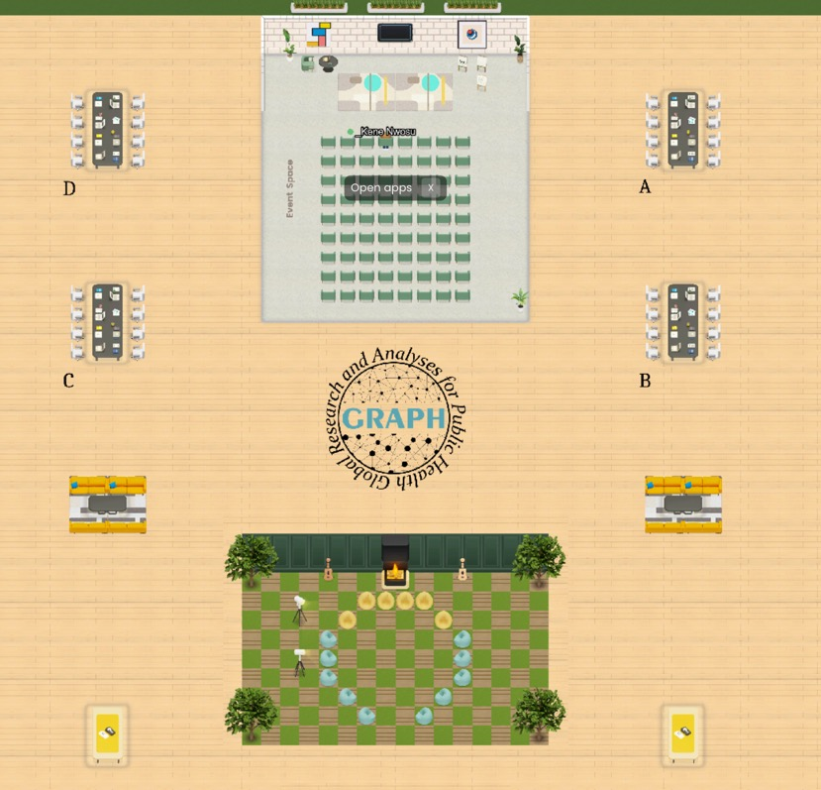
Classroom arrangement: quarter-class group
Conference desks
Pods 10 to 12
Pods 1 to 3
Pods 7 to 9
Pods 4 to 6

Slide 15
Classroom arrangement: half-class group
Conference desks
Pods 7 to 12
(left pods)
Pods 1 to 6
(right pods)

Slide 16
Classroom arrangement: half-class group alternative
Event space and Lounge room
Pods 1 to 6
(right pods)
Pods 7 to 9
(left pods)

Slide 17
Coaches
Coaches have an underscore before their names. E.g. _Laure, _Kene
They will either move from group to group or stay seated at the conference desks/ orange couches
To get help, go to a coaches’ desk directly
Or ping them in the chat with, for example @_Kene. When you use the @ symbol

Slide 18
Workshop outline
1. 👋🏽 GRAPH Network director intro + Info presentation
2. ⛸ Icebreaker: Where do you stand + Two words
3. 👩🏽‍💻 Exercise 1 on RStudio Cloud
Pair programming
4. 🥤15 minute tea/bathroom/games break
5. 👨‍👨‍👦‍👦 Discussion exercises
Pair discussion
Present to whole-class group

Slide 19
⛸ Icebreaker: Where do you stand? + Two-words
- Depending on your answer to questions below, go left or right (outside the room)
- Then answer the two-words question in your group
Left: Prefer in-person work | Right: Prefer remote work
In just two words tell us: Why is in-person/remote better?
Left: You work directly in public health | Right: Don’t work directly in public health
In just two words tell us: Your study/work area
Left: Would rather watch/play sports | Right: Would rather listen to/play music
In just two words tell us: Your favorite sport /music genre (put link in chat)

Slide 20
Workshop outline
1. 👋🏽 GRAPH Network director intro + Info presentation
2. ⛸ Icebreaker: Where do you stand + Two words
3. 👩🏽‍💻 Exercise 1 on RStudio Cloud
Pair programming
4. 🥤15 minute tea/bathroom/games break
5. 👨‍👨‍👦‍👦 Discussion exercises
Pair discussion
Present to whole-class group

Slide 21
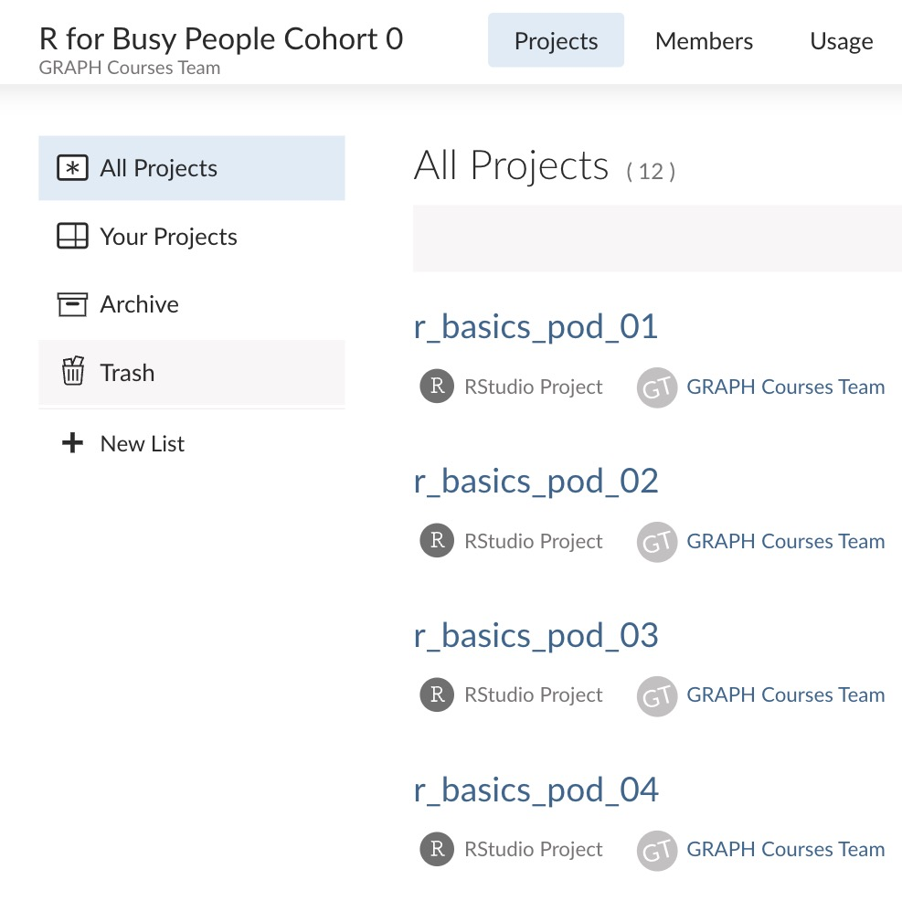
Exercise 1: Practice pair programming on Rstudio cloud
Find a partner and go to a pair room
Go to this link: tinyurl.com/rbp-cloud-workspace
Click on the Projects tab then on your pod project
Note: If you did not attend the workshop, you can skip to slide 19

Slide 22
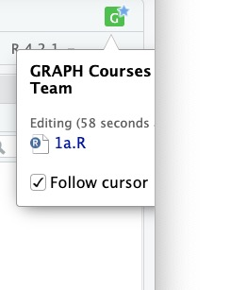
Exercise 1: Practice pair programming on Rstudio cloud
Click on the icon at the top right to follow the cursor of your partner.

Slide 23
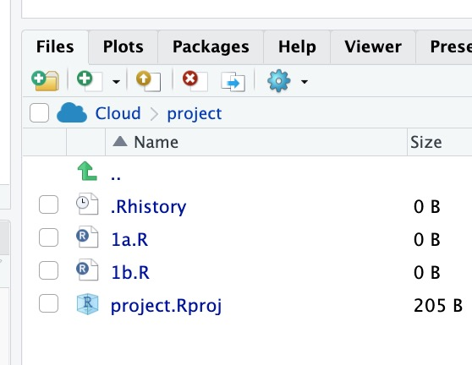
Exercise 1: Practice pair programming on Rstudio cloud
With your partner, open the file that corresponds to your pair room code.

Slide 24
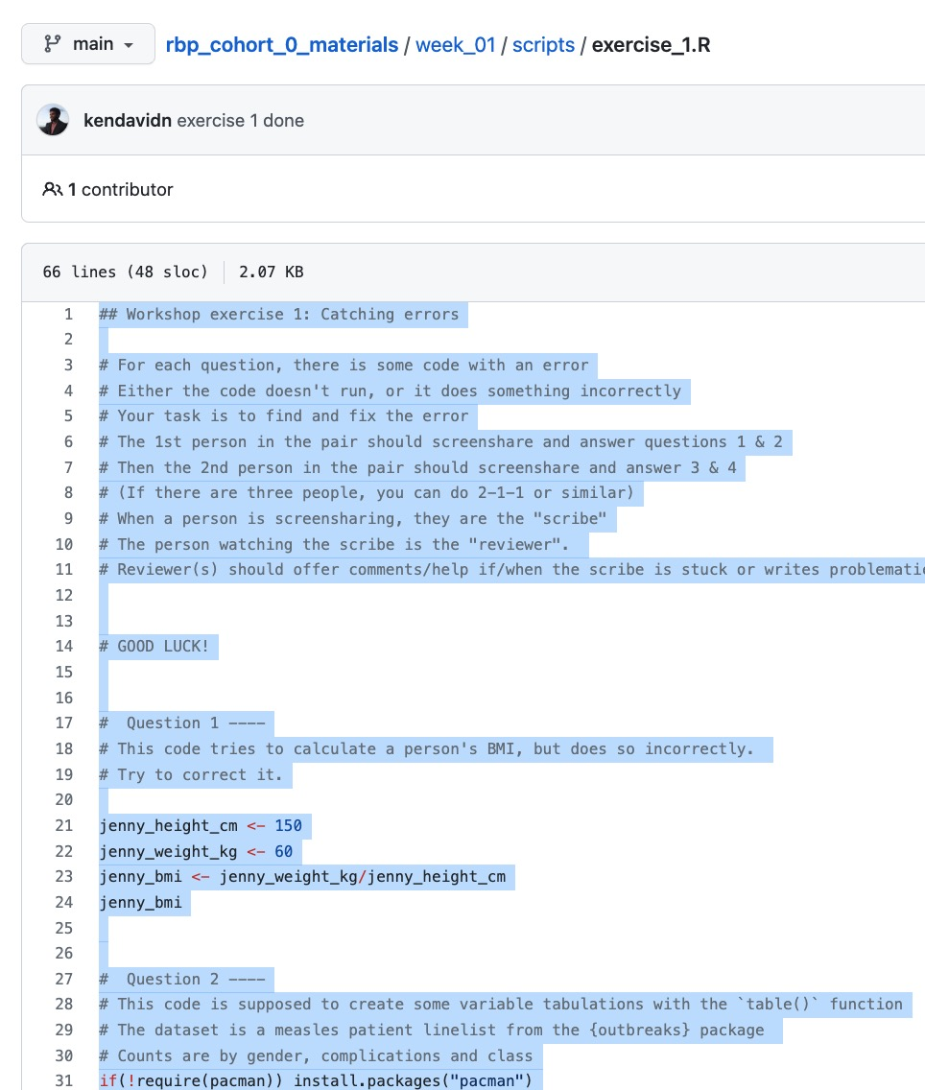
Exercise 1: Practice pair programming on Rstudio cloud
Go to this link:
tinyurl.com/rbp-week1-exercise1
And copy the code there into an R script
Then proceed with exercise 1

Slide 25
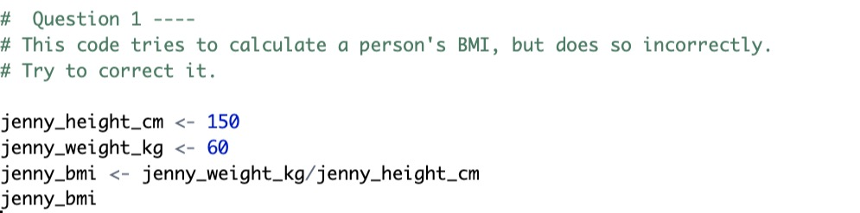
Exercise 1: Practice pair programming on Rstudio cloud
Exercise description
For each question, there is some code with an error.
Either the code doesn't run, or it does something incorrectly
The 1st person in the pair should screenshare and answer questions 1 & 2
Then the 2nd person in the pair should screenshare and answer 3 & 4
(If there are three people, you can do 1-1-2 or similar)
When a person is screensharing, they are the "scribe"
The person watching the scribe is the "reviewer".
Reviewer(s) should offer comments/help if/when the scribe is stuck or writes faulty code.

Slide 26
Exercise 1: Practice pair programming on Rstudio cloud
⏰
After around 30 minutes, we will reconvene for a whole group check-in
Then you will upload your scripts to the TGC website
Steps for this are given on the next slides

Slide 27
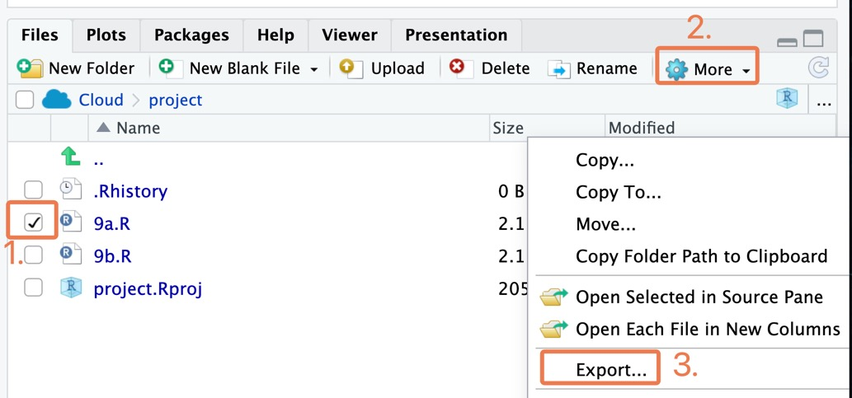
Steps for uploading script to TGC Website
Export the script from Rstudio Cloud
(If you’re not working on Rstudio Cloud, you can skip this step)

Slide 28
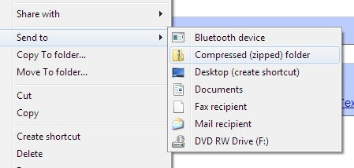
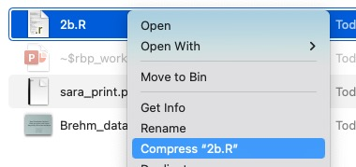
Steps for uploading script to TGC Website
Compress the R script to a zip file
Compressing on Windows:
Compressing on macOS:

Slide 29
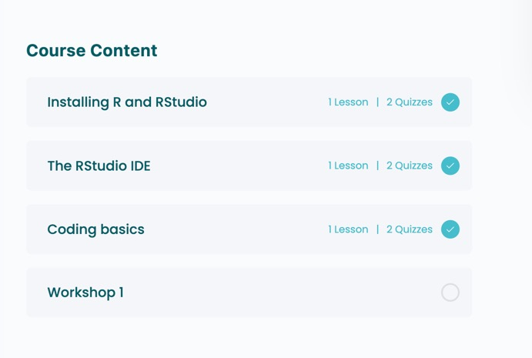
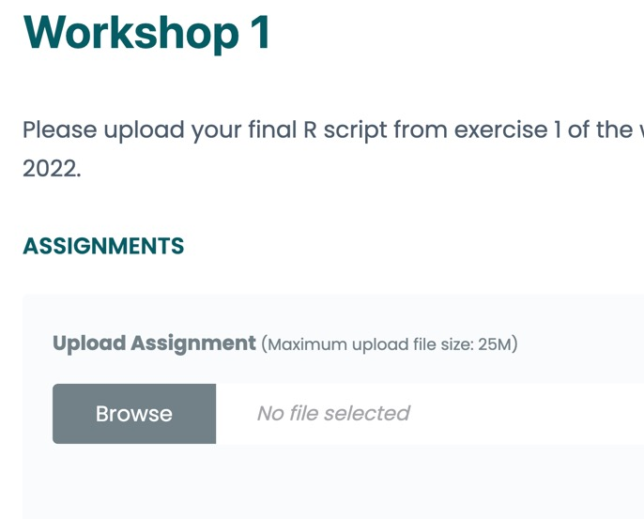
Steps for uploading script to TGC Website
Upload zip file to Workshop 1
2.
1.

Slide 30
Workshop outline
1. 👋🏽 GRAPH Network director intro + Info presentation
2. ⛸ Icebreaker: Where do you stand + Two words
3. 👩🏽‍💻 Exercise 1 on RStudio Cloud
Pair programming
4. 🥤15 minute tea/bathroom/games break
5. 👨‍👨‍👦‍👦 Discussion exercises
Pair discussion
Present to whole-class group

Slide 31
Discussion exercises: preview of data wrangling and data viz
Go back to your pair rooms
Go to the following link to view the assignment. rpubs.com/the-graph-courses/954551
First discuss them in your pairs
Then we’ll reunite as a whole class to discuss

Slide 32
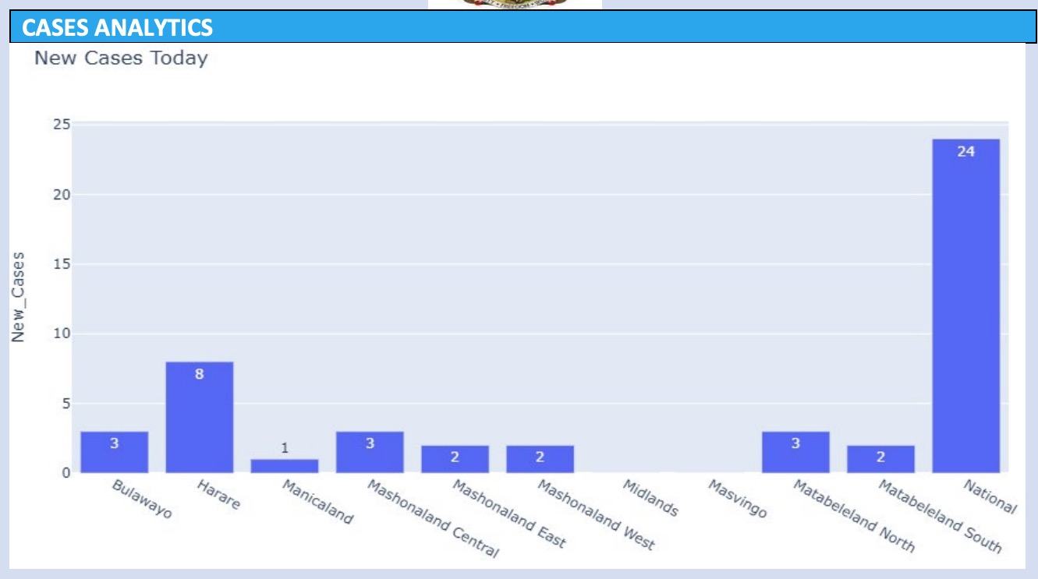
Data viz critique
Make it horizontal
Sort it
Remove underscore from y axis
National and regional should not be on the same axis
Most of the chart is empty space! This is a waste.
Numbers and text are too small relative to plot
Title should be more descriptive
Region axis should have a label

Slide 33
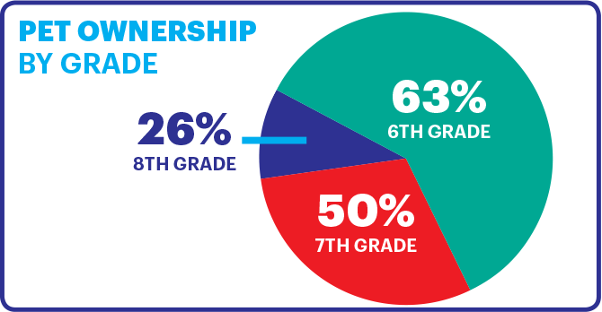
Data viz critique
This is not how mean & SD data should be presented. Need error bars instead
There is enough space to put the whole TGC abbreviation
Gradient bar colors are not useful here.

Slide 34
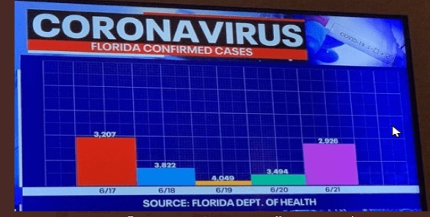
Data viz critique
Why is it multicolored?
Too much white space
Notes:
To start you off on your R journey, we'll need to set you up with the required software, R and RStudio. R is the programming language that you'll use write code, while RStudio is an integrated development environment (IDE) that makes working with R easier. To follow this course, you’ll need to get access to both these tools. So let’s get started.

