Slide 1


R for Busy People
Closing notes

Slide 2



Essential features. Important for feedback
- Yes
- No
- Partial
DATA SCIENCE
PLATFORMS
HIGHER-ED
MOOC
PLATFORMS
R FOR EPI RESOURCES
OTHER DATA SCIENCE BOOKS
Our solution
Datacamp, Dataquest,
Codeacademy,
etc.
R4Epi, Epirhandbook, RMRWR,
etc.
R4DS,
Datacarpentry
Psyteachr.,
etc.
The GRAPH Courses
Coursera,
EdX,
etc.
Epi focus
Rich video content
Learning community
Rich assessments and exercises
Affordable for LMICs

Slide 3
R for Busy People, Modules
Weeks 3 to 12
R foundations
Data wrangling
Data viz
Get acquainted with R, Rstudio & Rmarkdown
Learn to clean, transform, filter and summarize data with dplyr
Learn to make complex, beautiful visualizations and reports with ggplot2

Slide 4



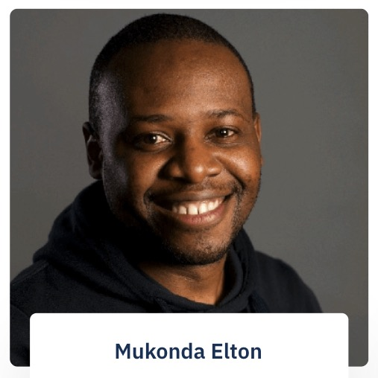



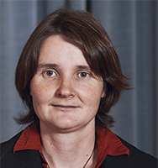

Thank you to the team!
etc
Yuling Lin
Zachary Anderson
Olivia Keiser

Slide 5
Build with us
Feedback, suggestions on content, structure, platform (expect bugs). We’ve been listening. Sorry for all bugs, delays with grading, etc. We’ll send a longer feedback survey form soon.
Seminal alumni to support future students. We’ll be in touch.
GRAPH courses evangelists 📢. Follow us on the platforms.
GRAPH courses models 📷 Sign your release forms!
Notes:
Projects that use contextually-relevant epidemiological data from SSA, LMICs
Core offerings philanthropically-funded & crowdsourced
Best-in-class solution

Slide 6
Grading
At the end of the course, you will receive a certificate if you have passed the course
The final grade will be a combination of
Completion of self-learning material on the website (25%)
Attendance (10%). We will be lenient
Graded materials from the workshop (25%)
Final project (40%) [Released Dec 19th. Due January 31st]
To pass the course, your overall grade will need to be above 70%

Slide 7
Support on the final assessment
Study halls will continue, every Tuesday!
Tutorial on how to post questions to our platform

Slide 8
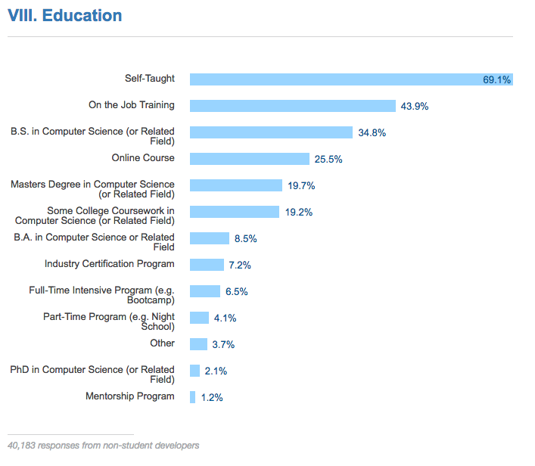
Only the beginning of your journey!

Slide 9
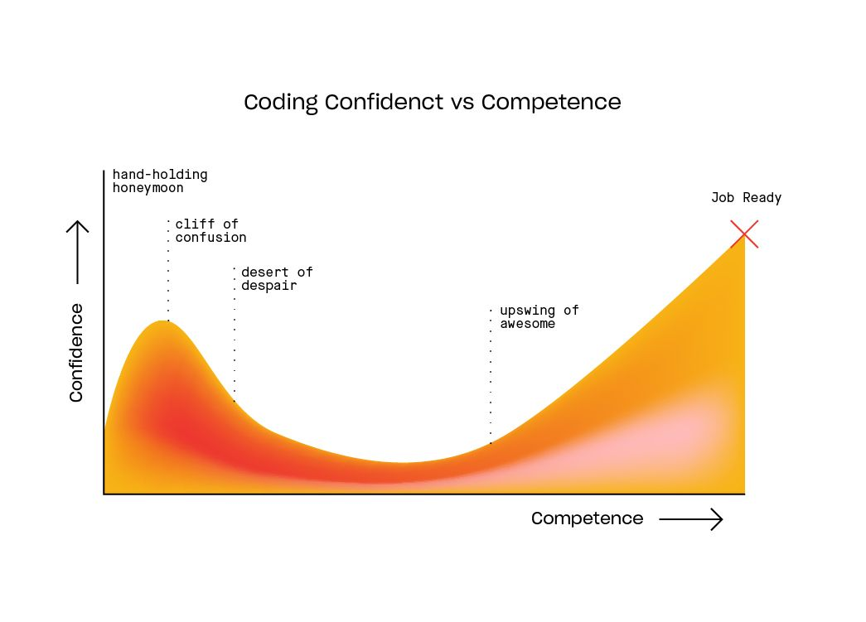
Only the beginning of your journey!

Slide 10
Closing photo!

