Slide 1


R for Busy People
Workshop 01

Slide 2
Workshop outline
1. 👋🏽 Welcome presentation
2. ⛸ Icebreaker: Where do you stand + Two words
3. 👩🏽‍💻 Short exercises on Rstudio Cloud
Pair program
Swap work within pods for review
Share answers in half-class group
4. 🥤15 minute tea/bathroom/games break
5. 👨‍👨‍👦‍👦 Discussion exercises
Pod work
Discuss in half-class group

Slide 3
R for Busy People, Format
Flipped classroom (~ 3 hours of self-work per week)
Mandatory workshops Tuesdays 6 to 8pm UTC+2, starting October 11
Optional study hall sessions three times a week
Wednesday 3 to 5 pm UTC+2
Thursday 6 to 8 pm UTC+2
Sunday 5 to 7 pm UTC+2
Online forum for private discussions
Final project
Certificate of completion (based on attendance, quiz completion, and final project & exam)

Slide 4
R for Busy People, Timeline
Week 1
Week 2
Weeks 3 to 12
Week starting Sep 26
Week starting Oct 3
Week starting Oct 11 to week starting Dec 12
Onboarding
Opening week
Regular program
Get acquainted with tools
Open for enrollment
One week to do some prerequisite lessons
First live session Tuesday, Oct 11
Lessons released a week before workshop
You are here

Slide 5
R for Busy People, Modules
Weeks 3 to 12
R foundations
Data wrangling
Data viz
Get acquainted with R, Rstudio & Rmarkdown
Learn to clean, transform, filter and summarize data with dplyr
Learn to make complex, beautiful visualizations and reports with ggplot2

Slide 6
Grading
At the end of the lesson, you will receive a certificate if you have passed the course.
The final grade will be composed of
Completing self-learning material on the website (80% attendance = 80% of that grade chunk
Attendance (80% attendance = 80% of that grade chunk)
Graded materials from the workshop (on a 0-1 scale)
0 = not done
1/2 = done poorly
1 = done well
Final project
Grade composition to be determined
Notes:
To start you off on your R journey, we'll need to set you up with the required software, R and RStudio. R is the programming language that you'll use write code, while RStudio is an integrated development environment (IDE) that makes working with R easier. To follow this course, you’ll need to get access to both these tools. So let’s get started.

Slide 7
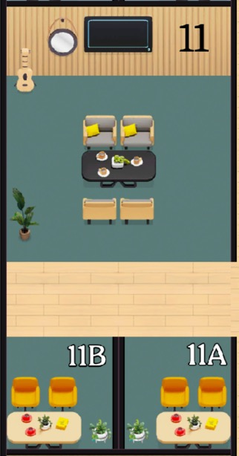

Classroom arrangement: pair rooms
Pair work: work with one other person in a pair room.
Can’t find a partner? Zoom out and look again.
If no success, join an existing pair to make a trio.
Sometimes pairs will be pre-assigned; sometimes you get to choose. Today you can pair yourselves.
Pair rooms
Notes:
To start you off on your R journey, we'll need to set you up with the required software, R and RStudio. R is the programming language that you'll use write code, while RStudio is an integrated development environment (IDE) that makes working with R easier. To follow this course, you’ll need to get access to both these tools. So let’s get started.

Slide 8
Classroom arrangement: pod rooms
Pod work: Join another pair in the pod room. 4 in a room.
Can’t find another pair to join? You can join an existing pod. Maximum of 6 people in a pod.
Pod/quartet room
Notes:
To start you off on your R journey, we'll need to set you up with the required software, R and RStudio. R is the programming language that you'll use write code, while RStudio is an integrated development environment (IDE) that makes working with R easier. To follow this course, you’ll need to get access to both these tools. So let’s get started.

Slide 9
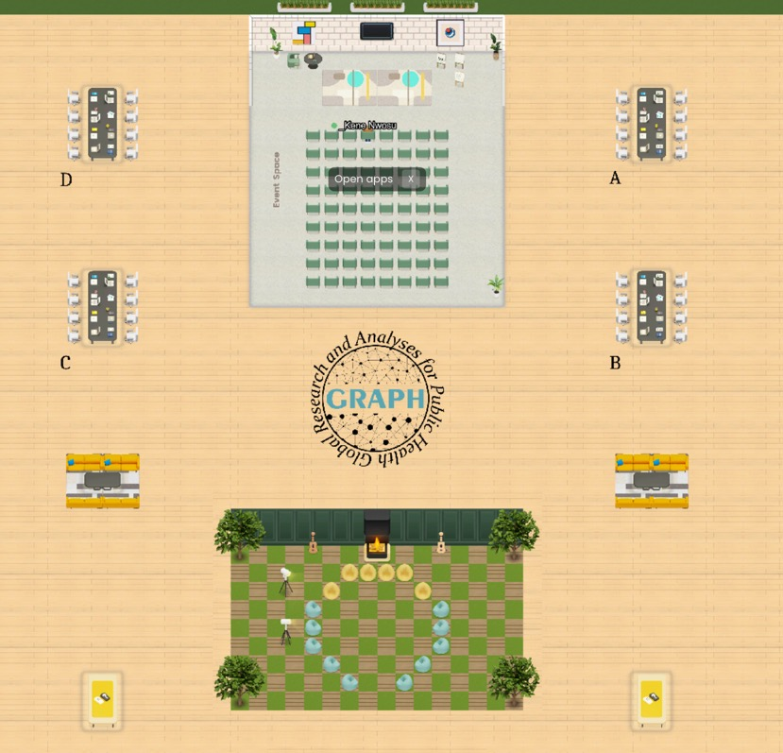
Classroom arrangement: quarter-class group
Conference desks
Pods 10 to 12
Pods 1 to 3
Pods 7 to 9
Pods 4 to 6
Notes:
To start you off on your R journey, we'll need to set you up with the required software, R and RStudio. R is the programming language that you'll use write code, while RStudio is an integrated development environment (IDE) that makes working with R easier. To follow this course, you’ll need to get access to both these tools. So let’s get started.

Slide 10
Classroom arrangement: half-class group
Conference desks
Pods 7 to 12
(left pods)
Pods 1 to 6
(right pods)
Notes:
To start you off on your R journey, we'll need to set you up with the required software, R and RStudio. R is the programming language that you'll use write code, while RStudio is an integrated development environment (IDE) that makes working with R easier. To follow this course, you’ll need to get access to both these tools. So let’s get started.

Slide 11
Classroom arrangement: half-class group alternative
Event space and Lounge room
Pods 1 to 3 and 10 to 12
(top pods)
Pods 4 to 9
(bottom pods)
Notes:
To start you off on your R journey, we'll need to set you up with the required software, R and RStudio. R is the programming language that you'll use write code, while RStudio is an integrated development environment (IDE) that makes working with R easier. To follow this course, you’ll need to get access to both these tools. So let’s get started.

Slide 12
Coaches
Coaches have an underscore before their names.
They will either move from group to group or stay seated at the conference desks/ orange couches
To get help, go to a coaches’ desk directly
Notes:
To start you off on your R journey, we'll need to set you up with the required software, R and RStudio. R is the programming language that you'll use write code, while RStudio is an integrated development environment (IDE) that makes working with R easier. To follow this course, you’ll need to get access to both these tools. So let’s get started.

Slide 13
⛸ Icebreaker: Where do you stand? + Two-words
First we’ll split up into two smaller groups
First name starting with A to I, stay in event space
First name from J to Z, go down to the checkered Lounge
Depending on your answer to questions below, go left or right (outside the room)
Then answer the two-words question.
Left: Prefer in-person work | Right: Prefer remote work
Two words: Why is in-person/remote better?
Left: You work directly in public health | Right: Don’t work directly in public health
Two words: Your study/work area
Left: Prefer Microsoft Excel | Right: Prefer Google Sheets
Two words: Favorite thing about Excel/Google Sheets
Left: Would rather watch/play sports | Right: Would rather listen to/play music
Two words: Your favorite sport /music genre (put link in chat)
If you finish your two-word round before we call you back, feel free to have a free-form chat

Slide 14
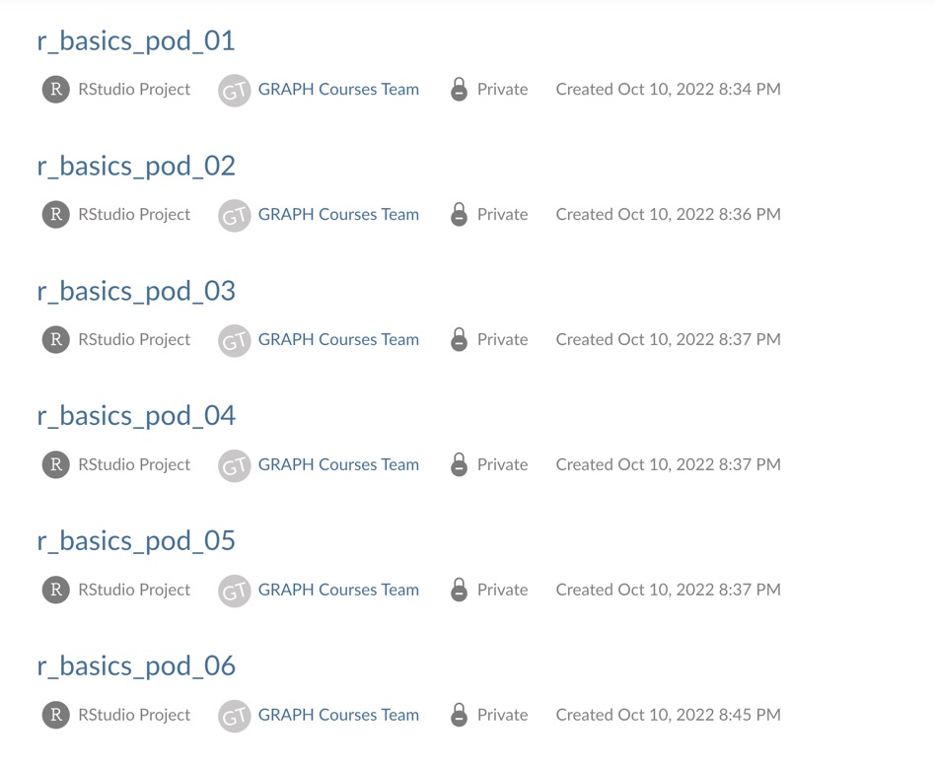
Practice & troubleshoot pair programming on Rstudio cloud
Click on your pod number
Notes:
To start you off on your R journey, we'll need to set you up with the required software, R and RStudio. R is the programming language that you'll use write code, while RStudio is an integrated development environment (IDE) that makes working with R easier. To follow this course, you’ll need to get access to both these tools. So let’s get started.

Slide 15
Practice & troubleshoot pair programming on Rstudio cloud
Click on your pod number
Notes:
To start you off on your R journey, we'll need to set you up with the required software, R and RStudio. R is the programming language that you'll use write code, while RStudio is an integrated development environment (IDE) that makes working with R easier. To follow this course, you’ll need to get access to both these tools. So let’s get started.

Slide 16
Practicing pair programming on Rstudio cloud
Click on your pod number
Notes:
To start you off on your R journey, we'll need to set you up with the required software, R and RStudio. R is the programming language that you'll use write code, while RStudio is an integrated development environment (IDE) that makes working with R easier. To follow this course, you’ll need to get access to both these tools. So let’s get started.

Slide 17
Practicing pair programming on Rstudio cloud
Notes:
To start you off on your R journey, we'll need to set you up with the required software, R and RStudio. R is the programming language that you'll use write code, while RStudio is an integrated development environment (IDE) that makes working with R easier. To follow this course, you’ll need to get access to both these tools. So let’s get started.

Slide 18
Classroom format
Pair work: work with one other person in a pair room.
I can’t find a partner? Zoom out and look again.
If no success, join an existing pair to make a trio.
Sometimes pairs will be pre-assigned; sometimes you get to choose. Today you can pair yourselves.
Pair rooms
Notes:
To start you off on your R journey, we'll need to set you up with the required software, R and RStudio. R is the programming language that you'll use write code, while RStudio is an integrated development environment (IDE) that makes working with R easier. To follow this course, you’ll need to get access to both these tools. So let’s get started.

Slide 19
Classroom format
Pod work: Join another pair in the pod room
Can’t find a pair?
Sometimes pairs will be pre-assigned; sometimes you get to choose. Today you can pair yourselves.
Pod room
Pair rooms
Notes:
To start you off on your R journey, we'll need to set you up with the required software, R and RStudio. R is the programming language that you'll use write code, while RStudio is an integrated development environment (IDE) that makes working with R easier. To follow this course, you’ll need to get access to both these tools. So let’s get started.

Slide 20
Classroom format:
Pair work: work with one other person in a pair room.
Can’t find a partner? Join an existing pair
Sometimes pairs will be pre-assigned; sometimes you get to choose. Today you can pair yourselves.
Notes:
To start you off on your R journey, we'll need to set you up with the required software, R and RStudio. R is the programming language that you'll use write code, while RStudio is an integrated development environment (IDE) that makes working with R easier. To follow this course, you’ll need to get access to both these tools. So let’s get started.

Slide 21
Wrangling preview
Notes:
To start you off on your R journey, we'll need to set you up with the required software, R and RStudio. R is the programming language that you'll use write code, while RStudio is an integrated development environment (IDE) that makes working with R easier. To follow this course, you’ll need to get access to both these tools. So let’s get started.

Slide 22
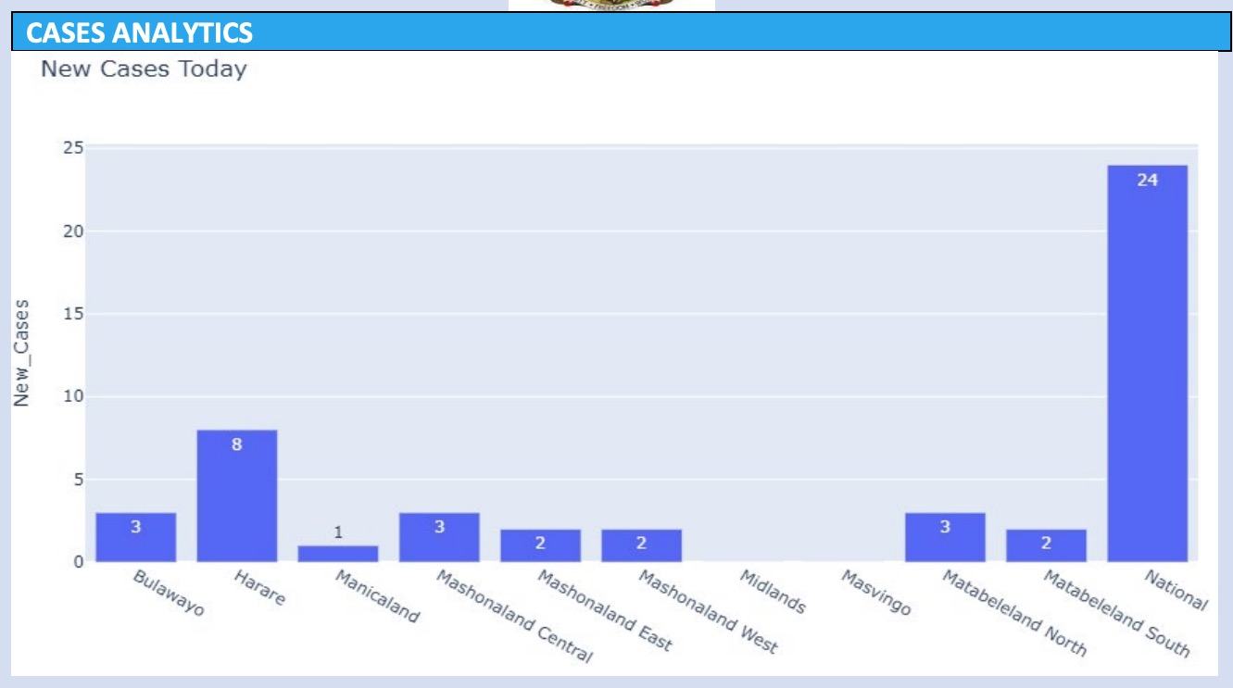
Data viz critique
Make it horizontal
Sort it
Remove underscore from y axis
National and regional should not be on the same axis
Most of the chart is empty space! This is a waste.
Numbers and text are too small relative to plot
Title should be more descriptive
Region axis should have a label
Notes:
To start you off on your R journey, we'll need to set you up with the required software, R and RStudio. R is the programming language that you'll use write code, while RStudio is an integrated development environment (IDE) that makes working with R easier. To follow this course, you’ll need to get access to both these tools. So let’s get started.

Slide 23
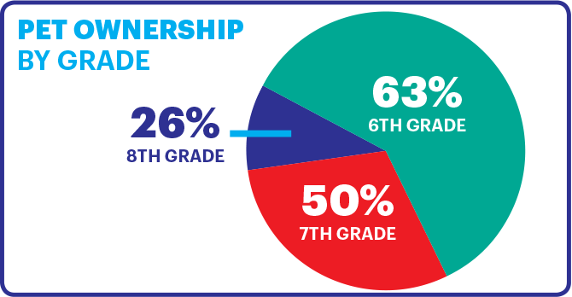
Data viz critique
This is not how mean & SD data should be presented. Need error bars instead
There is enough space to put the whole TGC abbreviation
Gradient bar colors are not useful here.
Notes:
To start you off on your R journey, we'll need to set you up with the required software, R and RStudio. R is the programming language that you'll use write code, while RStudio is an integrated development environment (IDE) that makes working with R easier. To follow this course, you’ll need to get access to both these tools. So let’s get started.

Slide 24
Data viz critique
This is not how mean & SD data should be presented. Need error bars instead
There is enough space to put the whole TGC abbreviation
Gradient bar colors are not useful here.
Notes:
To start you off on your R journey, we'll need to set you up with the required software, R and RStudio. R is the programming language that you'll use write code, while RStudio is an integrated development environment (IDE) that makes working with R easier. To follow this course, you’ll need to get access to both these tools. So let’s get started.

Slide 25
Data viz critique
Make it horizontal
Sort it
Remove underscore from y axis
National and regional should not be on the same axis
Most of the chart is empty space! This is a waste.
Numbers and text are too small relative to plot
Title should be more descriptive
Region axis should have a label
Notes:
To start you off on your R journey, we'll need to set you up with the required software, R and RStudio. R is the programming language that you'll use write code, while RStudio is an integrated development environment (IDE) that makes working with R easier. To follow this course, you’ll need to get access to both these tools. So let’s get started.

Slide 26
Data viz critique
Notes:
To start you off on your R journey, we'll need to set you up with the required software, R and RStudio. R is the programming language that you'll use write code, while RStudio is an integrated development environment (IDE) that makes working with R easier. To follow this course, you’ll need to get access to both these tools. So let’s get started.

Slide 27
Data viz critique
Notes:
To start you off on your R journey, we'll need to set you up with the required software, R and RStudio. R is the programming language that you'll use write code, while RStudio is an integrated development environment (IDE) that makes working with R easier. To follow this course, you’ll need to get access to both these tools. So let’s get started.

