Slide 1


R for Busy People
Workshop 01
Slides: tinyurl.com/rbp-week1-slides

Slide 2
Workshop outline
1. 👋🏽 Olivia intro + Info presentation
2. ⛸ Icebreaker: Where do you stand + Two words
3. 👩🏽‍💻 Short exercise on RStudio Cloud
Pair programming
Share answers in whole-class group
4. 🥤15 minute tea/bathroom/games break
5. 👨‍👨‍👦‍👦 Discussion exercises
Pair discussion
Pod discussion
Present to half-class group

Slide 3
R for Busy People, Format
Flipped classroom (~ 3 hours of self-work per week)
Mandatory workshops Tuesdays 6 to 8pm UTC+2, starting October 11
Optional study hall sessions three times a week
Wednesday 3 to 5 pm UTC+2
Thursday 6 to 8 pm UTC+2
Sunday 5 to 7 pm UTC+2
Online forum for private discussions
Final project
Certificate of completion (based on attendance, quiz completion, and final project & exam)

Slide 4
R for Busy People, Timeline
Week 1
Week 2
Weeks 3 to 12
Week starting Sep 26
Week starting Oct 3
Week starting Oct 11 to week starting Dec 12
Onboarding
Opening week
Regular program
Get acquainted with tools
Open for enrollment
One week to do some prerequisite lessons
First live session Tuesday, Oct 11
Lessons released a week before workshop
You are here

Slide 5
R for Busy People, Modules
Weeks 3 to 12
R foundations
Data wrangling
Data viz
Get acquainted with R, Rstudio & Rmarkdown
Learn to clean, transform, filter and summarize data with dplyr
Learn to make complex, beautiful visualizations and reports with ggplot2

Slide 6
Grading
At the end of the lesson, you will receive a certificate if you have passed the course.
The final grade will be a combination of
Completion of self-learning material on the website (80% attendance = 80% of that grade chunk
Attendance (80% attendance = 80% of that grade chunk)
Graded materials from the workshop (on a 0-2 scale)
0 = not done
1 = done poorly
2 = done well
Final project
Proportions to be determined
Notes:
To start you off on your R journey, we'll need to set you up with the required software, R and RStudio. R is the programming language that you'll use write code, while RStudio is an integrated development environment (IDE) that makes working with R easier. To follow this course, you’ll need to get access to both these tools. So let’s get started.

Slide 7
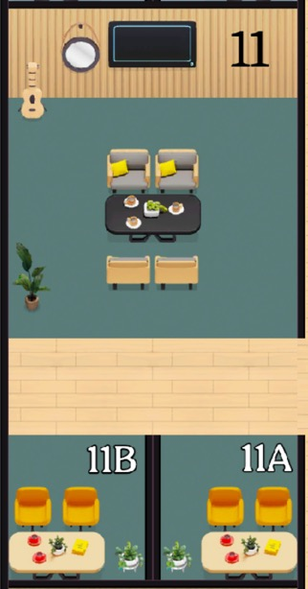

Classroom arrangement: pair rooms
Pair work: work with one other person in a pair room.
Can’t find a partner? Zoom out and look again.
If no success, join an existing pair to make a trio.
Sometimes pairs will be pre-assigned; sometimes you get to choose. Today you can pair yourselves.
Pair rooms
Notes:
To start you off on your R journey, we'll need to set you up with the required software, R and RStudio. R is the programming language that you'll use write code, while RStudio is an integrated development environment (IDE) that makes working with R easier. To follow this course, you’ll need to get access to both these tools. So let’s get started.

Slide 8
Classroom arrangement: pod rooms
Pod work: Join another pair in the pod room. 4 in a room.
Can’t find another pair to join? You can join an existing pod. Maximum of 6 people in a pod.
Pod/quartet room
Notes:
To start you off on your R journey, we'll need to set you up with the required software, R and RStudio. R is the programming language that you'll use write code, while RStudio is an integrated development environment (IDE) that makes working with R easier. To follow this course, you’ll need to get access to both these tools. So let’s get started.

Slide 9
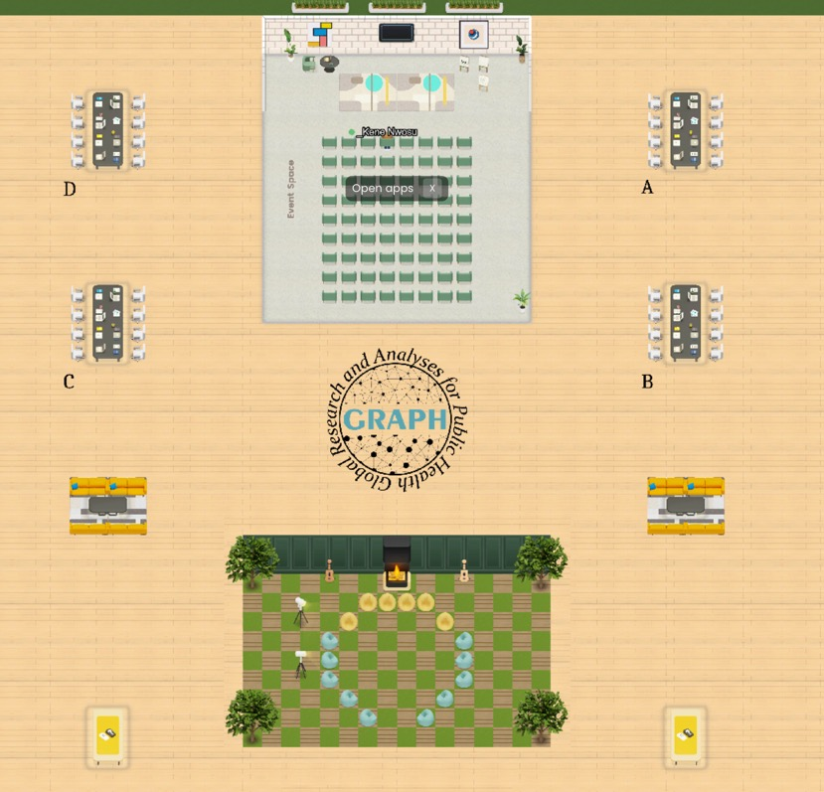
Classroom arrangement: quarter-class group
Conference desks
Pods 10 to 12
Pods 1 to 3
Pods 7 to 9
Pods 4 to 6
Notes:
To start you off on your R journey, we'll need to set you up with the required software, R and RStudio. R is the programming language that you'll use write code, while RStudio is an integrated development environment (IDE) that makes working with R easier. To follow this course, you’ll need to get access to both these tools. So let’s get started.

Slide 10
Classroom arrangement: half-class group
Conference desks
Pods 7 to 12
(left pods)
Pods 1 to 6
(right pods)
Notes:
To start you off on your R journey, we'll need to set you up with the required software, R and RStudio. R is the programming language that you'll use write code, while RStudio is an integrated development environment (IDE) that makes working with R easier. To follow this course, you’ll need to get access to both these tools. So let’s get started.

Slide 11
Classroom arrangement: half-class group alternative
Event space and Lounge room
Pods 1 to 6
(right pods)
Pods 7 to 9
(left pods)
Notes:
To start you off on your R journey, we'll need to set you up with the required software, R and RStudio. R is the programming language that you'll use write code, while RStudio is an integrated development environment (IDE) that makes working with R easier. To follow this course, you’ll need to get access to both these tools. So let’s get started.

Slide 12
Coaches
Coaches have an underscore before their names.
They will either move from group to group or stay seated at the conference desks/ orange couches
To get help, go to a coaches’ desk directly
Notes:
To start you off on your R journey, we'll need to set you up with the required software, R and RStudio. R is the programming language that you'll use write code, while RStudio is an integrated development environment (IDE) that makes working with R easier. To follow this course, you’ll need to get access to both these tools. So let’s get started.

Slide 13
Workshop outline
1. 👋🏽 Olivia intro + Info presentation
2. ⛸ Icebreaker: Where do you stand + Two words
3. 👩🏽‍💻 Short exercise on RStudio Cloud
Pair programming
Share answers in whole-class group
4. 🥤15 minute tea/bathroom/games break
5. 👨‍👨‍👦‍👦 Discussion exercises
Pair discussion
Pod discussion
Present to half-class group

Slide 14
⛸ Icebreaker: Where do you stand? + Two-words
First we’ll split up into two smaller groups
First name starting with A to I, stay in event space
First name from J to Z, go down to the checkered Lounge
Depending on your answer to questions below, go left or right (outside the room)
Then answer the two-words question.
Left: Prefer in-person work | Right: Prefer remote work
Two words: Why is in-person/remote better?
Left: You work directly in public health | Right: Don’t work directly in public health
Two words: Your study/work area
Left: Prefer Microsoft Excel | Right: Prefer Google Sheets
Two words: Favorite thing about Excel/Google Sheets
Left: Would rather watch/play sports | Right: Would rather listen to/play music
Two words: Your favorite sport /music genre (put link in chat)
If you finish your two-word round before we call you back, feel free to have a free-form chat

Slide 15
Workshop outline
1. 👋🏽 Olivia intro + Info presentation
2. ⛸ Icebreaker: Where do you stand + Two words
3. 👩🏽‍💻 Short exercise on RStudio Cloud
Pair programming
Share answers in whole-class group
4. 🥤15 minute tea/bathroom/games break
5. 👨‍👨‍👦‍👦 Discussion exercises
Pair discussion
Pod discussion
Present to half-class group

Slide 16
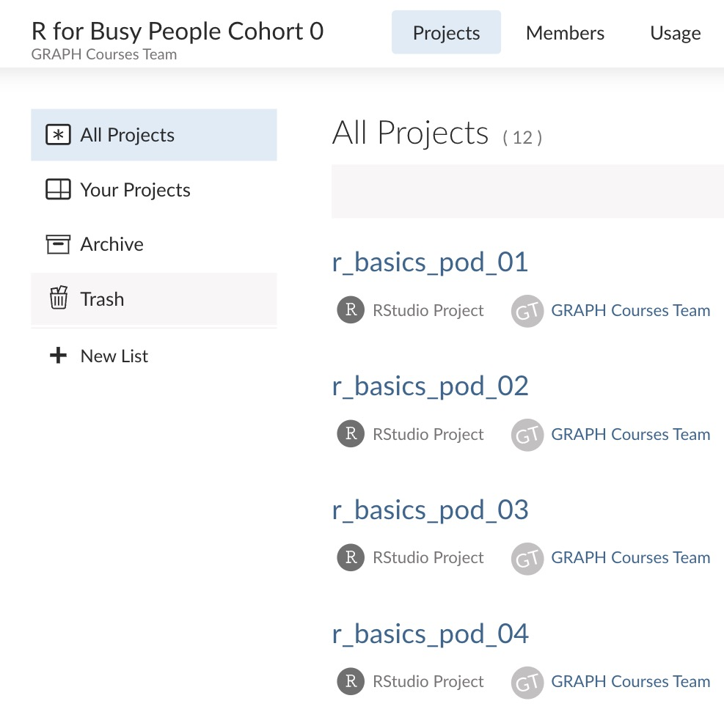
Practice & troubleshoot pair programming on Rstudio cloud
Find a partner and go to a pair room
Go to link
Click on the Projects tab then on your pod project
Notes:
To start you off on your R journey, we'll need to set you up with the required software, R and RStudio. R is the programming language that you'll use write code, while RStudio is an integrated development environment (IDE) that makes working with R easier. To follow this course, you’ll need to get access to both these tools. So let’s get started.

Slide 17
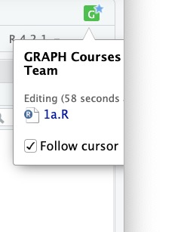
Practice & troubleshoot pair programming on Rstudio cloud
Click on the icon at the top right to follow the cursor of your partner.
Notes:
To start you off on your R journey, we'll need to set you up with the required software, R and RStudio. R is the programming language that you'll use write code, while RStudio is an integrated development environment (IDE) that makes working with R easier. To follow this course, you’ll need to get access to both these tools. So let’s get started.

Slide 18
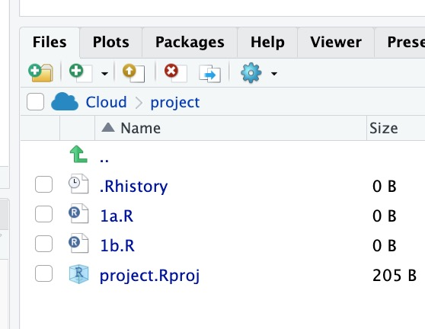
Practice & troubleshoot pair programming on Rstudio cloud
With your partner, open the file that corresponds to your pair room code.
Notes:
To start you off on your R journey, we'll need to set you up with the required software, R and RStudio. R is the programming language that you'll use write code, while RStudio is an integrated development environment (IDE) that makes working with R easier. To follow this course, you’ll need to get access to both these tools. So let’s get started.

Slide 19
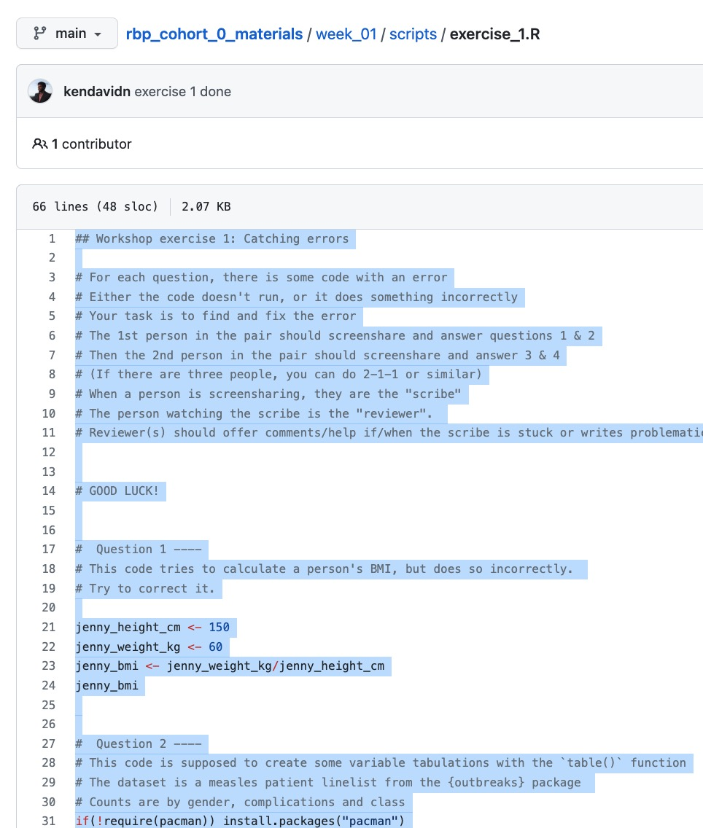
Practice & troubleshoot pair programming on Rstudio cloud
One person should then go to this link:
tinyurl.com/rbp-week1-exercise1
And copy the code there into your R script
Then proceed with exercise 1
Notes:
To start you off on your R journey, we'll need to set you up with the required software, R and RStudio. R is the programming language that you'll use write code, while RStudio is an integrated development environment (IDE) that makes working with R easier. To follow this course, you’ll need to get access to both these tools. So let’s get started.

Slide 20
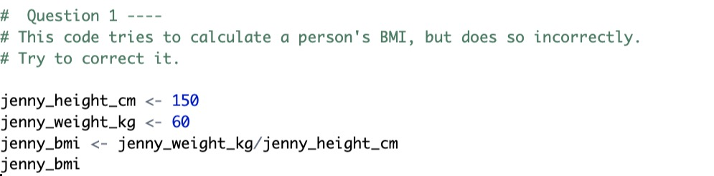
Practice & troubleshoot pair programming on Rstudio cloud
For each question, there is some code with an error.
Either the code doesn't run, or it does something incorrectly
The 1st person in the pair should screenshare and answer questions 1 & 2
Then the 2nd person in the pair should screenshare and answer 3 & 4
(If there are three people, you can do 1-1-2 or similar)
When a person is screensharing, they are the "scribe"
The person watching the scribe is the "reviewer".
Reviewer(s) should offer comments/help if/when the scribe is stuck or writes faulty code.
Notes:
To start you off on your R journey, we'll need to set you up with the required software, R and RStudio. R is the programming language that you'll use write code, while RStudio is an integrated development environment (IDE) that makes working with R easier. To follow this course, you’ll need to get access to both these tools. So let’s get started.

Slide 21
Practice & troubleshoot pair programming on Rstudio cloud
⏰
After around 15 minutes, we will reconvene for a whole group check-in
Then you will upload your scripts to the TGC website
Notes:
To start you off on your R journey, we'll need to set you up with the required software, R and RStudio. R is the programming language that you'll use write code, while RStudio is an integrated development environment (IDE) that makes working with R easier. To follow this course, you’ll need to get access to both these tools. So let’s get started.

Slide 22
Workshop outline
1. 👋🏽 Olivia intro + Info presentation
2. ⛸ Icebreaker: Where do you stand + Two words
3. 👩🏽‍💻 Short exercise on RStudio Cloud
Pair programming
Share answers in whole-class group
4. 🥤15 minute tea/bathroom/games break
5. 👨‍👨‍👦‍👦 Discussion exercises
Pair discussion
Pod discussion
Present to half-class group

Slide 23
Discussion exercises: preview of data wrangling and data viz
Go back to your pair rooms
Go to the provided link to view the assignment. rpubs.com/the-graph-courses/954551
First discuss them in your pairs
Then a larger discussion in pods
Select one person from each pod who will present an answer of their choosing the wider half-class group
Notes:
To start you off on your R journey, we'll need to set you up with the required software, R and RStudio. R is the programming language that you'll use write code, while RStudio is an integrated development environment (IDE) that makes working with R easier. To follow this course, you’ll need to get access to both these tools. So let’s get started.

Slide 24
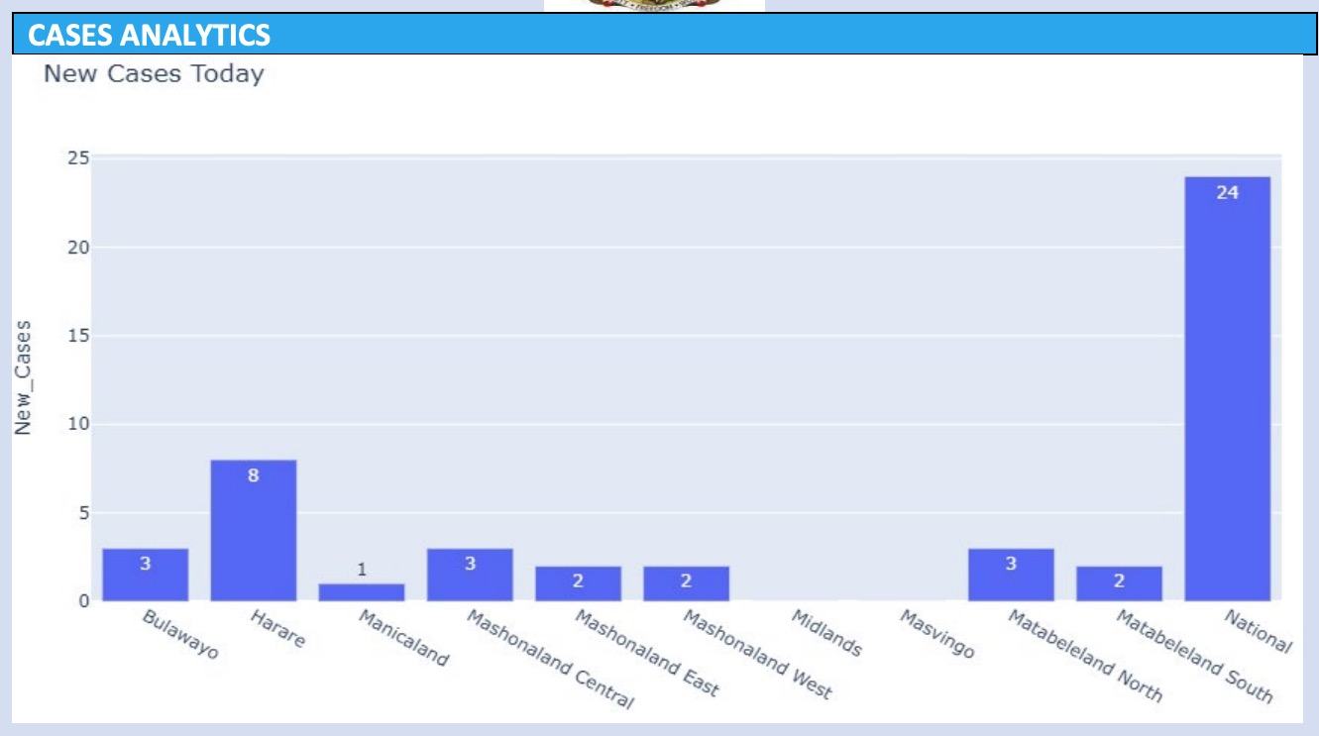
Data viz critique
Make it horizontal
Sort it
Remove underscore from y axis
National and regional should not be on the same axis
Most of the chart is empty space! This is a waste.
Numbers and text are too small relative to plot
Title should be more descriptive
Region axis should have a label
Notes:
To start you off on your R journey, we'll need to set you up with the required software, R and RStudio. R is the programming language that you'll use write code, while RStudio is an integrated development environment (IDE) that makes working with R easier. To follow this course, you’ll need to get access to both these tools. So let’s get started.

Slide 25
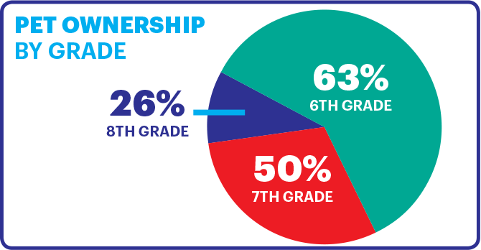
Data viz critique
This is not how mean & SD data should be presented. Need error bars instead
There is enough space to put the whole TGC abbreviation
Gradient bar colors are not useful here.
Notes:
To start you off on your R journey, we'll need to set you up with the required software, R and RStudio. R is the programming language that you'll use write code, while RStudio is an integrated development environment (IDE) that makes working with R easier. To follow this course, you’ll need to get access to both these tools. So let’s get started.

Slide 26
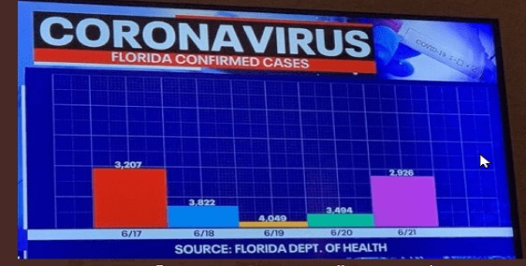
Data viz critique
Why is it multicolored?
Too much white space
Notes:
To start you off on your R journey, we'll need to set you up with the required software, R and RStudio. R is the programming language that you'll use write code, while RStudio is an integrated development environment (IDE) that makes working with R easier. To follow this course, you’ll need to get access to both these tools. So let’s get started.

Slide 27
Data viz critique
Notes:
To start you off on your R journey, we'll need to set you up with the required software, R and RStudio. R is the programming language that you'll use write code, while RStudio is an integrated development environment (IDE) that makes working with R easier. To follow this course, you’ll need to get access to both these tools. So let’s get started.

Slide 28
Data viz critique
Notes:
To start you off on your R journey, we'll need to set you up with the required software, R and RStudio. R is the programming language that you'll use write code, while RStudio is an integrated development environment (IDE) that makes working with R easier. To follow this course, you’ll need to get access to both these tools. So let’s get started.

