Slide 1


R for Busy People
December 6th, 2022

Slide 2
Activity 1

Slide 3
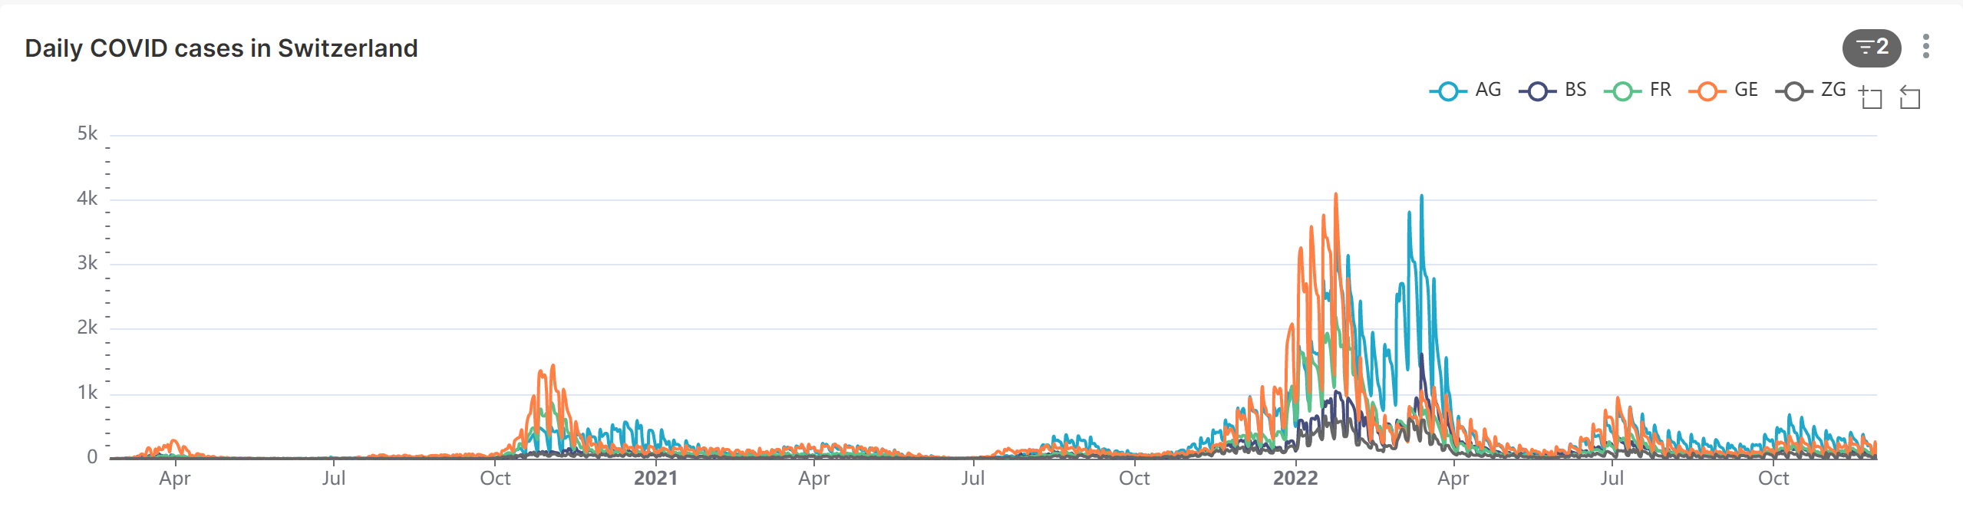
Recreate plots from EpigraphHub in R
We will recreate a line graph from the EpiGraphHub COVID-19 Switzerland dashboard using {ggplot2}
The graph we are aiming for looks like this
You have already learned how to create most of elements of this plot
There are additional modifications we want to make to the scales and themes

Slide 4

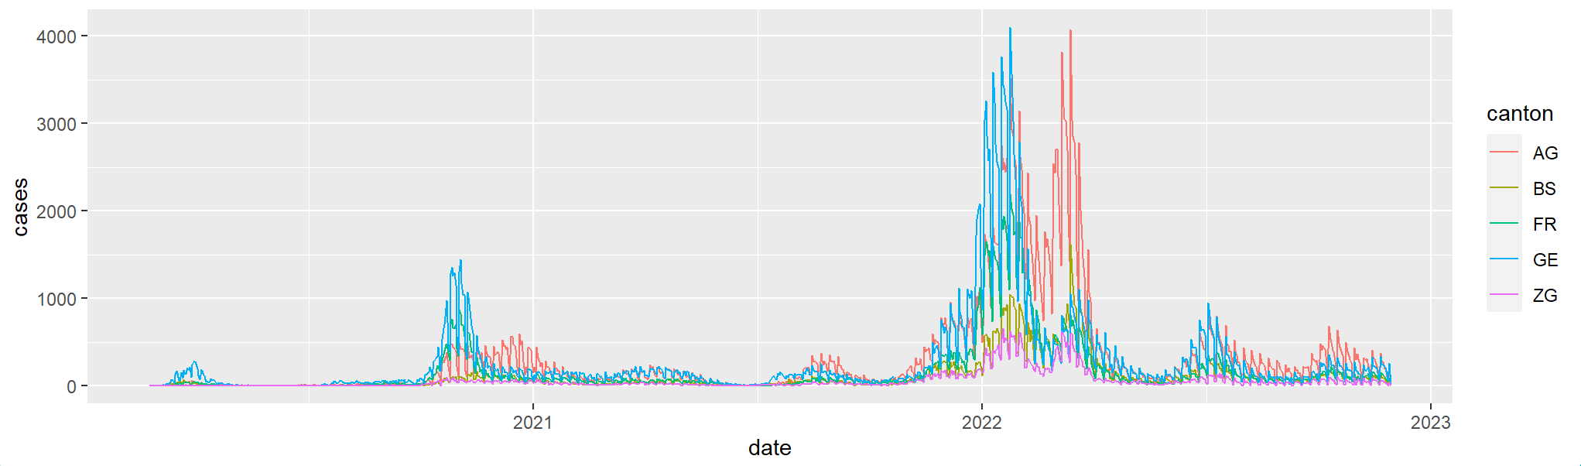
Notes:
Comparison

Slide 5
List of plot elements to change
Change background from gray to white
Relabel x-axis scale breaks to month abbreviations (Jan, Apr, Jul, etc.)
Remove axis titles
Remove grid lines (except major y-axis lines)
Relabel y-axis scale breaks with “k” suffix for 1000s

Slide 6
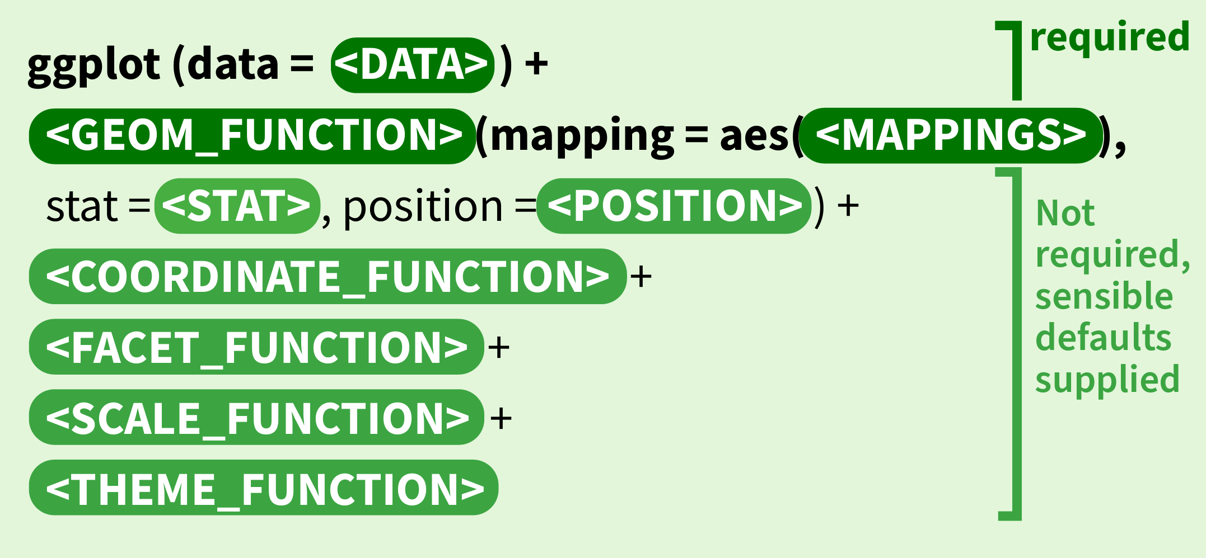
List of plot elements to change
Change background
Relabel x-axis scale breaks
Remove axis titles
Remove grid lines
Relabel y-axis scale breaks

Slide 7
Activity 2

Slide 8
Upload data to the EpigraphHub platform!
First you will need a a CSV of the gapminder data frame
To do this:
Load gapminder as a data frame in R
Use write_csv() and save the data frame as a CSV in your local files
Now you’re ready to upload this to Google sheets!

Slide 9
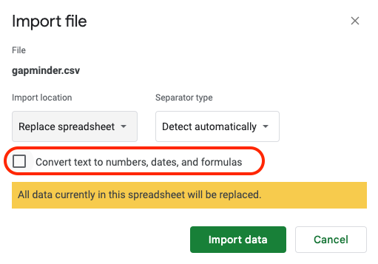
Upload data into Epigraphhub
Step 1: Import the csv into google sheets
It's important to uncheck the highlighted option

Slide 10
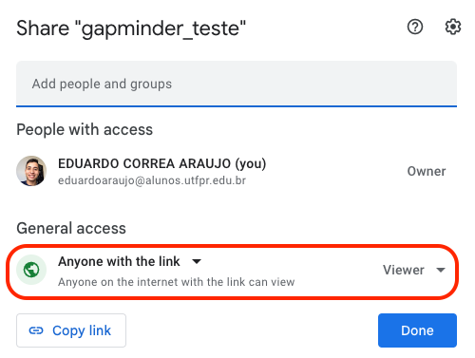
Step 2: Allow anyone with the link to access the table
Click on 'Copy link'

Slide 11
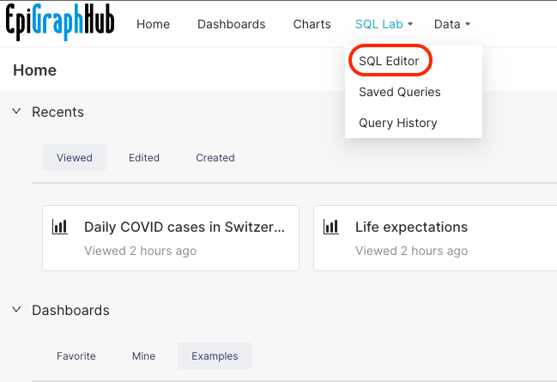
Step 3: Go to epigraphhub.org and log in
Click on 'SQL lab' and 'SQL Editor'

Slide 12
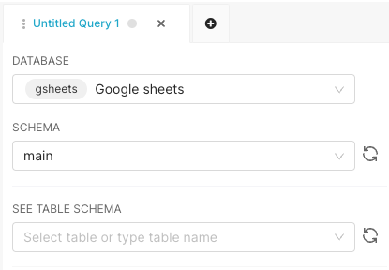
Step 4: Config the database as below (if necessary, click on the plus button to open a new tab)

Slide 13
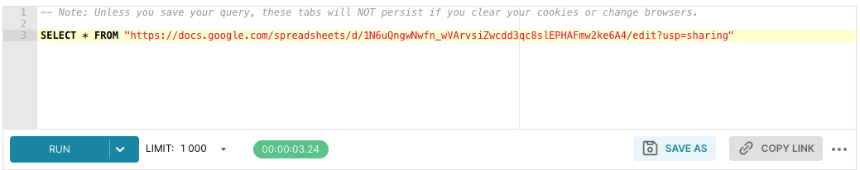
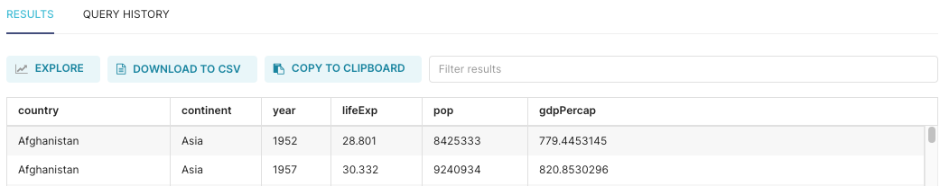
Step 5: Type: SELECT * FROM "{here copy the link from google}"
Step 6: Click on Run

Slide 14
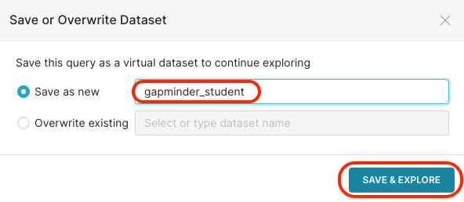
Step 7: Click on 'Explore' and choose a name for your dataset
Step 8: Click on 'SAVE & EXPLORE'

Slide 15
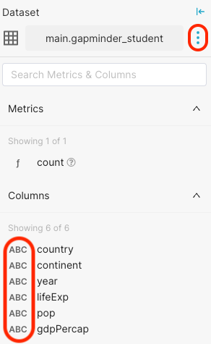
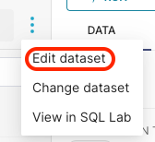
Step 10: Click on the 3 dots to change the data types of the columns
Step 11: Click on 'Edit dataset'

Slide 16
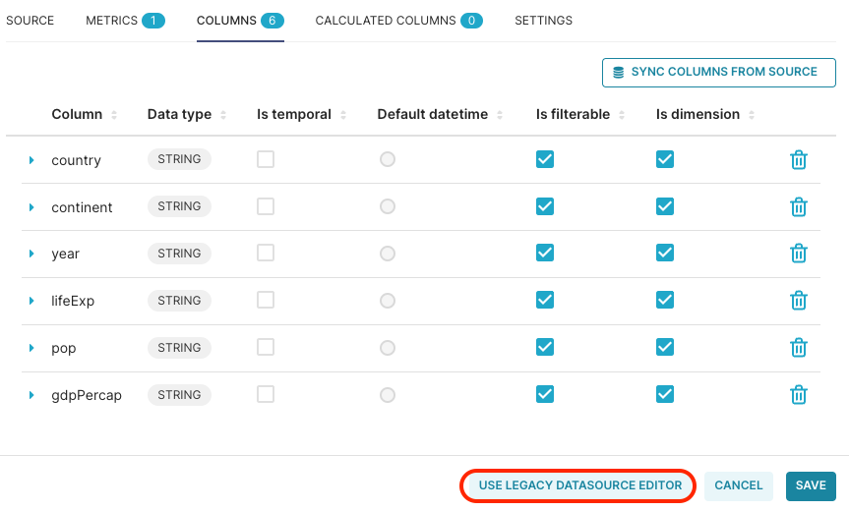
Step 12: Click on 'COLUMNS'
Step 13: Click on 'USE LEGACY DATASOURCE EDITOR'

Slide 17
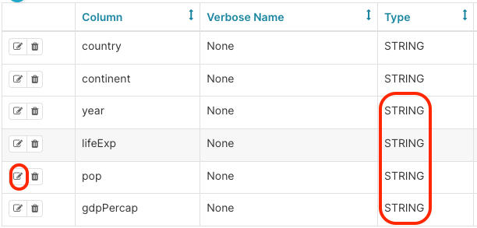
It's necessary to change the type of 'lifeExp' to FLOAT; 'pop' to INT; 'gdpPercap' to FLOAT and year to DATE.
Step 14: For 'lifeExp', 'pop' and 'gdpPercap' click on the icon highlighted below

Slide 18
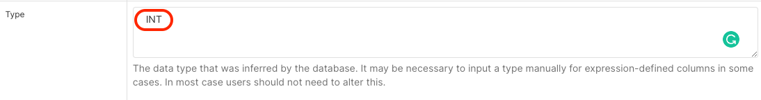
Step 15: Fill the 'Type' field with the right type
Step 16: Click on 'SAVE'

Slide 19
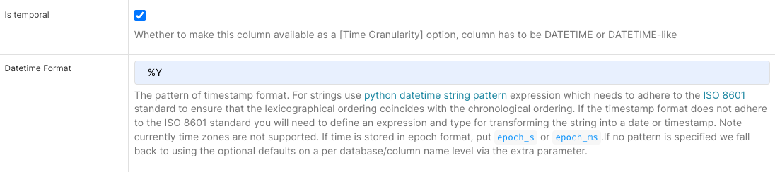
Step 17: To the year columns it's also necessary to check the `Is temporal` checkbox and fill the 'Datetime format' as %Y
Step 18: Click on 'SAVE'

Slide 20
Step 17: To the year columns it's also necessary to check the `Is temporal` checkbox and fill the 'Datetime format' as %Y
Step 18: Click on 'SAVE'

Slide 21
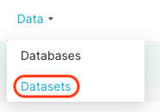
Step 19: Go to Datasets and click on the name that you give to your table in the Step 7.

