Slide 1
Linear Regression
Understanding Relationships Between Variables

Slide 2
Learning Objectives
By the end of this lesson, you will be able to:
1
Explain what linear regression does
Models relationship between two numeric variables with a "best fit" line
2
Interpret the slope of a regression line
"For every 1-unit increase in X, Y changes by [slope] units, on average"
3
Interpret the intercept of a regression line
Where the line crosses the Y-axis (predicted Y when X = 0)
4
Use the regression equation to make predictions
Plug values into: y = intercept + slope × x
5
Fit a linear regression model in R
Use lm() function and interpret the summary() output

Slide 3
Why Linear Regression?
It's often useful to understand the
relationships between two quantities/variables
Linear regression allows us to:
Quantify relationships
"How much lung capacity do you lose per year of smoking?"
"How many grams does a baby gain per week of gestation?"
Make predictions
"What lung capacity would we expect for a 20-year smoker?"
"What weight should we expect for a baby born at 34 weeks?"

Slide 4
Our Question & Data
How does gestational age relate to birthweight?
pacman::p_load(tidyverse, openintro) data(births14) preemie_data <- births14 %>% filter(premie == "premie") %>% slice_tail(n = 8) %>% select(weeks, weight)
Baby | Weeks | Weight (kg)
1 | 32 | 1.65
2 | 36 | 2.67
3 | 33 | 2.18
4 | 36 | 3.83
5 | 35 | 2.53
6 | 36 | 2.64
7 | 32 | 1.06
8 | 34 | 3.06
Data: CDC 2014 US birth records. Every year, the US releases birth data to the public. This sample of 1,000 births is available in R via the openintro package. We selected 8 preemies for simplicity.
We want to know: Is there a relationship? | How strong? | Can we quantify it?

Slide 5
Visualizing the Relationship
There seems to be a pattern...

Slide 6
Can We Fit a Line?
A straight line can summarize the pattern in this cloud of points.
Yes!

Slide 7
Many Possible Lines
Many Possible Lines
We could draw infinitely many lines through this data...
Which one is "best"?

Slide 8
Let's Try It Manually!
DESMOS DEMO desmos.com
Interactive demonstration
What did we discover?
To position a straight line, we need exactly TWO numbers!
Slope
Intercept

Slide 9
Practice — Slope & Intercept Concepts
Which number controls how steep a line is?
A) The slope
B) The intercept
Answer
A) The slope
The slope determines the steepness — how much Y changes per unit of X.

Slide 10
Practice — Slope & Intercept Concepts
In the equation y = 3 + 5x, what is the slope?
A) 3
B) 5
C) 8
Answer
B) 5
In y = intercept + slope × x, the number multiplied by x is the slope. Here: slope = 5.

Slide 11
Practice — Slope & Intercept Concepts
Fill in the blank:
In the equation y = 7 + 2x, the intercept is _____.
Answer
7
The intercept is the constant term — the value of y when x = 0. Here: y = 7 + 2(0) = 7.

Slide 12
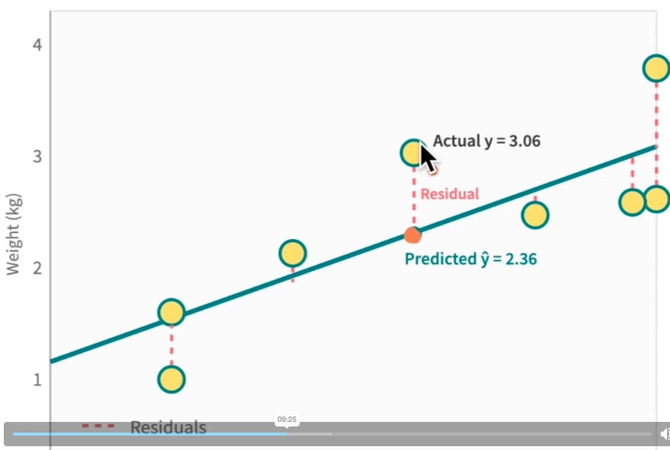
Finding the "Best" Line
The 'best' line minimizes the total prediction errors
Each point has a residual — the vertical distance from the point to the line.
R finds the line that minimizes the sum of squared residuals
"Least squares" = minimize squared residuals

Slide 13
Practice — Residuals
What does a residual represent?
A) The predicted value
B) Actual minus predicted
C) The slope of the line
Answer
B) Actual minus predicted
A residual is the difference between what we observed and what the model predicted.

Slide 14
Practice — Residuals
Fill in the blank:
If actual weight is 2.67 kg and predicted weight is 3.13 kg, the residual is _____ kg.
Answer
−0.46 kg
Residual = 2.67 − 3.13 = −0.46 kg. Negative because the actual is below the predicted.

Slide 15
Practice — Sum of Squared Residuals
Why do we square the residuals before adding them up?
A) So positive and negative errors don’t cancel out
B) To give more weight to points closer to the line
Answer
A) So positive and negative errors don’t cancel out
Some residuals are positive (above the line) and some are negative (below). If we just added them, they’d cancel toward zero. Squaring makes every residual positive before summing.
B) is backwards — squaring actually penalizes large errors more, not less.

Slide 16
R Finds the Best Line For Us
# Fit a linear regression model model <- lm(weight_kg ~ weeks, data = babies) # View the results summary(model)

Slide 17
Full R Script
if (!require(pacman)) install.packages("pacman")
pacman::p_load(tidyverse, openintro, equatiomatic)
baby_subset <- openintro::births14 %>%
filter(premie == "premie") %>%
slice_tail(n = 8) %>%
mutate(weight_kg = weight * 0.453592) # Convert pounds to kg
# Fit linear regression: weight_kg ~ weeks
model <- lm(weight_kg ~ weeks, data = baby_subset)
summary(model)

Slide 18
What Does summary(model) Show?
What Does summary(model) Show?
Call: lm(formula = weight_kg ~ weeks, data = preemie_bottom8) Residuals: Min 1Q Median 3Q Max -0.5256 -0.4674 -0.0709 0.3315 0.7067 Coefficients: Estimate Std.Error t value Pr(>|t|) (Intercept) -10.779 4.061 -2.655 0.0378 * weeks 0.386 0.118 3.262 0.0172 * Residual standard error: 0.5491 on 6 df Multiple R-squared: 0.6394 Adjusted R-squared: 0.5794 F-statistic: 10.64 on 1 and 6 DF p-value: 0.0172
Don't Panic!
Call: lm(formula = weight_kg ~ weeks, data = preemie_bottom8) Residuals: Min 1Q Median 3Q Max -0.5256 -0.4674 -0.0709 0.3315 0.7067 Coefficients: Estimate Std.Error t value Pr(>|t|) (Intercept) -10.779 4.061 -2.655 0.0378 * weeks 0.386 0.118 3.262 0.0172 * Residual standard error: 0.5491 on 6 df Multiple R-squared: 0.6394 Adjusted R-squared: 0.5794 F-statistic: 10.64 on 1 and 6 DF p-value: 0.0172
We'll explain all of this in due time. For now, focus on these two numbers:
Intercept = -10.779
Slope = 0.386
Understanding the intercept and slope is the foundation for everything else!

Slide 19
Practice — Reading R Output
In R's summary() output, the slope is found in the row for:
A) (Intercept)
Call: lm(formula = weight_kg ~ weeks, data = preemie_bottom8) Residuals: Min 1Q Median 3Q Max -0.5256 -0.4674 -0.0709 0.3315 0.7067 Coefficients: Estimate Std.Error t value Pr(>|t|) (Intercept) -10.779 4.061 -2.655 0.0378 * weeks 0.386 0.118 3.262 0.0172 * Residual standard error: 0.5491 on 6 df Multiple R-squared: 0.6394 Adjusted R-squared: 0.5794 F-statistic: 10.64 on 1 and 6 DF p-value: 0.0172
B) The predictor (e.g. 'weeks')
Answer
B) The predictor variable row
The slope is in the row named after the predictor variable. The (Intercept) row gives the intercept.

Slide 20
Practice — Reading R Output
In our summary() output, what is the Estimate for the slope (effect of weeks on weight)?
A) −10.779
Call: lm(formula = weight_kg ~ weeks, data = preemie_bottom8) Residuals: Min 1Q Median 3Q Max -0.5256 -0.4674 -0.0709 0.3315 0.7067 Coefficients: Estimate Std.Error t value Pr(>|t|) (Intercept) -10.779 4.061 -2.655 0.0378 * weeks 0.386 0.118 3.262 0.0172 * Residual standard error: 0.5491 on 6 df Multiple R-squared: 0.6394 Adjusted R-squared: 0.5794 F-statistic: 10.64 on 1 and 6 DF p-value: 0.0172
B) 0.386
C) 4.061
Answer
B) 0.386
The Estimate column in the 'weeks' row gives the slope: 0.386 kg per week.

Slide 21
Let's Check Our Line in Desmos
Go back to Desmos and enter:
y = -10.78 + 0.386x
Does the line fit nicely through the data?

Slide 22
Key Takeaway: The Slope
The slope tells you:
For every 1-unit increase in X, Y changes by [slope] units, on average
In our example:
slope = 0.386 kg/week
Each extra week of gestation adds ~0.386 kg to birthweight

Slide 23
Practice — Interpreting the Slope
A linear regression of test score on study hours has slope = 5. This means:
A) Students who study score ~5 points higher than those that don’t
B) Each extra hour of study increases score by 5 points on average
Answer
B) Each extra hour: +5 points, on average
The slope tells us the average change in Y per 1-unit increase in X.

Slide 24
Practice — Positive vs. Negative Slopes
Which scenario would have a negative slope?
A) Taller people weigh more
B) More rain → more crops
C) Older cars have lower prices
Answer
C) Older cars have lower prices
As car age increases, price decreases. That's a negative relationship = negative slope.

Slide 25
Making Predictions with the Slope
What birthweight do we predict for a baby born at 35 weeks?
Our equation: weight = -10.78 + 0.386 × weeks
1
Plug in weeks = 35
weight = -10.78 + 0.386 × 35
2
Multiply
weight = -10.78 + 13.51
3
Add
weight = 2.73 kg
Predicted birthweight at 35 weeks: 2.73 kg

Slide 26
Your Turn: Practice Prediction
Our equation: weight = -10.78 + 0.386 × weeks
What birthweight do we predict for a baby born at 36 weeks?
Work it out here...

Slide 27
What Does the Intercept Mean?
weight = -10.78 + 0.386 × weeks
Definition
In Our Example
The intercept is the predicted value of Y when X = 0
When weeks = 0: weight = -10.78 kg
Wait... negative weight? That doesn't make sense!
The intercept here is a mathematical artifact, not a real prediction.
Our data only covers 32–36 weeks — predicting at 0 weeks is extrapolation.

Slide 28
Visualizing the Intercept
The Intercept
Where the line crosses the Y-axis (when X = 0). It anchors the line vertically.
Extrapolation Zone
The dashed line extends far beyond our actual data

Slide 29
Practice — Interpreting the Intercept
Why is our intercept (−10.78 kg) not a meaningful prediction?
A) The slope is too small
B) 0 weeks is far outside our data range
C) The slope is too large
Answer
B) 0 weeks is far outside our data range
Our data covers 32–36 weeks. Predicting at 0 weeks is extrapolation far beyond the data.
(Also, a linear model may not be a good predictor outside of this window)

Slide 30
Practice — Interpreting the Intercept
Fill in the blank:
The intercept is the predicted value of Y when X equals _____.
???
Answer
0 (zero)
By definition, the intercept is where the line crosses the Y-axis, which is at X = 0.

Slide 31
What We Learned
1
Explain what linear regression does
Models relationship between two numeric variables with a "best fit" line
2
Interpret the slope of a regression line
"For every 1-unit increase in X, Y changes by [slope] units, on average"
3
Interpret the intercept of a regression line
Where the line crosses the Y-axis (predicted Y when X = 0)
4
Use the regression equation to make predictions
Plug values into: y = intercept + slope × x
5
Fit a linear regression model in R
Use lm() function and interpret the summary() output

