Slide 1
Learning Objectives | t Values and p Values
1
Compute the t-statistic for a regression slope ✅
Divide the estimated slope by its standard error to measure how many SEs away from zero the estimate sits
2
Define the null hypothesis, explain how a t-value is used to calculate a p-value, and describe what the p-value represents.✅
H₀: β₁ = 0 says x has no linear effect; the p-value is the probability of seeing a test statistic this extreme if H₀ is true
3
Connect the CI and p-value as two views of the same test ✅
The CI excludes zero exactly when the p-value falls below the significance level — both tools give the same verdict
4
Read and interpret the full regression output for slope coefficients
Locate the estimate, SE, t, p, and CI columns in software output and state what each number means

Slide 2
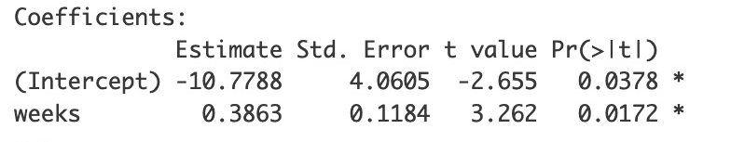
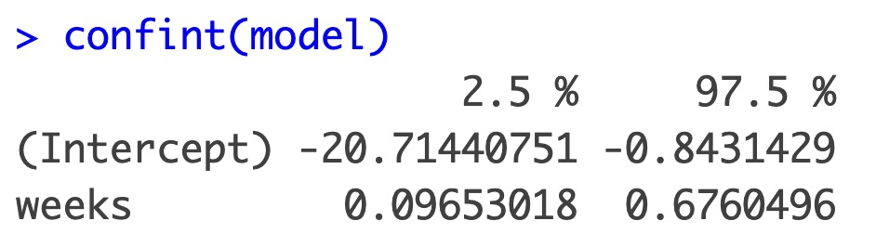
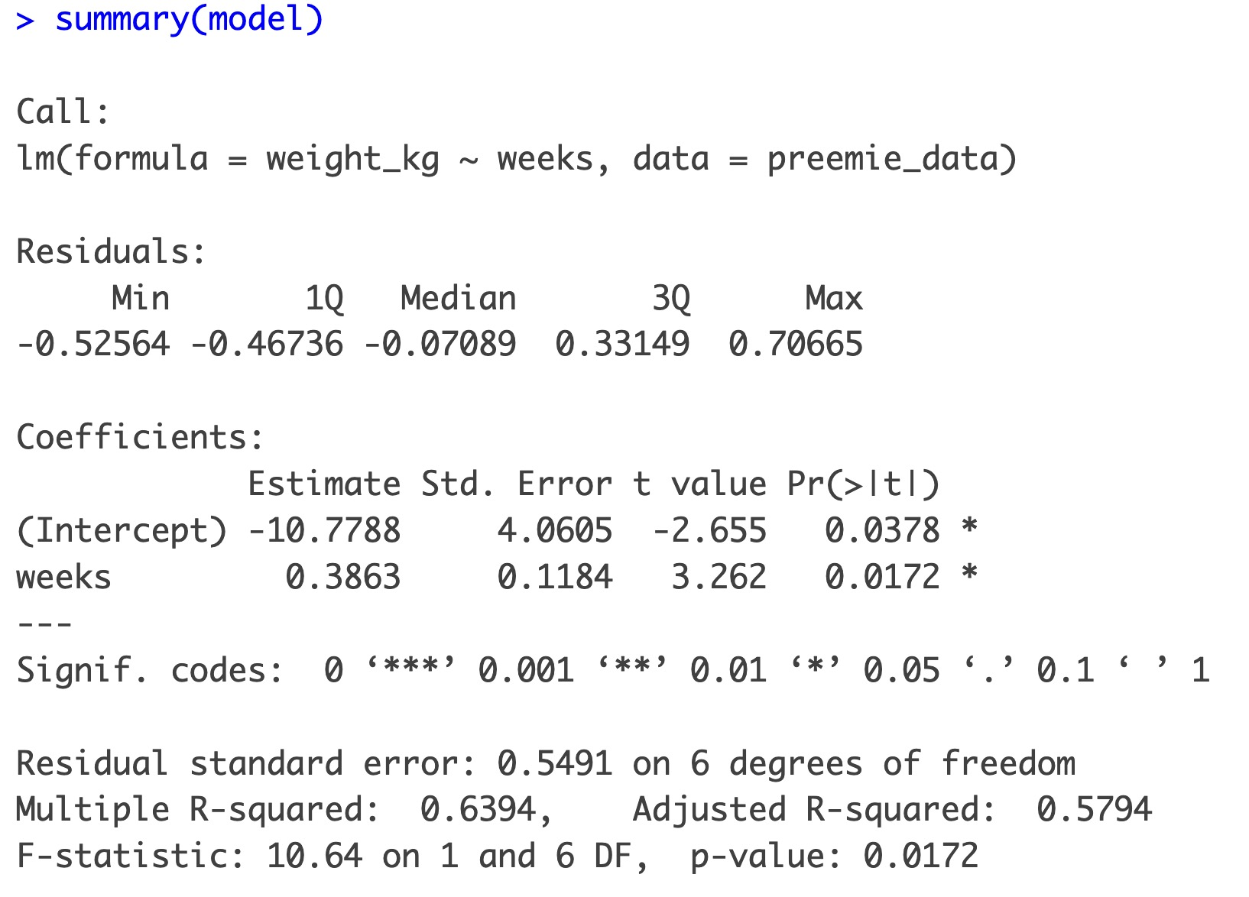
Understanding the Full Output for the Slope Coefficients
ESTIMATE
STD. ERROR
CONF INT
T VALUE
P VALUE
b₁ = 0.386
Our best-fit slope: birth weight increases 0.386 kgs per week
SE = 0.118
Unit of slope uncertainty.
High SE = More uncertain = Less precise
CI : [0.096, 0.676]
= b₁ ± t* × SE
Range we are 95% confident contains true slope
t = 3.26
= b1 / SE = 0.386 / 0.118
Signal/noise: slope is 3.26 SEs from zero
p = 0.017
PR(>|T|)
Only 1.7% chance of seeing a t-value this extreme if no real relationship
4
b₁ = 0.386
3
p-value = 0.86% * 2 = 1.72%
Birth Weight (kg)
t = b₁ / SE = 0.386 / 0.118 = 3.26
1SE
1SE
1SE
2
0.0
0.2
0.4
0.6
0.8
(1 SE)
1
Null hypothesis:
slope should be here
0.096
0.676
1SE
1SE
1SE
1SE
32
33
34
35
36
True slope’s plausible region: ± 2.45 SE
95% Confidence Interval
Gestational Weeks

Slide 3
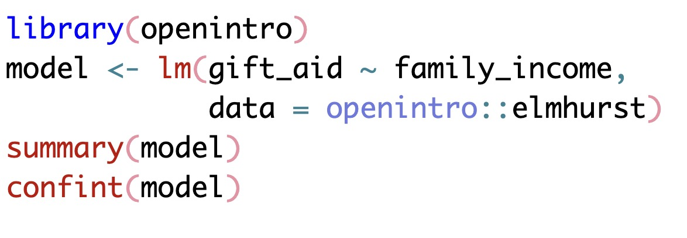
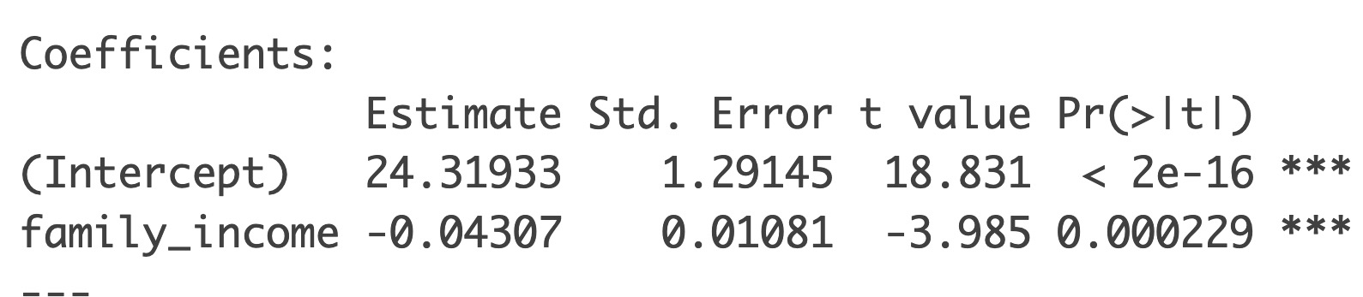
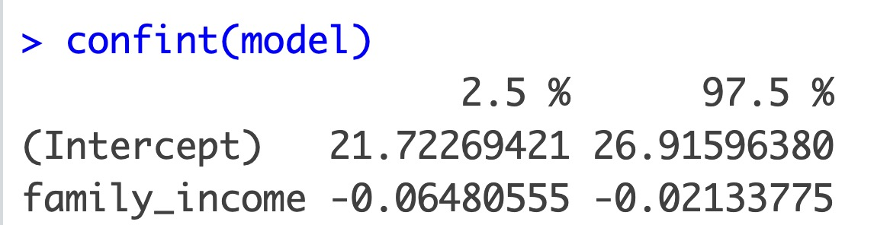
Practice: Reading the Full Output for the Slope Coefficients
Researchers modeled the amount of financial aid (in thousands of dollars) a student receives as a function of their family’s annual income (in thousands of dollars). The code and output are shown below.
Q1: Based on this output, what is the best conclusion about the relationship between family income and gift aid?
A) There is strong evidence of a negative linear association
B) There is no evidence of a linear association
C) There is strong evidence of a positive association
Answer: A
The p-value for the slope (0.0002) is far below 0.05. And the confidence interval does not contain zero

Slide 4
Practice: Reading Regression Output (PREVEND Study)
In a study of 500 adults, researchers modeled cognitive function (RFFT score) as a function of age. The regression output is shown below.
library(oibiostat)
set.seed(1); data(prevend)
prevend_sample <- prevend[sample(nrow(prevend), 500), ]
model_rfft <- lm(RFFT ~ Age, data = prevend_sample)
summary(model_rfft)
confint(model_rfft)
Estimate Std. Error t value Pr(>|t|) (Intercept) 128.490 4.683 27.44 <2e-16 Age -1.096 0.084 -13.03 <2e-16 95% CI for Age: (-1.26, -0.93)
Q3: What does the slope estimate of −1.096 tell us about the relationship between age and cognitive function?
Q4: The 95% CI is (−1.26, −0.93). Which of these could be the 99% CI?
A) For each additional year of age, RFFT score decreases by about 1.1 points on average
A) (−1.31, −0.88)
B) For each additional year of age, RFFT score increases by about 1.1 points on average
B) (−1.18, −1.01)
C) The average RFFT score in this sample is 1.1 points
Answer: A
The slope is −1.096, negative, so RFFT decreases with age. Option B gets the direction wrong. Option C confuses the slope with the mean.
Answer: A
The 99% CI must be wider than the 95% CI. Option B is narrower, so it cannot be a 99% CI.
To calculate in R: confint(model_rfft, level = 0.99)

Slide 5
Practice: Reading Regression Output (Beer & BAC)
In an experiment, 16 volunteers each drank a randomly assigned number of beers, and their blood alcohol content (BAC) was measured 30 minutes later.
library(openintro)
data(bac)
model_bac <- lm(bac ~ beers, data = bac)
summary(model_bac)
confint(model_bac)
Estimate Std. Error t value Pr(>|t|) (Intercept) -0.013 0.013 -1.00 0.332 beers 0.018 0.002 7.48 2.97e-06 *** 95% CI for beers: (0.013, 0.023)
Q5: Do the data provide strong evidence that the number of beers consumed is associated with BAC?
Q6: The 95% CI for the beers slope is (0.013, 0.023). A student says: "Since it's entirely above zero, the relationship is significant at 5%." Is this deduction correct?
A) No : the intercept is not significant (p = 0.332), so the model is not meaningful
A) Yes : a 95% CI excluding zero rejects H₀ at α = 0.05
B) Yes :the slope for beers has p < 0.0001, indicating a significant positive association
B) No : we need the p-value separately; the CI doesn't tell us about significance
Answer: B
The key test is for the slope, not the intercept. The p-value for beers (< 0.0001) gives strong evidence of a positive association. Option A wrongly focuses on the intercept.
Answer: A
A 95% CI excluding zero and a two-sided p < 0.05 are equivalent. The CI gives direction + precision on top of significance.

Slide 6
Learning Objectives | t Values and p Values
1
Compute the t-statistic for a regression slope ✅
Divide the estimated slope by its standard error to measure how many SEs away from zero the estimate sits
2
Define the null hypothesis, explain how a t-value is used to calculate a p-value, and describe what the p-value represents.✅
H₀: β₁ = 0 says x has no linear effect; the p-value is the probability of seeing a test statistic this extreme if H₀ is true
3
Connect the CI and p-value as two views of the same test ✅
The CI excludes zero exactly when the p-value falls below the significance level — both tools give the same verdict
4
Read and interpret the full regression output for slope coefficients ✅
Locate the estimate, SE, t, p, and CI columns in software output and state what each number means

