Slide 1
Learning Objectives | Standard Error and Confidence Intervals
1
Define the standard error of the slope ✅
SE(b₁) quantifies how much the slope typically varies from sample to sample
2
Identify the three ingredients that control SE ✅
Residual spread (s), sample size (n), and x-spread (Sxx) all affect precision
3
Construct and interpret a confidence interval for the slope
Combine the estimate, SE, and t-multiplier to build an interval that gives a plausible range for β₁
4
Use the CI to test for a significant effect
If zero falls outside the CI, the relationship is statistically significant
5
Distinguish the sample slope from the true slope
b₁ is our estimate from data; β₁ is the unknown population parameter

Slide 2
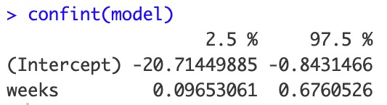
From Standard Error (0.118) of Slope to Confidence Interval
ORIGINAL FIT
Represent the slope on number line, denote variability with interval plots
4
Stretching to ± 2.45 SE captures a range we are 95% confident contains the true slope (thanks to central limit theorem)
3
Birth Weight (kg)
2
If this 95% CI does not contain zero, the slope is said to be significant
1
32
33
34
35
36
Gestational Weeks
SE ON NUMBER LINE
(± 1 SE)
b₁ = 0.386
R OUTPUT
0.268
0.504
0.0
0.2
0.4
0.6
0.8
Slope
(± 2.45 SE) 95% CI
= b₁ ± 2.45 × SE = 0.386 ± 2.45 × 0.118
0.096
0.676
With only n = 8, we need a wider interval. Use the t-distribution with df 6.
(df = n − 2 = 6).
Get t* in R:
qt(0.975, df = 6)
## [1] 2.446912
Reminder: No relationship ≃ zero slope
ASIDE
Why 2.45, not 1.96?
ASIDE
When there’s no relationship:
When there IS a relationship:
Slopes ≈ 0 (flat lines)
Slopes clearly away from 0

Slide 3
Practice: Significance & the Zero-Slope Test
R's confint(model) returns (0.097, 0.675) for the slope CI. What two values went into computing these?
Our 95% CI for a slope is (-0.45, -0.2). A colleague says the slope is "significant." Why?
A) The CI is relatively narrow
A) The slope and the standard error
B) The CI does not contain zero
B) The intercept and the confidence interval
Answer: B
Both -0.45 and -0.2 are below zero. Because the entire interval is negative, we can reject the null hypothesis that the true slope is zero.
If the CI straddled zero (e.g., -0.55 to 0.10), we could not rule out no relationship.
Answer: A
The CI endpoints are b₁ ± t* × SE. R uses the slope estimate (0.386) and the SE (0.118), multiplied by the t-critical value (2.45).
0.386 − 2.45×0.118 = 0.097 and 0.386 + 2.45×0.118 = 0.675.

Slide 4
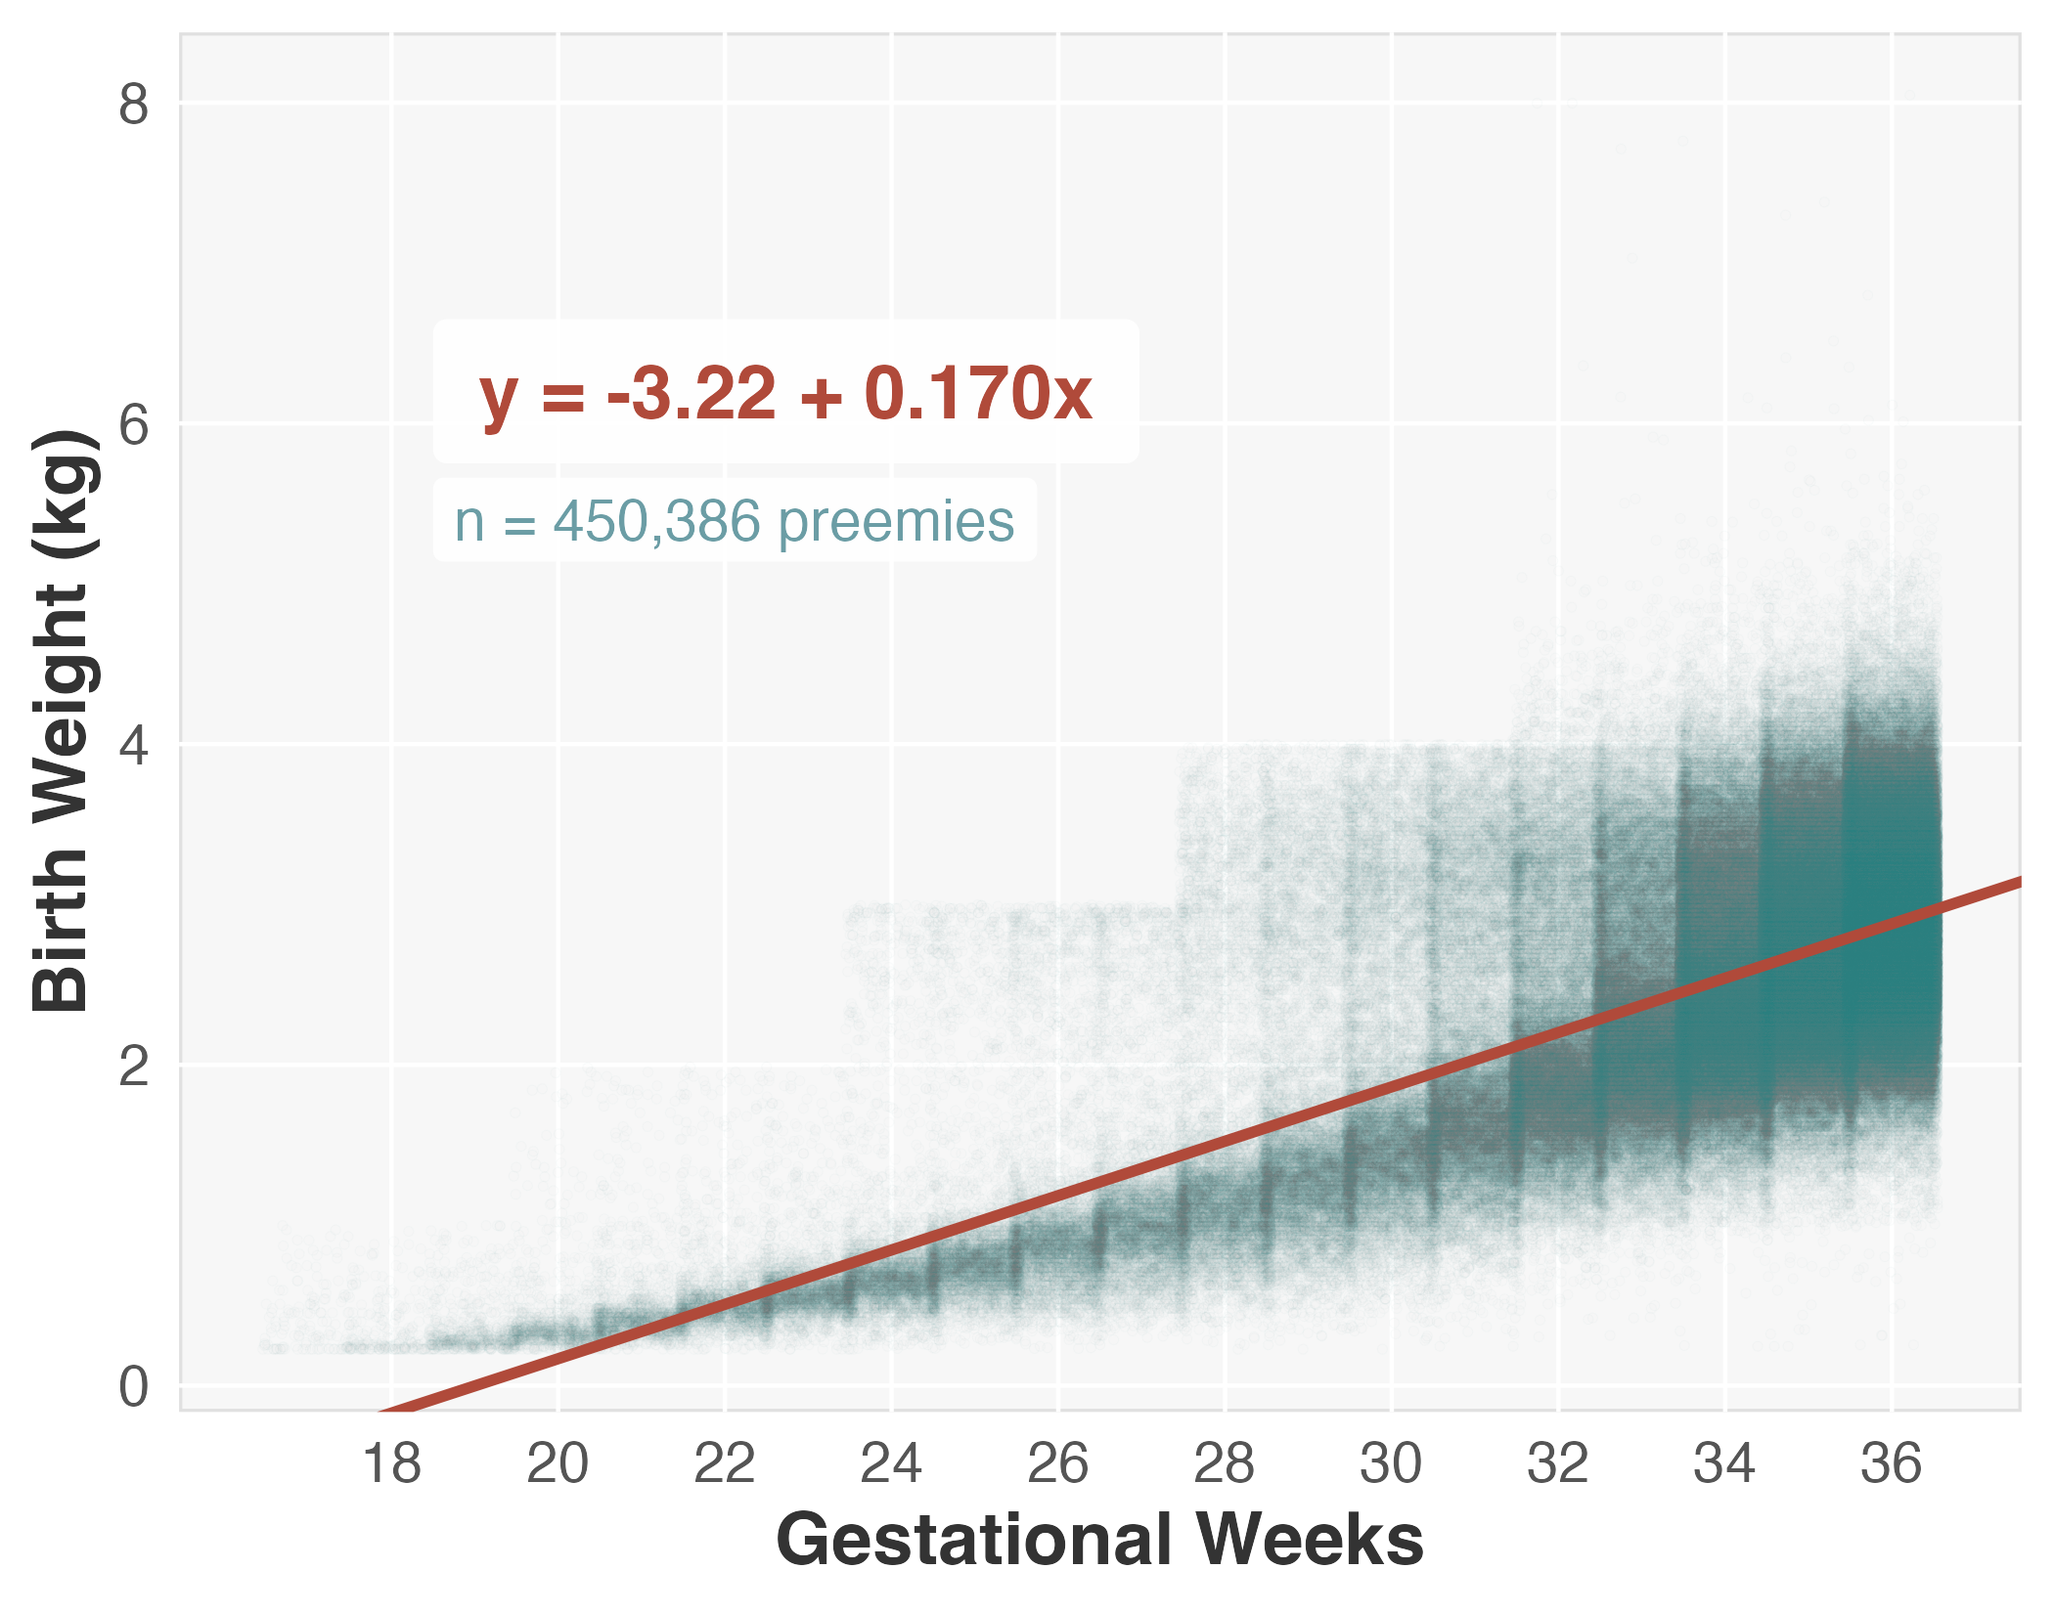
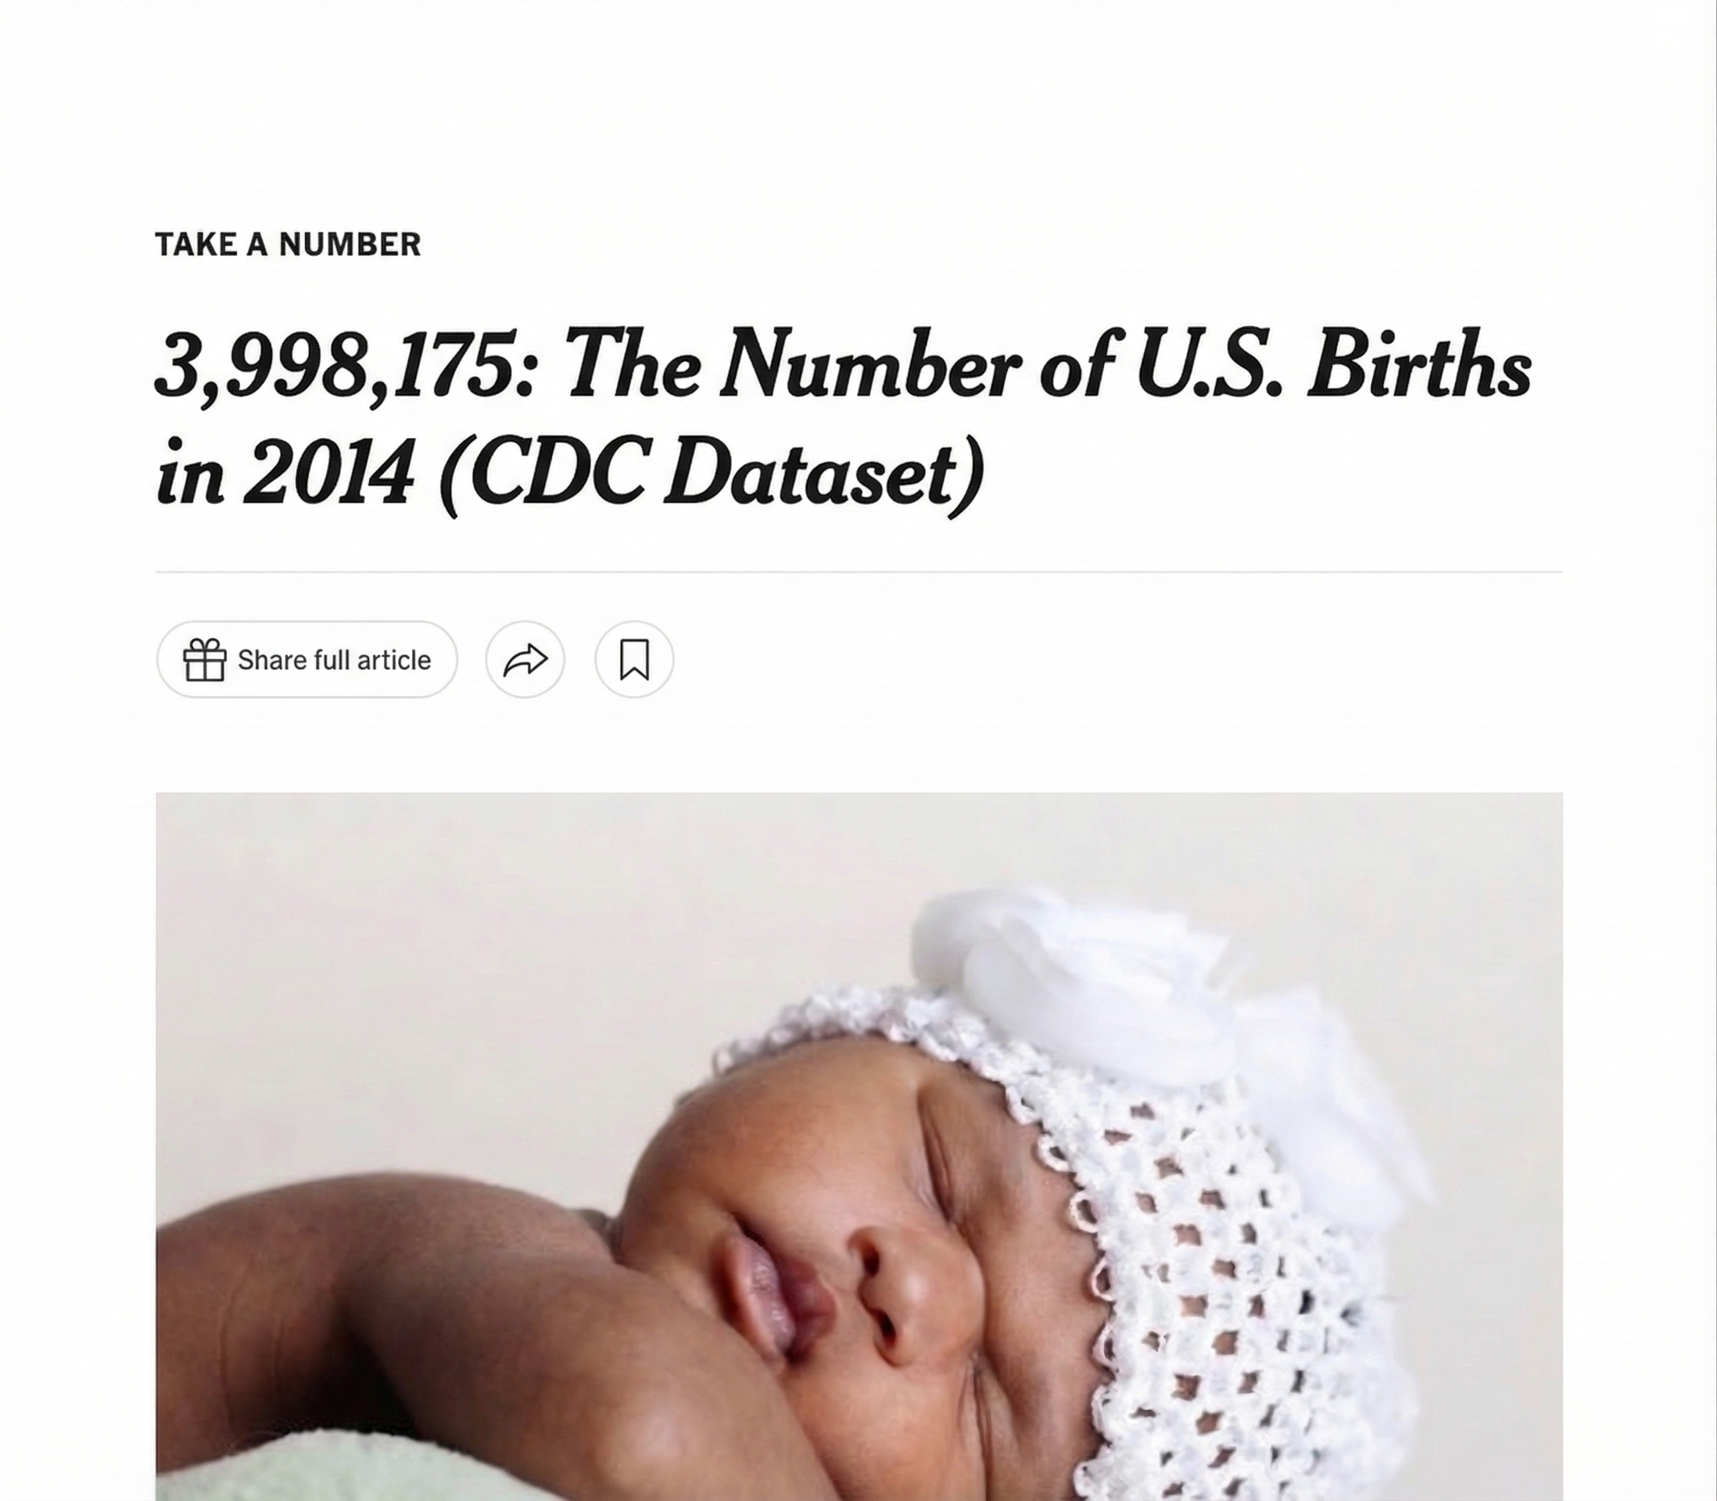
Did our Confidence Interval Contain the True Slope?
POPULATION DATA
CI contains the population slope β₁ = 0.170 ✓
SE ON NUMBER LINE
β₁ = 0.170
b₁ = 0.386
0.0
0.2
0.4
0.6
0.8
Slope
95% CI (± 2.45 SE)
0.096
0.676
KEY TAKEAWAY
Normally we don't have the population, so we can't check.
But with this data, we can confirm: our 95% CI captured the true slope.
We would expect this to happen (successful in capturing true slope) 19 out of 20 times (95%) that we use this procedure on a study.
* True slope may be different for other populations, other years. May also pertain to the data-generating process

Slide 5
Practice: Sample vs. Population Concepts
Which quantity comes directly from the data collected in a study?
The 95% CI (0.096 to 0.676) we constructed is a plausible range for:
A) The observed slope b₁, 0.386, for our 8-baby sample
A) The sample slope b₁
B) The true population slope β₁
B) The population slope β₁
Answer: B
The interval is always centered on b₁, but its purpose is to tell us where β₁ is likely to lie.
Answer: A
The sample slope b₁ is computed from the observed dataset. The population slope β₁ is the fixed true value we’re trying to estimate;it is not directly observed.

Slide 6
Practice: Sample vs. Population Concepts
If you could repeat the preemie study 1,000 times with a fresh sample of 8 babies each time, what would you expect?
Our sample gave b₁ = 0.386 , while the true population slope is β₁ = 0.170 . The difference between these two numbers illustrates
A) Every study would produce b₁ = 0.386
A) Sampling variability
B) Slopes would vary, scattered around β₁
B) Uncertainty in the regression software
C) Slopes would vary, scattered around b₁ = 0.386
C) An error in the confidence interval creation
Answer: B
Each sample gives a different b₁. These sample slopes cluster around the true β₁, not around any single sample’s estimate.
Answer: A
Due to sampling variability, the sample slope can be quite different from the population slope.

Slide 7
Learning Objectives | Standard Error and Confidence Intervals
1
Define the standard error of the slope ✅
SE(b₁) quantifies how much the slope typically varies from sample to sample
2
Identify the three ingredients that control SE ✅
Residual spread (s), sample size (n), and x-spread (Sxx) all affect precision
3
Construct and interpret a confidence interval for the slope ✅
Combine the estimate, SE, and t-multiplier to build an interval that gives a plausible range for β₁
4
Use the CI to test for a significant effect ✅
If zero falls outside the CI, the relationship is statistically significant
5
Distinguish the sample slope from the true slope ✅
b₁ is our estimate from data; β₁ is the unknown population parameter

Slide 8
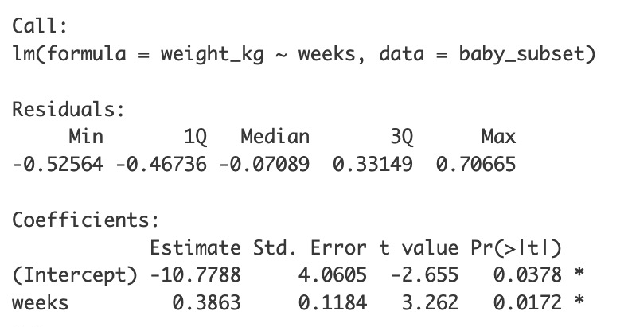
Side Note: SE of Slope vs. SE of the Intercept
The SE of the intercept (b₀) measures uncertainty in the y-intercept estimate. It exists but is rarely the focus in regression analysis.
SE of the Slope (b₁)
How precise is our slope (the effect of one var on another)?
High practical value
SE of the Intercept (b₀)
How precise is our y-intercept?
Often not scientifically meaningful

