Slide 1
Learning Objectives | Standard Error and Confidence Intervals
1
Define the standard error (SE) of the slope
SE(b₁) quantifies how much the slope typically varies from sample to sample
2
Identify the three ingredients that control standard error
Residual spread (s), sample size (n), and x-spread (Sxx) all affect precision

Slide 2
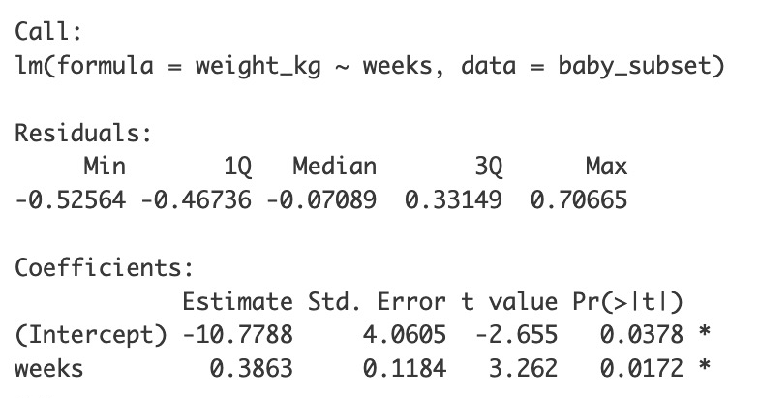
Our Data and the Best-Fit Line
Weeks | Weight (kg)
32 | 1.65
36 | 2.67
33 | 2.18
36 | 3.83
35 | 2.53
36 | 2.64
32 | 1.06
34 | 3.06
4
3
Birth Weight (kg)
ŷ = −10.78 + 0.386x
2
Best-Fit Slope b₁ = 0.386 kg per week.
Each extra week of gestation adds ~0.4 kg to birth weight.
But can we trust this number?
A different sample of 8 preemies would give a different slope.
To know how much to trust the number, we can ask “how different”?
1
32
33
34
35
36
Gestational Weeks

Slide 3
How Much Would the Slope Change?
4
Slopes highly variable
0.12 → 0.55 → −0.08
Hard to trust any slope
3
Birth Weight (kg)
b₁ = 0.12
b₁ = 0.55
b₁ = −0.08
2
Slopes consistent
0.35 → 0.41 → 0.38
Safe to ~trust the slope
1
32
33
34
35
36
Gestational Weeks
Typical variation from slope to slope
“Spread”
“Standard error” of the slope
b₁ = 0.35
b₁ = 0.41
b₁ = 0.38
✋But wait: we (usually) only have one sample!
We can’t actually resample from the population.
So how can we know how much the slope would vary?

Slide 4
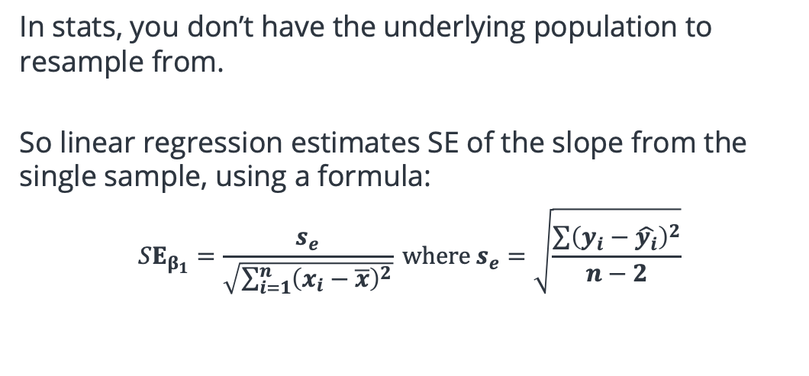
Estimating Slope Variability (SE) from a Single Sample
In stats, you don’t have the underlying population to resample from.
So linear regression estimates SE of the slope from the single sample, using a formula:
$$SE_{β_{1}}=\frac{s_{e}}{\sqrt{\sum_{i=1}^{n}{{\left(x_{i}−\overline{x}\right)}^{2}}}} where s_{e}=\sqrt{\frac{\sum{{\left(y_{i}−\hat{y_{i}}\right)}^{2}}}{n−2}}$$
4
3
Birth Weight (kg)
2
1
32
33
34
35
36
Gestational Weeks
Typical variation from slope to slope
“Spread”
“Standard error” of the slope
This estimate (0.118) gives us a sense of the typical variation of the slope across samples. (How wide the cloud is)

Slide 5
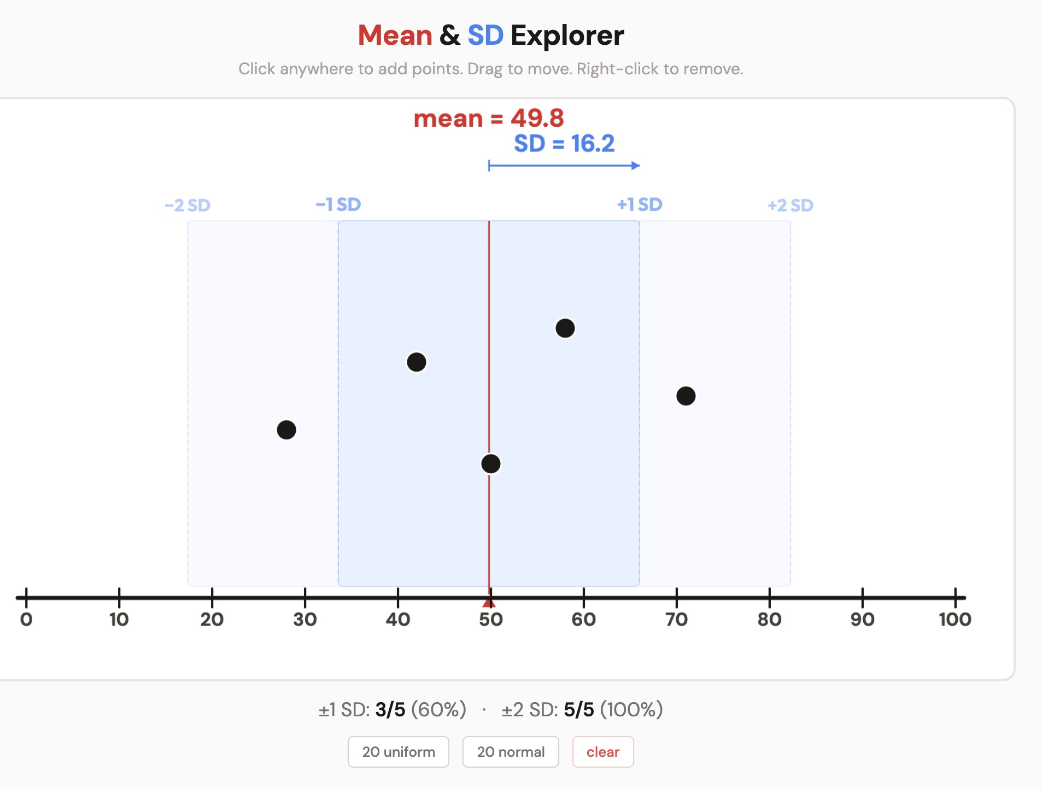
Intuition Pumps: Is that SE big or small?
1
The Sign-Flip Test
2
The Fraction Test
Compute slope ± 1 SE.
Does the interval cross zero?
If yes → the wobble is big enough to flip the sign of your effect.
Ex: slope = 0.15, SE = 0.20
Range: [–0.05, 0.35] → crosses zero!
Compare SE to |slope|:
SE > half the slope → big
SE < tenth of slope → small
slope = 0.44, SE = 0.008 → ?
slope = –0.11, SE = 0.061 → ?
3
Play with our SD simulation
4
Example SDs in the world
SE is like an SD for your slope estimate.
±1 SE covers ~68% of implied variation.
Physical SDs you already know:
• Nightly sleep: avg ~7 hrs, SD ≈ 1 hr
• Pregnancy length: avg ~ 9 months, SD ≈ 2 weeks

Slide 6
Practice: Sample vs. Population
If we repeated the study with 8 different babies, would the slope be identical?
What is the SE of the slope estimating?
A) No; different samples give different slopes
A) The variation of the x and y values within the selected sample
B) Yes, the slope is a fixed property
C) Only if gestational ages are the same
B) The variation of slopes across many hypothetical samples
Answer: A
Our slope of 0.386 is one estimate of the slope, not the one-true slope. A new sample might give 0.35 or 0.42.
This is why we need the standard error: to measure how much the slope varies.
Answer: B
Imagine drawing sample after sample from the population. Each gives a different slope. The variation (standard deviation) of all those slopes is the SE.

Slide 7
Practice: Sample vs. Population
In practice, how do we get the SE?
If the SE of the slope is large, what does that mean?
A) Repeat the study ~1000 times and check the variability
A) The slope estimate is probably wrong
B) Use a formula that estimates it from our one sample
B) Different samples would give very different slopes
Answer: B
We don't have the population, so we can't actually draw 2,000 samples. Instead, R uses: SE(b₁) = √(SER / ∑(x_{i} − x̄)²)
Answer: B
A large SE means that if we repeated the study with new samples, we'd get wide variation in the slopes between studies.
A small SE means different samples would give similar slopes; we can trust our estimate more.

Slide 8
Learning Objectives | Standard Error and Confidence Intervals
1
Define the standard error of the slope ✅
SE(b₁) quantifies how much the slope typically varies from sample to theoretical sample
2
Identify the three ingredients that control SE
Residual spread (s), sample size (n), and x-spread (Sxx) all affect precision
3
Construct and interpret a confidence interval for the slope
Combine the estimate, SE, and t-multiplier to build an interval that gives a plausible range for β₁
4
Use the CI to test for a significant effect
If zero falls outside the CI, the relationship is statistically significant
5
Distinguish the sample slope from the true slope
b₁ is our estimate from data; β₁ is the unknown population parameter

Slide 9
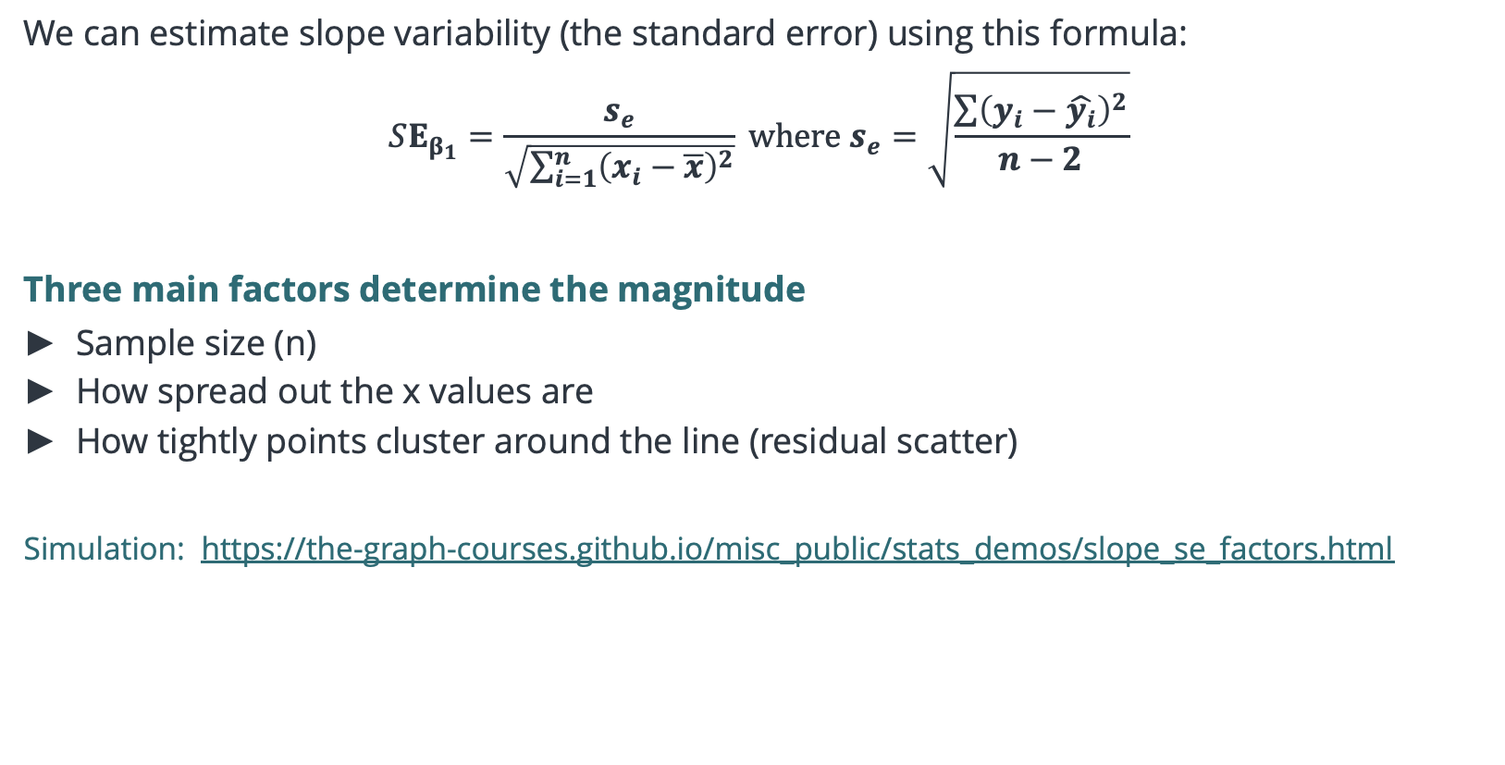
Three Factors that Drive Slope Variability
We can estimate slope variability (the standard error) using this formula:
$$SE_{β_{1}}=\frac{s_{e}}{\sqrt{\sum_{i=1}^{n}{{\left(x_{i}−\overline{x}\right)}^{2}}}} where s_{e}=\sqrt{\frac{\sum{{\left(y_{i}−\hat{y_{i}}\right)}^{2}}}{n−2}}$$
Three main factors determine the magnitude
Sample size (n)
How spread out the x values are
How tightly points cluster around the line (residual scatter)
Simulation: https://the-graph-courses.github.io/misc_public/stats_demos/slope_se_factors.html

Slide 10
Practice: Applying This to New Studies
A professor investigates hours studied vs. exam score with 12 students. To get a more precise slope estimate, she should:
A nutritionist studies daily sugar (g) vs. blood pressure. Which sample is more likely to give a more precise slope estimate?
A) Use a non-variant standard error formula
A) 20 people ranging from 10 g to 120 g of sugar/day
B) Recruit more students into the study
B) 20 people who all eat 45–55 g of sugar/day
Answer: B
More students = larger n = bigger denominator = smaller SE.
This is the single most actionable thing a researcher can do: collect more data.
Answer: A
Same n, but sample A has a much wider spread of x.
That makes ∑(xᵢ − x̄)² much larger → smaller SE. The line is anchored across a wide range, so it can't wobble much.
Lesson: when designing a study, sample across a wide range of your x variable!

Slide 11
Learning Objectives | Standard Error and Confidence Intervals
1
Define the standard error of the slope ✅
SE(b₁) quantifies how much the slope typically varies from sample to sample
2
Identify the three ingredients that control SE ✅
Residual spread (s), sample size (n), and x-spread (Sxx) all affect precision

