Slide 1
Learning Objectives | t Values and p Values
1
Compute the t-statistic for a regression slope
Divide the estimated slope by its standard error to measure how many SEs away from zero the estimate sits
2
Define the null hypothesis, explain how a t-value is used to calculate a p-value, and describe what the p-value represents.
H₀: β₁ = 0 says x has no linear effect; the p-value is the probability of seeing a test statistic this extreme if H₀ is true
3
Connect the CI and p-value as two views of the same test
The CI excludes zero exactly when the p-value falls below the significance level — both tools give the same verdict

Slide 2
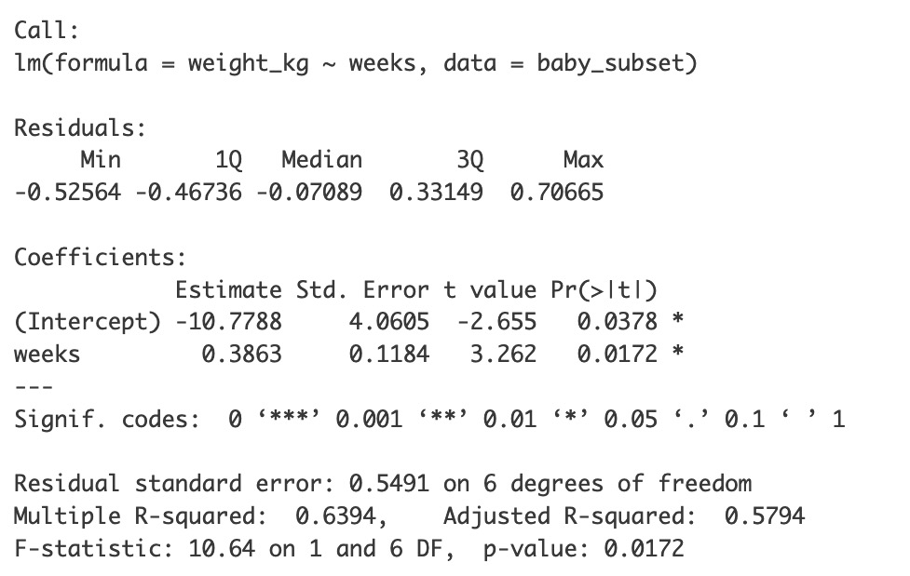
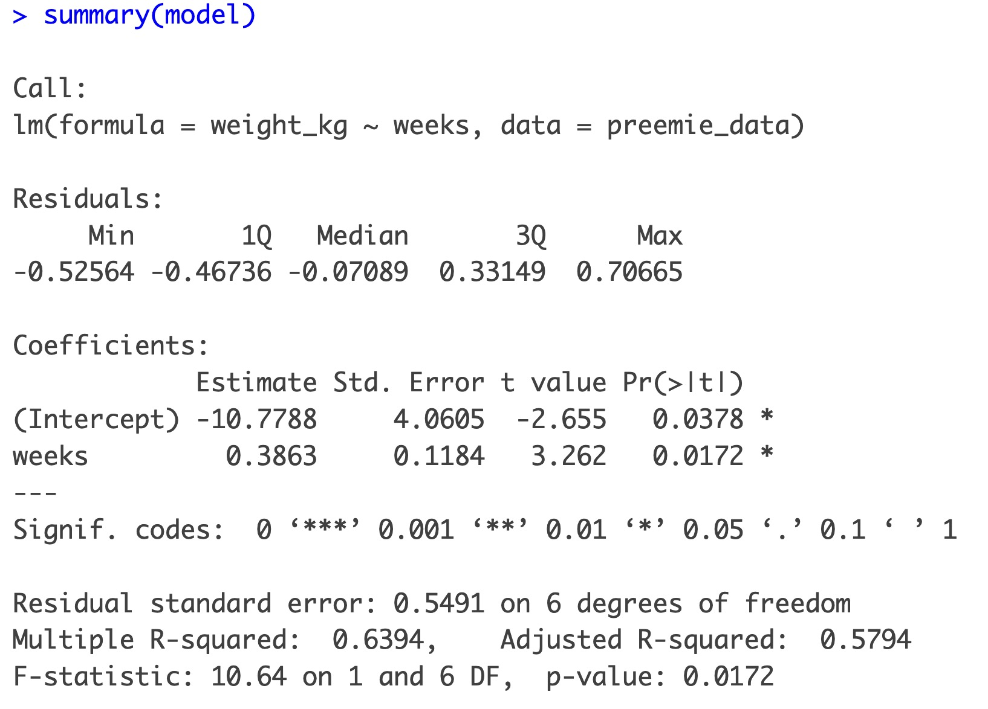
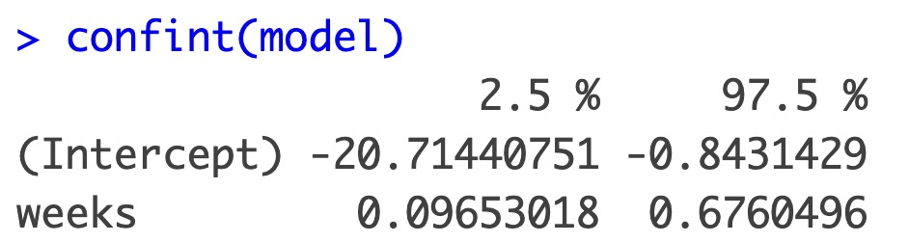
Recap
Computing the t statistic
Weeks | Weight (kg)
32 | 1.65
36 | 2.67
33 | 2.18
36 | 3.83
35 | 2.53
36 | 2.64
32 | 1.06
34 | 3.06
pacman::p_load(tidyverse, openintro)
# Prep data
preemie_data <- openintro::births14 %>%
filter(premie == "premie") %>%
mutate(weight_kg = weight * 0.453592) %>%
slice_tail(n = 8)
# Fit model
model <- lm(weight_kg ~ weeks, data = preemie_data)
# View results
summary(model)
confint(model)
The t-statistic is a signal-to-noise ratio. It asks: how big is the slope compared to the uncertainty around it?
Computed as b₁/SE
SIGNAL
NOISE
RATIO
b₁
= 0.386
The estimated slope
SE
= 0.118
The standard error
How much the slope would vary across samples
t = 3.26
= 0.386 / 0.118
Signal ÷ Noise
How many SEs the slope is from zero
💡 A big |t| means the slope is large relative to its uncertainty: strong evidence of a linear association.
MODEL FIT
MODEL FIT ON A NUMBER LINE
b₁ = 0.386
4
3
t = b₁ / SE = 0.386 / 0.118 = 3.26
Birth Weight (kg)
1SE
1SE
1SE
2
0.0
0.2
0.4
0.6
0.8
1
0.096
0.676
32
33
34
35
36
1SE
1SE
1SE
1SE
Gestational Weeks
True slope’s plausible region: ± 2.45 SE
95% Confidence Interval

Slide 3
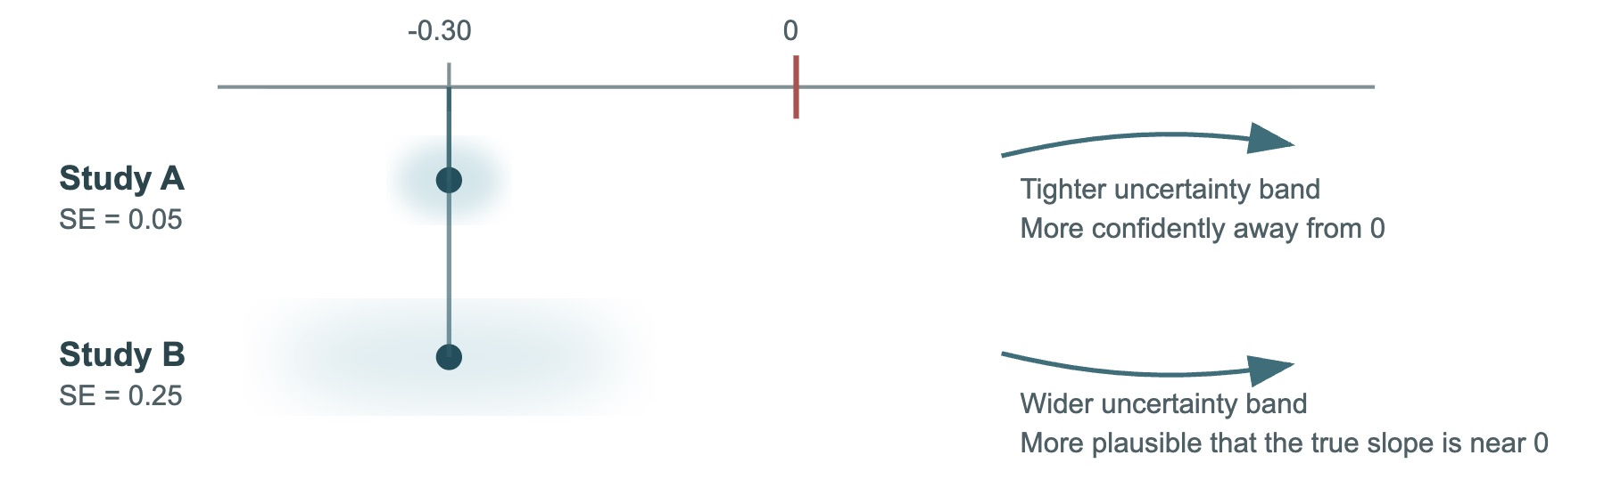
Practice: t-statistic
A study of exercise vs. weight loss finds b₁ = 0.45 with SE = 0.15. Compute the t-statistic.
Two studies with similar sample sizes were performed and found a slope of -0.30. For study A: SE = 0.05; For Study B: SE = 0.25. Which has stronger evidence for an effect?
A) t = 3.00
A) Study A
B) t = 0.33
B) Study B
C) t = 0.60
C) Equal because the slopes are the same
Answer: A
t = b₁ / SE = 0.45 / 0.15 = 3.00
The slope is 3 standard errors away from zero.
Answer: A Study A: t = -0.30 / 0.05 = -6.0
Study B: t = -0.30 / 0.25 = -1.2
💡 A big |t| means the slope is large relative to its uncertainty: evidence of a linear association

Slide 4
Learning Objectives | t Values and p Values
1
Compute the t-statistic for a regression slope ✅
Divide the estimated slope by its standard error to measure how many SEs away from zero the estimate sits
2
Define the null hypothesis, explain how a t-value is used to calculate a p-value, and describe what the p-value represents.
H₀: β₁ = 0 says x has no linear effect; the p-value is the probability of seeing a test statistic this extreme if H₀ is true
3
Connect the CI and p-value as two views of the same test
The CI excludes zero exactly when the p-value falls below the significance level

Slide 5
From the t statistic to the p-value : Entering the null world
b₁ = 0.386
t = b₁ / SE = 0.386 / 0.118 = 3.26
1SE
1SE
1SE
0.0
0.2
0.4
0.6
0.8
0.096
0.676
1SE
1SE
1SE
1SE
True slope’s plausible region: ± 2.45 SE
95% Confidence Interval

Slide 6
From the t statistic to the p-value : Entering the null world
The null hypothesis: "There is no relationship between x and y.”
True slope of zero
In such a world, random samples of 8 would still produce some slope, and a corresponding t value
Forming a bell curve around 0
The null distribution shows what t-values (signal-to-noise ratios) we'd see
ASIDE
Reminder: No relationship ≃ zero slope
When there’s no relationship:
When there IS a relationship:
Slopes ≈ 0 (flat lines)
Slopes clearly away from 0
Side note:
Our null:
- Gestational weeks has no association with birth weight
For a believable null world, consider:
trial testing dosages of a drug on symptom severity
the effect of reading a specific prep book on exam scores.
We’re imagining the drug/prep book do not work
b₁ = 0.386
t = b₁ / SE = 0.386 / 0.118 = 3.26
1SE
1SE
1SE
0.0
0.2
0.4
0.6
0.8
0.096
0.676
1SE
1SE
1SE
1SE
True slope’s plausible region: ± 2.45 SE
95% Confidence Interval

Slide 7
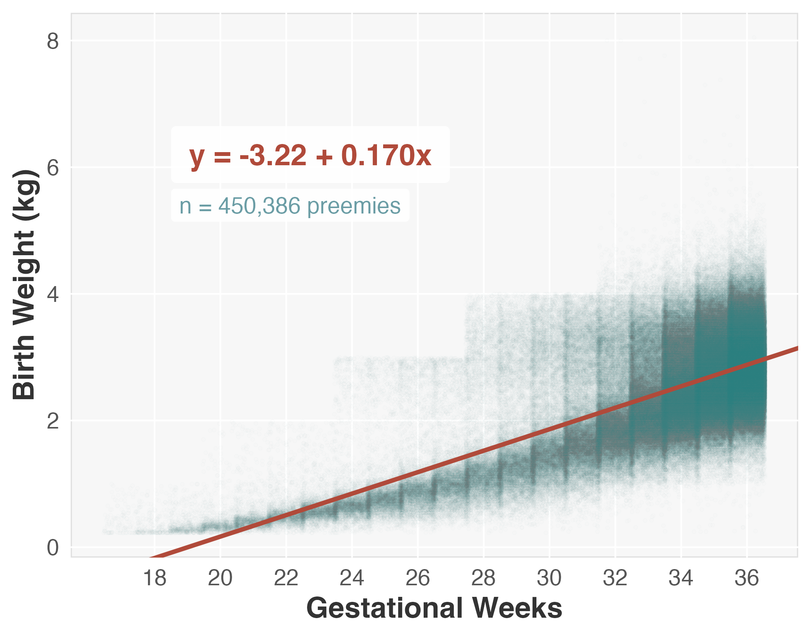
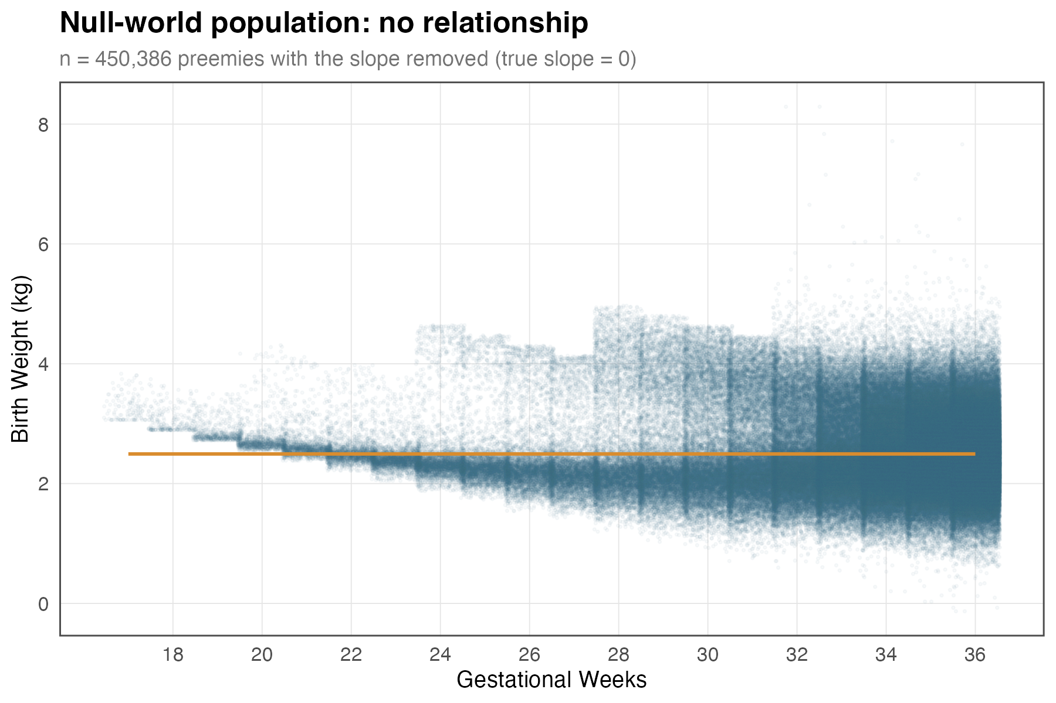
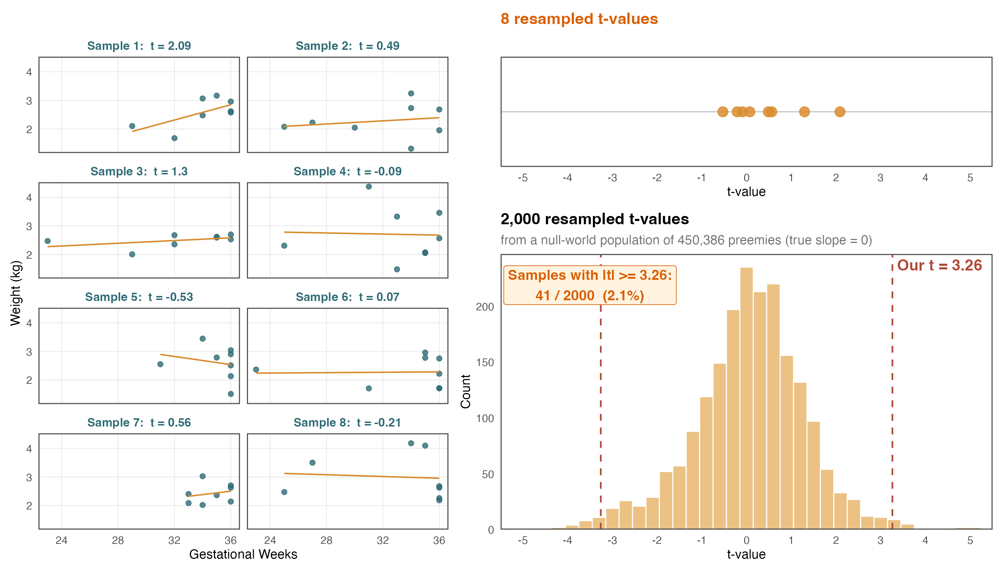
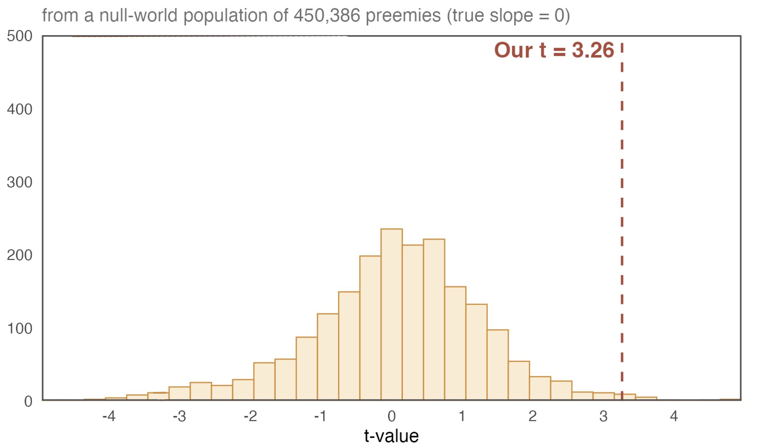
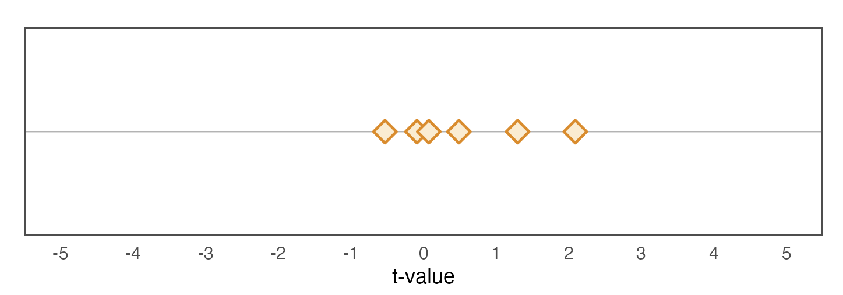
From the t statistic to the p-value : Entering the null world
The null hypothesis: "There is no relationship between x and y.”
True slope of zero
In such a world, random samples of 8 would still produce some slope, and a corresponding t value
Forming a bell curve around 0
The null distribution shows what t-values (signal-to-noise ratios) we'd see
POPULATION DATA
NULL HYPOTHESIS WORLD
Flatten out the data
2000 resampled t-values
6 resampled t-values

Slide 8
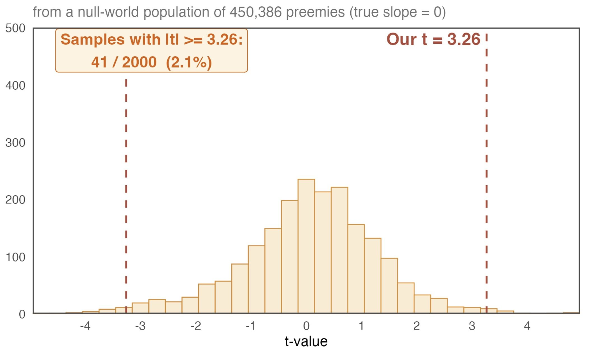

From the t statistic to the p-value : Entering the null world
The null hypothesis: "There is no relationship between x and y.”
True slope of zero
In such a world, random samples of 8 would still produce some slope, and a corresponding t value
Forming a bell curve around 0
The null distribution shows what t-values (signal-to-noise ratios) we'd see
P-value: in this world, how often would we get a t-value as extreme as 3.26?
Simulation answer: 41 out of 2,000 samples (~2%)
Theoretical answer (how it’s actually done): using a t-distribution with df = n - 2 = 6, we get p = 0.0172 (1.7%)
T to p conversion depends on df. Software handles this. Roughly, |t|statistic above 2 ≃ p-value below 0.05 for samples > 30
Conclusion: the "no relationship" world is not a good explanation of our data. We reject the null hypothesis.
POPULATION DATA
NULL HYPOTHESIS WORLD
Flatten out the data
2000 resampled t-values

Slide 9
From the t statistic to the p-value : Entering the null world
The null hypothesis: "There is no relationship between x and y.”
True slope of zero
In such a world, random samples of 8 would still produce some slope, and a corresponding t value
Forming a bell curve around 0
The null distribution shows what t-values (signal-to-noise ratios) we'd see
P-value: in this world, how often would we get a t-value as extreme as 3.26?
Simulation answer: 41 out of 2,000 samples (~2%)
Theoretical answer (how it’s actually done): using a t-distribution with df = n - 2 = 6, we get p = 0.0172 (1.7%)
T to p conversion depends on df. Software handles this. Roughly, |t|statistic above 2 ≃ p-value below 0.05 for samples > 30
Conclusion: the "no relationship" world is not a good explanation of our data. We reject the null hypothesis.
Star codes
***
p < 0.001
Very strong evidence against the null
**
p < 0.01
Strong evidence against the null
*
p < 0.05
Moderate evidence (our result: p = 0.017)
.
p < 0.10
Weak / suggestive
p ≥ 0.10
Very weak
b₁ = 0.386
p-value = 0.86% * 2 = 1.72%
t = b₁ / SE = 0.386 / 0.118 = 3.26
1SE
1SE
1SE
0.0
0.2
0.4
0.6
0.8
0.096
0.676
1SE
1SE
1SE
1SE
True slope’s plausible region: ± 2.45 SE
95% Confidence Interval

Slide 10
Practice: Understanding the null hypothesis and the p-value
Q1: Under the null hypothesis in this lesson, which statement is true?
Q2: In the simulation, only 41 out of 2,000 null-world samples had a t-statistic at least as extreme as ours. What does that suggest?
A) All sample slopes will be zero, but the true slope may be non-zero
A) Our result would be unusual if the true slope were 0
B) The true slope is zero, but sample slopes will vary by chance
B) The null hypothesis is a good explanation of the data
Answer: B Even if the true slope is 0, random samples will usually give slightly positive or negative slopes just from chance.
This variability gives rise to the t-distribution under the null
Answer: A If only a small fraction of null-world samples produce a result this extreme, then our observed data do not fit very well with the null world. That is why the result counts as evidence against the null hypothesis, or evidence in favor of there being a real effect.

Slide 11
Avoiding misinterpretations of the p-Value
✓ CORRECT: "If the null hypothesis were true, there is a 1.72% chance of seeing a test statistic as extreme as 3.26 in a sample of 8."
Common Misinterpretations
✗ A small p value means ”the effect is large”.
Wrong: a small p only says the effect is unlikely to be zero, not that it is big
✗ A p-value > 0.05 proves there is no association
Wrong: It only means your current data is inconclusive. Larger sample size could still capture an association
b₁ = 0.386
p-value = 0.86% * 2 = 1.72%
t = b₁ / SE = 0.386 / 0.118 = 3.26
1SE
1SE
1SE
0.0
0.2
0.4
0.6
0.8
0.096
0.676
1SE
1SE
1SE
1SE
True slope’s plausible region: ± 2.45 SE
95% Confidence Interval

Slide 12
Practice: Properly interpreting the p-Value
Q1: A study examines whether hours spent studying predict exam scores. The results show that each additional hour of studying is associated with a 4.2-point increase in exam score (out of 100), with a p-value of 0.03 for the slope. Which interpretation of this p-value is correct?
Q2: In a similar study analyzing the effect of preparation time on SAT scores (n = 50,000), the slope is 0.002 with p < 0.001. Does this indicate a 'large effect'?
A) No : the p-value measures evidence against a zero slope, not the size of the effect.
A) There is a 3% probability that studying has an effect on scores, and the effect is likely to be large
B) Yes: because p < 0.001 is an exceptionally strong threshold, it guarantees a substantial impact.
B) If studying had no effect on exam scores, we would observe a |slope| 4.2 or larger about 3% of the time
Answer: A No evidence of large effect. The slope is tiny.
But with so many observations, even a small effect can yield a highly significant p-value
Answer: B The p-value describes the probability of observing data this extreme if the null hypothesis is true.
It does not measure the probability of the hypothesis itself (A),

Slide 13
Learning Objectives | t Values and p Values
1
Compute the t-statistic for a regression slope ✅
Divide the estimated slope by its standard error to measure how many SEs away from zero the estimate sits
2
Define the null hypothesis, explain how a t-value is used to calculate a p-value, and describe what the p-value represents.✅
H₀: β₁ = 0 says x has no linear effect; the p-value is the probability of seeing a test statistic this extreme if H₀ is true
3
Connect the CI and p-value as two views of the same test
The CI excludes zero exactly when the p-value falls below the significance level

Slide 14
From the t statistic to the p-value : Entering the null world
The null hypothesis: "There is no relationship between x and y.”
True slope of zero
In such a world, random samples of 8 would still produce some slope, and a corresponding t value
Forming a bell curve around 0
The null distribution shows what t-values (signal-to-noise ratios) we'd see
P-value: in this world, how often would we get a t-value as extreme as 3.26?
Simulation answer: 41 out of 2,000 samples (~2%)
Theoretical answer (how it’s actually done): using a t-distribution with df = n - 2 = 6, we get p = 0.0172 (1.7%)
T to p conversion depends on df. Software handles this. Roughly, |t|statistic above 2 ≃ p-value below 0.05 for samples > 30
Conclusion: the "no relationship" world is not a good explanation of our data. We reject the null hypothesis.
Star codes
***
p < 0.001
Very strong evidence against the null
**
p < 0.01
Strong evidence against the null
*
p < 0.05
Moderate evidence (our result: p = 0.017)
.
p < 0.10
Weak / suggestive
p ≥ 0.10
Not significant
b₁ = 0.386
p-value = 0.86% * 2 = 1.72%
t = b₁ / SE = 0.386 / 0.118 = 3.26
1SE
1SE
1SE
0.0
0.2
0.4
0.6
0.8
0.096
0.676
1SE
1SE
1SE
1SE
True slope’s plausible region: ± 2.45 SE
95% Confidence Interval

Slide 15
The CI and p-Value Tell the Same Story, but Reporting the CI is preferred
OPTION A: ESTIMATE + CI (PREFERRED)
OPTION B: ESTIMATE + P-VALUE
Question: Does the 95% CI (± 2.45 SE) around the slope contain zero?
Zero in CI? No ✔. Significant at α = 0.05
Reporting: “Birth weight increased by 0.39 kgs per gestational week (95% CI: 0.10, 0.68).”
What it shows:
☑️The size of the effect
☑️ Significance (CI doesn’t include zero)
✅ The precision of the estimate (range 0.10 to 0.68)
Question: Is p-value < 0.05? (Does 0 ± 2.45 SE contain the estimate)
p < 0.05? Yes ✔ Significant at α = 0.05
Reporting:“Birth weight increased by 0.39 kgs per gestational week (p = 0.017).”
What it shows:
☑️ The size of the effect
☑️ Significance (below critical value)
Null’s plausible region: ± 2.45 SE
Middle 95% of Null’s distribution
1SE
1SE
1SE
1SE
From zero, ± 2.45 SE, did we touch the estimate?
0.0
0.2
0.4
0.6
0.8
From the estimate, ± 2.45 SE, did we touch zero?
0.096
0.676
1SE
1SE
1SE
1SE
True slope’s plausible region: ± 2.45 SE
95% Confidence Interval

Slide 16
Practice: Connecting CI, t, and p
Q1: confint(model) returns a 95% CI of (−0.12, 0.45) for the slope. Is the slope significant at 5% level?
Q2: 1. A study reports: “the drug reduced weight by 2.5 kg ( 95% CI: 1.9, 3.1)." Which of these can you conclude? Mark all that are correct.
A) Yes : it is significant (p < 0.05)
A) The effect is significant
B) No : it is not significant (p ≥ 0.05)
B) The confidence interval does not include zero
C) Cannot tell from CI alone
C) The p value is below 0.05
Answer: B The CI includes zero (−0.12 to 0.45), so we cannot reject H₀.
This automatically means p ≥ 0.05
D) We are 95% confident that there is an effect
Answer: A, B and C

Slide 17
Learning Objectives | t Values and p Values
1
Compute the t-statistic for a regression slope ✅
Divide the estimated slope by its standard error to measure how many SEs away from zero the estimate sits
2
Define the null hypothesis, explain how a t-value is used to calculate a p-value, and describe what the p-value represents.✅
H₀: β₁ = 0 says x has no linear effect; the p-value is the probability of seeing a test statistic this extreme if H₀ is true
3
Connect the CI and p-value as two views of the same test ✅
The CI excludes zero exactly when the p-value falls below the significance level — both tools give the same verdict

