Slide 1
Learning Objectives | Multiple Linear Regression
1
See why fitting a single predictor can give misleading slopes
2
Fit a multiple linear regression in R with lm(y ~ x1 + x2) and read the coefficient table
3
3
Recognize confounding using a directed acyclic graph (DAG)
4
Extend LO2 to three or more variables

Slide 2

Scenario | Does handwashing reduce sick days?
MOCK DATASET
pacman::p_load(tidyverse, broom, equatiomatic, plotly)
df <- tribble(
~kids, ~washes, ~sick_days,
0, 1, 10,
0, 2, 10,
0, 3, 12,
0, 4, 8,
1, 4, 14,
1, 5, 13,
1, 6, 13,
1, 7, 11,
2, 7, 19,
2, 8, 16,
2, 9, 15,
2, 10, 14)
washes = how many times a day do you typically wash your hands
kids = number of children at home
sick_days = respiratory sick days in year after survey

Slide 3
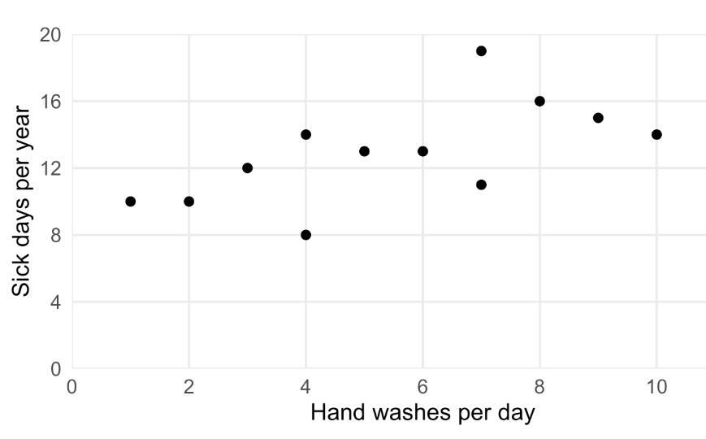
Scenario | Does handwashing reduce sick days?
MOCK DATASET
pacman::p_load(tidyverse, broom, equatiomatic, plotly)
df <- tribble(
~kids, ~washes, ~sick_days,
0, 1, 10,
0, 2, 10,
0, 3, 12,
0, 4, 8,
1, 4, 14,
1, 5, 13,
1, 6, 13,
1, 7, 11,
2, 7, 19,
2, 8, 16,
2, 9, 15,
2, 10, 14)
BASIC SCATTERPLOT
ggplot(df, aes(washes, sick_days)) + geom_point()
washes = how many times a day do you typically wash your hands
kids = number of children at home
sick_days = respiratory sick days in year after survey

Slide 4
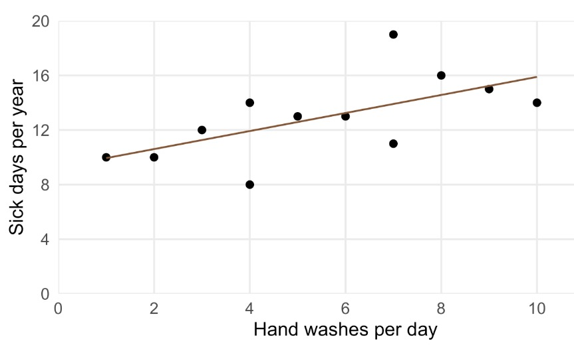

Fit a single predictor
THE NAIVE MODEL
PLOT THE MODEL
mod1 <- lm(sick_days ~ washes, data = df)
summary(mod1)
ggplot(df, aes(washes, sick_days)) +
geom_point() +
geom_line(aes(y = fitted(mod1)))
Estimate Std. Error t value Pr(>|t|)
(Intercept) 9.2816 1.6204 5.728 0.000191 ***
washes 0.6609 0.2646 2.498 0.031568 *
preview_eq(extract_eq(mod1, use_coefs = T))
WHAT IT SAYS
Each extra wash predicts 0.76 more sick days.
p < 0.05, so the slope is "significant".

Slide 5
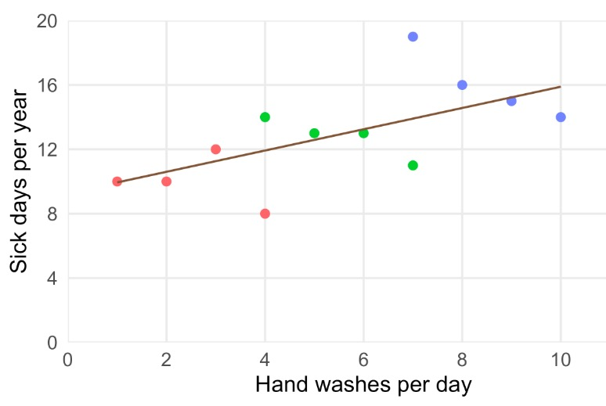
Look closer: is something hidden in the data?
COLOUR EACH POINT BY KIDS
THE NAIVE MODEL
ggplot(df, aes(washes, sick_days)) + geom_point(aes(colour = factor(kids))) + geom_line(aes(y = fitted(mod1)))
mod1 <- lm(sick_days ~ washes, data = df)
summary(mod1)
Estimate Std. Error t value Pr(>|t|)
(Intercept) 9.2816 1.6204 5.728 0.000191 ***
washes 0.6609 0.2646 2.498 0.031568 *
preview_eq(extract_eq(mod1, use_coefs = T))
Maybe kids is what's driving the slope, not handwashing itself.
Let's adjust for kids in the regression.
0 kids
1 kid
2 kids

Slide 6
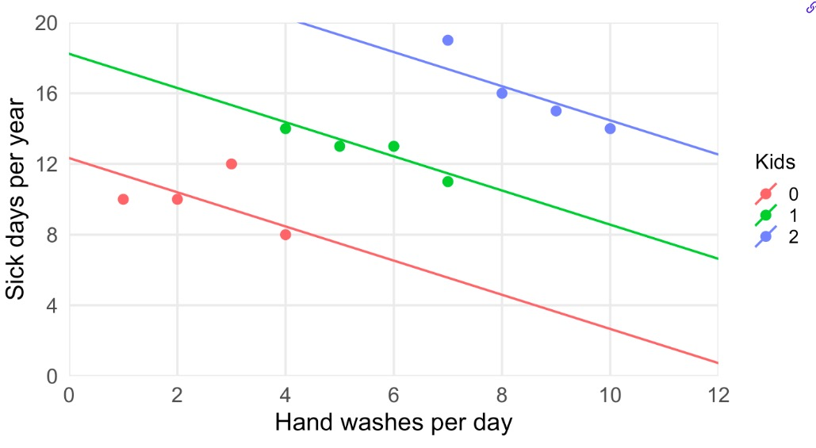
Add the second predictor to the equation
PLOT ONE LINE PER GROUP
ggplot(df, aes(washes, sick_days, colour = factor(kids))) +
geom_point() +
geom_abline(
data = tibble(kids = 0:2,
intercept = coef(mod2)[1] + coef(mod2)[3] * kids,
slope = coef(mod2)[2]),
aes(intercept = intercept, slope = slope,
colour = factor(kids)))
THE MODEL CALL
mod2 <- lm(sick_days ~ washes + kids, data = df)
summary(mod2)
Estimate Std. Error t value Pr(>|t|)
(Intercept) 12.3333 0.9465 13.031 3.81e-07 ***
washes -0.9667 0.3091 -3.127 0.012177 *
kids 5.9000 1.0194 5.788 0.000263 ***
preview_eq(extract_eq(mod2, use_coefs = T))
• Holding kids constant, each extra wash is associated with ~1 fewer sick day per year. • Holding washes constant, each extra child is associated with about 6 more sick days.
Sometimes phrased as “adjusting for” or “controlling for”.

Slide 7
Add the second predictor to the equation
Example: 6 washes, 2 kids
sick_days = 12.33 + (-0.97 × 6) + (5.9 × 2)
= 12.33 − 5.8 + 11.8
≈ 18.3 sick days/year
THE MODEL CALL
mod2 <- lm(sick_days ~ washes + kids, data = df)
summary(mod2)
Estimate Std. Error t value Pr(>|t|)
(Intercept) 12.3333 0.9465 13.031 3.81e-07 ***
washes -0.9667 0.3091 -3.127 0.012177 *
kids 5.9000 1.0194 5.788 0.000263 ***
preview_eq(extract_eq(mod2, use_coefs = T))
• Holding kids constant, each extra wash is associated with ~1 fewer sick day per year. • Holding washes constant, each extra child is associated with about 6 more sick days.
Sometimes phrased as “adjusting for” or “controlling for”.

Slide 8
Add the second predictor to the equation
Example: 0 washes, 3 kids
sick_days = 12.33 + (-0.97 × 0) + (5.9 × 3)
= 12.33 + 0 + 17.7
≈ 30.0 sick days/year
THE MODEL CALL
mod2 <- lm(sick_days ~ washes + kids, data = df)
summary(mod2)
Estimate Std. Error t value Pr(>|t|)
(Intercept) 12.3333 0.9465 13.031 3.81e-07 ***
washes -0.9667 0.3091 -3.127 0.012177 *
kids 5.9000 1.0194 5.788 0.000263 ***
preview_eq(extract_eq(mod2, use_coefs = T))
• Holding kids constant, each extra wash is associated with ~1 fewer sick day per year. • Holding washes constant, each extra child is associated with about 6 more sick days.
Sometimes phrased as “adjusting for” or “controlling for”.

Slide 9
Practice | Reading a two-predictor table
THE SETUP
A model predicts hospital length of stay (days) from age (years) and a numeric severity score, n = 240 patients.
lm(length_of_stay ~ age + severity, data = df)
THE OUTPUT
term
estimate
SE
p
(Intercept)
2.10
0.45
<0.001 ***
age
0.04
0.01
<0.001 ***
severity
1.85
0.12
<0.001 ***
PREDICT A NEW PATIENT
INTERPRET THE AGE SLOPE
Predicted stay for a 60-year-old with severity = 3?
A) (0.04 x 60) + (1.85 x 3) = 7.95 days
B) 2.10 + (0.04 x 60) + (1.85 x 3) = 10.05 days
Which interpretation of the age slope (0.04) is correct?
A) Age matters less than severity for predicting stay, since 0.04 << 1.85.
B) A 10-year increase in age, at the same severity, predicts about 0.4 days longer stay.
Answer: B.
A drops the intercept
Answer: B.
A compares raw coefs across different units (years vs. severity points).

Slide 10
Formal notation
ONE PREDICTOR (recap)
y = b₀ + b₁·x + ε
one intercept, one slope, one predictor
TWO PREDICTORS
y = b₀ + b₁·x₁ + b₂·x₂ + ε
one intercept, one slope per predictor
FOR THE HANDWASHING STUDY
sick_days = b₀ + b₁·washes + b₂·kids + ε

Slide 11
Practice | Reading the R output
THE SETUP
A consultancy fits a model predicting employee salary (in $1000s) from years of experience and years of post-secondary education, n = 312 employees.
lm(salary ~ exp + edu, data = staff)
THE OUTPUT
term
estimate
SE
p
(Intercept)
28.450
2.134
<0.001 ***
exp
1.820
0.310
<0.001 ***
edu
3.260
0.482
<0.001 ***
THE MODEL EQUATION
EXTRA YEAR OF EXPERIENCE
Which equation is the fitted model?
A) salary = 1.820·exp + 3.260·edu
B) salary = 28.450 + 1.820·exp + 3.260·edu
For two people with the same education but differing by one year of experience, which slope term in the equation is most informative?
1.820·exp
3.260·edu
Answer: B.
A drops the intercept
Answer: A.
The exp slope is 1.820 ($1000s), holding education fixed.

Slide 12
Thinking of two-predictor linear regression as fitting a plane
washes_seq <- seq(0, 12, length.out = 25)
kids_seq <- seq(0, 5, length.out = 25)
grid <- expand.grid(washes = washes_seq, kids = kids_seq)
grid$pred <- predict(mod2, newdata = grid)
z_mat <- matrix(grid$pred,
nrow = length(washes_seq),
ncol = length(kids_seq)) |> t()
# shared axis styling: no wall, no spikes, no grid
ax <- list(showspikes = FALSE,
zeroline = FALSE)
plot_ly() |>
add_markers(
data = df, x = ~washes, y = ~kids, z = ~sick_days,
marker = list(size = 5, color = "black"),
name = "observed"
) |>
add_surface(
x = washes_seq, y = kids_seq, z = z_mat,
opacity = 0.5, showscale = FALSE,
name = "fitted plane"
) |>
layout(scene = list(
xaxis = modifyList(ax, list(title = "washes", range = c(0, 12))),
yaxis = modifyList(ax, list(title = "kids", range = c(0, 5))),
zaxis = modifyList(ax, list(title = "sick_days", range = c(0, 25)))
))

Slide 13
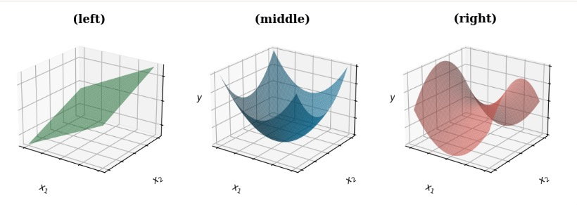
Practice | the geometry of multiple linear regression
THE SETUP
A consultancy fits a model predicting employee salary (in $1000s) from years of experience and years of post-secondary education, n = 312 employees.
lm(salary ~ exp + edu, data = staff)
THE OUTPUT
term
estimate
SE
p
(Intercept)
28.450
2.134
<0.001 ***
exp
1.820
0.310
<0.001 ***
edu
3.260
0.482
<0.001 ***
Which of the three images best illustrates the fitted model?
An observed employee sits above the fitted plane. What does that mean geometrically?
A) Their observed salary is lower than predicted.
B) Their education value was entered incorrectly.
C) Their residual is positive.
Answer: C. Observed > predicted, so the residual y − ŷ is positive.
Answer: Left

Slide 14
Illustrating the confounding
Z
kids
Effect of kids
X
washes
Y
Sick days
Directed acyclic graph (DAG)
NOTE:
Confounding doesn't always flip the slope
it can also inflate, shrink, mask, or fabricate an effect.

Slide 15
Practice | Confounding & DAGs
THE SETUP
An agronomist studies crop yield (kg/acre) and fits two models.
Model 1: lm(yield ~ fertilizer)
Model 2: lm(yield ~ fertilizer + rainfall)
THE OUTPUT
term
estimate
SE
p
M1: fertilizer
12.40
1.85
<0.001 ***
M2: fertilizer
2.10
2.18
0.34
M2: rainfall
5.80
0.74
<0.001 ***
EXPLAIN THE COEFFICIENT CHANGE
WHICH DAG SHOWS CONFOUNDING?
Which of these might explain the fertilizer estimate drop from 12.40 to 2.10 once rainfall is added?
A) Fertilizer use is correlated with rainfall, which drives most of the yield gain.
B) Adding predictors always shrinks coefficients toward zero, due to higher residual variance.
In which DAG is rainfall a confounder of fertilizer → yield?
DAG 1
DAG 2
DAG 3
Rain
Rain
Rain
Fert
Yield
Fert
Yield
Fert
Yield
Answer: A.
Answer: DAG 2

Slide 16
So is our regression wrong?
OLS regression gives a valid association in the sample.
"On average, hand washers had more sick days."
Valid description
Not causal effect of washing on sick days.

Slide 17
Controlling helps, but may not get you all the way to cause
Add controls → get a conditional association.
Slope on X is now "holding controls fixed."
"Among people with the same number of kids…"
Closes back-door paths through variables you measured.
Unobserved confounders may still be there
(e.g. travel habits, city)

Slide 18
A regression coefficient is not automatically a causal effect
Several things can produce the slope without a causal link:
• Confounding: kids, travel, crowding, income etc.
• Reverse causation: Being sick may cause more washing.
• Selection / missing data: Oversampled from medical personnel with high washing habits and high sickness.
• Measurement error: “washes per day” and “sick days” misremembered or misreported.
GOLD STANDARD FOR CAUSAL INFERENCE: Randomized controlled experiments

Slide 19
Learning Objectives | Multiple Linear Regression
1
See why fitting a single predictor can give misleading slopes
2
Fit a multiple linear regression in R with lm(y ~ x1 + x2) and read the coefficient table
3
3
Recognize confounding using a directed acyclic graph (DAG)
4
Extend LO2 to three or more variables

Slide 20
From two predictors to many
TWO PREDICTORS
y = b₀ + b₁·x₁ + b₂·x₂ + ε
k PREDICTORS
y = b₀ + b₁·x₁ + b₂·x₂ + ... + bₖ·xₖ + ε
One intercept. One slope per predictor. One error term.
IN R
lm(sick_days ~ washes + kids, data = df)
lm(sick_days ~ washes + kids + age, data = df)
lm(sick_days ~ washes + kids + age + commute, data = df)
Just add a "+ predictor" to the formula. R adds one more row to the coefficient table.
Every slope is still read the same way: effect, holding the other predictors constant.

Slide 21
Practice | Three predictors
We add commute time (minutes on public transit) to the handwashing model.
lm(sick_days ~ washes + kids + commute, data = df)
Estimate Std.Error t value Pr(>|t|)
(Intercept) 10.50 1.10 9.55 < 0.001 ***
washes -0.95 0.25 -3.80 0.005 **
kids 5.80 0.85 6.82 < 0.001 ***
commute 0.08 0.02 4.00 0.003 **
Q1. INTERPRET THE COMMUTE SLOPE
Q2. PREDICT A NEW PERSON
How should the commute coefficient (0.08) be read?
A) Holding washes and kids fixed, each extra minute predicts ~0.08 more sick days/year.
B) Longer commutes cause more sick days because the slope is > 0, and p < 0.01.
Predicted sick days for someone who washes 8×/day, has 1 kid, commutes 30 min?
A) 10.50 + (−0.95 + 5.80 + 0.08) · 39 = 200.7 days
B) 10.50 + (−0.95·8) + (5.80·1) + (0.08·30) = 11.10 days
C) (−0.95·8) + (5.80·1) + (0.08·30) = 0.60 days
Answer: A.
B overclaims causation
Answer: B.
A lumps the slopes and applies them to (8 + 1 + 30). C drops the intercept.

Slide 22
Learning Objectives | Multiple Linear Regression
1
See why fitting a single predictor can give misleading slopes
2
Fit a multiple linear regression in R with lm(y ~ x1 + x2) and read the coefficient table
3
3
Recognize confounding using a directed acyclic graph (DAG)
4
Extend LO2 to three or more variables

