Slide 1
Residuals & Residual Standard Error
Reading the top of R's summary() output for a linear model
LONGER VERSION

Slide 2
Learning Objectives | Residuals & Residual Standard Error
1
Define a residual
A residual is the vertical distance from an observed point to the fitted line: y − ŷ
2
Read the 5-number residual summary in summary(model)
Min, 1Q, Median, 3Q, Max of the residuals
3
Build and understand the residual standard error (RSE)
3
Square residuals, average over (n − 2), take the square root

Slide 3
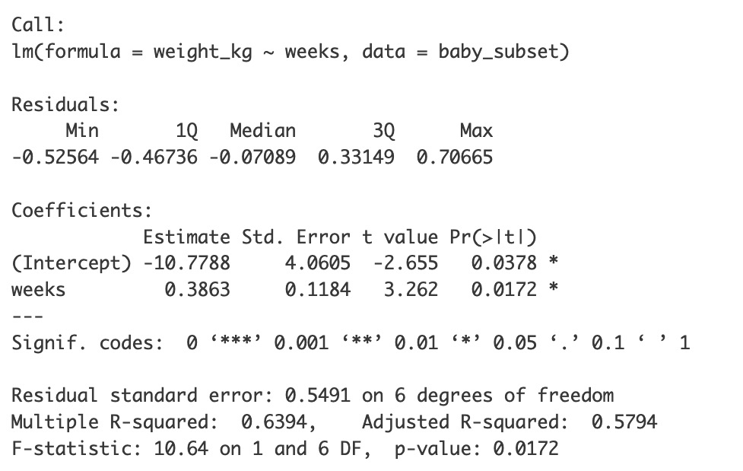
Recap
pacman::p_load(tidyverse, openintro)
# Prep data
preemie_data <- openintro::births14 %>%
filter(premie == "premie") %>%
mutate(weight_kg = weight * 0.453592) %>%
slice_tail(n = 8) %>%
select(weeks, weight_kg)
# Fit model
model <- lm(weight_kg ~ weeks, data = preemie_data)
# View results
summary(model)
#8
3.5
#
weeks
weight
1
32
1.057
3.0
#4
2
32
1.651
#7
3
33
2.177
2.5
#5
#6
Birth weight (kg)
4
34
3.062
#3
5
35
2.531
2.0
ŷ = −10.78 + 0.3863x
6
36
2.640
#2
1.5
7
36
2.667
8
36
3.828
1.0
#1
32
33
34
35
36
Gestational age (weeks)

Slide 4
The block we want to dissect
Five-number summary of the residuals.

Slide 5
What is a residual?
#8
3.5
The difference between an observed data point and the value predicted by the regression line
3.0
#4
residualᵢ = yᵢ − ŷᵢ
#7
Birth weight (kg)
#5
#6
(observed) − (predicted)
2.5
Example
#3
predicted = -10.78 + 0.3863 (32)
2.0
ŷ = −10.78 + 0.3863x
= -10.78 + 12.361
= 1.58
#2
residual = 1.06 – 1.58
= -0.52
1.5
#
weeks
weight
ŷ
residual
1.0
#1
32
33
34
35
36
1
32
1.06
1.58
-0.52
Gestational age (weeks)
2
32
1.65
1.58
+0.07
Why residuals matter
Best Fit: Regression line is calculated by minimizing the sum of squared residuals
Model Accuracy: Leftover residuals indicate the "error" or unexplained variation in the model.
Assumptions: We use residual plots to check if a linear model is appropriate
3
33
2.18
1.97
+0.21
4
34
3.06
2.36
+0.71
5
35
2.53
2.74
-0.21
6
36
2.64
3.13
-0.49
7
36
2.67
3.13
-0.46
8
36
3.83
3.13
+0.70

Slide 6
What is a residual?
#8
3.5
The difference between an observed data point and the value predicted by the regression line
3.0
#4
residualᵢ = yᵢ − ŷᵢ
#7
Birth weight (kg)
#5
#6
(observed) − (predicted)
2.5
Example
#3
predicted = -10.78 + 0.3863 (32)
2.0
ŷ = −10.78 + 0.3863x
= -10.78 + 12.361
= 1.58
#2
residual = 1.06 – 1.58
= -0.52
1.5
#
weeks
weight
ŷ
residual
1.0
#1
32
33
34
35
36
1
32
1.06
1.58
-0.52
Gestational age (weeks)
2
32
1.65
1.58
+0.07
3
33
2.18
1.97
+0.21
4
34
3.06
2.36
+0.71
5
35
2.53
2.74
-0.21
6
36
2.64
3.13
-0.49
7
36
2.67
3.13
-0.46
8
36
3.83
3.13
+0.70

Slide 7
What is a residual?
#8
3.5
The difference between an observed data point and the value predicted by the regression line
3.0
#4
residualᵢ = yᵢ − ŷᵢ
#7
Birth weight (kg)
#5
#6
(observed) − (predicted)
2.5
Example
#3
predicted = -10.78 + 0.3863 (32)
2.0
ŷ = −10.78 + 0.3863x
= -10.78 + 12.361
= 1.58
#2
residual = 1.06 – 1.58
= -0.52
1.5
#
weeks
weight
ŷ
residual
1.0
#1
32
33
34
35
36
1
32
1.06
1.58
-0.52
Gestational age (weeks)
6
36
2.64
3.13
-0.49
7
36
2.67
3.13
-0.46
5
35
2.53
2.74
-0.21
2
32
1.65
1.58
+0.07
3
33
2.18
1.97
+0.21
8
36
3.83
3.13
+0.70
4
34
3.06
2.36
+0.71

Slide 8
What is a residual?
#8
3.5
The difference between an observed data point and the value predicted by the regression line
3.0
#4
residualᵢ = yᵢ − ŷᵢ
#7
Birth weight (kg)
#5
#6
(observed) − (predicted)
2.5
Example
#3
predicted = -10.78 + 0.3863 (32)
2.0
ŷ = −10.78 + 0.3863x
= -10.78 + 12.361
= 1.58
#2
residual = 1.06 – 1.58
= -0.52
1.5
#
weeks
weight
ŷ
residual
1.0
#1
32
33
34
35
36
1
32
1.06
1.58
-0.52
Gestational age (weeks)
6
36
2.64
3.13
-0.49
7
36
2.67
3.13
-0.46
5
35
2.53
2.74
-0.21
2
32
1.65
1.58
+0.07
1Q, Median, 3Q
interpolated
3
33
2.18
1.97
+0.21
8
36
3.83
3.13
+0.70
4
34
3.06
2.36
+0.71

Slide 9
#8
What should we check?
3.5
3.0
#4
Three quick checks
#7
Birth weight (kg)
#5
#6
2.5
1
Median ≈ 0
#3
2.0
ŷ = −10.78 + 0.3863x
2
|Q1| ≈ |Q3|
#2
1.5
3
|Min| ≈ |Max|
#1
1.0
32
33
34
35
36
Gestational age (weeks)
→
This symmetry points to normality of the residuals. To be discussed in full later.

Slide 10
Practice: Identifying residuals
Points A and B are both above the best-fit line.
Which point has the larger residual?
best-fit line
C
D
A) Point A
B) Point B
B
A
y
Point C is above the line. Point D is below the line.
Which point has a negative residual?
A) Point C
B) Point D
x

Slide 11
Practice: Residual concepts
Which of these would indicate a better fit for a regression line
A) Larger residuals
B) Smaller residuals

Slide 12
Learning Objectives | Residuals & Residual Standard Error
1
Define a residual ✅
A residual is the vertical distance from an observed point to the fitted line: y − ŷ
2
Read the 5-number residual summary in summary(model) ✅
Min, 1Q, Median, 3Q, Max of the residuals
3
Build and understand the residual standard error (RSE)
3
Square residuals, average over (n − 2), take the square root

Slide 13
Residual Standard Error / Standard error of the regression / Residual standard deviation

Slide 14
Residual Standard Error / Standard error of the regression / Residual standard deviation
Ways to measure typical error
MAE (Mean Absolute Error)
→ average size of errors
→ treats all errors equally
RSE (Residual Standard Error). What is actually used in regression.
→ penalizes large errors more (recall: regression minimizes residual²)
→ connects to the normal curve → enables statistical tests
What is the residual standard error?
A measure of the typical size of the residual
Why does RSE matter?
Goodness of fit. Higher RSE means worse fit.
Foundation for inference. Standard errors, confidence intervals, and prediction intervals are built from RSE.
MEAN
ABSOLUTE ERROR (MAE)
RESIDUAL STD ERROR
weeks
weight
ŷ
residual
|residual|
residual²
32
1.06
1.58
-0.53
+0.53
0.2809
36
2.64
3.13
-0.49
+0.49
0.2401
36
2.67
3.13
-0.46
+0.46
0.2116
#8
35
2.53
2.74
-0.21
+0.21
0.0441
3.5
32
1.65
1.58
+0.07
+0.07
0.0049
3.0
#4
33
2.18
1.97
+0.21
+0.21
0.0441
#5
#7
36
3.83
3.13
+0.70
+0.70
0.4900
Birth weight (kg)
#6
2.5
#3
34
3.06
2.36
+0.71
+0.71
0.5041
Why 6?
n – 2
2.0
ŷ = −10.78 + 0.386x
#2
SUM:
0 kg
SUM:
3.38
SUM:
1.8198 kg²
1.5
3.38/8= 0.42kg
AVERAGE
0/8=0kg
AVERAGE
AVERAGE:*
1.8198/6 = 0.303 kg²
1.0
#1
√0.303 = 0.55 kg
32
33
34
35
36
SQRT:
Gestational age (weeks)

Slide 15
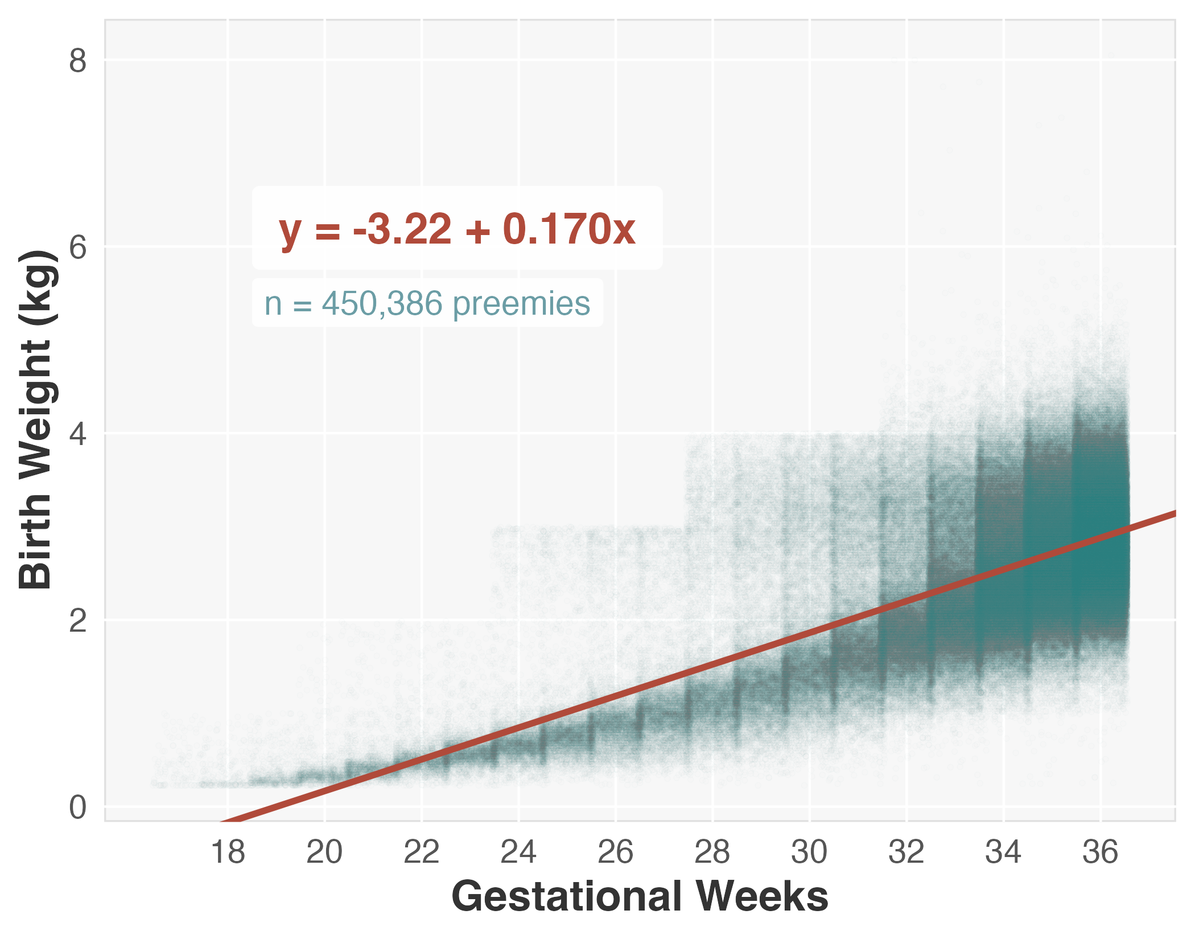
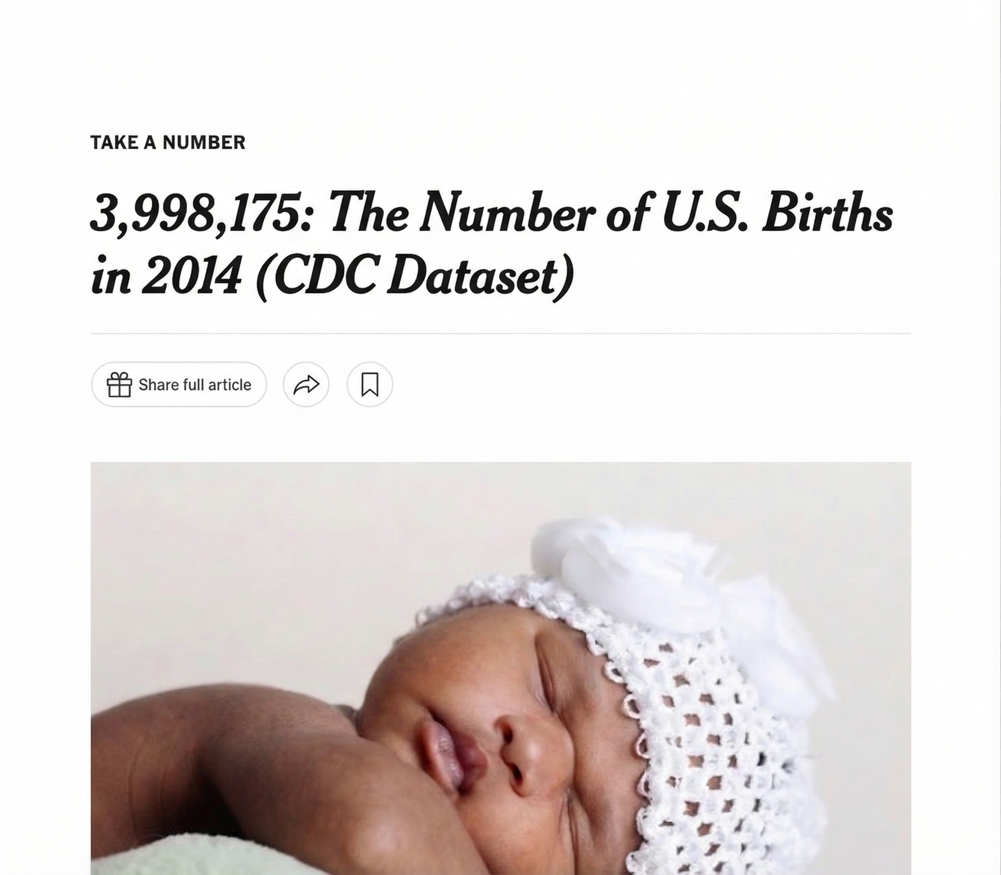
Why divide by n − 2, not n (raising the RSE)?
Two ways to think about it:
1. Sample vs population noise
RSE: Using the sample to estimate population noise
2. You used up two “degrees of freedom” drawing the fitted line
POPULATION DATA
3.5
3.0
Birth weight (kg)
2.5
2.0
1.5
1.0
32
33
34
35
36
Gestational age (weeks)
#8
To fit a line for bivariate regression (1 predictor)
• n = 1:
Can't fit a line
• n = 2:
Residuals are 0 by definition
(not because there's no real error!)
• n = 3:
We really have only one “free” residual
Dividing by 3 underestimates the error
3.5
3.0
#4
#5
#7
Birth weight (kg)
#6
2.5
2.0
#3
ŷ = −10.78 + 0.386x
1.5
#2
1.0
#1
32
33
34
35
36
Gestational age (weeks)

Slide 16
One way to interpret RSE: compare to the mean
2.45 kg
0.549 kg
22.4%
Mean birth weight
Residual Standard Error
RSE as a share of mean
in our 8-baby sample
typical miss of the line
relative size of that miss
The interpretation
"On average, the line misses each baby's weight by about 0.55 kg ; roughly a fifth of the average birth weight."

Slide 17
Practice | Residual Standard Error
R reports Residual standard error: 0.549 on 6 degrees of freedom. What does the 6 refer to?
In a study of tree height (m) vs. age (yr), R reports RSE = 1.8 m. Which is the best interpretation?
A) The number of predictors in the model
A) The line typically misses an observation by about 1.8 m
B) n − 2, i.e. the count of "free" residuals
B) The slope is uncertain by 1.8 m per year
C) The number of data points
Answer: B
For simple linear regression df = n − 2 = 8 − 2 = 6. We "spent" two residuals pinning down the intercept and the slope, so only 6 of the 8 residuals are free to vary.
Answer: A
RSE is a typical miss, and it is not the same as the SE of the slope, which quantifies a different kind of uncertainty.

Slide 18
Practice | Residual Standard Error
Two models are fit to the same data. Model A: RSE = 4.1; Model B: RSE = 2.7. Which fits better?
A) Model A. larger RSE means wider coverage
B) Model B. smaller RSE means less prediction error
Answer: B
RSE measures the typical size of a residual. Smaller RSE = predictions closer to observed values = better fit.

Slide 19
Learning Objectives | Residuals & Residual Standard Error
1
Define a residual ✅
A residual is the vertical distance from an observed point to the fitted line: y − ŷ
2
Read the 5-number residual summary in summary(model) ✅
Min, 1Q, Median, 3Q, Max of the residuals
3
Build and understand the residual standard error (RSE) ✅
3
Square residuals, average over (n − 2), take the square root

