Slide 1
Residuals & Residual Standard Error
Reading the top of R's summary() output for a linear model
Linear Regression | GRAPH Courses

Slide 2
Learning Objectives | Residuals & Residual Standard Error
1
Define a residual
A residual is the vertical distance from an observed point to the fitted line: y − ŷ
2
Read the 5-number residual summary in summary(model)
Min, 1Q, Median, 3Q, Max of the residuals
3
Build and understand the residual standard error (RSE)
3

Slide 3
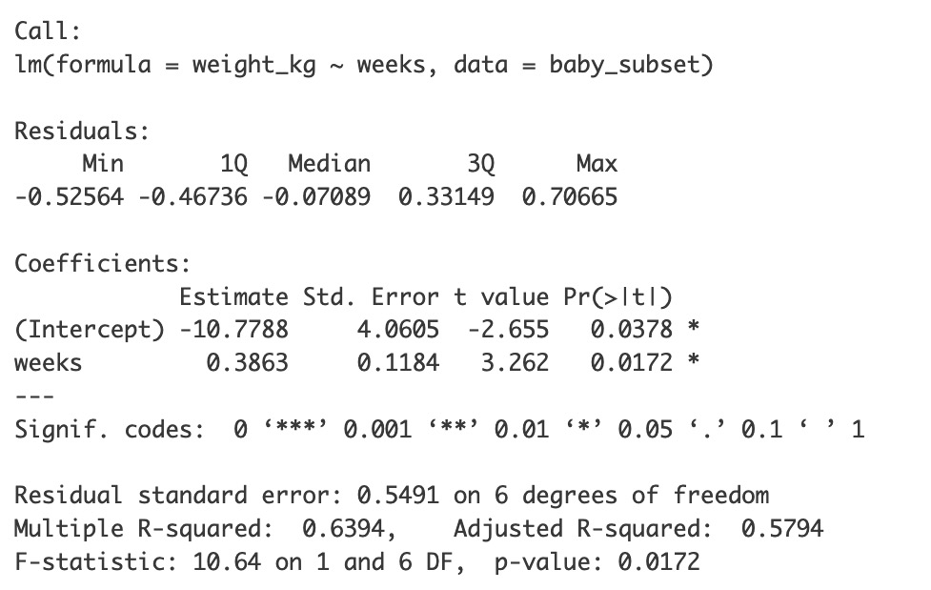
Recap
pacman::p_load(tidyverse, openintro)
# Prep data
preemie_data <- openintro::births14 %>%
filter(premie == "premie") %>%
mutate(weight_kg = weight * 0.453592) %>%
slice_tail(n = 8) %>%
select(weeks, weight_kg)
# Fit model
model <- lm(weight_kg ~ weeks, data = preemie_data)
# View results
summary(model)
#8
3.5
#
weeks
weight
1
32
1.057
3.0
#4
2
32
1.651
#7
3
33
2.177
2.5
#5
#6
Birth weight (kg)
4
34
3.062
#3
5
35
2.531
2.0
ŷ = −10.78 + 0.3863x
6
36
2.640
#2
1.5
7
36
2.667
8
36
3.828
1.0
#1
32
33
34
35
36
Gestational age (weeks)

Slide 4
The block we want to dissect
Five-number summary of the residuals.

Slide 5
What is a residual?
#8
3.5
The difference between an observed data point and the value predicted by the regression line
3.0
#4
residualᵢ = yᵢ − ŷᵢ
#7
Birth weight (kg)
#5
#6
(observed) − (predicted)
2.5
#3
2.0
ŷ = −10.78 + 0.3863x
#2
1.5
#
weeks
weight
ŷ
residual
1.0
#1
32
33
34
35
36
1
32
1.06
1.58
-0.52
Gestational age (weeks)
2
32
1.65
1.58
+0.07
Why residuals matter
Best Fit: Regression line is calculated by minimizing the sum of squared residuals
Model Accuracy: Leftover residuals indicate the "error" or unexplained variation in the model.
3
33
2.18
1.97
+0.21
4
34
3.06
2.36
+0.71
5
35
2.53
2.74
-0.21
6
36
2.64
3.13
-0.49
7
36
2.67
3.13
-0.46
8
36
3.83
3.13
+0.70

Slide 6
What is a residual?
#8
3.5
The difference between an observed data point and the value predicted by the regression line
3.0
#4
residualᵢ = yᵢ − ŷᵢ
#7
Birth weight (kg)
#5
#6
(observed) − (predicted)
2.5
#3
2.0
ŷ = −10.78 + 0.3863x
#2
1.5
#
weeks
weight
ŷ
residual
1.0
#1
32
33
34
35
36
1
32
1.06
1.58
-0.52
Gestational age (weeks)
2
32
1.65
1.58
+0.07
3
33
2.18
1.97
+0.21
4
34
3.06
2.36
+0.71
5
35
2.53
2.74
-0.21
6
36
2.64
3.13
-0.49
7
36
2.67
3.13
-0.46
8
36
3.83
3.13
+0.70

Slide 7
What is a residual?
#8
3.5
The difference between an observed data point and the value predicted by the regression line
3.0
#4
residualᵢ = yᵢ − ŷᵢ
#7
Birth weight (kg)
#5
#6
(observed) − (predicted)
2.5
#3
2.0
ŷ = −10.78 + 0.3863x
#2
1.5
#
weeks
weight
ŷ
residual
1.0
#1
32
33
34
35
36
1
32
1.06
1.58
-0.52
Gestational age (weeks)
6
36
2.64
3.13
-0.49
7
36
2.67
3.13
-0.46
5
35
2.53
2.74
-0.21
2
32
1.65
1.58
+0.07
3
33
2.18
1.97
+0.21
8
36
3.83
3.13
+0.70
4
34
3.06
2.36
+0.71

Slide 8
What is a residual?
#8
3.5
The difference between an observed data point and the value predicted by the regression line
3.0
#4
residualᵢ = yᵢ − ŷᵢ
#7
Birth weight (kg)
#5
#6
(observed) − (predicted)
2.5
#3
2.0
ŷ = −10.78 + 0.3863x
#2
1.5
#
weeks
weight
ŷ
residual
1.0
#1
32
33
34
35
36
1
32
1.06
1.58
-0.52
Gestational age (weeks)
6
36
2.64
3.13
-0.49
7
36
2.67
3.13
-0.46
5
35
2.53
2.74
-0.21
2
32
1.65
1.58
+0.07
1Q, Median, 3Q
interpolated
3
33
2.18
1.97
+0.21
8
36
3.83
3.13
+0.70
4
34
3.06
2.36
+0.71

Slide 9
#8
What should we check?
3.5
3.0
#4
Three quick checks
#7
Birth weight (kg)
#5
#6
2.5
1
Median ≈ 0
#3
2.0
ŷ = −10.78 + 0.3863x
2
|Q1| ≈ |Q3|
#2
1.5
3
|Min| ≈ |Max|
#1
1.0
32
33
34
35
36
Gestational age (weeks)
→
This symmetry points to normality of the residuals. To be discussed in full later.

Slide 10
Practice: Identifying residuals
Points A and B are both above the best-fit line.
Which point has the larger residual?
best-fit line
C
D
A) Point A
B) Point B
B
A
y
Point C is above the line. Point D is below the line.
Which point has a negative residual?
A) Point C
B) Point D
x

Slide 11
Learning Objectives | Residuals & Residual Standard Error
1
Define a residual ✅
2
Read the 5-number residual summary in summary(model) ✅
3
Build and understand the residual standard error (RSE)
3

Slide 12
Residual Standard Error / Standard error of the regression / Residual standard deviation

Slide 13
Residual Standard Error / Standard error of the regression / Residual standard deviation
What is the residual standard error?
A measure of the typical size of the residual
Why does RSE matter?
Goodness of fit. Higher RSE means worse fit.
Foundation for inference. Standard errors, confidence intervals, and prediction intervals are built from RSE.
#
weeks
weight
ŷ
residual
1
32
1.06
1.58
-0.52
6
36
2.64
3.13
-0.49
7
36
2.67
3.13
-0.46
5
35
2.53
2.74
-0.21
2
32
1.65
1.58
+0.07
#8
3.5
3
33
2.18
1.97
+0.21
3.0
#4
8
36
3.83
3.13
+0.70
#5
#7
4
34
3.06
2.36
+0.71
Birth weight (kg)
#6
2.5
2.0
#3
ŷ = −10.78 + 0.386x
1.5
#2
1.0
#1
32
33
34
35
36
Gestational age (weeks)

Slide 14
Why is degrees of freedom n-2?
3.5
You used up two “degrees of freedom” drawing the fitted line
3.0
Birth weight (kg)
2.5
2.0
1.5
1.0
32
33
34
35
36
Gestational age (weeks)
To fit a line for bivariate regression (1 predictor)
• n = 1:
Can't fit a line
• n = 2:
Residuals are 0 by definition
(not because there's no real error!)
• n = 3:
We really have only one “free” residual
Dividing by 3 underestimates the error

Slide 15
Practice | Residual Standard Error
R reports Residual standard error: 0.549 on 6 degrees of freedom. What does the 6 refer to?
In a study of tree height (m) vs. age (yr), R reports RSE = 1.8 m. Which is the best interpretation?
A) The number of predictors in the model
A) The line typically misses an observation by about 1.8 m
B) n − 2, i.e. the count of "free" residuals
B) The slope is uncertain by 1.8 m per year
C) The number of data points
Answer: B
For simple linear regression df = n − 2 = 8 − 2 = 6. We "spent" two residuals pinning down the intercept and the slope, so only 6 of the 8 residuals are free to vary.
Answer: A
RSE is a typical miss, and it is not the same as the SE of the slope, which quantifies a different kind of uncertainty.

Slide 16
Learning Objectives | Residuals & Residual Standard Error
1
Define a residual ✅
2
Read the 5-number residual summary in summary(model) ✅
3
Build and understand the residual standard error (RSE) ✅
3

