Slide 1
Learning Objectives | Binary Predictor Regression
1
Extend simple linear regression to a binary predictor
A 0/1 encoded x variable still fits inside the same y = b₀ + b₁x model framework
2
Interpret the intercept and slope as group means and a difference
b₀ = reference group mean, b₁ = difference between the two group means
3
Read the SE and 95% CI for the group difference
Same logic as before: the CI is a plausible range for the population difference
4
Use the t value as a standardized distance from zero
t = estimate / SE asks: how many SEs is the estimate away from no effect?
5
Translate t into a p-value via tail area
A larger |t| pushes further into the tail and gives a smaller p-value

Slide 2
Revision: What is Regression?
Regression definition: Finding the best fit line between a predictor and an outcome
Questions Answered by Regression
Is there a relationship? Is the slope significantly different from zero?
How big is it? Quantify the effect size.
What do we predict? Estimate Y for a given X.
BEFORE: continuous predictor
NOW: binary predictor
Birth Weight
Birth Weight
Female
Male
Weeks of Gestation
0
1

Slide 3
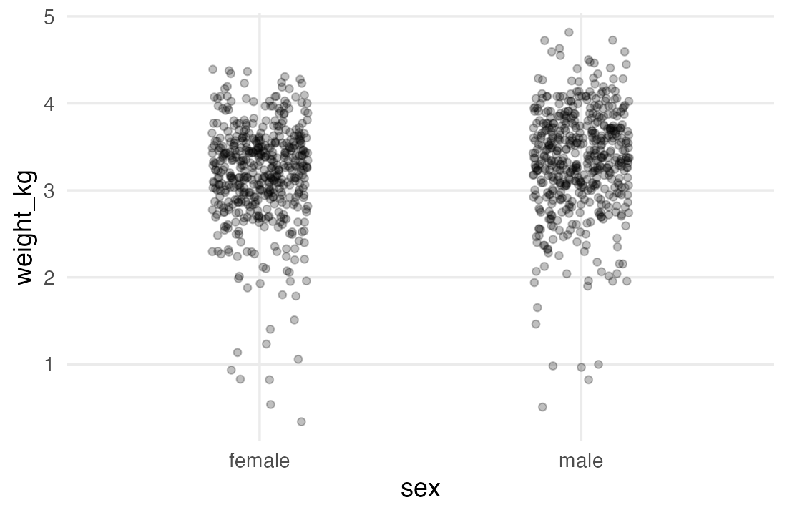
Viewing the dataset
PLOT WEIGHT_KG BY SEX
LOAD + PREP DATA
ggplot(births, aes(sex, weight_kg)) +
geom_jitter(width = 0.15, alpha = 0.25)
library(openintro)
library(tidyverse)
library(equatiomatic)
births <- births14 %>%
mutate(weight_kg = weight * 0.45359,
sex = factor(sex, levels = c("female", "male"))) %>%
select(weight_kg, sex, weeks)
head(births)
births %>%
group_by(sex) %>%
summarise(n = n(),
mean_kg = mean(weight_kg))
weight_kg sex weeks
1 3.16 male 37
2 4.02 female 41
3 3.41 female 37
4 2.81 male 38
5 3.06 female 36
6 3.03 female 39
sex n mean_kg
1 female 495 3.18
2 male 505 3.35
NEXT
We can easily calculate the gap….so why regression?
Is the 0.162 kg gap real/significant, or just noise? (p-value)
What range likely contains the true population difference? (confidence interval)
Can we predict weight from sex and other factors? (multiple regression)

Slide 4

Fitting and Interpreting the model
mod <- lm(weight_kg ~ sex, data = births)
summary(mod)
Residuals:
Min 1Q Median 3Q Max
-2.84276 -0.28845 0.05114 0.36946 1.47168
Coefficients:
Estimate Std. Error t value Pr(>|t|)
(Intercept) 3.18296 0.02640 120.552 < 2e-16 ***
sexmale 0.16249 0.03715 4.373 1.35e-05 ***
3.34
3.18
0.16
preview_eq(extract_eq(mod, use_coefs = TRUE))
Equivalent to
y = b + m·x (Same as y = m·x + b) familiar form
y_{i} = β₀ + β₁x_{i} + ε_{i} regression form
“Dummy” variable: sexmale
weight_kg = 3.18 + 0.16 (sexmale)
When sex is female, sexmale is 0 : ŷ = 3.18 + 0.16·0 = 3.18 kg
When sex is male, sexmale is 1: ŷ = 3.18 + 0.16·1 = 3.34 kg

Slide 5
Progress check | Objectives 1–2 covered
✓
Extend simple linear regression to a binary predictor
A 0/1 encoded x variable still fits inside the same y = b₀ + b₁x model framework
✓
Interpret the intercept and slope as group means and a difference
b₀ = reference group mean, b₁ = difference between the two group means
3
Read the SE and 95% CI for the group difference
Same logic as before: the CI is a plausible range for the population difference
4
Use the t value as a standardized distance from zero
t = estimate / SE asks: how many SEs is the estimate away from no effect?
5
Translate t into a p-value via tail area
A larger |t| pushes further into the tail and gives a smaller p-value

Slide 6
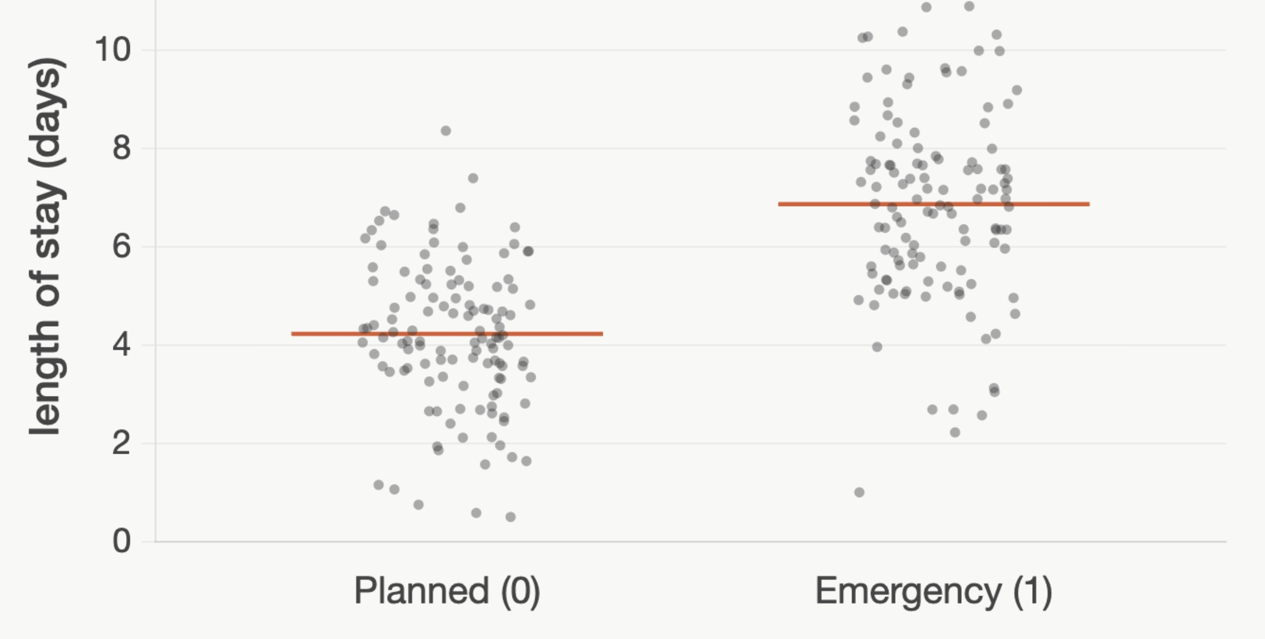
Practice: Length of Stay ~ Emergency
A model predicts hospital length of stay (days) based on emergency admission (1 = yes, 0 =no), n = 240 patients. R output below:
Coefficients:
Estimate Std.Error t value Pr(>|t|)
(Intercept) 4.220 0.180 23.44 < 2e-16 ***
emergency 2.640 0.290 9.10 1.8e-17 ***
Signif. codes: 0 '***' 0.001 '**' 0.01 '*' 0.05 '.' 0.1 ' ' 1
Interpret the emergency coefficient (2.64).
Predicted stay for a non-emergency admission?
A) Emergencies stay 2.64 days in the hospital, on average.
A) ~4.22 days
B) Emergencies stay 2.64 days longer than planned admissions.
B) ~6.86 days
Answer: B
For a binary predictor, the slope is the difference in the group means between the two levels.
Answer: A
For planned admissions, emergency = 0, so ŷ = 4.22 + 2.64 × 0.
That's just the intercept: 4.22 days
Emergencies (option B, ≈ 6.86) get the intercept plus the slope.
ŷ = 4.22 + 2.64 (emergency)

Slide 7
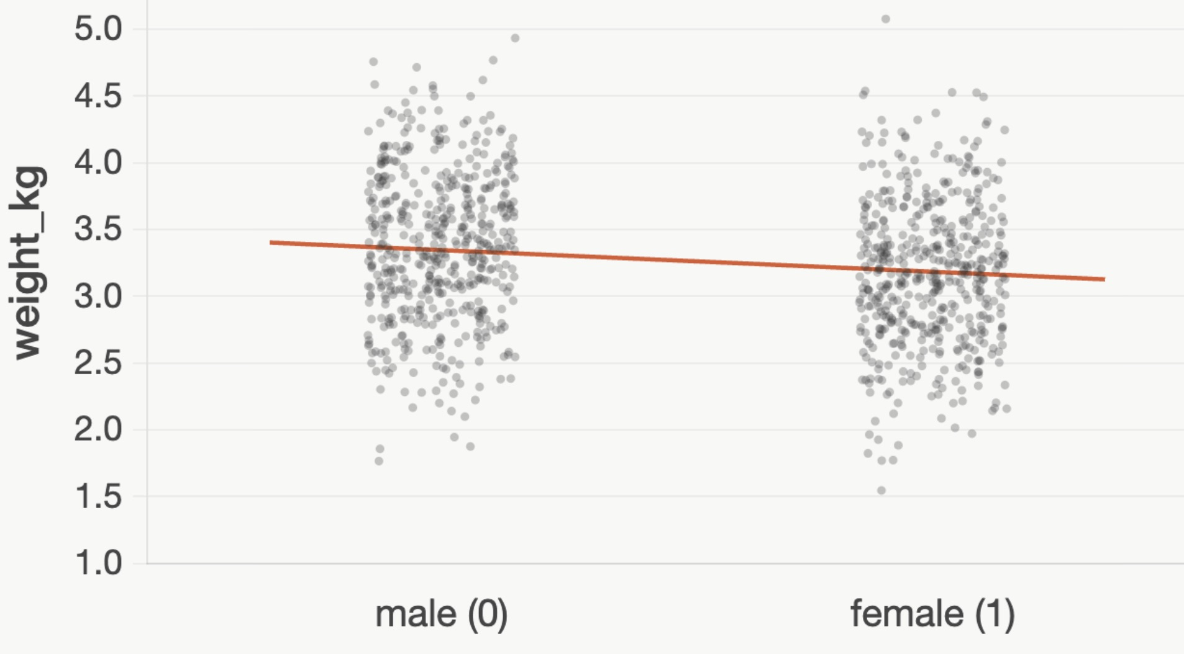
Practice: Binary predictor in lm()
births <- births14 %>% mutate(weight_kg = weight * 0.45359, sex = factor(sex, levels = c("male", "female"))) mod <- lm(weight_kg ~ sex, data = births) summary(mod)
A model fit on the births data, with male as the reference:
Estimate Std. Error t value Pr(>|t|)
(Intercept) 3.34545 0.02614 127.979 < 2e-16 ***
sexfemale -0.16249 0.03715 -4.373 1.35e-05 ***
Q2. What is the mean weight for a female baby?
Q1. What is the mean weight for a male baby?
A) 1.625 kg
A) 3.345 kg
weight_kg = 3.345 − 0.162 · sex_{female}
B) 3.183 kg
B) 3.183 kg
Answer: B. For a female, sexfemale = 1, so weight = 3.345 − 0.162 = 3.183 kg.
Q3. Which statement is incorrect?
1) The intercept (3.345) is the mean for the reference group
2) The reference group lacks a row in the regression output
3) To get the non-reference group mean, calculate 3.345 –0.162 kg
4) The intercept does not depend on the reference group.
Answer: A. For a male, sexfemale = 0, so weight = 3.345 + 0 = 3.345 kg. The intercept is the mean for the reference group.
Answer: 4
The intercept DOES depend on the reference group

Slide 8
Practice: Smoking & birth weight
births <- births14 %>% mutate(weight_kg = weight * 0.45359, habit = factor(habit, levels = c("nonsmoker","smoker")))
mod <- lm(weight_kg ~ habit, data = births) summary(mod)
A model fit on the births data, with nonsmoker as the reference:
Estimate Std. Error t value Pr(>|t|)
(Intercept) 3.29754 0.01972 167.218 < 2e-16 ***
habitsmoker -0.26883 0.05785 -4.647 3.82e-06 ***
Q2. What is the mean weight for a smoker's baby?
Q1. What is the mean weight for a nonsmoker's baby?
A) 3.567 kg
A) 3.298 kg
weight_kg = 3.298 − 0.269 · habit_{smoker}
B) 3.029 kg
B) 3.029 kg
Answer: B. habitsmoker = 1, so 3.298 − 0.269 = 3.029 kg.
Dummy variable: habitsmoker
Q3. How should we interpret the slope (−0.269)?
habitsmoker = 0 (nonsmoker, the reference):
ŷ = 3.298 − 0.269·0 = 3.298 kg
habitsmoker = 1 (smoker):
ŷ = 3.298 − 0.269·1 = 3.029 kg
A) Smokers' babies weigh 0.269 kg more on average
B) Smokers' babies weigh 0.269 kg less on average
C) Smoking causes a 0.269 kg drop in birth weight
Answer: B. The slope is an association, not a causal effect.
Answer: A. habitsmoker = 0, so weight = 3.298 + 0 = 3.298 kg (the reference group's mean).

Slide 9
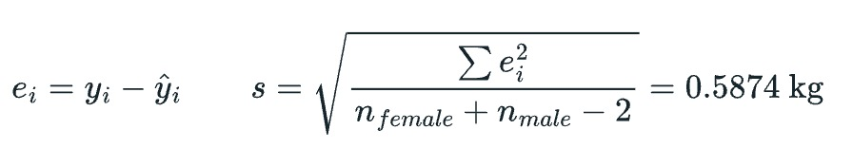
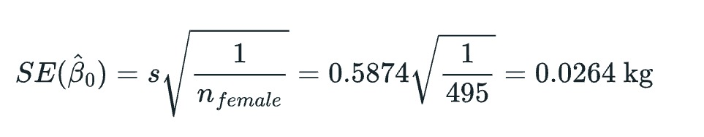
Standard error of the intercept
INTUITION
Larger residuals → larger SE
Larger sample size → smaller SE
mod <- lm(weight_kg ~ sex, data = births)
summary(mod)
Coefficients:
Estimate Std. Error t value Pr(>|t|)
(Intercept) 3.18296 0.02640 120.552 < 2e-16 ***
sexmale 0.16249 0.03715 4.373 1.35e-05 ***
Uncertainty: if we drew other samples of births from the population, how much would the estimated female mean shift?
3.34
3.18
0.162
STEP 1 RESIDUAL
STEP 2 RESIDUAL STANDARD ERROR
STEP 3 STANDARD ERROR OF THE INTERCEPT

Slide 10
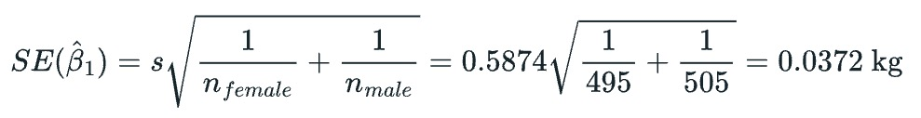
Standard error of the slope
INTUITION
Larger residuals → larger SE
Larger sample size → smaller SE
SE of estimate of slope takes into account variability of female mean + variability of male mean
mod <- lm(weight_kg ~ sex, data = births)
summary(mod)
Coefficients:
Estimate Std. Error t value Pr(>|t|)
(Intercept) 3.18296 0.02640 120.552 < 2e-16 ***
sexmale 0.16249 0.03715 4.373 1.35e-05 ***
Uncertainty: if we drew other samples of births from the population, how much would the estimated male–female difference shift?
3.34
3.18
0.162
STEP 1 RESIDUAL
STEP 2 RESIDUAL STANDARD ERROR
STEP 3 STANDARD ERROR OF THE SLOPE

Slide 11
Practice: Reading SEs from R output
Coefficients:
Estimate Std. Error t value Pr(>|t|)
(Intercept) 3.298 0.020 164.9 < 2e-16 ***
habitsmoker −0.269 0.058 −4.64 4.0e-06 ***
Reference group: nonsmoker. Outcome is birth weight in kg.
lm(weight_kg ~ habit, data = births) Birth weight (kg) on smoking status
Which estimate is more precise?
Interpret SE = 0.020 on the intercept
A) The intercept
B) The slope
C) Can't tell from this output
A) The mean weight of nonsmokers' babies would very by ~0.020 kg across other samples
B) Each baby was weighed to within 0.020 kg by the weighing apparatus used in the study
A. Intercept SE/est = 0.006; slope SE/est = 0.22 — intercept is far tighter.
A. SE captures sampling variability. True mean within 3.298 ± 0.020 (~68%), 3.298 ± 0.040 (~95%).

Slide 12
From the standard error to the confidence interval (CI)
mod <- lm(weight_kg ~ sex, data = births)
summary(mod)
3.34
3.18
0.162
Coefficients:
Estimate Std. Error t value Pr(>|t|)
(Intercept) 3.18296 0.02640 120.552 < 2e-16 ***
sexmale 0.16249 0.03715 4.373 1.35e-05 ***
confint(mod)
2.5 % 97.5 %
(Intercept) 3.13114336 3.2347678
sexmale 0.08958085 0.2354006
b₁ = 0.162
What the 95% CI tells us
• A range of plausible values for the true male–female difference. We are 95% confident the true difference lies in [0.090, 0.235] kg.
• The 95% CI does not include 0: We can reject the null hypothesis at an alpha of 0.05
0.0
0.1
0.2
0.3
CI = b₁ ± t* x SE
= 0.162 ± 1.96 x 0.0372
= 0.162 ± 0.0729
= [0.090, 0.235]
1 SE
0.090
0.235
1 SE
1 SE
1 SE
1 SE
95% CI
b₁ ± t* x SE

Slide 13
Progress check | Objectives 1–3 covered
✓
Extend simple linear regression to a binary predictor
A 0/1 encoded x variable still fits inside the same y = b₀ + b₁x model framework
✓
Interpret the intercept and slope as group means and a difference
b₀ = reference group mean, b₁ = difference between the two group means
✓
Read the SE and 95% CI for the group difference
Same logic as before: the CI is a plausible range for the population difference
4
Use the t value as a standardized distance from zero
t = estimate / SE asks: how many SEs is the estimate away from no effect?
5
Translate t into a p-value via tail area
A larger |t| pushes further into the tail and gives a smaller p-value

Slide 14
Practice: SE and 95% CI for the group difference
A model predicts hospital length of stay (days) based on emergency admission (1 = yes, 0 =no), n = 240 patients. R output below:
Coefficients:
Estimate Std.Error t value Pr(>|t|)
(Intercept) 4.220 0.180 23.44 < 2e-16 ***
emergency 2.640 0.290 9.10 1.8e-17 ***
confint(mod) -> emergency: 2.5% = 2.069, 97.5% = 3.211
Best one-sentence reading of the 95% CI [2.07, 3.21]?
How do we calculate this 95% CI
A) We are 95% confident emergency admissions stay on average 2.07–3.21 days longer than planned admissions.
A) Expand the estimate to the 5% bounds of modal distribution
B) The estimate plus or minus 1.96 x Standard Error
B) 95% of emergency patients stay between 2.07 and 3.21 days longer.
Answer: B
Answer: A
0.0
0.1
0.2
0.3
The CI is for the population mean difference, not for individual patients.
Option B describes the spread of individual stays, which is much wider than this interval.
1 SE
1 SE
1 SE
1 SE
95% CI
b₁ ± t* x SE

Slide 15
The t value / t statistic
mod <- lm(weight_kg ~ sex, data = births)
summary(mod)
3.34
3.18
0.162
Coefficients:
Estimate Std. Error t value Pr(>|t|)
(Intercept) 3.18296 0.02640 120.552 < 2e-16 ***
sexmale 0.16249 0.03715 4.373 1.35e-05 ***
What the t-value tells us
How large is the association, accounting for the uncertainty?
Here, 4.37 SEs above 0. Well beyond the ±2 noise band.
How unlikely is that under chance? → p-value (next).
b₁ = 0.162
t-value = b₁ / SE
= 0.162/0.037
= 4.37
1 SE
1 SE
1 SE
1 SE
0.0
0.1
0.2
0.3
1 SE
0.090
0.235
By the way, t-value (and p value) of the intercept is not particularly meaninful
1 SE
1 SE
1 SE
1 SE
95% CI
b₁ ± t* x SE
0.125
0.199
± 1 SE
-0.05
0.00
0.05
0.10
0.15
0.20
0.25
0.30
± 1.96 SE 95% CI
zero
0.090
0.235
Zero is not in the interval [0.090, 0.235].
So we are 95% confident the true male−female mean difference is positive. Statistically significant at 5%.

Slide 16
Progress check | Objectives 1–4 covered
✓
Extend simple linear regression to a binary predictor
A 0/1 encoded x variable still fits inside the same y = b₀ + b₁x model framework
✓
Interpret the intercept and slope as group means and a difference
b₀ = reference group mean, b₁ = difference between the two group means
✓
Read the SE and 95% CI for the group difference
Same logic as before: the CI is a plausible range for the population difference
✓
Use the t value as a standardized distance from zero
t = estimate / SE asks: how many SEs is the estimate away from no effect?
5
Translate t into a p-value via tail area
A larger |t| pushes further into the tail and gives a smaller p-value

Slide 17
Practice: Reading the t value
Same births model: R output:
Estimate Std.Error t value Pr(>|t|) (Intercept) 3.1830 0.0264 120.55 < 2e-16 sexmale 0.1625 0.0372 4.37 1.4e-05
How is the t value 4.37 computed?
Which would provide stronger evidence of an effect: a t-value of 3 or 4?
A) Estimate × SE = 0.1625 × 0.0372.
A) 3
B) Estimate / SE = 0.1625 / 0.0372.
B) 4
Answer: B
t = estimate / SE: how many SE units the estimate sits away from 0.
Check: 0.1625 / 0.0372 ≈ 4.37 ✓
Answer: B
Larger t means larger association

Slide 18
The p value
mod <- lm(weight_kg ~ sex, data = births)
summary(mod)
Coefficients:
Estimate Std. Error t value Pr(>|t|)
(Intercept) 3.18296 0.02640 120.552 < 2e-16 ***
sexmale 0.16249 0.03715 4.373 1.35e-05 ***
From t-statistic to p-value
• Under the null t-distribution, R computes the probability of seeing a t at least as extreme as 4.37. (on both ends of the distribution)
• That probability is p = 1.35 × 10⁻⁵
• if there were no real male–female difference, we'd see a t this extreme only 1 in 74,000 times.
• Strong evidence the true difference is not zero.
b₁ = 0.16
t-value = b₁ / SE
= 0.162/0.037
= 4.37
p-value = 0.00135%
Area of null distribution as extreme as our t value
1 SE
1 SE
1 SE
1 SE
0.0
0.1
0.2
0.3
1 SE
Null hypothesis:
slope should be here
0.090
0.235
1 SE
1 SE
1 SE
1 SE
95% CI
b₁ ± t* x SE
0.125
0.199
± 1 SE
-0.05
0.00
0.05
0.10
0.15
0.20
0.25
0.30
± 1.96 SE 95% CI
zero
0.090
0.235
Zero is not in the interval [0.090, 0.235].
So we are 95% confident the true male−female mean difference is positive. Statistically significant at 5%.

Slide 19
Progress check | Objectives 1–5 covered
✓
Extend simple linear regression to a binary predictor
A 0/1 encoded x variable still fits inside the same y = b₀ + b₁x model framework
✓
Interpret the intercept and slope as group means and a difference
b₀ = reference group mean, b₁ = difference between the two group means
✓
Read the SE and 95% CI for the group difference
Same logic as before: the CI is a plausible range for the population difference
✓
Use the t value as a standardized distance from zero
t = estimate / SE asks: how many SEs is the estimate away from no effect?
✓
Translate t into a p-value via tail area
A larger |t| pushes further into the tail and gives a smaller p-value

Slide 20
Practice: Reading the p-value
A model predicts hospital length of stay (days) based on emergency admission (1 = yes, 0 =no), n = 240 patients. R output below:
Coefficients:
Estimate Std.Error t value Pr(>|t|)
(Intercept) 4.220 0.180 23.44 < 2e-16 ***
emergency 2.640 0.290 9.10 1.8e-17 ***
Signif. codes: 0 '***' 0.001 '**' 0.01 '*' 0.05 '.' 0.1 ' ' 1
What does p = 1.8e-17 tell you?
If |t| dropped from 9.1 to 1.20, the p-value would…
A) We’re unlikely to get a mean difference as large as 2.640 by chance if there were no relationship
A) Get smaller (more extreme).
B) Get larger (closer to 1).
B) The null hypothesis is significantly likely to be correct, after taking into account the standard error
Answer: B
Answer: A

Slide 21
All objectives covered
✓
Extend simple linear regression to a binary predictor
A 0/1 encoded x variable still fits inside the same y = b₀ + b₁x model framework
✓
Interpret the intercept and slope as group means and a difference
b₀ = reference group mean, b₁ = difference between the two group means
✓
Read the SE and 95% CI for the group difference
Same logic as before: the CI is a plausible range for the population difference
✓
Use the t value as a standardized distance from zero
t = estimate / SE asks: how many SEs is the estimate away from no effect?
✓
Translate t into a p-value via tail area
A larger |t| pushes further into the tail and gives a smaller p-value

Slide 22
LINEAR REGRESSION WITH A BINARY PREDICTOR
Data: openintro::births14
THE MODEL
VISUALIZING THE MODEL
KEY METRICS EXPLAINED
Dataset: births14
Outcome: weight_kg
Predictor: sex
Group means →
sex | weight_kg
female | 3.183
male | 3.345
Coefficient Table
Term | Estimate | Std Error | t | p
(Intercept) | 3.183 | 0.026 | 121.7 | <2e-16
sexmale | 0.162 | 0.037 | 4.37 | 1.4e-05
Formula:
lm(weight_kg ~ sex, data = births)
Highlighted row = predictor of interest (sexmale)
Quick read: Male babies weigh on average 0.162 kg more than female babies.
95% CI: [0.090, 0.235] kg — excludes 0, so the difference is statistically significant.
Predicted weight_kg = β₀ + β₁ · I(sex = male)
= 3.183 + 0.162 · I(male)
Intercept = Female mean | Slope = Male − Female
Fitted mean for males = 3.183 + 0.162 = 3.345 kg
1
COEFFICIENT
2
STD ERROR
3
95% CI
4
t-VALUE
5
P-VALUE
0.162 kg
0.037 kg
[0.090, 0.235]
4.373
1.35e-05
Group mean difference
Sampling variability
Plausible range
Estimate ÷ SE
Evidence vs. null
Predicted change in weight when sex flips from female to male.
Smaller SE = more precise estimate. Used to build CI and t-value.
Interval excludes 0, so the difference is real, not just sampling noise.
How many SEs is the estimate from 0? Bigger |t| = stronger signal.
Tiny p-value: strong evidence the population means differ.
MODEL DIAGNOSTICS
✓
Linearity
✓
Equal variance
✓
Normality of residuals
Check residuals vs. fitted plot — look for no pattern.
Spread of residuals should be roughly constant.
Q-Q plot points should follow the diagonal.

