Slide 1
Categorical Predictors with k > 2 Levels

Slide 2
Learning Objectives | SLR with Polytomous Categorical Predictors (k > 2)
1
Extend regression from binary to k-level categorical predictors
2
Interpret the intercept and each dummy coefficient as group means and contrasts

Slide 3
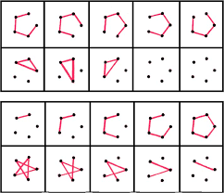
Viewing the dataset | Ruff Figural Fluency Test for Cognitive Function
LOAD + PREP DATA
pacman::p_load(tidyverse, equatiomatic, ggstatsplot)
pacman::p_load_gh("the-graph-courses/rsr")
prevend <- rsr::prevend |>
select(rfft, age_yrs, sex, education) |>
mutate(
sex = fct_relevel(sex, "female"),
education = fct_relevel(education,
"primary", "lower_secondary", "higher_secondary", "university"))
head(prevend)
rfft age_yrs sex education
1 62 55 female higher_secondary
2 79 65 female lower_secondary
3 89 46 male university
4 70 68 female higher_secondary
5 35 70 male higher_secondary
6 14 53 male primary
Random sample of size 500 from the prevend dataset
Source:
https://rdrr.io/github/OpenIntroStat/openintro/man/prevend.samp.html
https://datadryad.org/dataset/doi:10.5061/dryad.6qs53

Slide 4
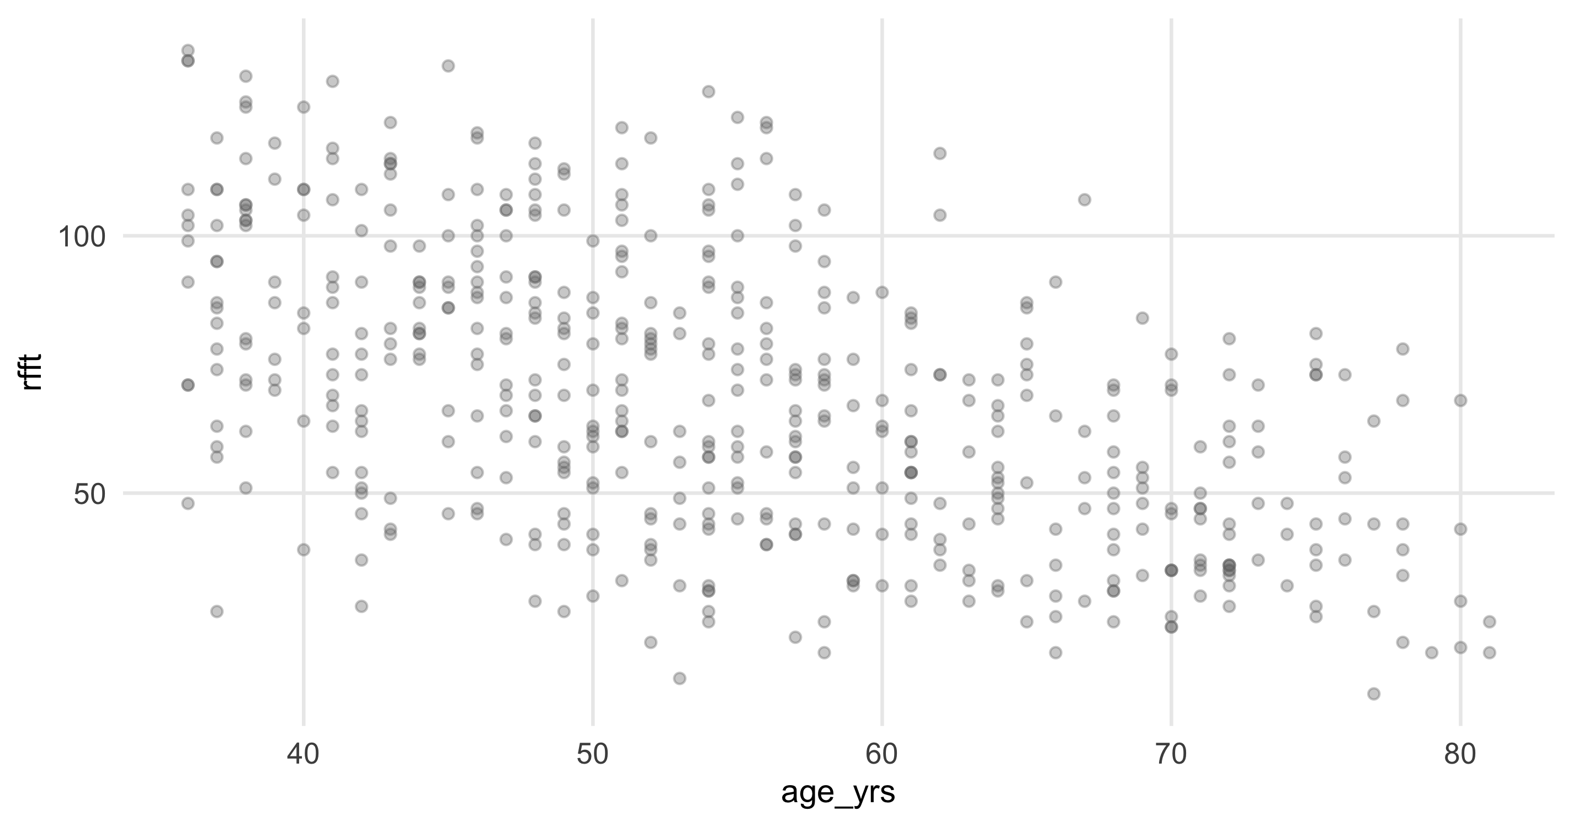

RFFT vs Age | Continuous outcome and continuous predictor
FIT MODEL
VISUALIZE DATA
mod_age <- lm(rfft ~ age_yrs, data = prevend)
summary(mod_age)
ggplot(prevend, aes(age_yrs, rfft)) +
geom_point(alpha = 0.35, color = "gray45", size = 1.8)
Call:
lm(formula = rfft ~ age_yrs, data = prevend)
Residuals:
Min 1Q Median 3Q Max
-63.879 -16.845 -1.095 15.524 58.564
Coefficients:
Estimate Std. Error t value Pr(>|t|)
(Intercept) 137.54972 5.01614 27.42 <2e-16 ***
age_yrs -1.26136 0.08953 -14.09 <2e-16 ***
preview_eq(extract_eq(mod_age, use_coefs = TRUE))
How to read it
• age_yrs is numeric, so the model fits a single straight line.
• Slope = mean change in RFFT for one extra year of age.
• Significant negative slope → older participants score lower on average.

Slide 5
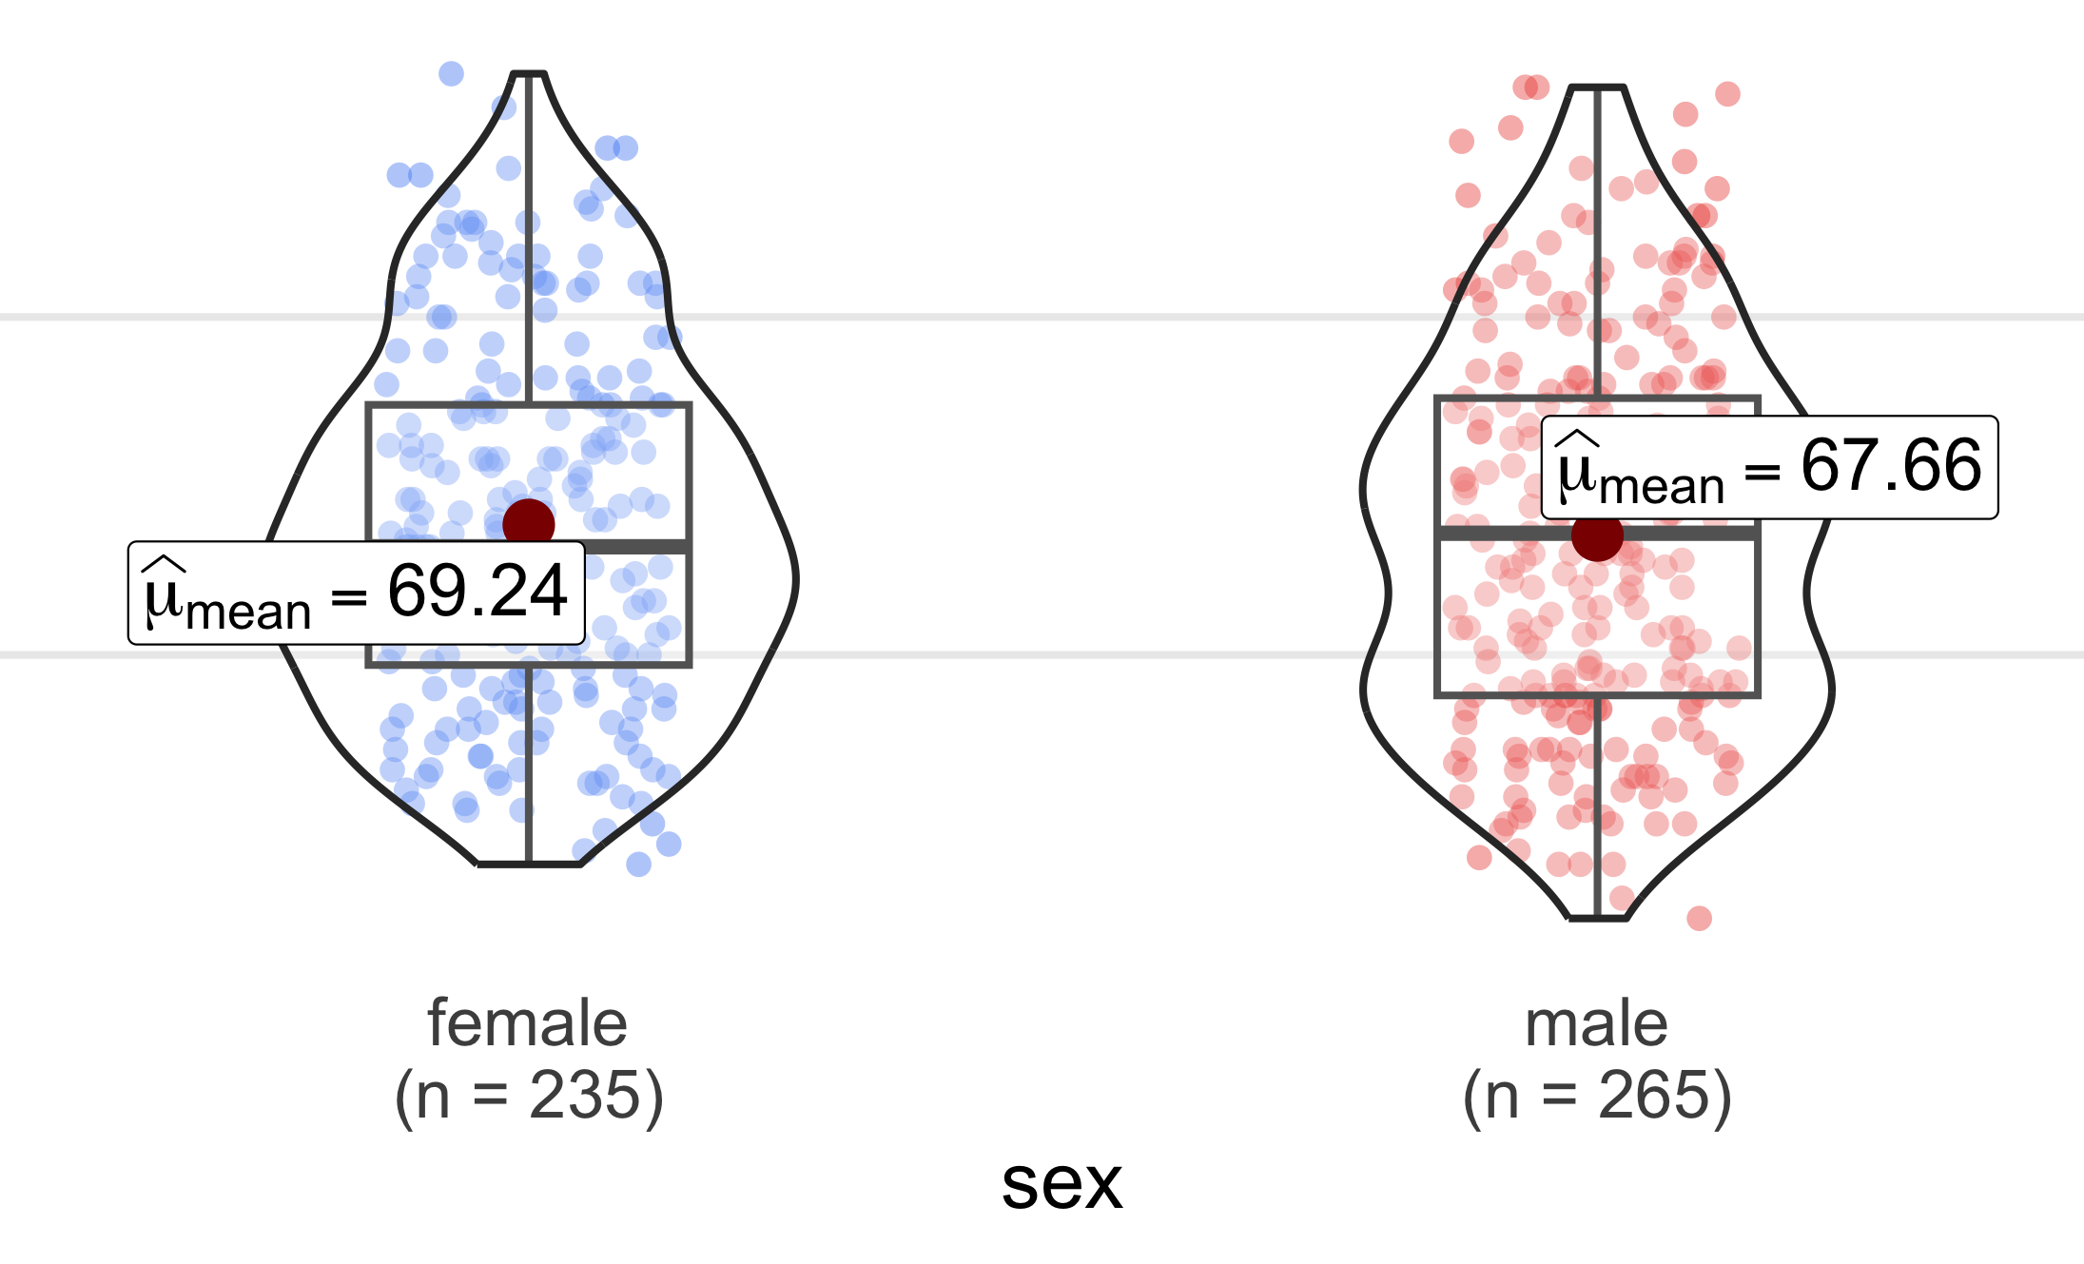

RFFT vs Sex | Continuous outcome and categorical binary predictor
FIT MODEL
VISUALIZE DATA
mod_sex <- lm(rfft ~ sex, data = prevend)
summary(mod_sex)
ggbetweenstats(prevend, x = sex, y = rfft,
results.subtitle = FALSE)
Call:
lm(formula = rfft ~ sex, data = prevend)
Residuals:
Min 1Q Median 3Q Max
-56.660 -22.344 -1.449 19.340 66.762
Coefficients:
Estimate Std. Error t value Pr(>|t|)
(Intercept) 69.238 1.788 38.721 <2e-16 ***
sexmale -1.578 2.456 -0.642 0.521
preview_eq(extract_eq(mod_sex, use_coefs = TRUE))
How to read it
• x axis: female = 0, male = 1
• Intercept = mean for female (the reference). • sexmale estimate = mean difference (not significant)

Slide 6
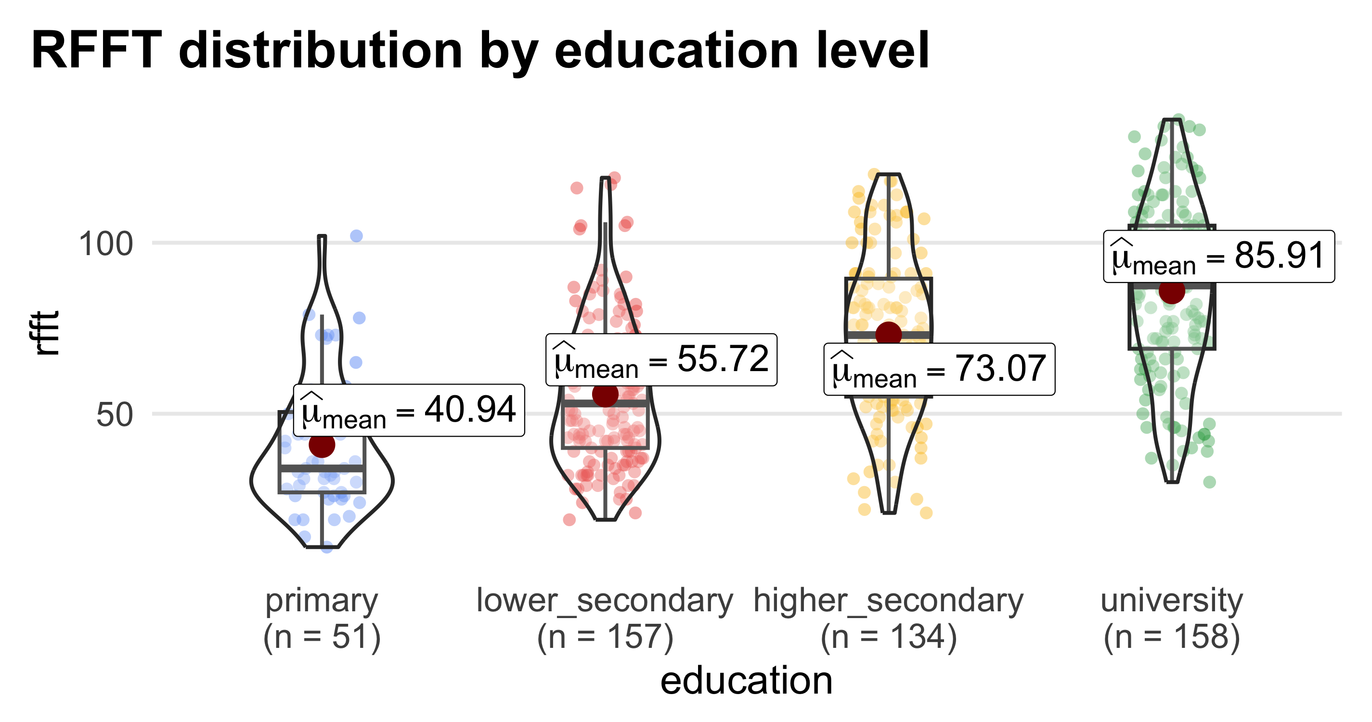
RFFT vs Education| Continuous outcome and categorical polytomous predictor
FIT MODEL
VISUALIZE DATA
mod_edu <- lm(rfft ~ education, data = prevend)
summary(mod_edu)
ggbetweenstats(prevend, x = education, y = rfft,
results.subtitle = FALSE)
Call:
lm(formula = rfft ~ education, data = prevend)
Residuals:
Min 1Q Median 3Q Max
-55.905 -15.975 -0.905 16.068 63.280
Coefficients:
Estimate Std. Error t value Pr(>|t|)
(Intercept) 40.941 3.203 12.783 < 2e-16 ***
educationlower_secondary 14.779 3.686 4.009 7.04e-05 ***
educationhigher_secondary 32.133 3.763 8.539 < 2e-16 ***
educationuniversity 44.964 3.684 12.207 < 2e-16 ***
preview_eq(extract_eq(mod_edu, use_coefs = TRUE))

Slide 7
The key: Each estimate = mean difference vs. the reference group
Call:
lm(formula = rfft ~ education, data = prevend)
Residuals:
Min 1Q Median 3Q Max
-55.905 -15.975 -0.905 16.068 63.280
Coefficients:
Estimate Std. Error t value Pr(>|t|)
(Intercept) 40.941 3.203 12.783 < 2e-16 ***
educationlower_secondary 14.779 3.686 4.009 7.04e-05 ***
educationhigher_secondary 32.133 3.763 8.539 < 2e-16 ***
educationuniversity 44.964 3.684 12.207 < 2e-16 ***
How to read it
• Naively, one might imagine fitting a single straight line. No!
• Intercept = mean RFFT in the reference group
• Each β = mean difference vs. the reference group
• Add Intercept + β to get each group's mean
Primary 40.94 = 40.94
Lower secondary 40.94 + 14.78 = 55.72
Higher secondary 40.94 + 32.13 = 73.07
University 40.94 + 44.96 = 85.91

Slide 8
Practice: Interpreting coefficients
A fitness study (n = 240) looked at the outcome of resting heart rate (bpm), as predicted by weekly exercise, categorized into sedentary, light and vigorous Predictor: weekly exercise; reference = sedentary. R output:
Estimate Std.Error t value Pr(>|t|)
(Intercept) 78.00 0.84 92.86 < 2e-16 ***
exerciselight -5.20 1.18 -4.41 1.6e-05 ***
exercisevigorous -9.80 1.21 -8.10 2.3e-14 ***
Predicted resting HR for someone in the vigorous category?
Best reading of the light coefficient (−5.20)?
A) 68.2 bpm
B) Light exercisers averaged 5.2 bpm lower than vigorous.
B) 9.8 bpm
B) Light exercisers averaged 5.2 bpm lower than sedentary.
C) 63 bpm
Answer: B
All rows in the table are compared to the reference group.
Answer: A
Vigorous dummy = 1, light = 0:
HR = 78.0 + (−9.8)·1 = 68.2 bpm.

Slide 9
Changing the reference does not change the magnitude of associations
mod_edu <- lm(rfft ~ education, data = prevend)
summary(mod_edu)
Coefficients:
Estimate Std. Error t value Pr(>|t|)
(Intercept) 40.941 3.203 12.783 < 2e-16 ***
educationlower_secondary 14.779 3.686 4.009 7.04e-05 ***
educationhigher_secondary 32.133 3.763 8.539 < 2e-16 ***
educationuniversity 44.964 3.684 12.207 < 2e-16 ***
Primary 40.94 = 40.94
Lower secondary 40.94 + 14.78 = 55.72
Higher secondary 40.94 + 32.13 = 73.07
University 40.94 + 44.96 = 85.91
prevend_uni <- prevend |>
mutate(education = fct_relevel(education, "university"))
mod_edu_uni <- lm(rfft ~ education, data = prevend_uni)
summary(mod_edu_uni)
Coefficients:
Estimate Std. Error t value Pr(>|t|)
(Intercept) 85.905 1.820 47.211 < 2e-16 ***
educationprimary -44.964 3.684 -12.207 < 2e-16 ***
educationlower_secondary -30.185 2.577 -11.712 < 2e-16 ***
educationhigher_secondary -12.830 2.686 -4.777 2.35e-06 ***
University 85.91 = 85.91
Primary 85.91 − 44.96 = 40.94
Lower secondary 85.91 − 30.19 = 55.72
Higher secondary 85.91 − 12.83 = 73.07

Slide 10
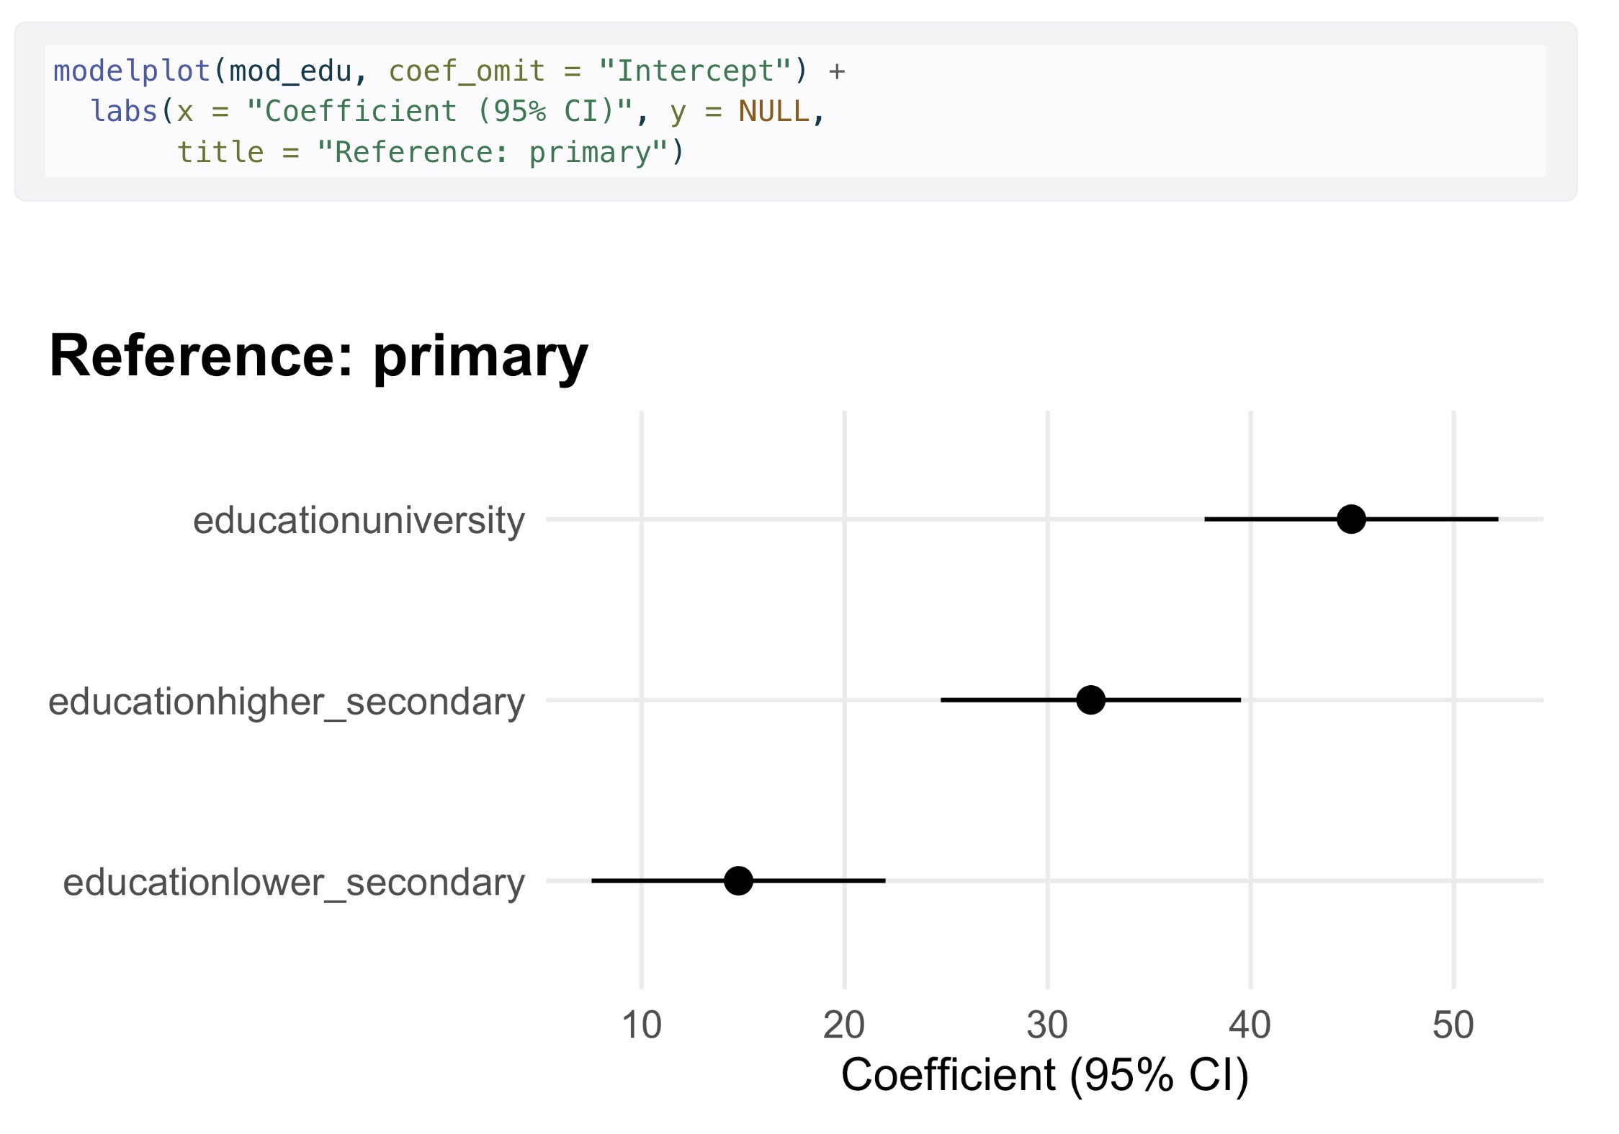
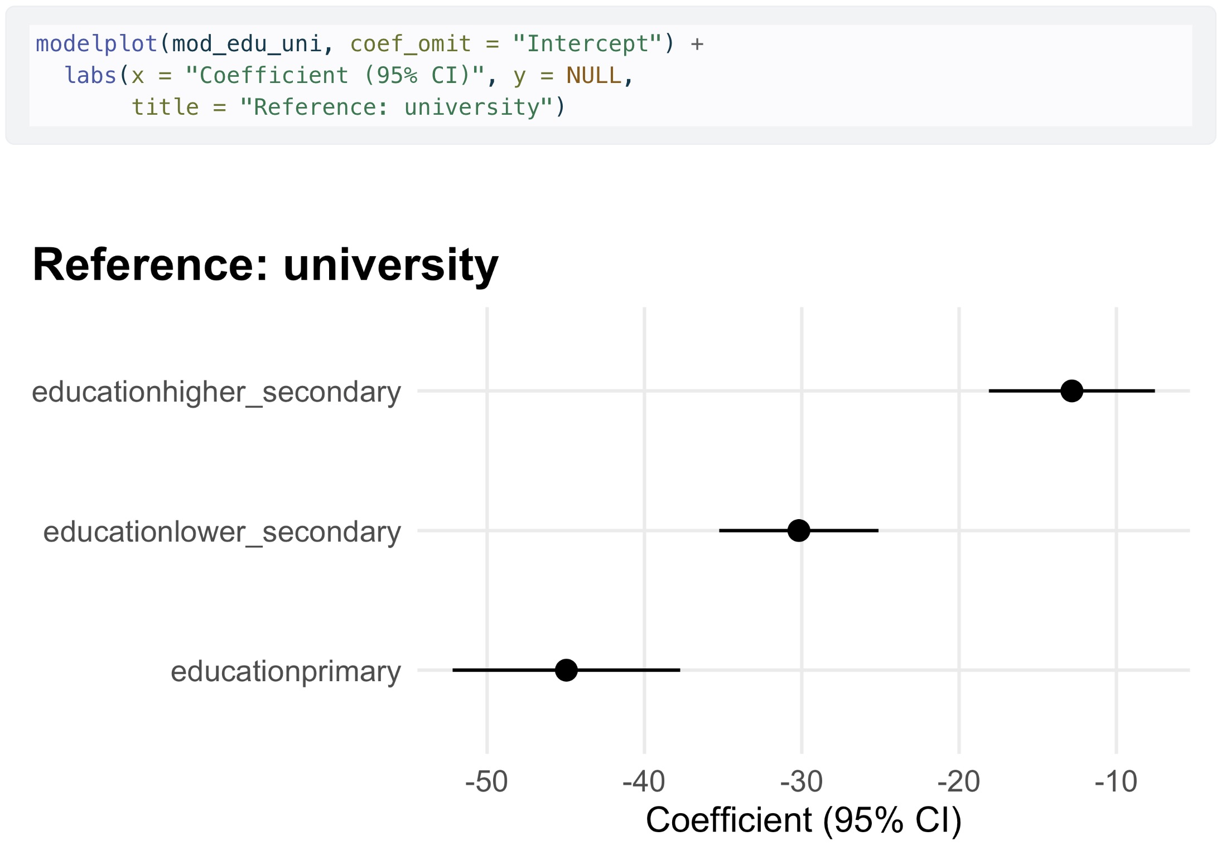
Picking the reference category: some principles
Clinical control / standard
The natural ”first” or ”last” level of predictor
Highest or lowest outcome
The largest group
• Pick the placebo or untreated group.
• Each coefficient then reads as the effect of a treatment vs. doing nothing.
• That's usually the comparison you actually care about.
• e.g. drug trial ref= placebo.
• Pick the group with the highest (or lowest) outcome.
• Every other coefficient then takes the same sign.
• Reads as "gain over worst" or "deficit from best".
e.g. education, ref = university.
• Pick the category with the most observations.
• Each coefficient's standard error depends partly on the reference group's size.
• A bigger reference tightens every comparison at once.
• Use when categories have a natural order.
• Pick the lowest rung.
• Each coefficient is one step up the scale.
e.g. education, ref = primary.
Each row reads as how much higher RFFT is than primary.
Each row reads as how far behind university each group is.

Slide 11
Practice: Choosing a reference category
A trial (n = 320) tested a new pain reliever at three doses against placebo. Outcome: pain score (0–10, higher = worse). Predictor: dose (placebo, 200mg, 400mg, 800mg);. R output:
Estimate Std.Error t value Pr(>|t|)
(Intercept) 6.85 0.18 38.06 < 2e-16 ***
dose200mg -1.10 0.25 -4.40 1.4e-05 ***
dose400mg -2.30 0.25 -9.20 < 2e-16 ***
dose800mg -2.80 0.25 -11.20 < 2e-16 ***
What would be the most recommended reference category?
If we re-leveled to ref = 800mg, what does (Intercept) become?
A) Placebo
A) Mean pain on placebo.
B) 800 mg
B) Mean pain on 800mg.
Answer: A
Each dose coefficient then reads directly as drug effect vs. placebo, which is the question the trial was designed to answer.
Answer: B
The intercept is always the mean outcome at the reference. The other coefficients flip sign and now read as placebo / lower-dose pain relative to 800mg.

Slide 12
Learning Objectives | SLR with Polytomous Categorical Predictors (k > 2)
1
Extend regression from binary to k-level categorical predictors
2
Interpret the intercept and each dummy coefficient as group means and contrasts

