Slide 1
1/9
What is Least Squares?
•
A method for fitting a model to noisy data.
•
It chooses the model that makes total squared error as small as possible.
•
The goal is to describe the trend behind the measurements.

Slide 2
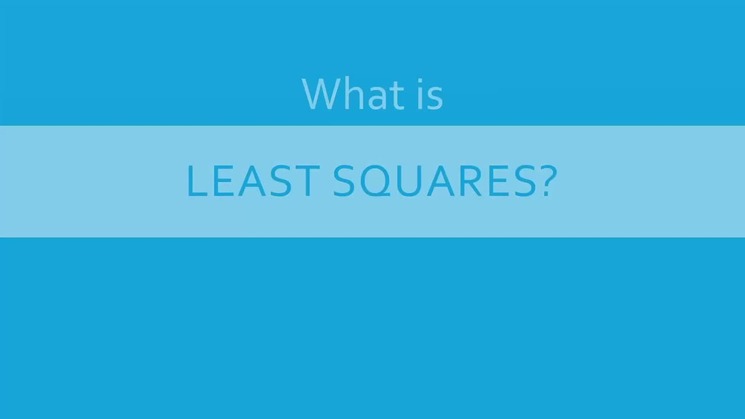
2/9
The problem: noisy data
•
Measurements often appear as scattered points.
•
The dots represent observations, not perfect answers.
•
We want a simple curve or line that captures the trend.
Source frame · 0:10

Slide 3

3/9
Fit a model to observations
•
Least squares shows up in science, finance, engineering, and astronomy.
•
The same question appears everywhere: which model best explains the measurements?
•
It works for experiments, economics, and physical observations.
Source frame · 0:30

Slide 4
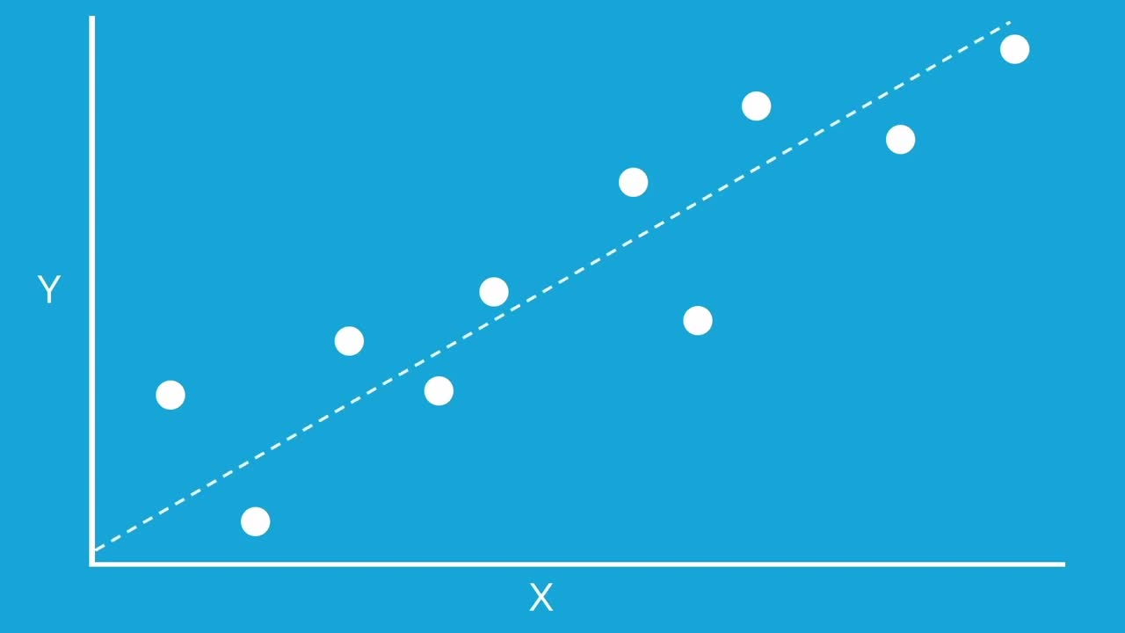
4/9
Choose a candidate line
•
For a line, the model is y = mx + b.
•
The slope m and intercept b are the adjustable parameters.
•
The line estimates the y-value for each x-value.
Source frame · 0:45

Slide 5
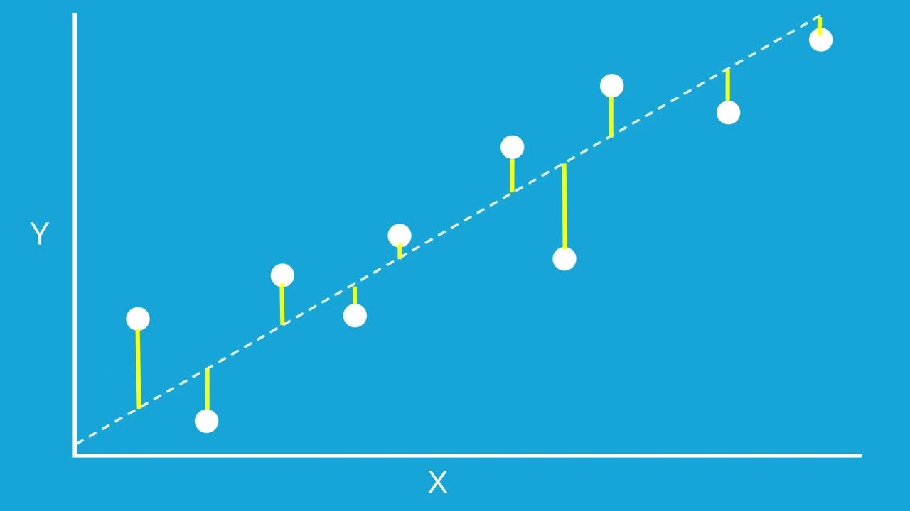
5/9
Residuals measure error
•
A residual is the vertical gap between a data point and the model.
•
Some residuals are positive, and others are negative.
•
Vertical gaps match the standard setup where y is modeled as a function of x.
Source frame · 1:05

Slide 6
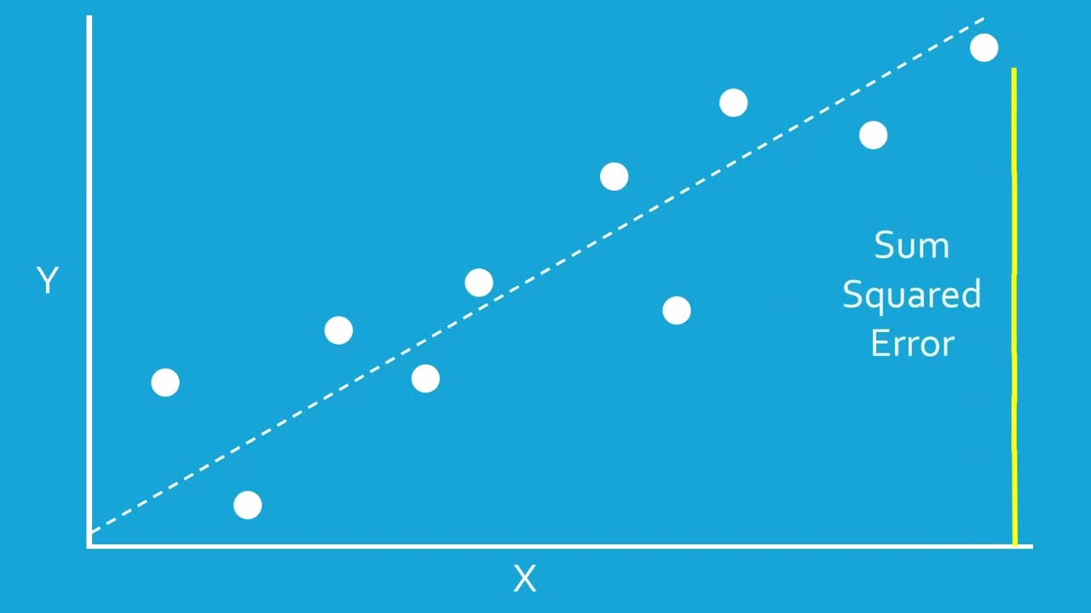
6/9
Square the residuals
•
Squaring prevents positive and negative errors from canceling.
•
Large errors count more because they are squared.
•
This is why the method is called least squares.
Source frame · 1:20

Slide 7
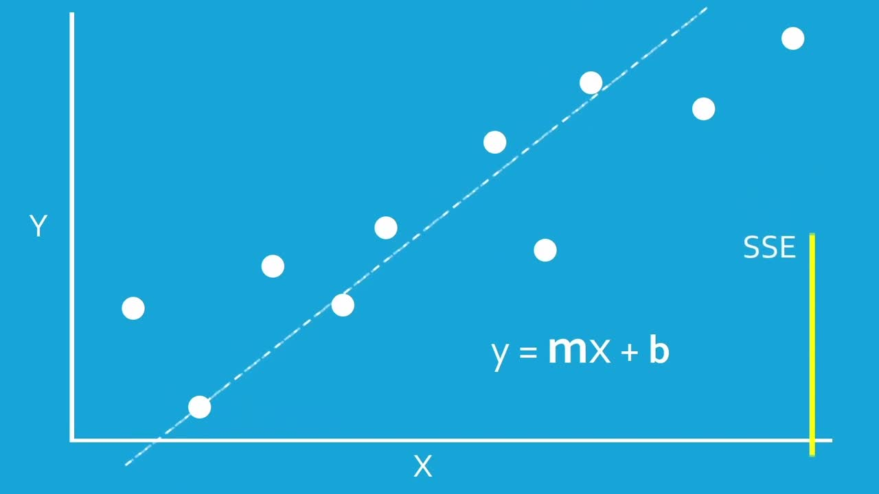
7/9
Minimize SSE
•
SSE = residual₁² + residual₂² + … + residualₙ².
•
SSE is the total squared error for one model.
•
The best fit is the model with the smallest SSE.
Source frame · 1:35

Slide 8
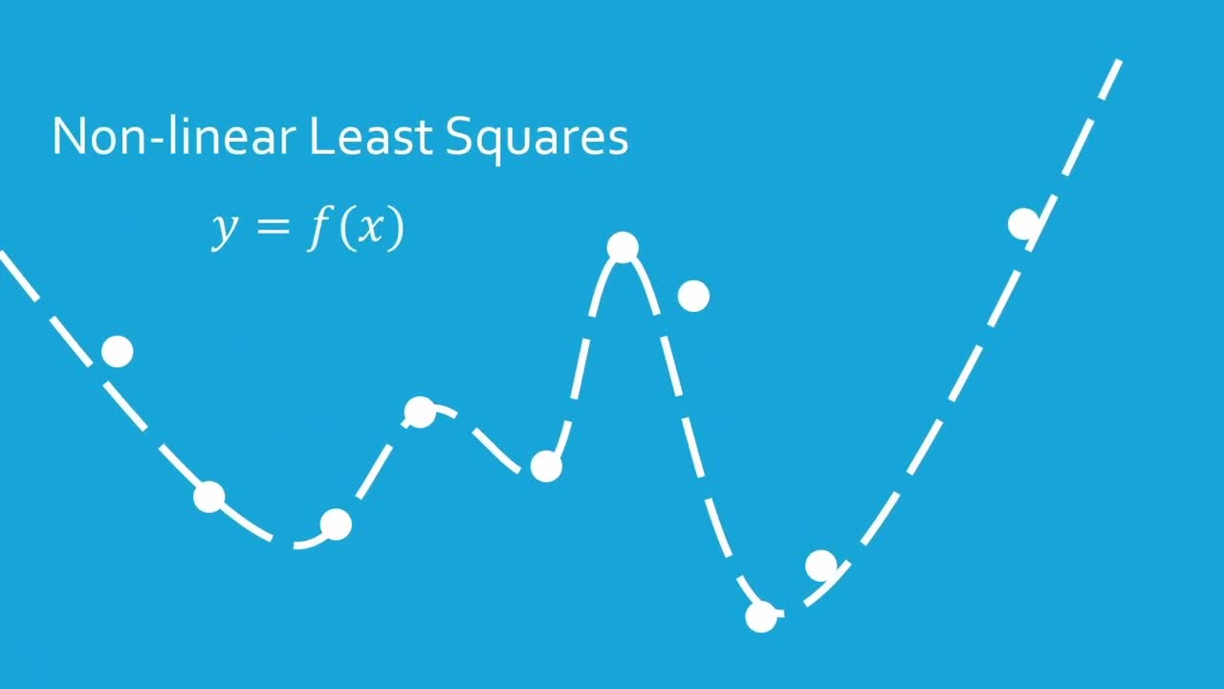
8/9
Nonlinear least squares
•
The same residual-minimization idea works for more flexible functions.
•
Some models cannot be solved with a simple linear formula.
•
They are often fit by improving the parameters step by step.
Source frame · 2:10

Slide 9
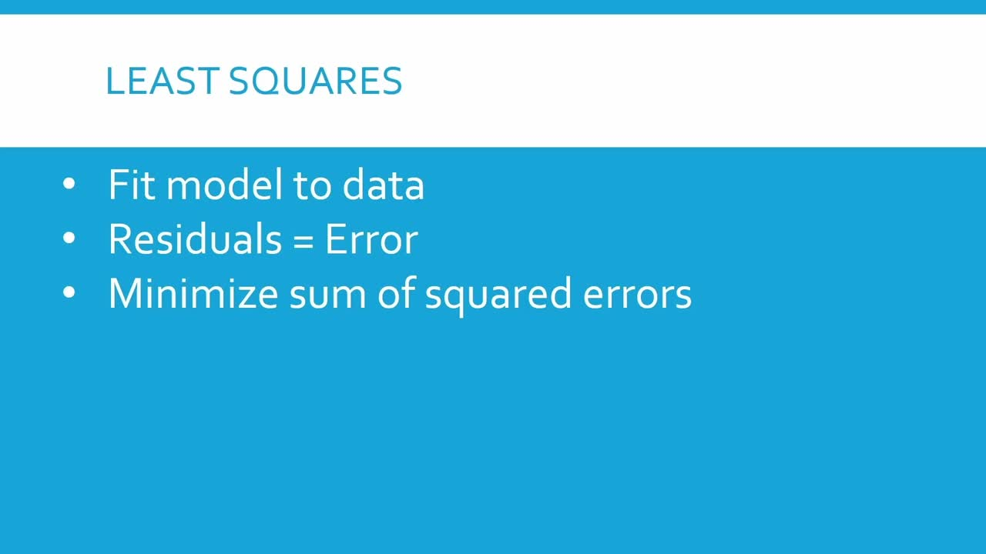
9/9
Core takeaway
•
Fit a model to data.
•
Compute the residuals, which are the model errors.
•
Square and add those errors to get SSE.
•
Choose the parameters that make SSE as small as possible.
Source frame · 2:25

