Slide 1
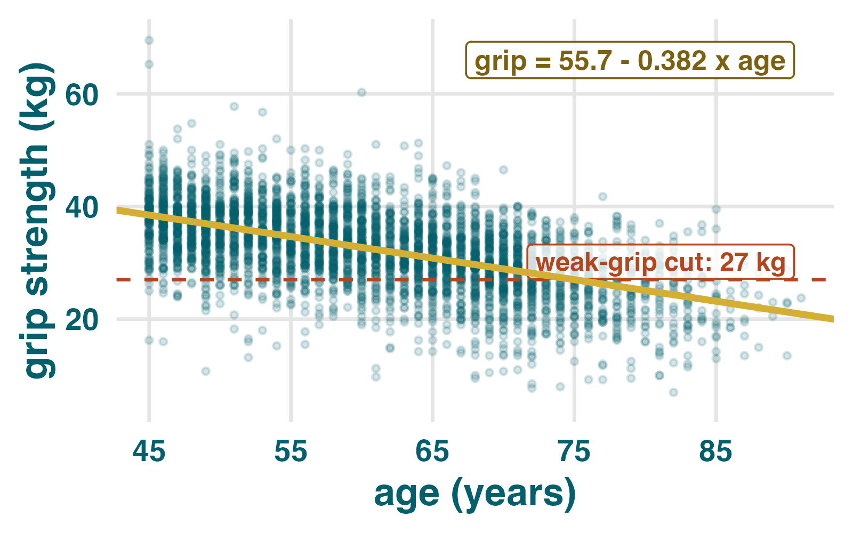
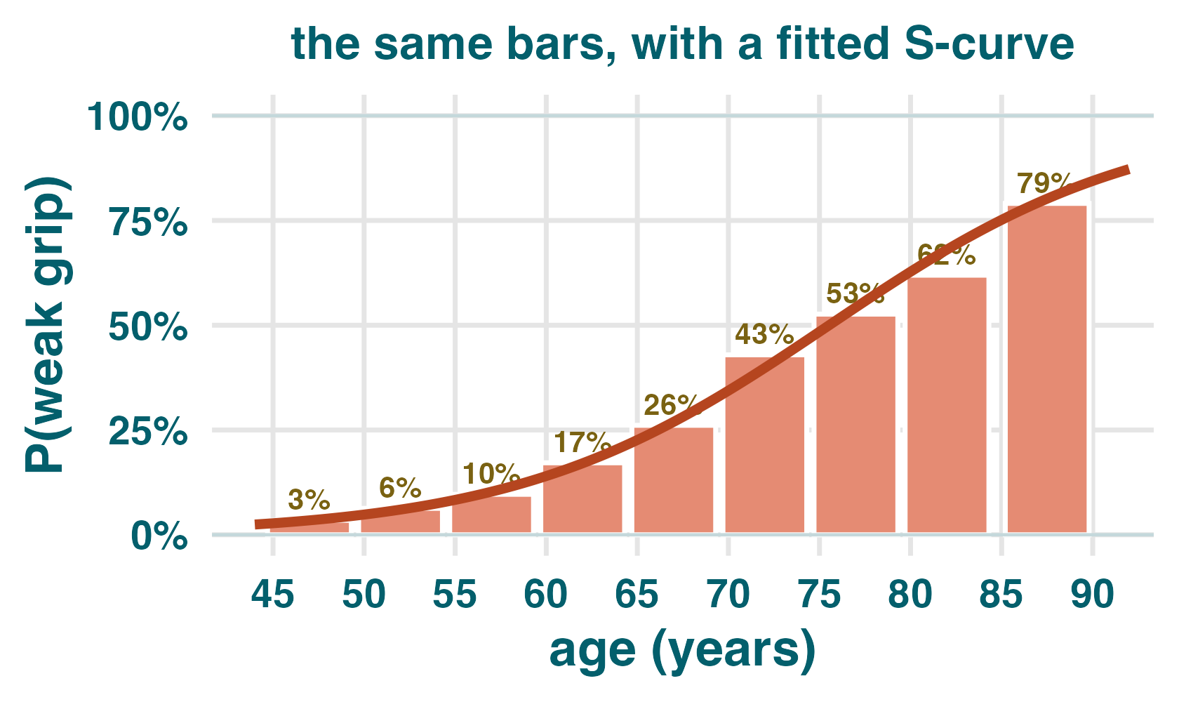
KLoSA Wave 1, 2006 | 4,184 Korean men aged 45+
Start with the familiar line, then ask a probability question
Suppose we measure people at different ages. Each dot is one person: age on the horizontal axis, measured grip strength on the vertical axis.
grip = 55.68 - 0.382 x age
The slope has a direct meaning: each additional year lowers predicted mean grip strength by 0.382 kg.
That change is constant. Age 50 to 51 and age 80 to 81 use the same slope.
But the clinical question may be binary: is grip strength below a low-strength cutoff?
Linear regression: predicted mean grip strength falls by about 0.38 kg per year.
First logistic fit: P(low grip) stays inside 0-1.
The key switch
We are no longer predicting someone's exact grip strength. We are estimating the probability that the person falls into the low-grip-strength category at a particular age.
continuous outcome: grip in kg -> binary outcome: low grip = 1, not low grip = 0

Slide 2
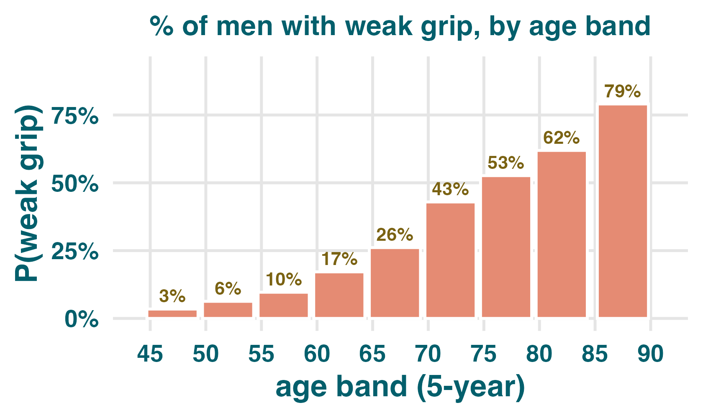
From measured strength to a yes / no outcome
A zero-or-one outcome turns averages into proportions
Create the binary variable
Read one age group
Clinicians can define a cutoff for low grip strength. For the men in this example, weak_grip = 1 if grip <= 27 kg and weak_grip = 0 otherwise.
Example: if 169 of 647 people aged 65 to 69 have low grip strength, then
P(low grip | age 65-69) = 169 / 647 = 0.26
The mean of the zero-or-one variable is exactly that proportion.
mean(0, 1, 0, 1, 1, ...) = proportion equal to 1
A one means the person has low grip strength.
A zero means the person does not.
The raw scatter now has many points stacked at 0 and many stacked at 1.
Age bands make the pattern visible.
All predicted probabilities must stay between 0 and 1.
For each age group, the plotted value is the percentage with weak grip.
The question has changed from an expected value in kilograms to a risk: at a particular age, what is the probability that a person falls into the low-grip category?

Slide 3
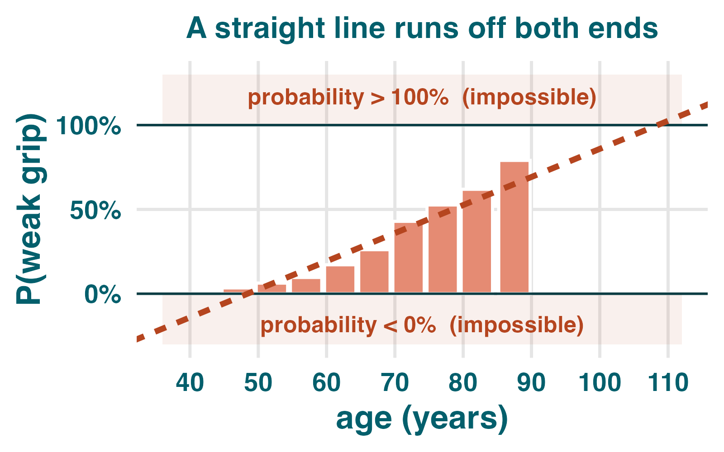
Why ordinary least squares is not enough
A straight line cannot respect the probability box
Two problems
The shape we want
1. The boundary problem
Always stays between 0 and 1.
Can increase or decrease smoothly.
Flattens as it approaches the boundaries.
Still has a straight-line part hidden inside it.
A straight line has no lower or upper bound. Probabilities do: they must stay between 0 and 1.
2. The constant-change problem
sigmoid = S-shaped
A straight line says each year adds the same number of percentage points everywhere. Many risks change slowly near 0, quickly in the middle, and slowly again near 1.
logistic curve:
p = 1 / (1 + e^(-x))
If extended far enough, the line predicts impossible probabilities below 0 or above 1.
The exact value of e matters less than what the formula does: very negative inputs give probabilities near 0, x = 0 gives 0.5, and very positive inputs give probabilities near 1.

Slide 4
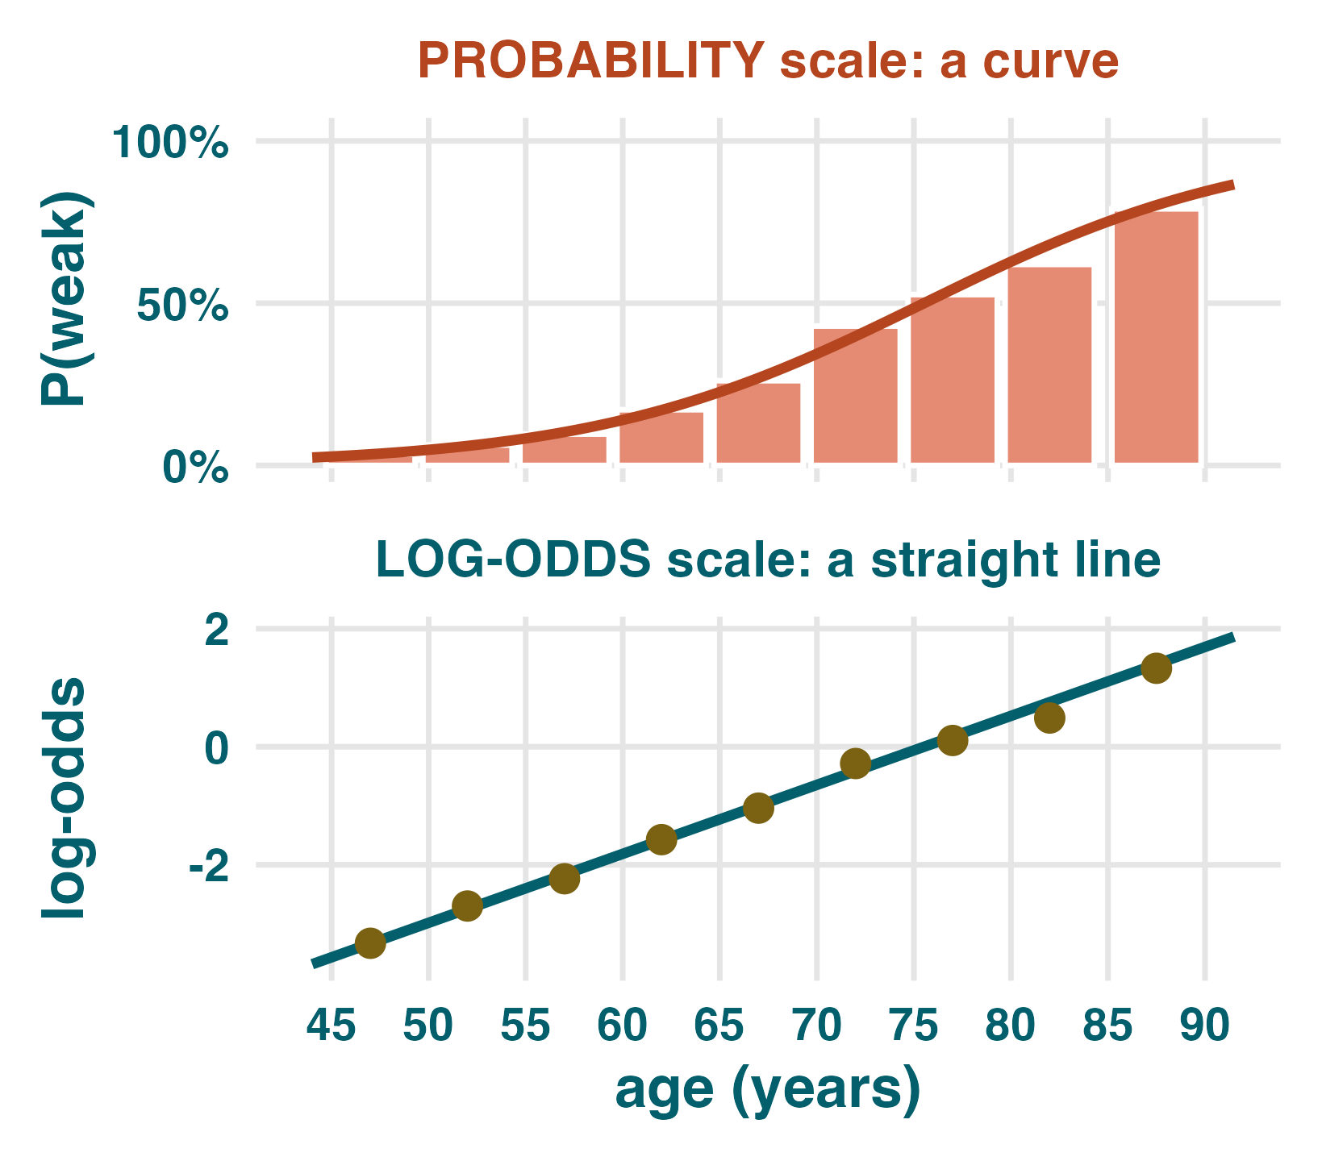
The model is still built from a line
The logistic curve wraps a straight line
p = 1 / (1 + e^(-(beta0 + beta1 x age)))
The expression inside is linear
eta = beta0 + beta1 x age
beta0 is the intercept.
beta1 is the coefficient for age.
The logistic function bends eta into a probability.
Changing the intercept moves the curve's midpoint.
Changing beta1 changes how rapidly the curve rises or falls.
The sign of beta1 determines whether probability increases or decreases with age.
What software estimates
The same fitted model is curved on the probability scale and straight on the log-odds scale.
The fitted model chooses beta0 and beta1 so the observed zeroes and ones are reasonably likely under a binomial generalized linear model with a logit link.

Slide 5
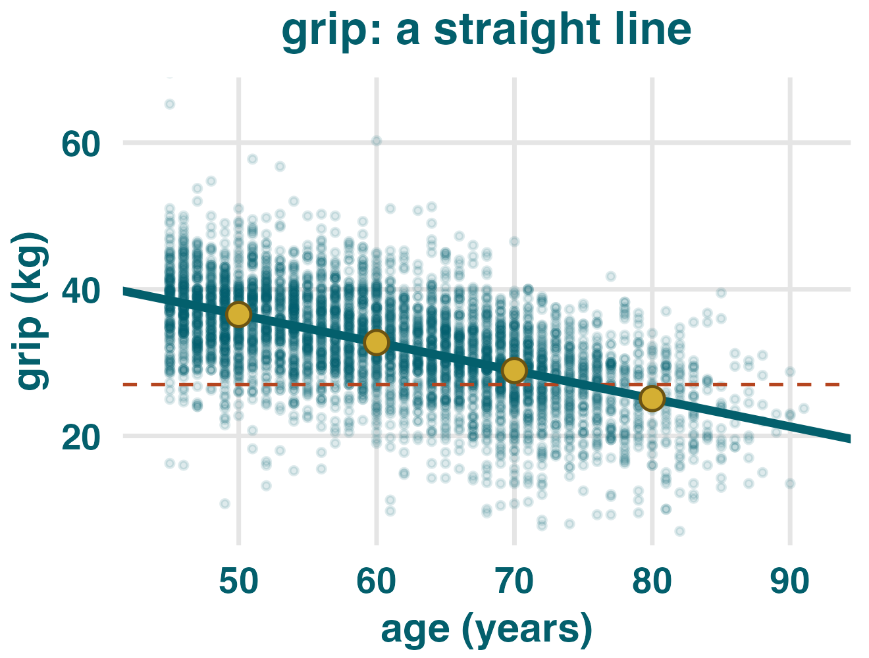
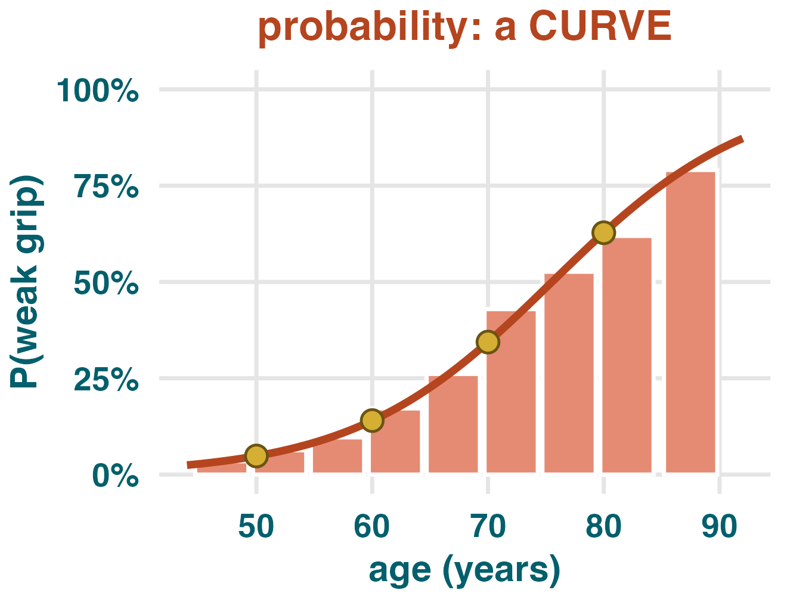
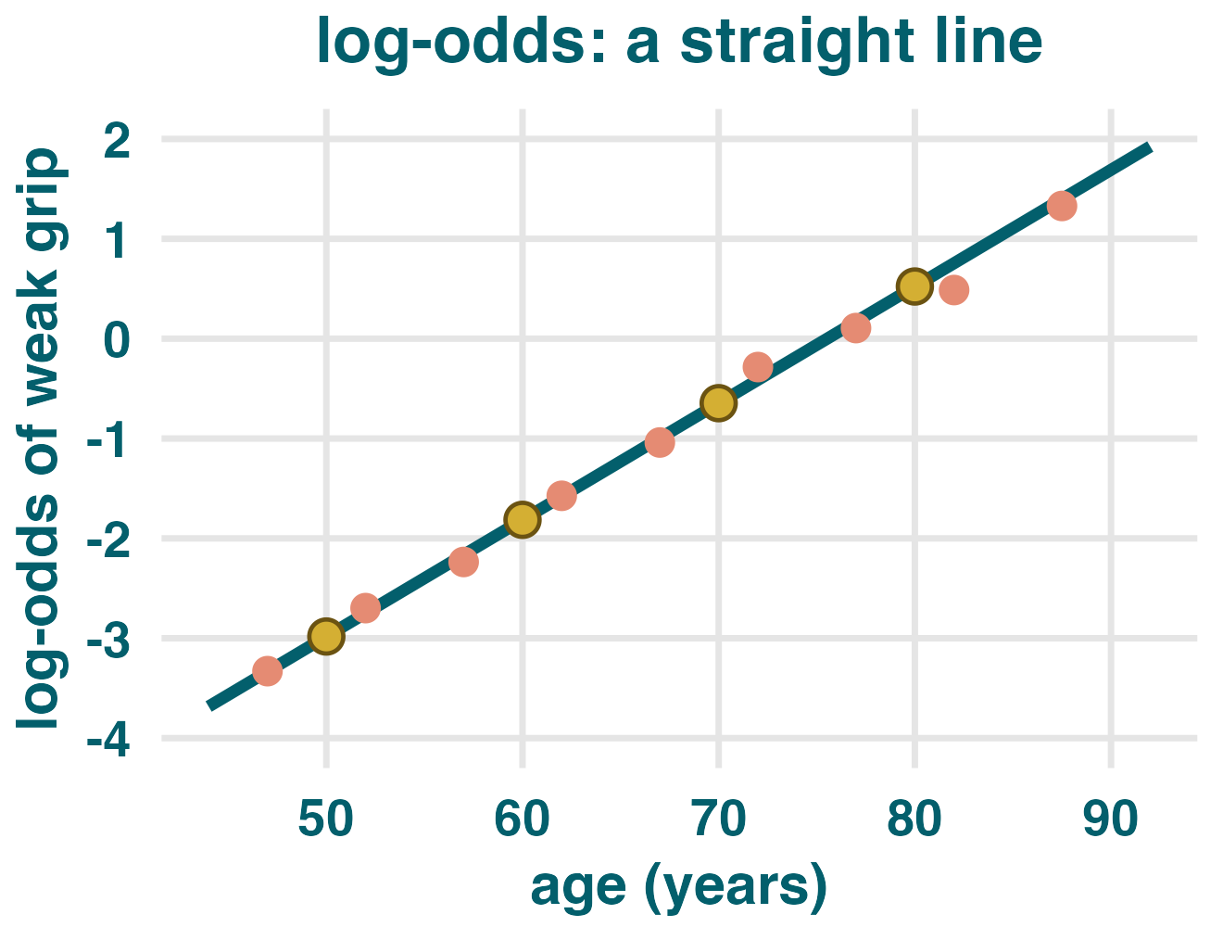
Same predictor, same people, three scales
Only the probability scale bends
A. Grip in kg
B. Low grip as probability
C. Low grip as log-odds
One slope: -0.382 kg per year.
No single probability slope.
One slope again: +0.117 log-odds per year.
Linear regression
Probability curve
Logistic regression output
The coefficient is a constant change in the predicted outcome. A one-year age increase has the same predicted kg change at every age.
The change in probability is not constant. It is small near the ends and larger in the middle.
The coefficient lives on the log-odds scale, where the relationship is straight again.

Slide 6
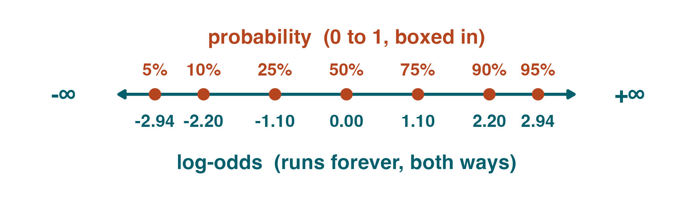
Uncover the straight line hidden inside the curve
Logit means log odds, and that is where the model is linear
Start with the fitted probability
p = 1 / (1 + e^(-eta))
eta = beta0 + beta1 x age
Move to odds and log odds
Probability is boxed into 0 to 1. Log-odds runs from negative infinity to positive infinity.
odds = p / (1 - p)
logit(p) = log(p / (1 - p))
Worked band example
Important fitting note
Ages 65-69:
p = 169 / 647 = 0.26
odds = 0.26 / 0.74 = 0.35
log-odds = log(0.35) = -1.04
Software does not take the log-odds of each individual 0/1 value and run lm(). Individual log-odds would be infinite. It fits the binomial model by maximum likelihood.
Then the line appears
log(p / (1 - p)) = beta0 + beta1 x age
Logistic regression is not linear in probability. It is linear in log odds.

Slide 7
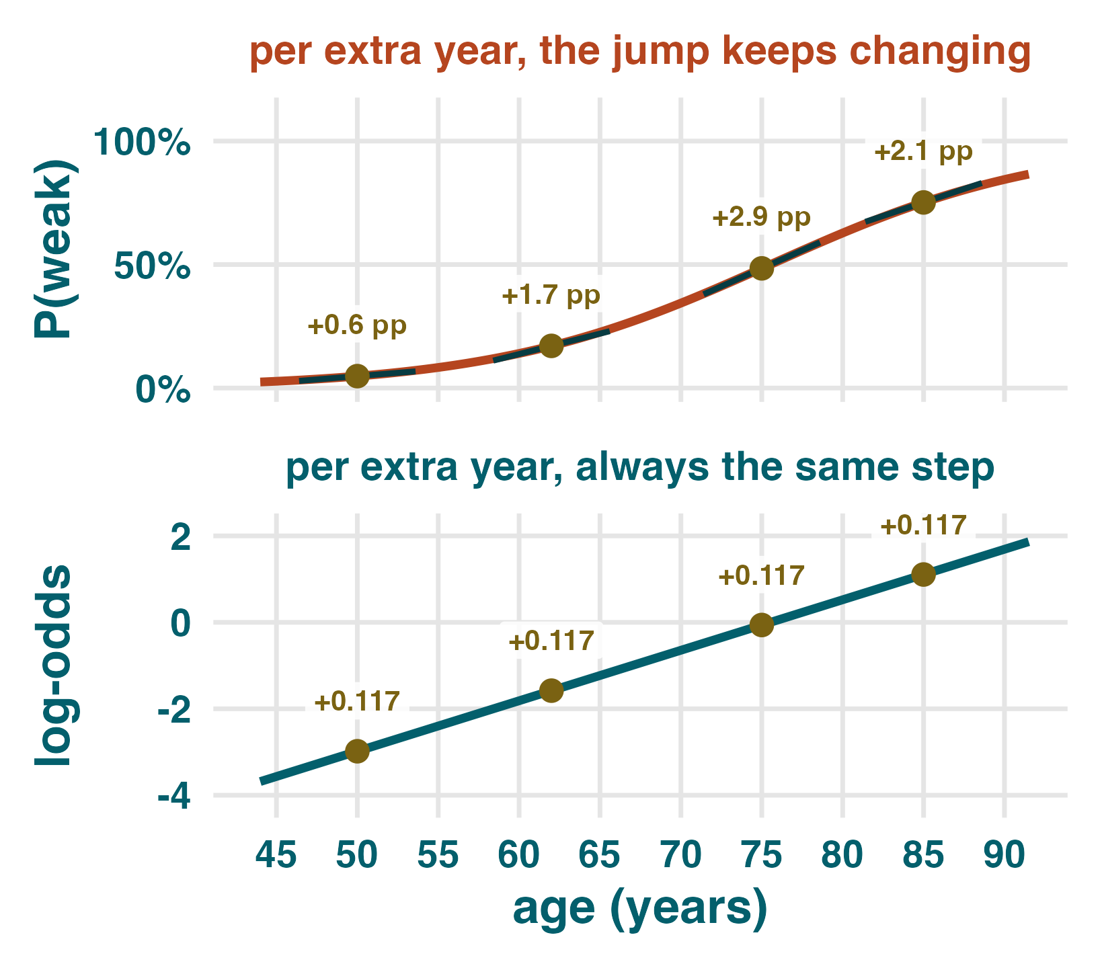
Interpreting beta1 requires changing scale
The coefficient is a constant additive change in log odds
What beta1 = 0.1168 says
Do not say this
Log-odds
Each additional year of age adds 0.1168 to the log-odds of low grip. This is exact, but hard to explain clinically.
"Each year raises the probability by 11.7%."
Odds ratio
Exponentiate the coefficient: exp(0.1168) = 1.12. Each additional year multiplies the odds by 1.12.
Say one of these instead
Odds wording: each additional year is associated with 12% higher odds of low grip.
Probability wording: predicted probability rises from 4.8% at age 50 to 34.4% at age 70.
The probability statement must name ages, because the curve's slope keeps changing.
Per decade
exp(10 x 0.1168) = 3.22. A decade of age roughly triples the odds in this fitted model.
The probability jump changes by age; the log-odds step is constant.

Slide 8
Probability changes are allowed to vary
Predicted probabilities must be anchored to named ages
Fitted values from the men's model
Why the probability step changes
age
P(low grip)
log-odds
odds
next-year probability step
Near zero, the curve has little room to move. Through the middle, it can rise faster. Near one, it slows again because it cannot exceed one.
50
4.8%
-2.98
0.05
+0.6 pp
60
14.0%
-1.81
0.16
+1.5 pp
70
34.4%
-0.65
0.52
+2.7 pp
75
48.5%
-0.06
0.94
+2.9 pp
Central distinction
80
62.8%
+0.52
1.69
+2.7 pp
Linear regression: the coefficient is a constant change in the outcome.
Logistic regression: the coefficient is a constant change in log odds.
Exponentiating beta1 gives a constant multiplicative change in odds.
The probability change varies with the starting age or baseline risk.
85
75.1%
+1.11
3.02
+2.1 pp
constant log-odds step -> constant odds ratio -> varying probability step

Slide 9
Practice: read the model without mixing scales
Use odds ratios for coefficients and named ages for probabilities
1. Interpret a coefficient
2. Read a real output
3. Spot the error
A diabetes model gives a BMI coefficient of 0.09. The right reading is:
Each BMI unit raises the log-odds by 0.09, so the odds are multiplied by exp(0.09) = 1.09.
It is not a 9 percentage-point probability increase.
Women in the same KLoSA wave:
glm(weak_grip ~ age, family = binomial)
(Intercept) -8.4105
age 0.1115
z = 28.78, p < .001
"Age was associated with weak grip (beta = 0.117). Each year therefore increased the probability by 11.7%."
The fix
Why not lm(weak_grip ~ age)?
Log-odds: each year adds 0.1115.
Odds ratio per year: exp(0.1115) = 1.12.
Odds ratio per decade: exp(1.115) = 3.05.
50% probability occurs around age 75.4.
Error: beta is on the log-odds scale, not the probability scale.
Odds sentence: each additional year was associated with 12% higher odds of weak grip.
Probability sentence: predicted probability rose from 4.8% at age 50 to 34.4% at age 70.
A linear probability model can predict values below 0 or above 1. Logistic regression keeps fitted probabilities inside the possible range.
Rule: exponentiate for odds; predict at named ages for probabilities.

