Slide 1

Welcome
Problem#1: Using Careem app without internet.
By:
Umair Israr
Dareer Ahmad Mufti

Slide 2
Technologies We used:
NodeJS / Express.JS
MongoDB
3rd Party Libraries:
Google Map API
Google App Script
SMS APIs

Slide 3
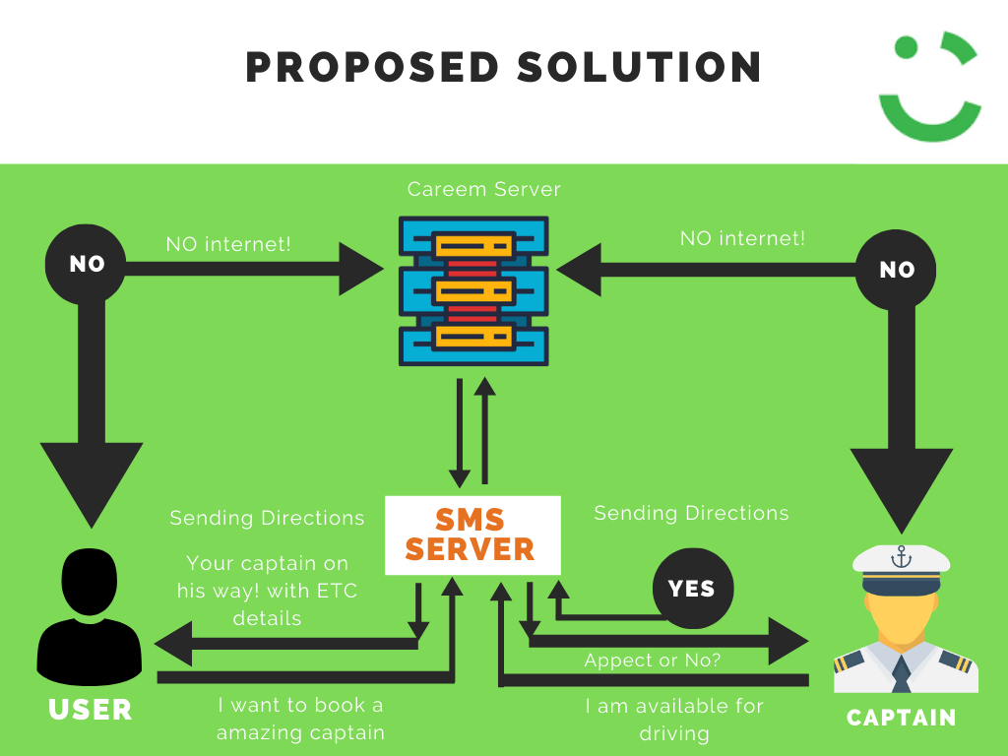

Slide 4
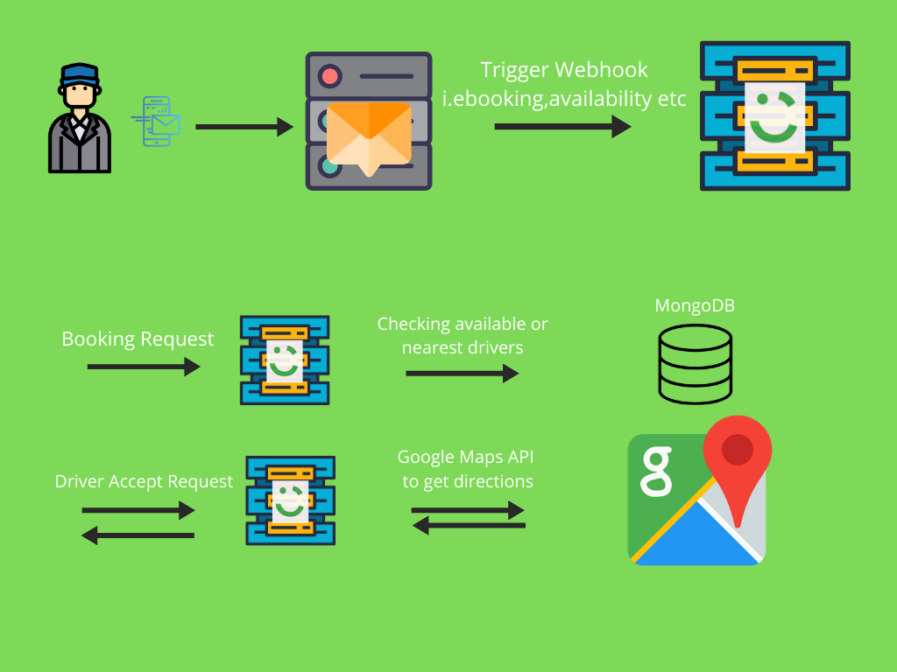
Backend Architechture:

Slide 5
Demo

Slide 6
Scalability:
Load balancers
Serverless Functions

Slide 7
Thank You

