Slide 1
Careem SMS Ride System
Problem no. 01

Slide 2
Architectural Components
Java , kotlin
MVVM
KOIN for dependency injection
Firebase

Slide 3
Applications
Customer Application
Driver Application

Slide 4
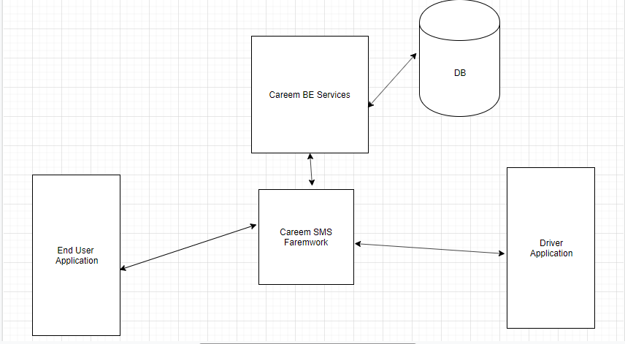

Slide 5
Features
Will Keep careem operation live
No internet Required
Highly scalable and cohesive

