Slide 1
Classification Model for Housing Renewal Decisions
Henry k. Tran
EliseAI Case Study

Slide 2
Goals for Project
Preprocess the data and form/select necessary features to predict housing renewals.
Propose and evaluate a model that can predict housing renewals. Test the model against baseline benchmarks and apply the model on the test dataset.
Parse through the messages from each user and categorize the reason for not renewing their leases using sentence transformers.

Slide 3
1 – Data Processing
Preprocess the data and form/select necessary features to predict housing renewals.
Determine which columns of non-numerical data could be encoded into a numerical feature, if it is worth doing so.
Find incomplete data and determine the best way to handle this (throw away or fill in with set value).
Propose new features that would lend insight into housing renewal decisions.

Slide 4
1 – Data Processing
File: residents (db)
Numerical:
resident_id
age
parking_space_id
unit_number
monthly_rent
Non-Numerical:
name
phone_number
emergency_contact
lease_start_date
lease_end_date
pet_details
referral
call_history
payment_method
ADA_support
newletter_opt_in

Slide 5
1 – Data Processing
File: residents (db)
Numerical:
resident_id
age
parking_space_id
unit_number
monthly_rent
Identifiers
Non-Numerical:
name
phone_number
emergency_contact
lease_start_date
lease_end_date
pet_details
referral
call_history
payment_method
ADA_support
newletter_opt_in
Convert to numerics
Integer Embedding (lose pet type)
One-Hot Embedding
Convert to binary
(lose information about type of support)

Slide 6
1 – Data Processing
File: maintenance (db)
Numerical:
work_order_id
resident_id
unit_number
Non-Numerical:
date_submitted
issue_type
issue_description
priority
status
assigned_to
target_completion date
date_completed
materials_required
submission_method
notes
Convert to numerics
Issue type might be important, description and priority indicates severity of problem, but this might require far more data than we have
Identifiers
Convert to binary
Completed dates missing
Many repeats to be dealt with

Slide 7
1 – Data Processing
File: offers (db)
Numerical:
unit
rent
renewal_decision
Non-Numerical:
date_sent
sent_by
Identifiers
Convert to numerics
Target
Renewals are done by unit, not resident so there are repeats for units with multiple people

Slide 8
1 – Data Processing
File: conversations (json)
Numerical:
resident_id
Non-Numerical:
conversations
Integer Embedding
(lose content of messages, retain number of messages)
Missing conversations given 0.
Identifiers

Slide 9
1 – Data Processing
New Features
completion_time = target_completion_date – date_submitted
completion_diff = target_completion_date – date_completed
rent_diff = rent – monthly_rent
percentage_rent_diff = rent_diff / monthly_rent
lease_length = lease_end_date – lease_start_date_sent
lease_window_length = lease_end_date – date_sent
Aggregate on unit_number and lease_end_date
Sum message and maintenance data per household
occupancy_count: number of residents in the same unit with the same lease_end_date
Note: Averages are calculated after aggregation
Merge Residents ← Maintenance (on = resident_id)
avg_completion_time: for no completed requests fill in with median
avg_completion_diff: for no completed requests fill in with median
number_of_completed_requests
number_of_requests
percent_completion = number_of_completed_requests / number_of_requests
New features replace old features.
Renewal Decisions are made by the unit, not the resident. It would be unwise to train on repeat data.
Merge Residents ← Conversations (on = resident_id)
msg_count: sum over number of messages sent by user

Slide 10
1 – Data Processing
New Features
Aggregate on unit_number and lease_end_date
occupancy_count
1 220
2 164
4 45
3 25
pet_details
1.0 213
0.0 154
2.0 87
msg_count
1 220
2 164
4 45
3 25
Sum message and maintenance data per household
occupancy_count: number of residents in the same unit with the same lease_end_date
Note: Averages are calculated after aggregation
New features replace old features.
Renewal Decisions are made by the unit, not the resident. It would be unwise to train on repeat data.

Slide 11
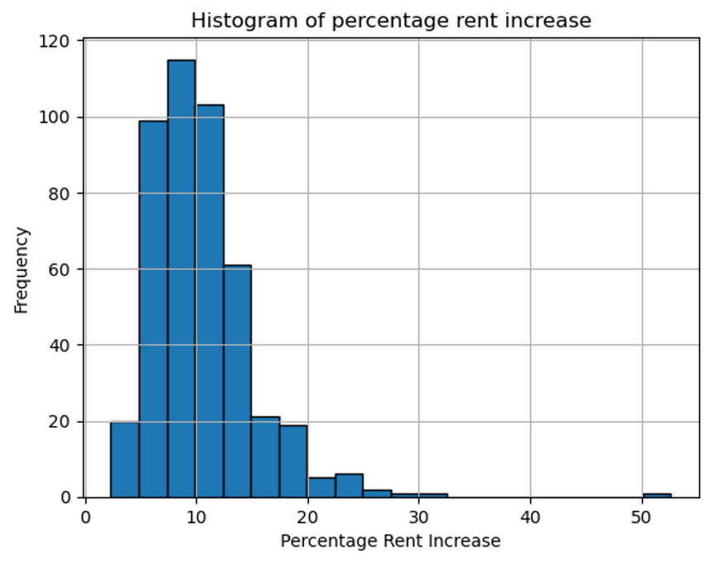
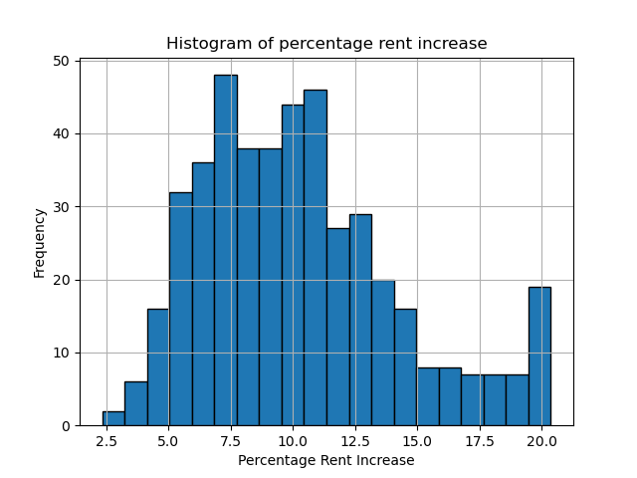
1 – Data Processing
Outlier Analysis
IQR Winsorization
Monthly Rent: 2406
New Rent: 3673 – Typo?

Slide 12
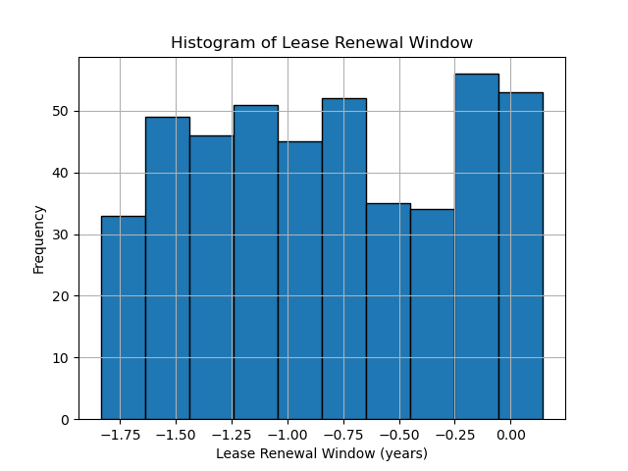
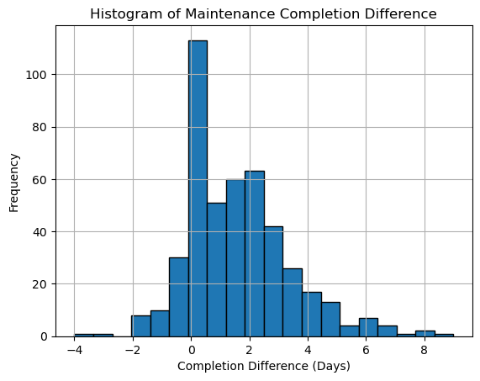
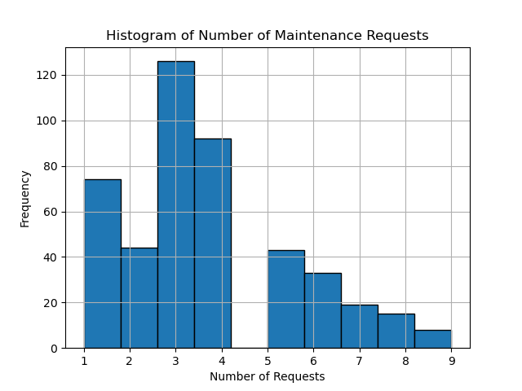
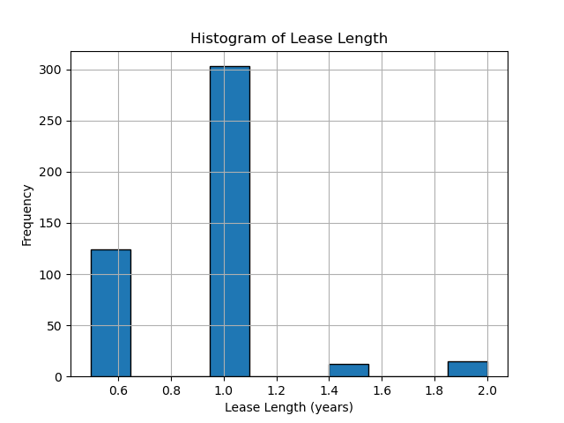
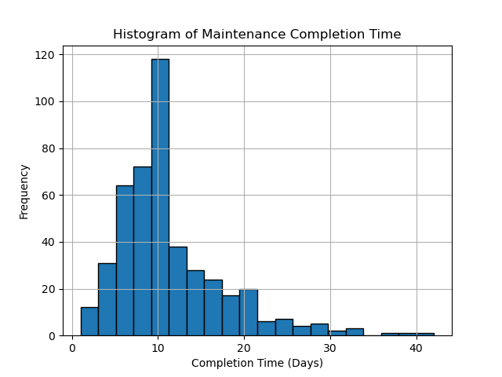
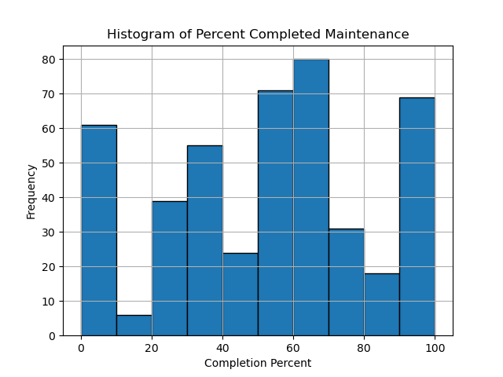
1 – Data Processing
Percent completed is surprisingly low. Perhaps input error
Worth an outlier check for late inputs

Slide 13
2 – Model Development
Propose and evaluate a model that can predict housing renewals. Test the model against baseline benchmarks and apply the model on the test dataset.
Determine a metric for accuracy (hit-rate and AUC) to be calculated using k-fold cross validation.
Use Gradient Boosted Classifier models and optimize the hyperparameters and determine which features are most important.
Develop a set of test models to compare against
Analyze model accuracy and feature importance.

Slide 14
2 – Model Development
Initial features that we examine
init_features = ['age', 'pet_details', 'ADA_support', 'newsletter_opt_in',
'monthly_rent', 'percent_rent_diff', 'msg_count',
'number_of_requests', 'percent_completion',
'occupancy_count', 'avg_completion_time',
'avg_completion_diff', 'lease_length',
'lease_renew_window',
'referral_craigslist', 'referral_ex-resident',
'referral_facebook', 'referral_resident', 'referral_walk-in',
'referral_zillow', 'referral_None']

Slide 15
2 – Model Development
Accuracy determined through 5-fold cross validation on training data. Accuracy scores are determined using two metrics.
Hit-Rate (Used for hyperparameter optimization)
Area Under the Curve (AUC) – Demonstrates the accuracy of the model itself.
--- Features with High Colinearity ---
msg_count
occupancy_count
--- Importance Scores ---
age: 0.1500
pet_details: 0.0000 - DISCARDED
ADA_support: 0.0000 - DISCARDED
newsletter_opt_in: 0.0283
monthly_rent: 0.0043
percent_rent_diff: 0.1543
msg_count: 0.0000 - DISCARDED
number_of_requests: 0.2304
percent_completion: 0.0043
occupancy_count: 0.0000 - DISCARDED
avg_completion_time: 0.0087
avg_completion_diff: 0.0109
lease_length: 0.0848
lease_renew_window: 0.0022
referral_craigslist: 0.0000 - DISCARDED
referral_ex-resident: 0.0000 - DISCARDED
referral_facebook: 0.0000 - DISCARDED
referral_resident: 0.0000 - DISCARDED
referral_walk-in: 0.0000 - DISCARDED
referral_zillow: 0.0000 - DISCARDED
referral_None: 0.0000 - DISCARDED
Feature importance determined using permutation importance. Features that are not important are dropped from the feature set.

Slide 16
2 – Model Development
Tabular, non-linear data is typically modeled using Gradient Boosted models. We deploy the Gradient Boosted Classifier model as implemented by scikit-learn
First, we optimize the hyperparameters by doing a coarse grid search over different paramters. The hyperparameters to be optimized and the coarse search we used are:
lrs = [0.1, 0.05, 0.01]
n_estimators = [10, 100, 500]
subsamples = [1.0, 0.75, 0.5]
min_sample_splits = [2, 5, 10]
max_depths = [3, 5, 10]
Should try to extend these extreme values

Slide 17
2 – Model Development
Models to compare to:
Zero-R: Predicts the most frequent occurrence – Typical benchmark
Weighted Coin Flip: Randomly predicts classifier based on percentage of each classifier in the training set – Typical random benchmark
Logistic Regression: Linear model with a sigmoid output to predict classes - Typical Linear Benchmark
Raw Gradient Boosted Classifier – Same BG classifier model but trained on only the numerical data available without processing : Determine if the data processing helped improve our prediction.
Minimal Gradient Boosted Classifier – Same BG classifier model but trained on three features (percent_rent_diff, number_of_requests, age) which were determined to be the most important features: Determine if we can achieve the same accuracy in fewer features.
And some custom models:

Slide 18
2 – Model Development
--- MODEL RESULTS ---
Model Accur. AUC
GBC 0.8768 0.8910
MIN 0.8570 0.8694
RAW 0.7371 0.7945
LOG 0.6873 0.7514
Z-R 0.5595 0.5000
WCF 0.5064 0.5000
Analyzing feature importances...
percent_rent_diff: 0.26039206822990624
age: 0.23425328311870275
number_of_requests: 0.22941512262405903
lease_length: 0.09358002252217802
avg_completion_time: 0.048544691539268096
monthly_rent: 0.04505907972897842
lease_renew_window: 0.03994241669274943
avg_completion_diff: 0.03470413814814109
percent_completion: 0.0072115488336335675
newsletter_opt_in: 0.006897628562383365
The additional feature and feature processing improves the model
We outperform the standard test models
Most import features are:
Percentage Rent Increase
Number of Requests
Age (???)

Slide 19
2 – Model Development
Future Directions
Include message semantics into feature space.
Given the prevalence and importance of maintenance, use more features from that dataset. For example, one-hot embedding of priority and semantic encoding of some of the comments, perhaps projecting onto “angry.”
Finely tune the hyperparameters of the model.

Slide 20
3 – Categorize Messages
Parse through the messages from each user and categorize the reason for not renewing their leases using sentence transformers.
Sentences are formed for each user by concatenating all of there messages into one sentence.
k-means clustering analysis is done to cluster the data and allow for easier human parsing of the text to identify semantic clusters.
Four clusters are identified (Rent, Maintenance, Life, Questions) and projections into these subspaces are analyzed.
Example semantic embeddings are formulated for each cluster and a cosine similarity score is used to categorize each user.

Slide 21
3 – Categorize Messages
All user comments are concatenated into a large sentence for each user. This might introduce some messy sentences with many extraneous words.
All sentences in this discussion are encoded using the gte-base transformer model to form sentence vectors for each user’s sentence.

Slide 22
3 – Categorize Messages
10-means clustering is first performed in order to identify trends in the messages.
Nearly every comment mentions the increasing rent prices. If there is another reason, rent is brought up along side that other reason.
Many comments mentioning maintenance issues, including number of them and slow service. However, nearly all of these comments mention rent prices.
Some comments mention life events like new jobs or moving. These are very few but they don’t usually mention rent.
Some comments are just questions with no follow up.
4-means clustering is then performed in order to try and get these exact clusters. It didn’t work, there’s rent in every cluster.

Slide 23
3 – Categorize Messages
Projected the embeddings into a 2D vector space trying to incorporate each of these categories. Included happiness dimension and a confusion dimension.
The vectors uses to define the axes are:
rent_sentences = ["The rent price increase is too high", "The rent price is very reasonable"]
maintenance_sentences = ["The maintenance issues are too much and repair requests are too slow", "This place is well maintained with no issues"]
personal_sentences = ["My circumstances have changed and I have to move for a new job", "My life is stable and happy"]
happy_sentences = ["I enjoy living here", "I hate this place"]
question_sentences = ["What are the details?", "I know what I want."]

Slide 24
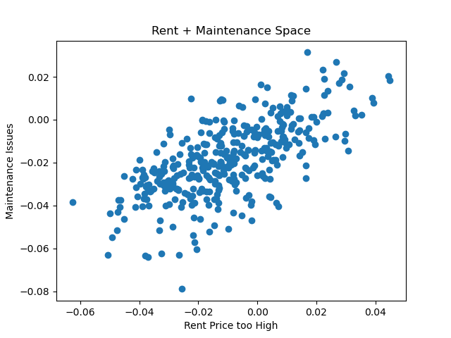
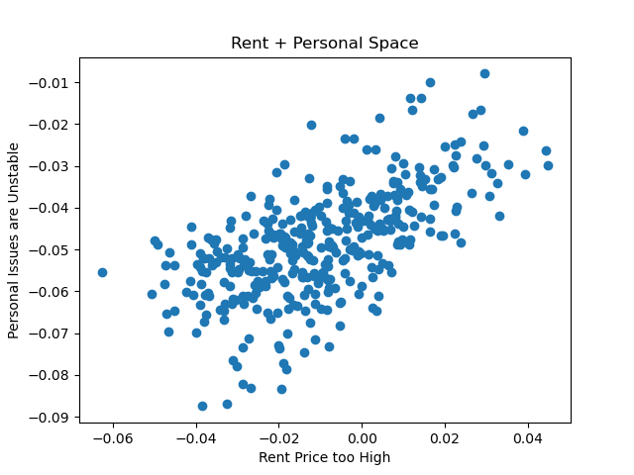
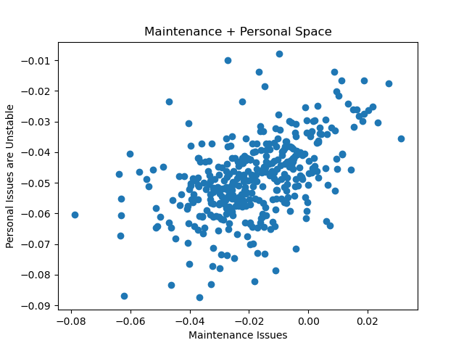
3 – Categorize Messages
STRONG correlation between these dimensions, seeming to indicate some redundancy.

Slide 25
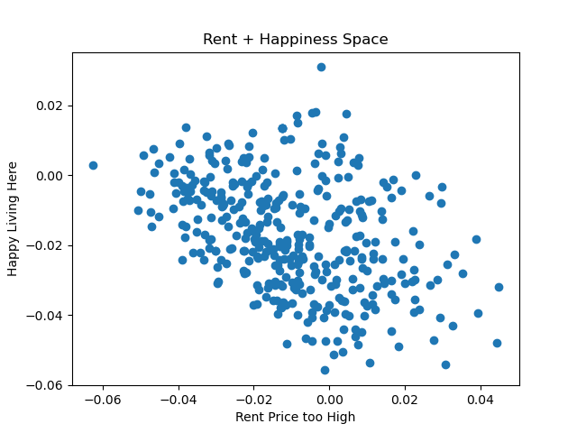
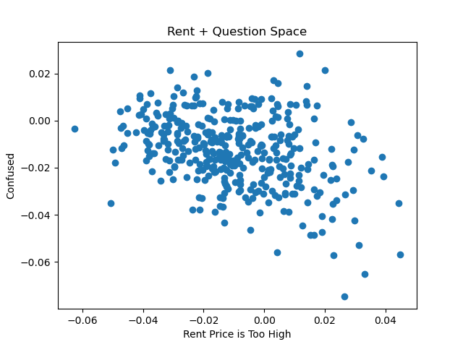
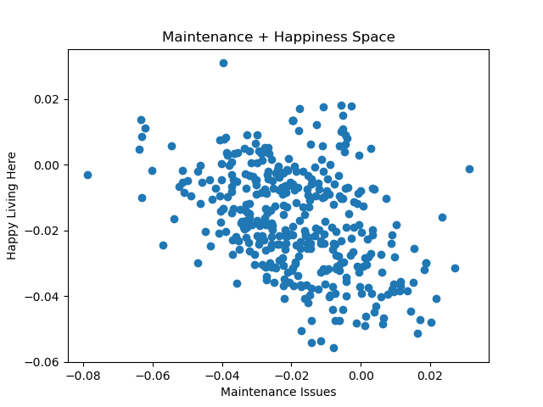
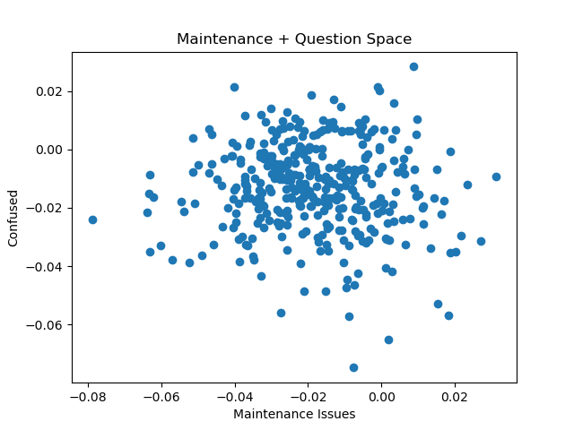
3 – Categorize Messages
Also looked at how confused and how happy people tend to be in these messages.
People less concerned about rent prices are more confused, probably because they don’t know the rent price yet.
More maintenance and rent price problems means less happy, as expected
Confusion doesn’t correlate to maintenance issues.

Slide 26
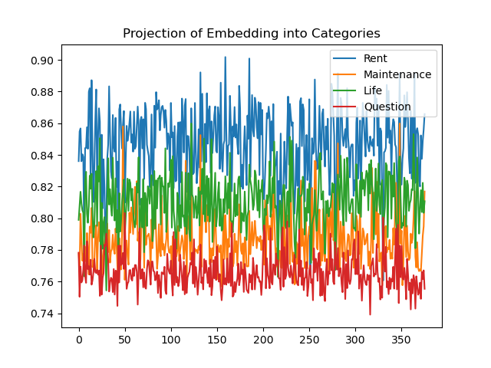
3 – Categorize Messages
Category embeddings defined by the following:
category_definitions_and_examples = {
"Rent" : "The rent price is too high.",
"Maintenance" : "There are too many maintenance issues and repairs are slow.",
"Life" : "My circumstances and job have changed and I need to move.",
"Question" : "I'm not sure. What are the details?"
}
Projecting all the embeddings onto these categories yields this. All messages basically have a lot of each category in them, which is not great.

Slide 27
3 – Categorize Messages
Calculated the cosine similarity between each sentence and the category embedding. Categorized each comment according to highest cosine similarity
--- TOTAL CATEGORY COUNT ---
reason
Rent 363
Life 6
Question 5
Maintenance 2
Rent is in everything as expected. Questions seem about right. Maintenance is way too low and that’s probably because rent is always mentioned with maintenance.

Slide 28
3 – Categorize Messages
Future Directions
Given the prevalence of rent prices in the sentences, perhaps it’s best to project out rent price semantics before analyzing each sentence? This would allow for things like maintenance to come to the forefront.
Better parse the sentences. Having them all concatenated has too many stray words that could effect the encoding.
I suspect a PCA analysis would reduce these categories down.

