Slide 1
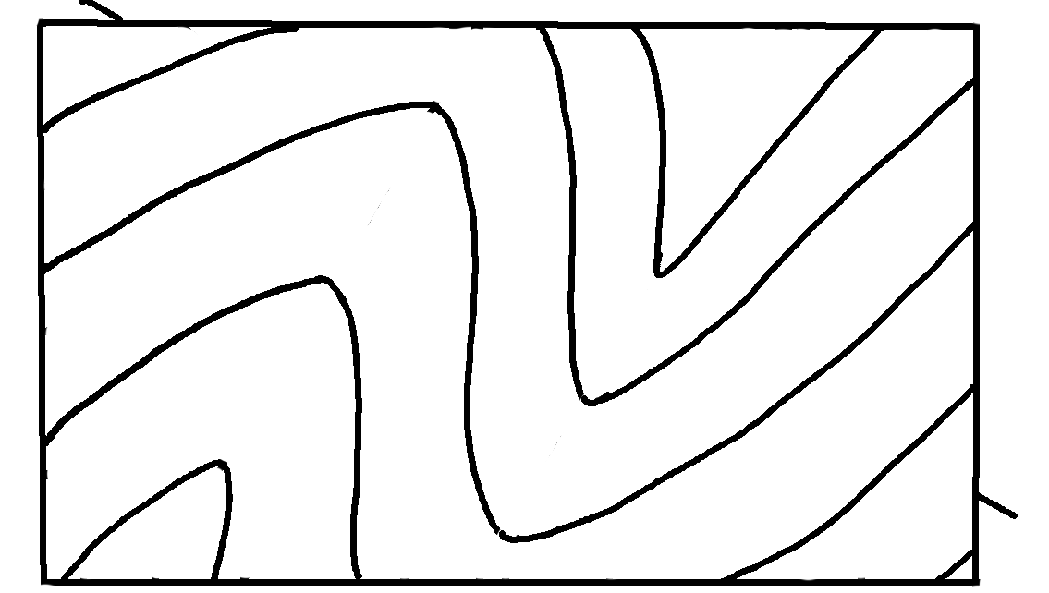
Plunging Folds – Map View
✄
A
North
1
3
2
2
4
3
5
4
5
B
6
6

Slide 2
⠠⠏⠇⠥⠝⠛⠬⠀⠠⠋⠕⠇⠙⠎⠀⠤⠀⠠⠍⠁⠏⠀⠠⠧⠊⠑⠺
✄
⠠⠁
⠠⠝⠕⠗⠹
⠼⠁
⠼⠉
⠼⠃
⠼⠃
⠼⠙
⠼⠉
⠼⠑
⠼⠙
B
⠼⠋
⠼⠑
⠼⠋

Slide 3
✄

