Slide 1
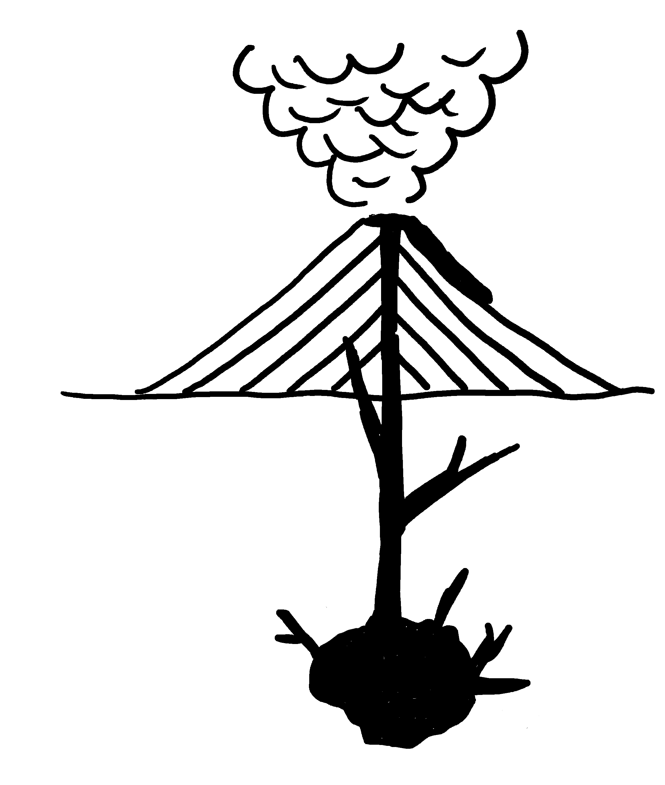
Magmatic Environments
✄
ash cloud
extrusive or
volcanic
lava flow
volcano
dike
intrusive or
plutonic
magma chamber
modified from Fig. 6.3 (a) in Marshak, 2019, Earth: Portrait of a Planet, 6th edition

Slide 2
⠍⠁⠛⠍⠁⠞⠊⠉⠀⠑⠝⠧⠊⠗⠕⠝⠍⠢⠞⠎
✄
⠁⠩⠀⠉⠇⠳⠙
⠑⠭⠞⠗⠥⠎⠊⠧⠑⠀⠕⠗⠀⠧⠕⠇⠉⠁⠝⠊⠉
⠧⠕⠇⠉⠁⠝⠕
⠇⠁⠧⠁⠀⠋⠇⠪
⠙⠊⠅⠑
⠔⠞⠗⠥⠎⠊⠧⠑⠀⠕⠗⠀⠏⠇⠥⠞⠕⠝⠊⠉
⠍⠁⠛⠍⠁⠀⠡⠁⠍⠃⠻

Slide 3
✄

