Slide 1
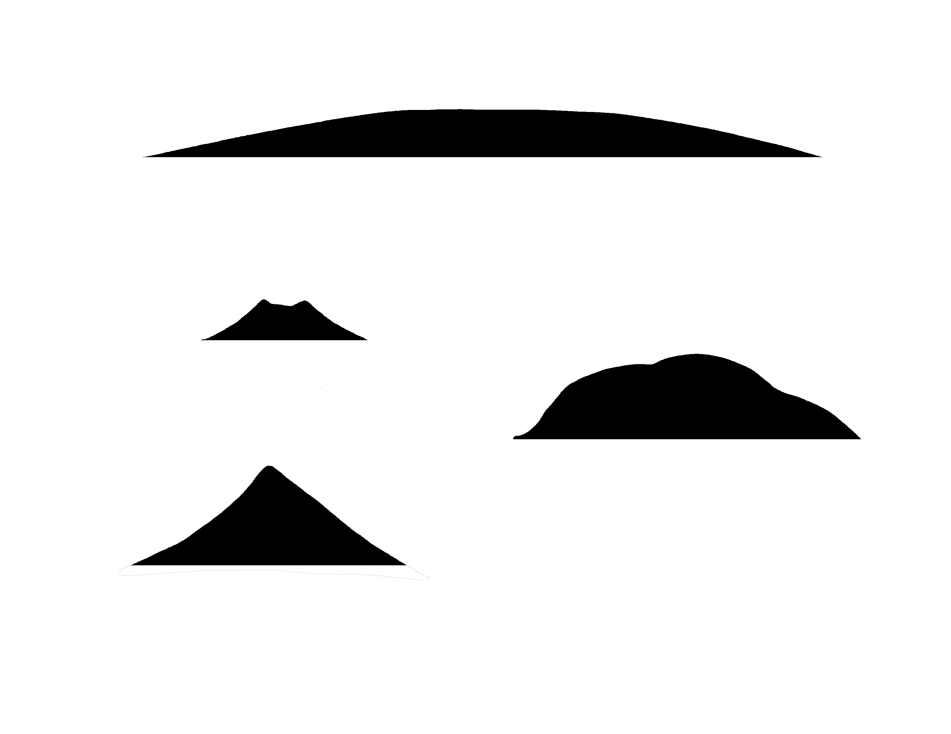
✄
Volcano Types
< 18000 ft.
shield
< 1200 ft.
< 5500 ft.
cinder cone
< 8000 ft.
lava dome
stratovolcano or composite cone

Slide 2
✄
⠠⠧⠕⠇⠉⠁⠝⠕⠀⠠⠞⠽⠏⠑⠎
✄
⠈⠣⠀⠼⠁⠓⠂⠼⠚⠚⠚⠀⠋⠞⠲
⠩⠊⠑⠇⠙
⠈⠣⠀⠼⠁⠂⠼⠃⠚⠚⠀⠋⠞⠲
⠈⠣⠀⠼⠑⠂⠼⠑⠚⠚⠀⠋⠞⠲
⠉⠔⠙⠻⠀⠉⠐⠕
⠈⠣⠀⠼⠓⠂⠼⠚⠚⠚⠀⠋⠞⠲
⠇⠁⠧⠁⠀⠙⠕⠍⠑
⠌⠗⠁⠞⠕⠧⠕⠇⠉⠁⠝⠕⠀⠕⠗⠀⠉⠕⠍⠏⠕⠎⠊⠞⠑⠀⠉⠐⠕

Slide 3
✄

