Slide 1
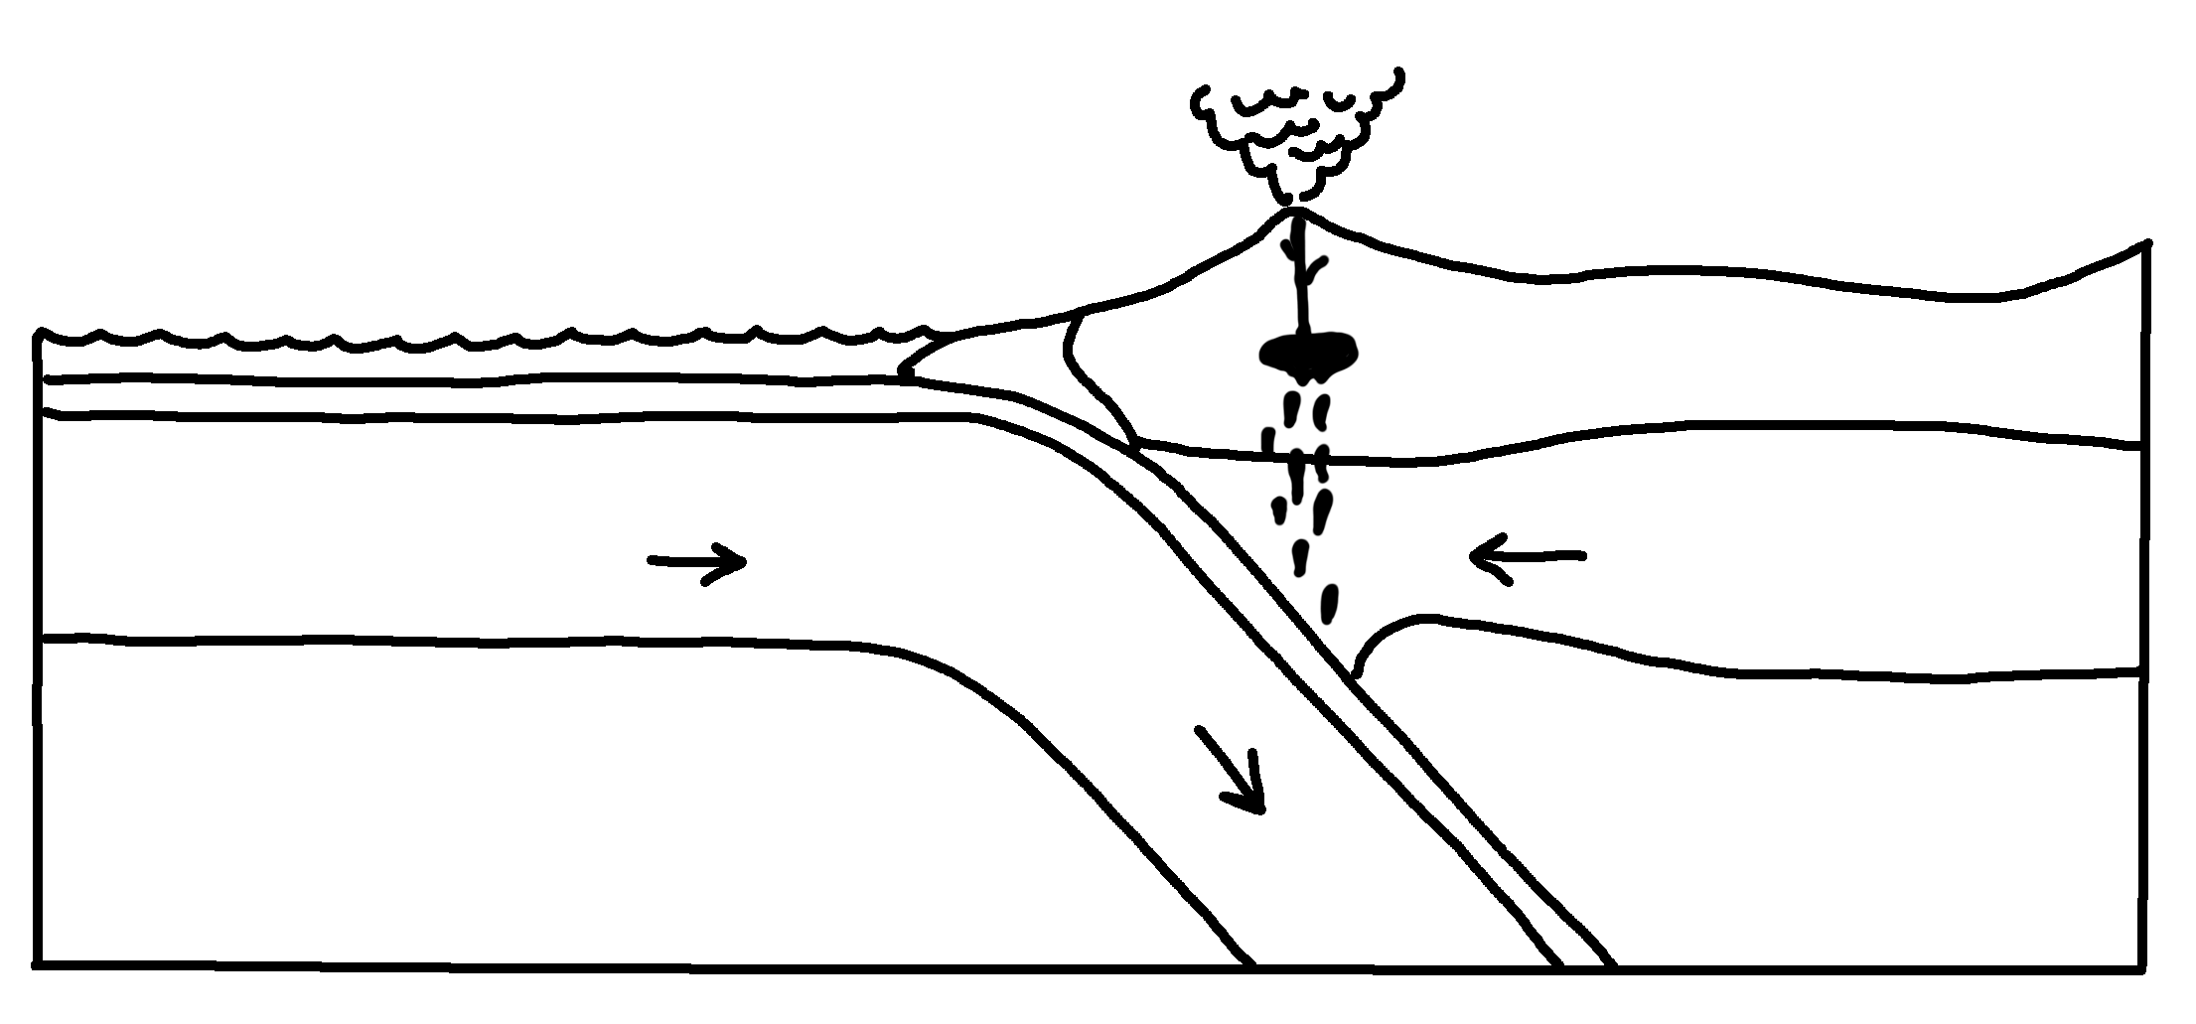
✄
Continental Margin Subduction Zone
volcanic arc
oceanic crust
accretionary wedge
trench
continental crust
lithospheric mantle
lithospheric mantle
asthenospheric mantle
asthenospheric mantle

Slide 2
⠠⠉⠕⠝⠞⠔⠢⠞⠁⠇⠀⠠⠍⠜⠛⠔⠀⠠⠎⠥⠃⠙⠥⠉⠰⠝⠀⠠⠵⠐⠕
✄
⠕⠉⠂⠝⠊⠉⠀⠉⠗⠥⠌
⠧⠕⠇⠉⠁⠝⠊⠉⠀⠜⠉
⠁⠒⠗⠑⠞⠊⠕⠝⠜⠽⠀⠺⠫⠛⠑
⠞⠗⠢⠡
⠉⠕⠝⠞⠔⠢⠞⠁⠇⠀⠉⠗⠥⠌
⠇⠊⠹⠕⠎⠏⠓⠻⠊⠉
⠍⠁⠝⠞⠇⠑
⠇⠊⠹⠕⠎⠏⠓⠻⠊⠉
⠍⠁⠝⠞⠇⠑
⠁⠎⠮⠝⠕⠎⠏⠓⠻⠊⠉
⠍⠁⠝⠞⠇⠑
⠁⠎⠮⠝⠕⠎⠏⠓⠻⠊⠉ ⠍⠁⠝⠞⠇⠑

Slide 3
✄

