Slide 1
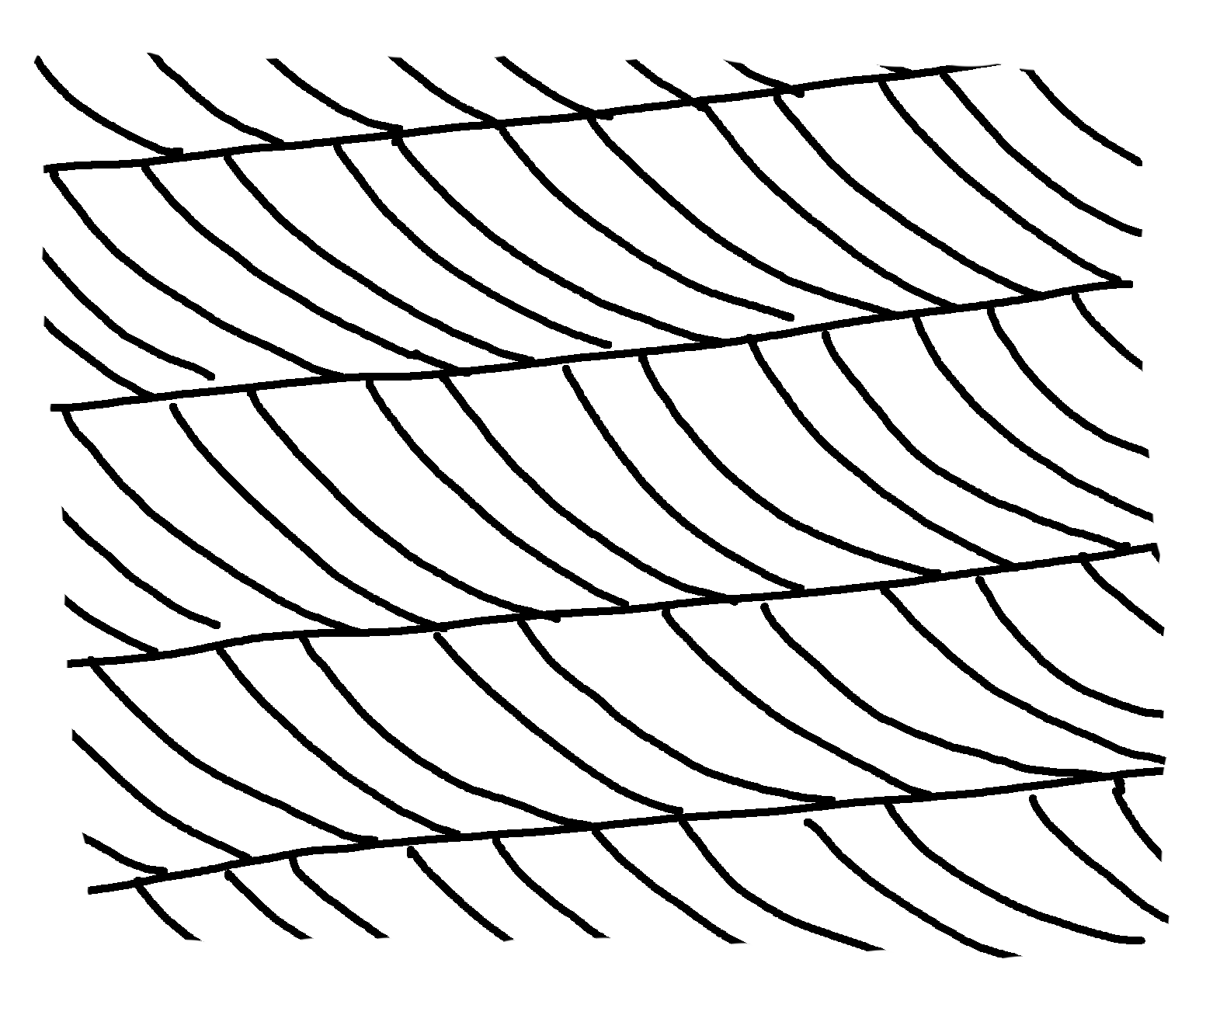
✄
Cross-Bedding
crossbeds
masterbed
masterbed
current
direction
masterbed

Slide 2
✄
⠠⠉⠗⠕⠎⠎⠤⠃⠫⠙⠬
⠉⠗⠕⠎⠎⠃⠫⠎
⠍⠁⠌⠻⠃⠫⠎
⠍⠁⠌⠻⠃⠫⠎
⠉⠥⠗⠢⠞⠀⠙⠊⠗⠑⠉⠰⠝
⠍⠁⠌⠻⠃⠫⠎

Slide 3
✄

