Slide 1
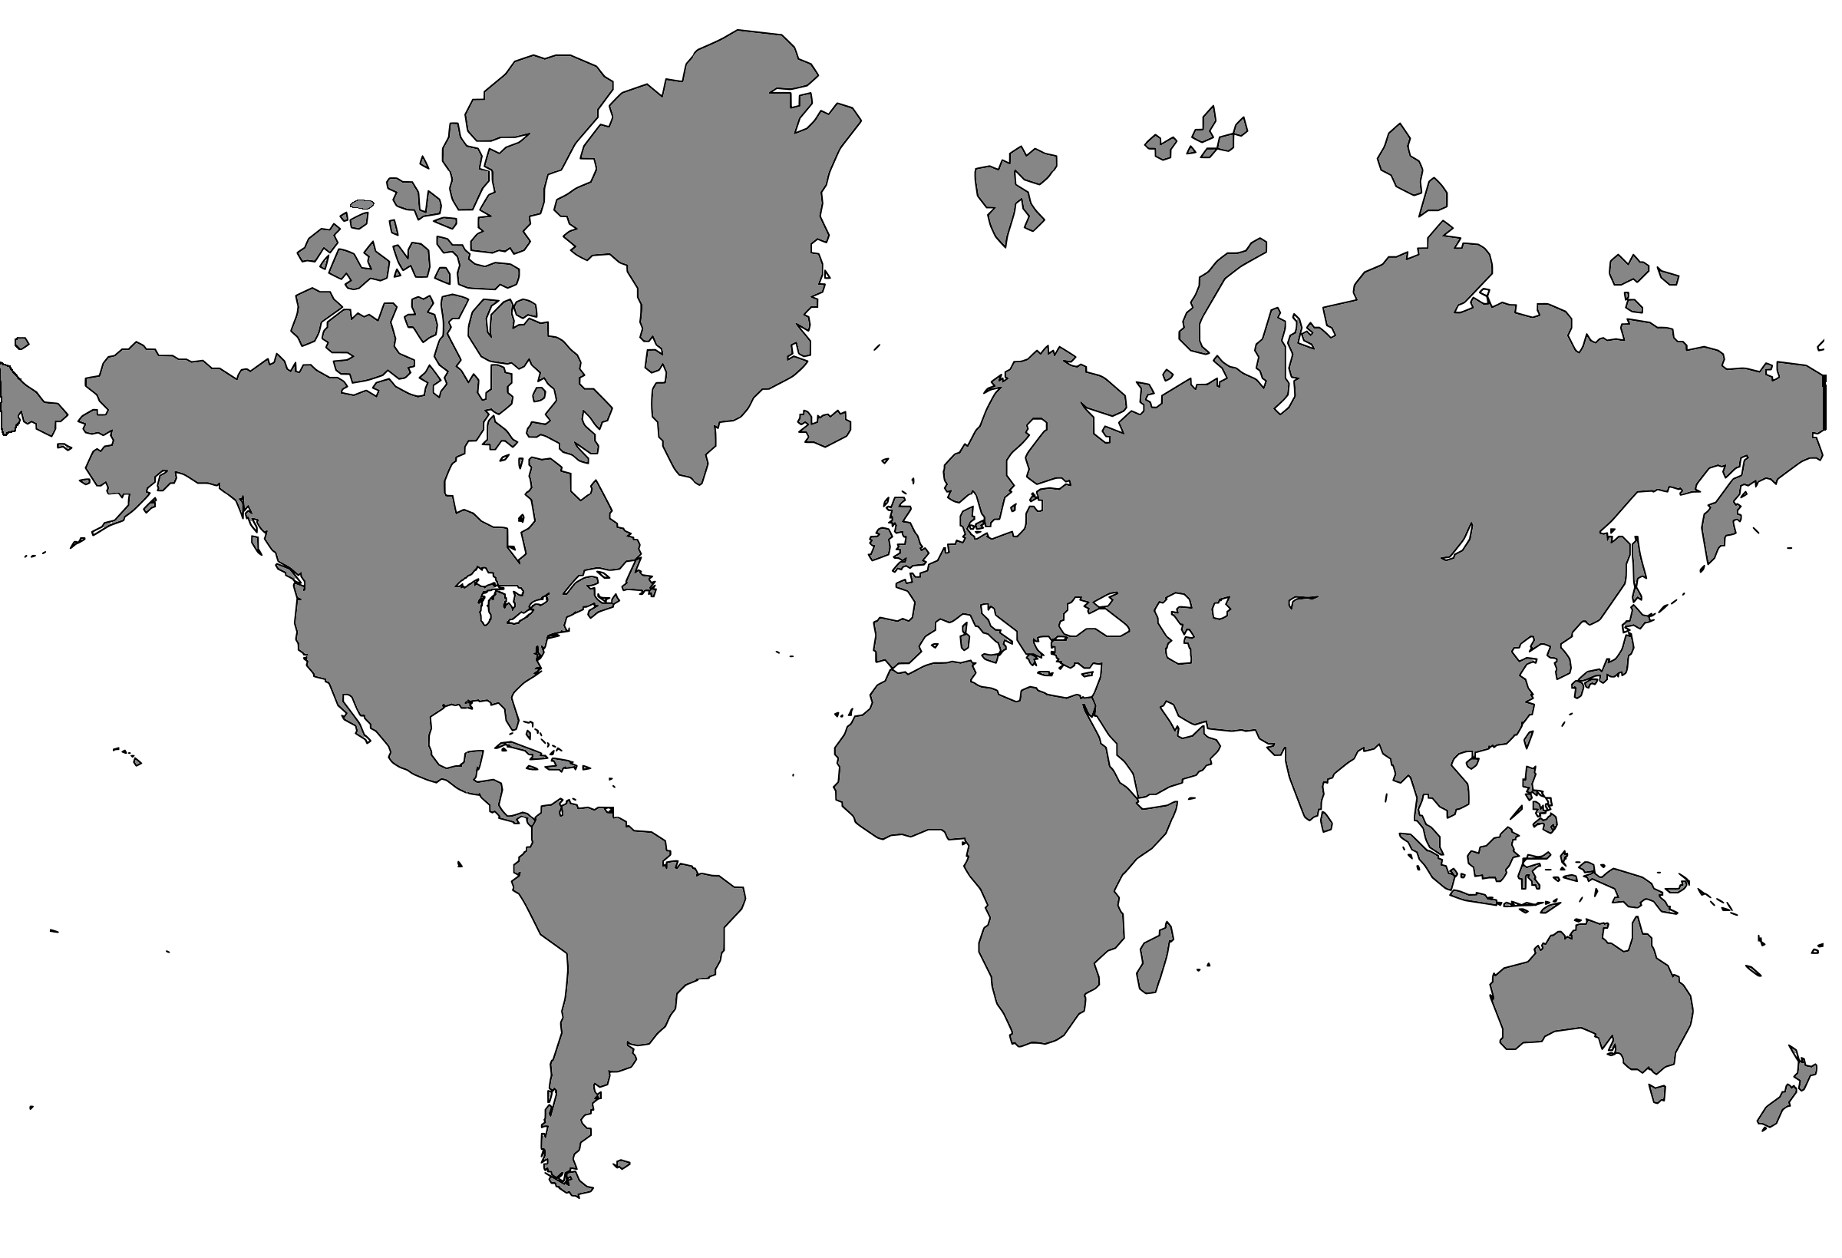
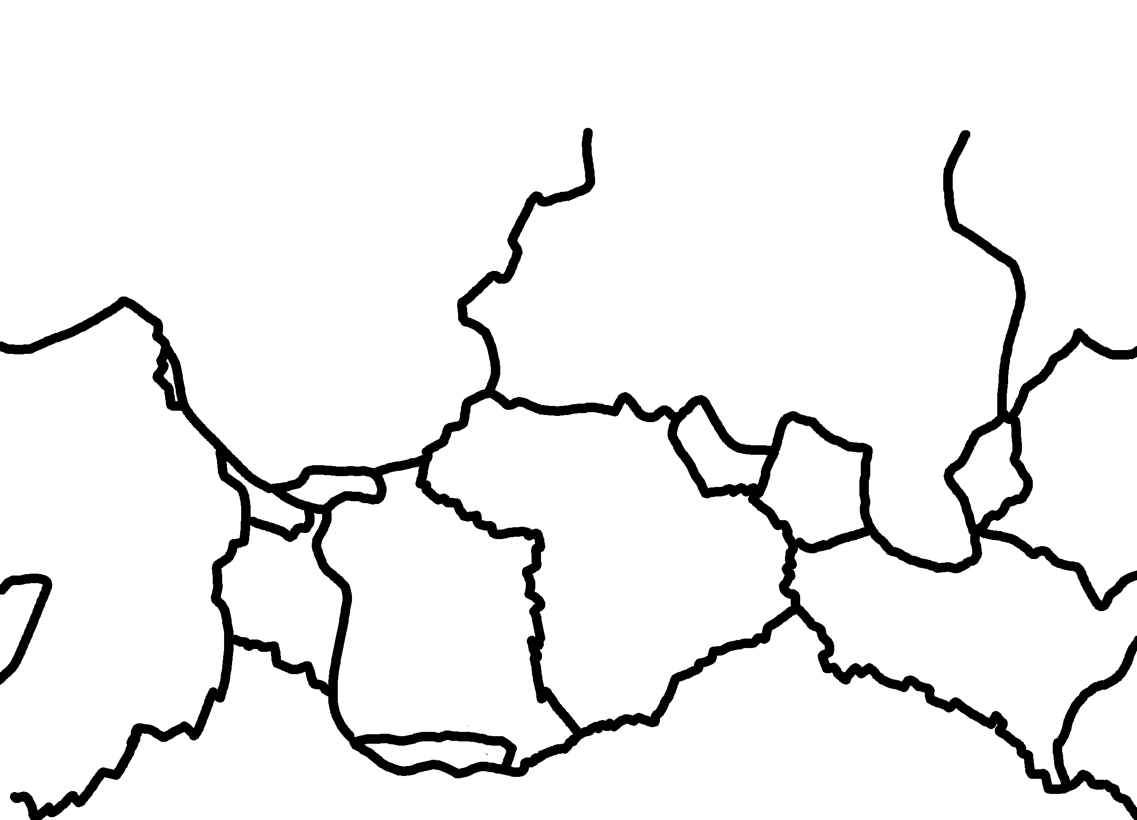
✄
Tectonic Plates (with continents)

Slide 2
⠠⠞⠑⠉⠞⠕⠝⠊⠉⠀⠠⠏⠇⠁⠞⠑⠎⠀⠐⠣⠾⠀⠉⠕⠝⠞⠔⠢⠞⠎⠐⠜
✄

Slide 3
✄

