Slide 1
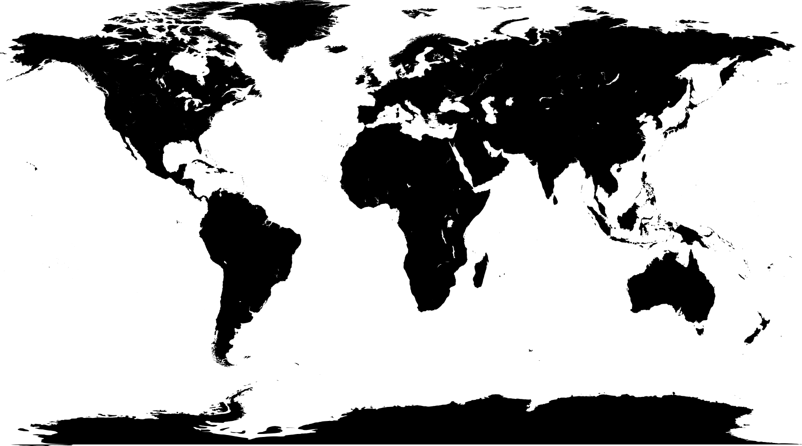
✄
World Map (Equirectangular)

Slide 2
✄
⠠⠸⠺⠀⠠⠍⠁⠏⠀⠤⠀⠠⠑⠟⠥⠊⠗⠑⠉⠞⠁⠝⠛⠥⠇⠜

Slide 3
✄

