Slide 1
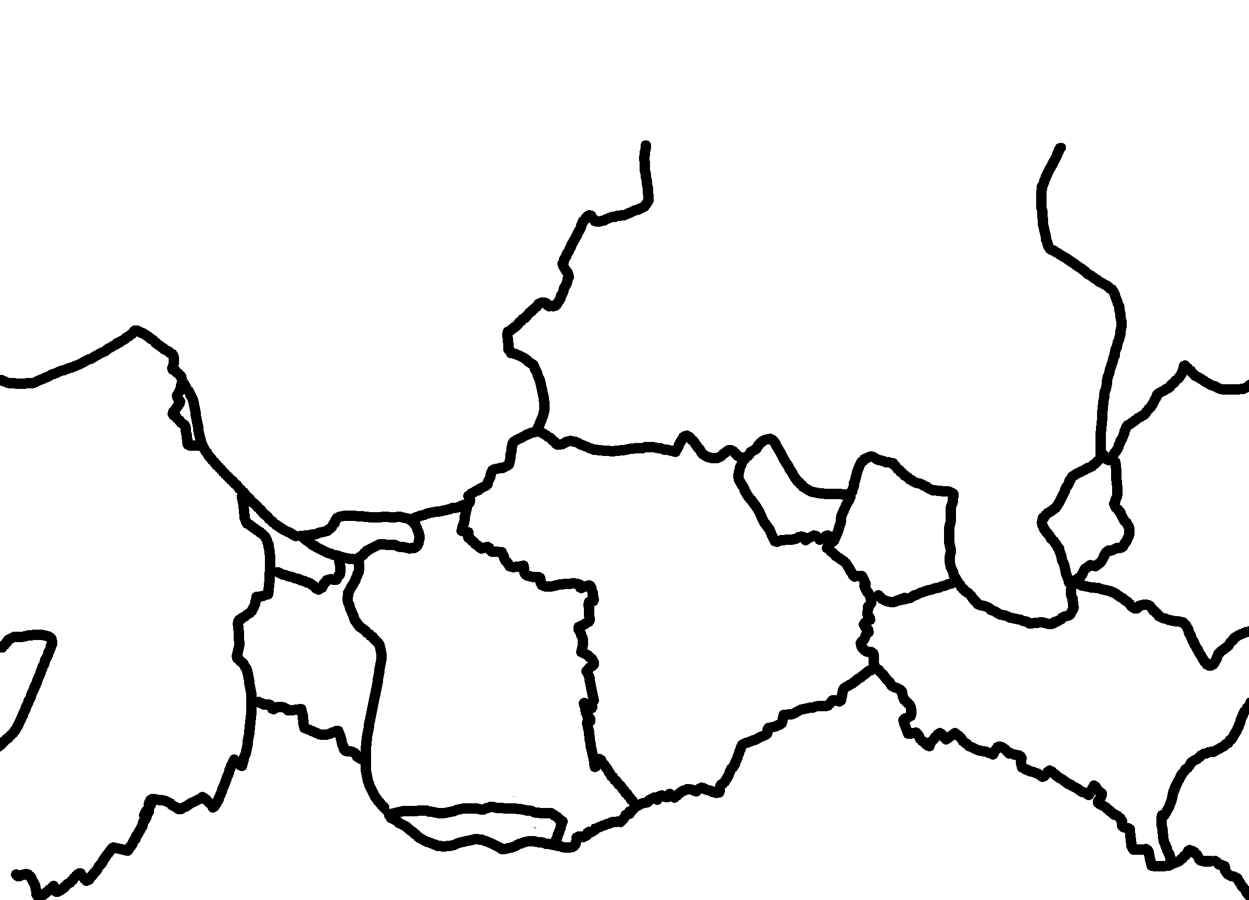
✄
Tectonic Plates (without continents)
N. Amer.
Juan
de Fuca
North
American
Eurasian
Indian
Caribbean
Philippine
Arabian
Pacific
Cocos
Pacific
African
South American
Australian
Nazca
Antarctic
Scotia

Slide 2
✄
⠠⠞⠑⠉⠞⠕⠝⠊⠉⠀⠠⠏⠇⠁⠞⠑⠎⠀⠐⠣⠾⠳⠞⠀⠉⠕⠝⠞⠔⠢⠞⠎⠐⠜
⠠⠚⠥⠁⠝
⠙⠑⠀
⠠⠋⠥⠉⠁
⠠⠝⠲⠀
⠠⠁⠍⠻⠲
⠠⠝⠕⠗⠹
⠠⠁⠍⠻⠊⠉⠁⠝
⠠⠑⠥⠗⠁⠎⠊⠁⠝
⠠⠔⠙⠊⠁⠝
⠠⠏⠓⠊⠇⠤
⠊⠏⠏⠔⠑
⠠⠉⠜⠊⠆⠂⠝
⠠⠏⠁
⠉⠊
⠋⠊⠉
⠠⠉⠕⠉⠕⠎
⠠⠜⠁⠃⠊⠁⠝
⠠⠏⠁⠉⠊⠋⠊⠉
⠠⠁⠋⠗⠊⠉⠁⠝
⠠⠎⠳⠹⠀
⠠⠁⠍⠻⠤
⠊⠉⠁⠝
⠠⠁⠥⠌⠗⠁⠇⠊⠁⠝
⠠⠝⠁⠵⠉⠁
⠠⠁⠝⠞⠜⠉⠞⠊⠉
⠠⠎⠉⠕⠞⠊⠁

Slide 3
✄

