Slide 1
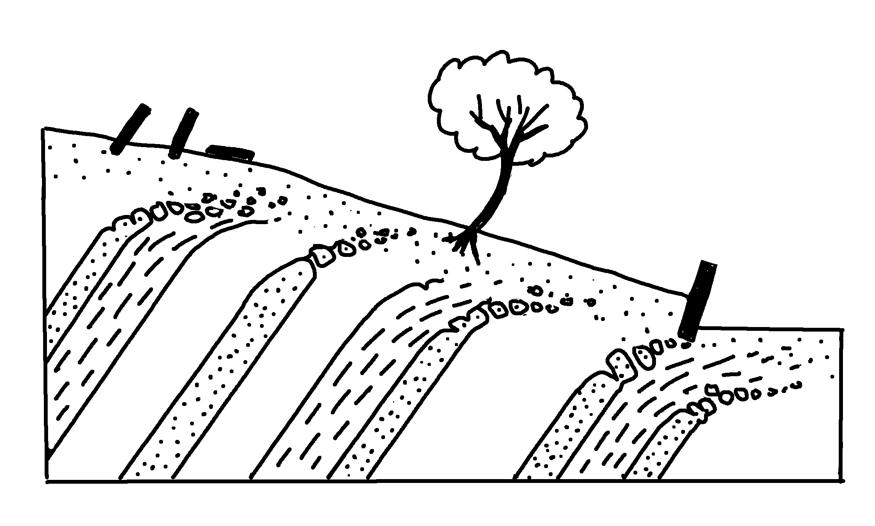
✄
Creep
tree with curved trunk
leaning and topped gravestones
zone of creep
leaning retaining wall
bedrock layers
modified from https://wps.prenhall.com/esm_tarbuck_earth_8/19/5076/1299583.cw/index.html

Slide 2
✄
⠠⠉⠗⠑⠑⠏
⠇⠂⠝⠬⠀⠯⠀⠞⠕⠏⠏⠇⠫⠀⠛⠗⠁⠧⠑⠌⠐⠕⠎
⠞⠗⠑⠑⠀⠾⠀⠉⠥⠗⠧⠫⠀⠞⠗⠥⠝⠅
⠵⠐⠕⠀⠷⠀⠉⠗⠑⠑⠏
⠇⠂⠝⠬⠀⠗⠑⠞⠁⠔⠬⠀⠺⠁⠇⠇
⠃⠫⠗⠕⠉⠅⠀⠇⠁⠽⠻⠎

Slide 3
✄

